Slide 1


Java – Logic A Roni Purwanto
Ver. 0.1

Slide 2
Content Material
1
Content from day 01 – day 10

Slide 3
Day 01
Java Structure
Naming Convention
Data Type
Looping For, While, Do While
Hello World
Study Case – Logic 01

Slide 4
Day 02
Nested If – Else
Switch – Case
Study Case – Logic 02

Slide 5
Day 03
Array Introduction
Array 1 Dimention
Array 2 Dimention

Slide 6
Day 04
Exception Handing
Try Catch Block
Finaly
Study Case

Slide 7
Day 05
Class
Property and Method
Object
Constructor
Study Case

Slide 8
Day 06
Inheritance
Agregation
Method Overloading
Method Overriding
Super Keyword
Instance initializer block
Final keyword
Dynamic Binding
Intanceof keyword

Slide 9
Day 07
Abstract Class
Interface
Nested Interface
Abstract vs Interface
Package
Access Modifier
Encaptulation

Slide 10
Day 08, Day 09
DDL
DML

Slide 11
Day 09,10
Introduction SQL
Syntax
DDL

Slide 12
Study Case
2
Logic study case

Slide 13
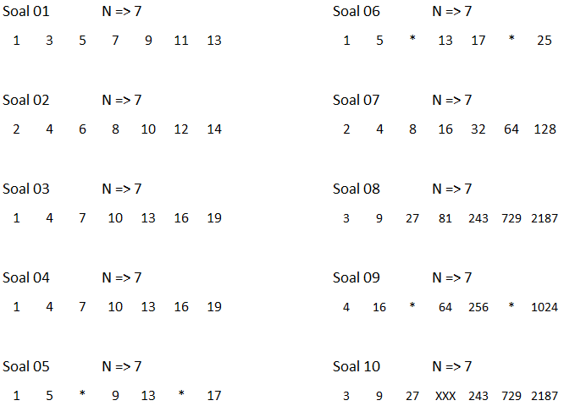
Logic 01

Slide 14
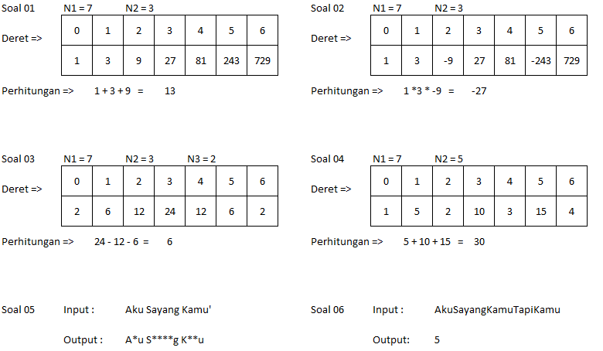
Logic 02

Slide 15
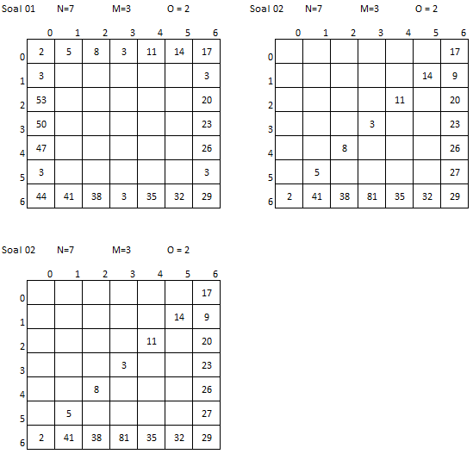
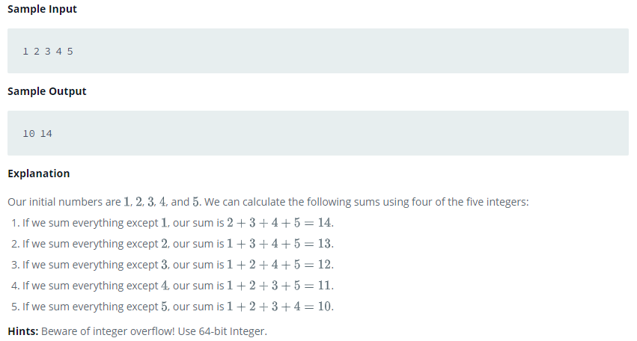
Logic 03

Slide 16
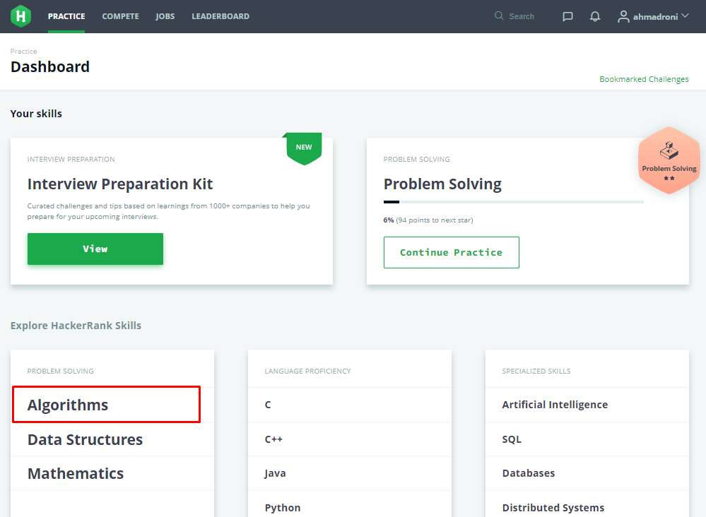
Hacker Rank

Slide 17
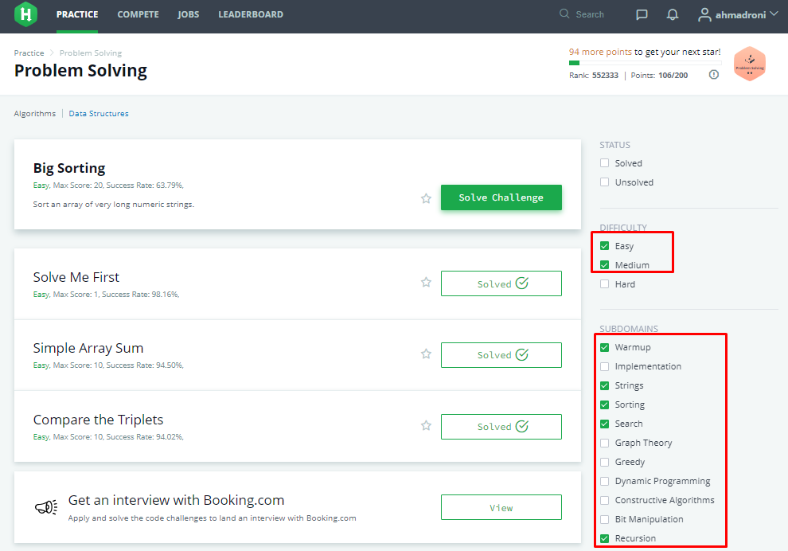
Hacker Rank Category

Slide 18
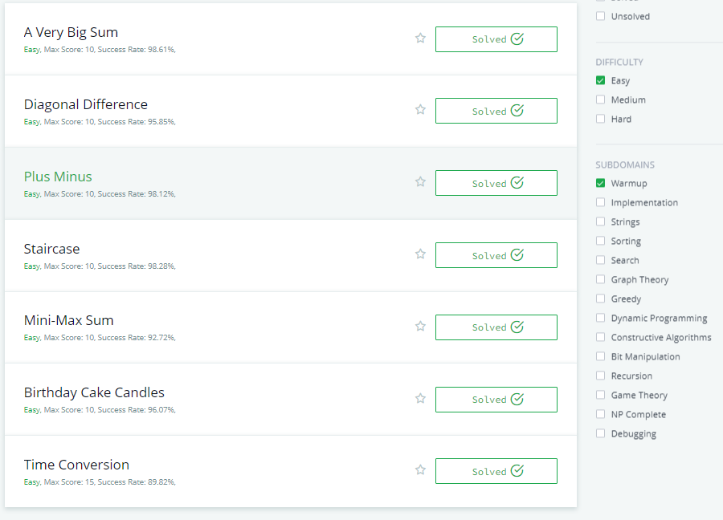
Easy - Warmup

Slide 19
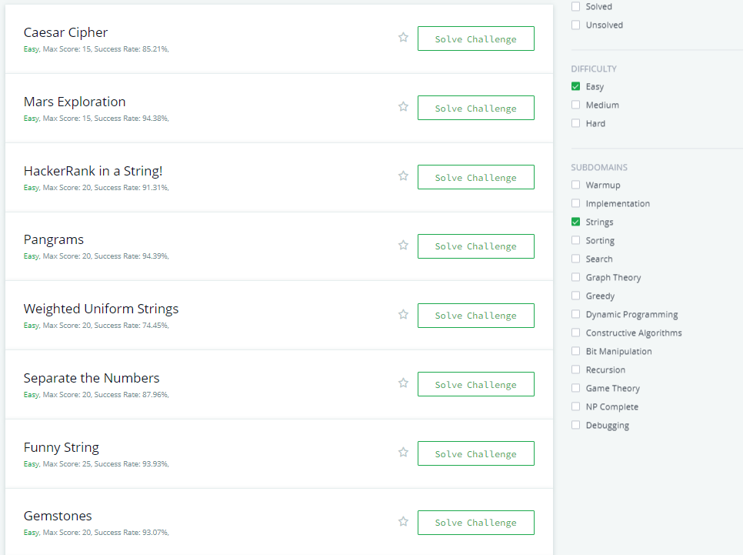
Easy - String

Slide 20
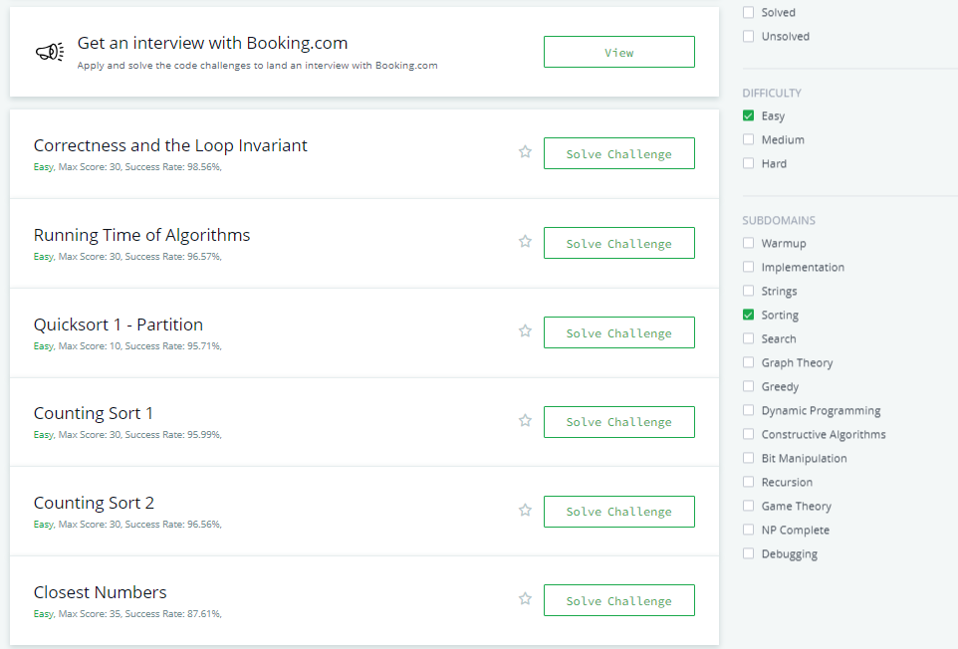
Easy - Sorting

Slide 21
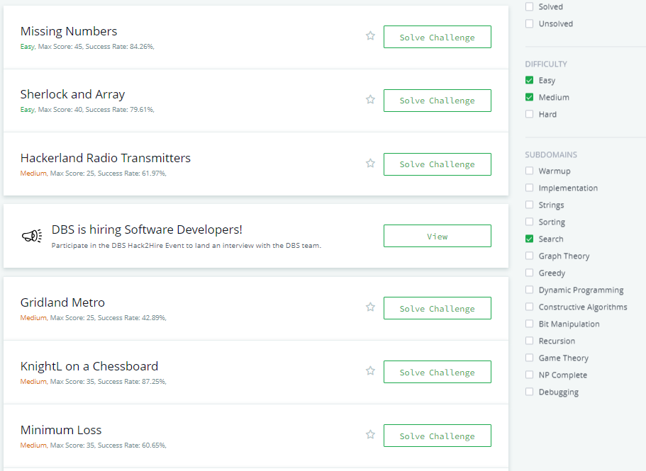
Easy – Medium – Search

Slide 22
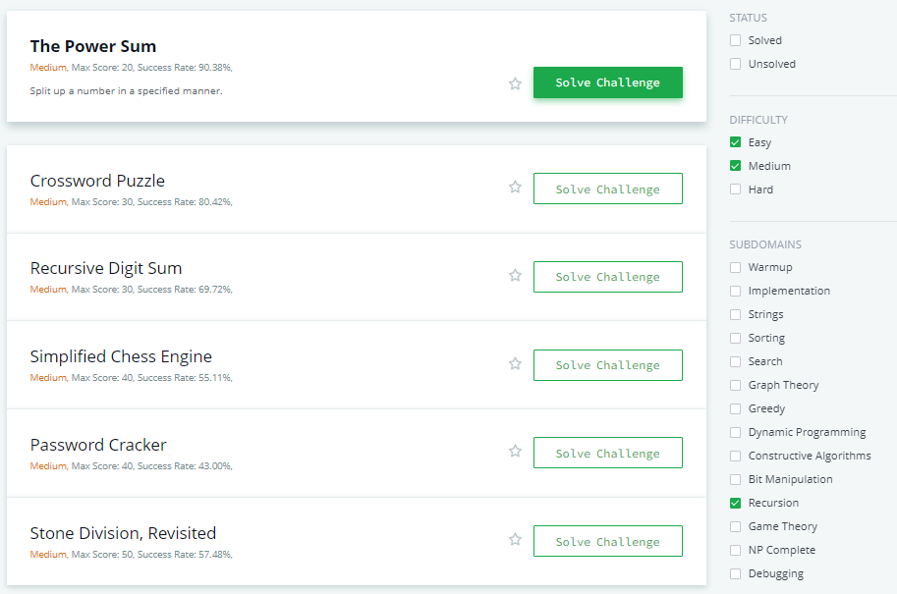
Easy – Medium – Recursion

