Slide 1


Java – Logic Day 03
Ver. 0.1

Slide 2
Day 03
1
What is Array

Slide 3
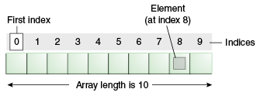
Goal Material
Normally, an array is a collection of similar type of elements that have a contiguous memory location.
Java array is an object which contains elements of a similar data type. It is a data structure where we store similar elements. We can store only a fixed set of elements in a Java array.
Array in java is index-based, the first element of the array is stored at the 0 index.
Advantages :
Code Optimization: It makes the code optimized, we can retrieve or sort the data efficiently.
Random access: We can get any data located at an index position.
Disadvantages :
Size Limit: We can store only the fixed size of elements in the array. It doesn't grow its size at runtime. To solve this problem, collection framework is used in Java which grows automatically.

Slide 4
Types of Array in java
There are two types of array :
Single Dimensional Array
Multidimensional Array

Slide 5
Day 03
2
Array One Dimention

Slide 6

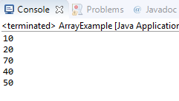
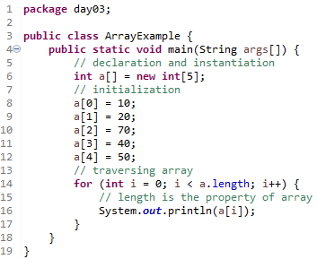
Single Dimensional Array in Java
Syntax :
Instantiation of array :
Example :
Output :

Slide 7
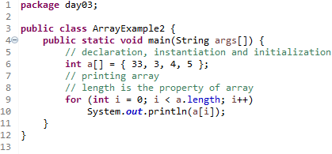
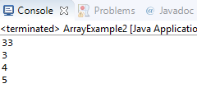
Declaration, Instantiation and Initialization of Java Array
Example :
Output :

Slide 8

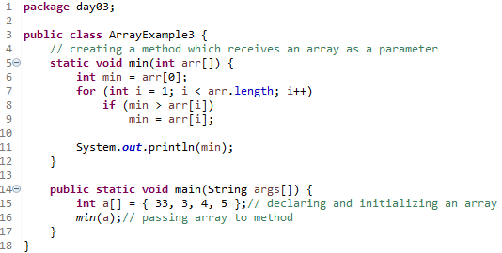
Passing Array to Method in Java
We can pass the java array to method so that we can reuse the same logic on any array.
Let's see the simple example to get the minimum number of an array using a method.
Example :
Output :

Slide 9
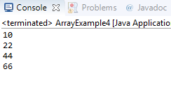
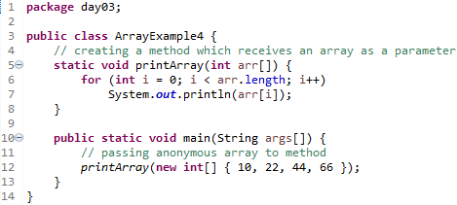
Anonymous Array in Java
Java supports the feature of an anonymous array, so you don't need to declare the array while passing an array to the method.
Example :
Output :

Slide 10
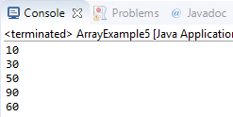
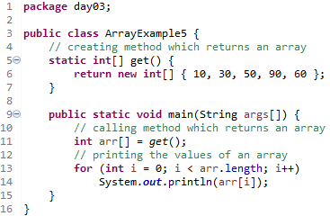
Returning Array from the Method
We can also return an array from the method in Java.
Example :
Output :

Slide 11
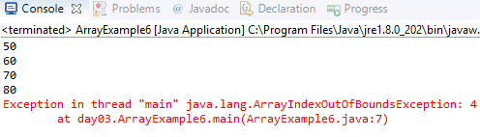
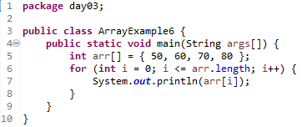
ArrayIndexOutOfBoundsException
The Java Virtual Machine (JVM) throws an ArrayIndexOutOfBoundsException if length of the array in negative, equal to the array size or greater than the array size while traversing the array.
Example :
Output :

Slide 12
Day 03
3
Multidimensional Array

Slide 13
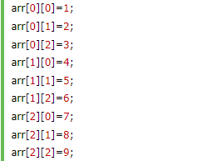

Multidimensional Array in Java
In such case, data is stored in row and column based index (also known as matrix form).
Syntax :
Instantiation of multidimensional array :
Example :

Slide 14
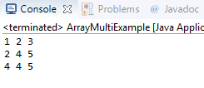
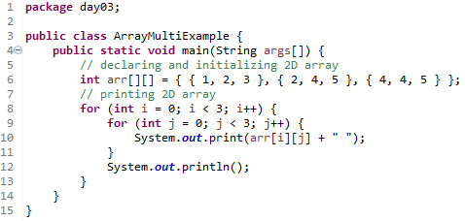
Multidimensional Array in Java
Let's see the simple example to declare, instantiate, initialize and print the 2Dimensional array.
Example :
Output :

Slide 15
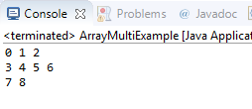
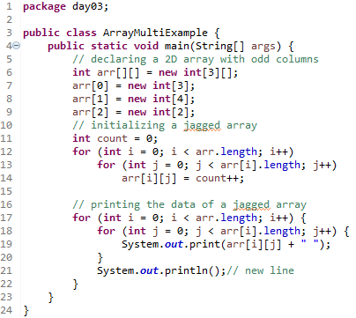
Jagged Array in Java
If we are creating odd number of columns in a 2D array, it is known as a jagged array. In other words, it is an array of arrays with different number of columns.
Example :
Output :

Slide 16
Day 03
4
What is the class name of Java array?

Slide 17
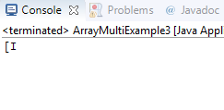
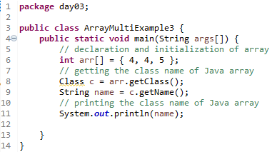
What is the class name of Java array?
In Java, an array is an object. For array object, a proxy class is created whose name can be obtained by getClass().getName() method on the object
Example :
Output :

Slide 18
Day 03
5
Copying an Array

Slide 19


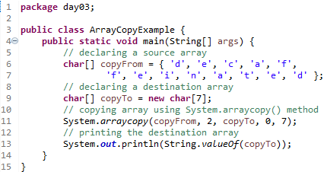
We can copy an array to another by the arraycopy() method of System class.
Syntax :
Example :
Output :

Slide 20

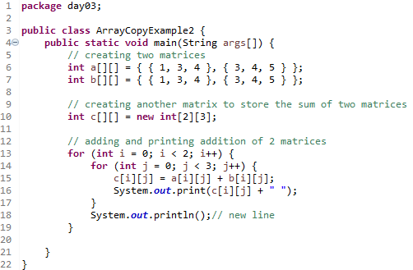
Addition of 2 Matrices in Java
Let's see a simple example that adds two matrices.
Example :
Output :

Slide 21
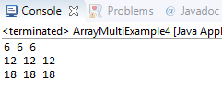
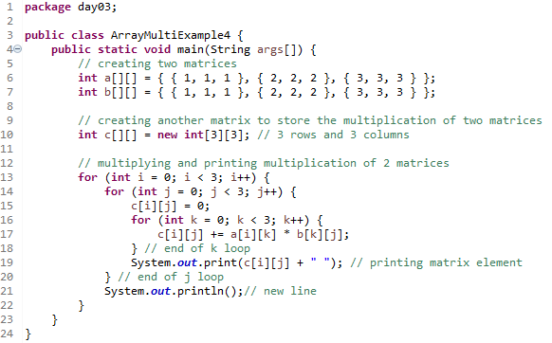
Multiplication of 2 Matrices in Java
In the case of matrix multiplication, a one-row element of the first matrix is multiplied by all the columns of the second matrix which can be understood by the image given below.
Example :
Output :

Slide 22
Day 03
6
Study Case – Logic 03

Slide 23
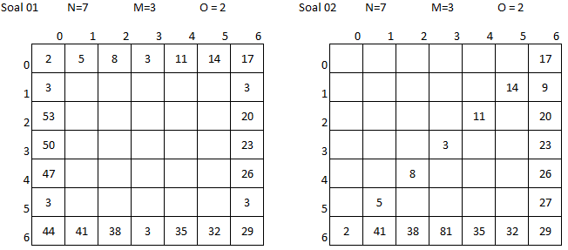
Study Case – Logic 03

Slide 24
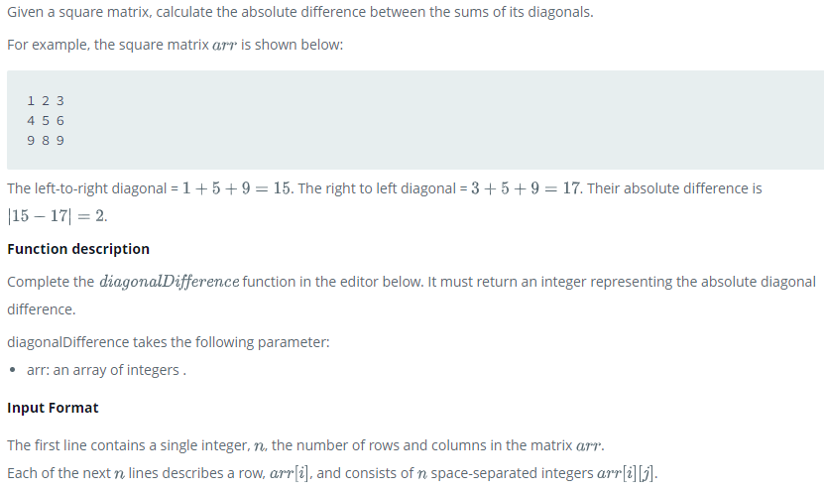
Study Case – Logic 03

Slide 25
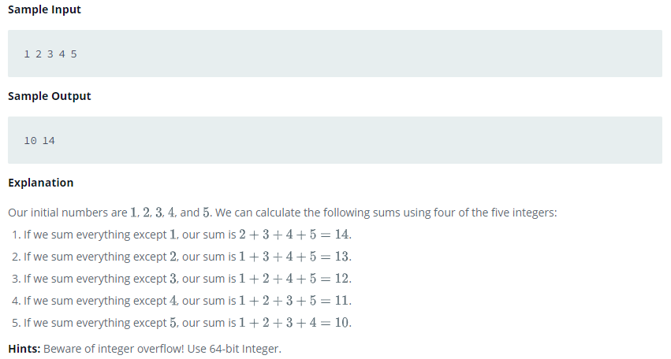
Study Case – Logic 03

Slide 26
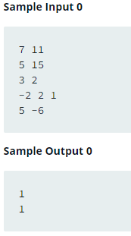
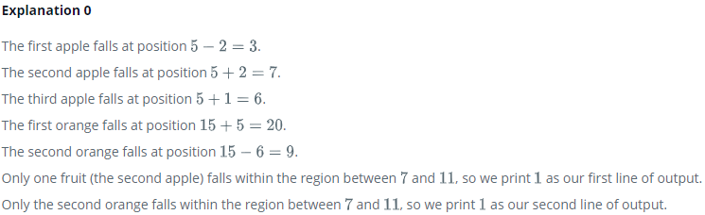
Study Case – Logic 03

Slide 27
GOOD LUCK!

Slide 28
THANKS!
Any questions?
Contact Your Trainer

