Slide 1


Java – Logic Day 04
Ver. 0.1

Slide 2
Day 04
1
Goal Material

Slide 3
Java Introduction
Exception Handing
Try Catch Block
Finaly
Study Case

Slide 4
Day 04
2
Exception Handling

Slide 5
Exception Description
An exception (or exceptional event) is a problem that arises during the execution of a program.
When an Exception occurs the normal flow of the program is disrupted and the program/Application terminates abnormally, which is not recommended, therefore, these exceptions are to be handled

Slide 6
Exception Accur
A user has entered an invalid data.
A file that needs to be opened cannot be found.
A network connection has been lost in the middle of communications or the JVM has run out of memory.

Slide 7
Exception Handling Works
Checked exceptions − A checked exception is an exception that is checked (notified) by the compiler at compilation-time, these are also called as compile time exceptions. These exceptions cannot simply be ignored, the programmer should take care of (handle) these exceptions.
Unchecked exceptions − An unchecked exception is an exception that occurs at the time of execution. These are also called as Runtime Exceptions. These include programming bugs, such as logic errors or improper use of an API. Runtime exceptions are ignored at the time of compilation.

Slide 8
Exception Handling Works
Errors − These are not exceptions at all, but problems that arise beyond the control of the user or the programmer. Errors are typically ignored in your code because you can rarely do anything about an error. For example, if a stack overflow occurs, an error will arise. They are also ignored at the time of compilation

Slide 9
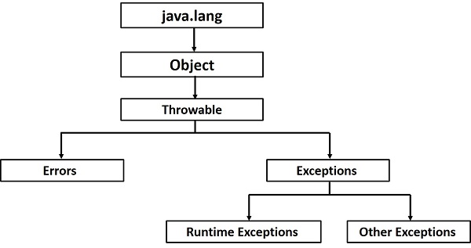
Exception Hierarchy

Slide 10
Exceptions Method
public String getMessage()
Returns a detailed message about the exception that has occurred. This message is initialized in the Throwable constructor.
public Throwable getCause()
Returns the cause of the exception as represented by a Throwable object
public String toString()
Returns the name of the class concatenated with the result of getMessage().
public void printStackTrace()
Prints the result of toString() along with the stack trace to System.err, the error output stream.

Slide 11
Exceptions Method
public StackTraceElement [] getStackTrace()
Returns an array containing each element on the stack trace. The element at index 0 represents the top of the call stack, and the last element in the array represents the method at the bottom of the call stack..
public Throwable fillInStackTrace()
Fills the stack trace of this Throwable object with the current stack trace, adding to any previous information in the stack trace.

Slide 12
Day 04
3
Try Catch Block

Slide 13
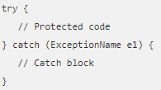
Catching Exceptions
A method catches an exception using a combination of the try and catch keywords.
A try/catch block is placed around the code that might generate an exception.
Code within a try/catch block is referred to as protected code.

Slide 14
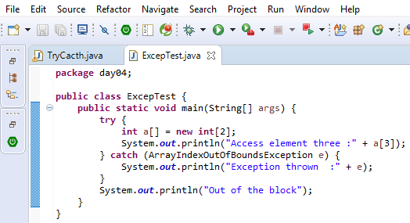
Catching Exceptions Example

Slide 15
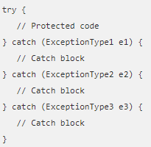
Multiple Catch Blocks
A try block can be followed by multiple catch blocks

Slide 16
Day 04
4
The Finally Block

Slide 17
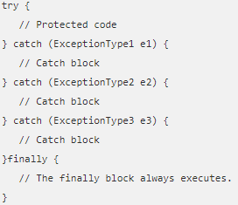
The Finally Block
The finally block follows a try block or a catch block. A finally block of code always executes, irrespective of occurrence of an Exception.
Using a finally block allows you to run any cleanup-type statements that you want to execute, no matter what happens in the protected code.
A finally block appears at the end of the catch blocks

Slide 18
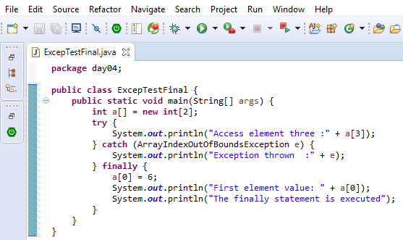
The Finally Block Example

Slide 19
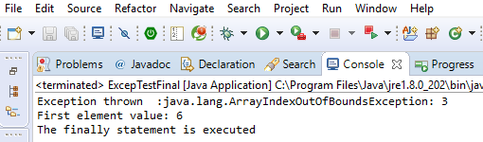
The Finally Block Example
A catch clause cannot exist without a try statement.
It is not compulsory to have finally clauses whenever a try/catch block is present.
The try block cannot be present without either catch clause or finally clause.
Any code cannot be present in between the try, catch, finally blocks.

Slide 20
Day 04
5
Study Case

Slide 21
GOOD LUCK!

Slide 22
THANKS!
Any questions?
Contact Your Trainer

