Slide 1


Java – Logic Day 05
Ver. 0.1

Slide 2
Day 01
1
Goal Material

Slide 3
Goal Material
Class
Property and Method
Object
Constructor
Study Case

Slide 4
Day 05
2
Class

Slide 5
Java OOPs Concepts
Object-Oriented Programming is a paradigm that provides many concepts such as inheritance, data binding, polymorphism, etc.
Simula is considered the first object-oriented programming language. The programming paradigm where everything is represented as an object is known as a truly object-oriented programming language.
Smalltalk is considered the first truly object-oriented programming language.
The popular object-oriented languages are Java, C#, PHP, Python, C++, etc.
The main aim of object-oriented programming is to implement real-world entities for example object, classes, abstraction, inheritance, polymorphism, etc.

Slide 6
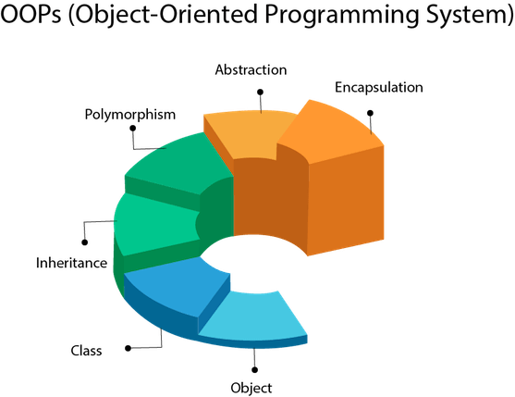
OOPs (Object-Oriented Programming System)
Object means a real-world entity such as a pen, chair, table, computer, watch, etc. Object-Oriented Programming is a methodology or paradigm to design a program using classes and objects. It simplifies the software development and maintenance by providing some concepts:
Object
Class
Inheritance
Polymorphism
Abstraction
Encapsulation

Slide 7
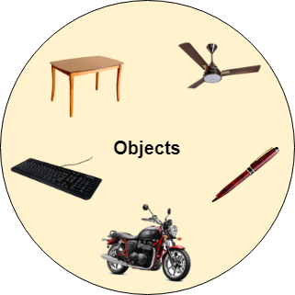
Object
Any entity that has state and behavior is known as an object. For example a chair, pen, table, keyboard, bike, etc. It can be physical or logical.
An Object can be defined as an instance of a class. An object contains an address and takes up some space in memory. Objects can communicate without knowing the details of each other's data or code. The only necessary thing is the type of message accepted and the type of response returned by the objects.
Example: A dog is an object because it has states like color, name, breed, etc. as well as behaviors like wagging the tail, barking, eating, etc.

Slide 8
Class
Collection of objects is called class. It is a logical entity.
A class can also be defined as a blueprint from which you can create an individual object. Class doesn't consume any space.

Slide 9
Inheritance
When one object acquires all the properties and behaviors of a parent object, it is known as inheritance. It provides code reusability. It is used to achieve runtime polymorphism.

Slide 10
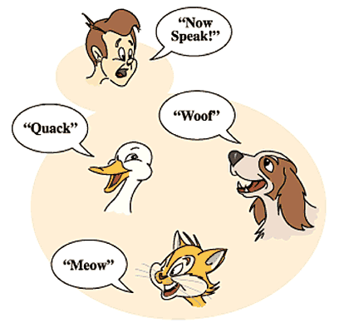
Polymorphism
If one task is performed by different ways, it is known as polymorphism. For example: to convince the customer differently, to draw something, for example, shape, triangle, rectangle, etc.
In Java, we use method overloading and method overriding to achieve polymorphism.
Another example can be to speak something; for example, a cat speaks meow, dog barks woof, etc.

Slide 11
Abstraction
Hiding internal details and showing functionality is known as abstraction. For example phone call, we don't know the internal processing.
In Java, we use abstract class and interface to achieve abstraction.

Slide 12

Encapsulation
Binding (or wrapping) code and data together into a single unit are known as encapsulation. For example capsule, it is wrapped with different medicines.
A java class is the example of encapsulation. Java bean is the fully encapsulated class because all the data members are private here.

Slide 13
Day 05
3
Initialize Object

Slide 14
Initialize Object
There are 3 ways to initialize object in java.
By reference variable
By method
By constructor

Slide 15
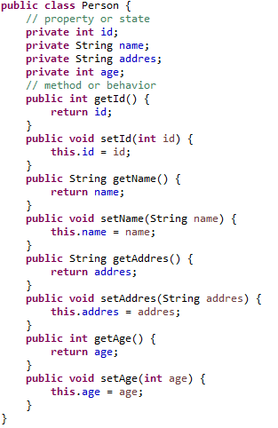
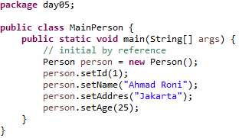
Initial By Reference

Slide 16
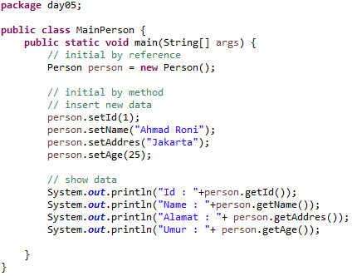
Initial By Method

Slide 17
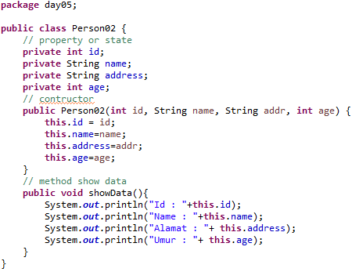
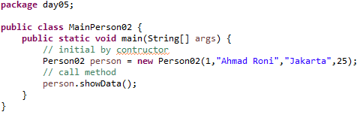
Initial By Constructor

Slide 18
Day 05
3
Constructor

Slide 19
Constructor
In Java, a constructor is a block of codes similar to the method. It is called when an instance of the object is created, and memory is allocated for the object.
It is a special type of method which is used to initialize the object.

Slide 20
When is a constructor called
Every time an object is created using new() keyword, at least one constructor is called. It calls a default constructor.
Note: It is called constructor because it constructs the values at the time of object creation. It is not necessary to write a constructor for a class. It is because java compiler creates a default constructor if your class doesn't have any.

Slide 21
Rules for creating Java constructor
There are two rules defined for the constructor.
Constructor name must be the same as its class name
A Constructor must have no explicit return type
A Java constructor cannot be abstract, static, final, and synchronized

Slide 22
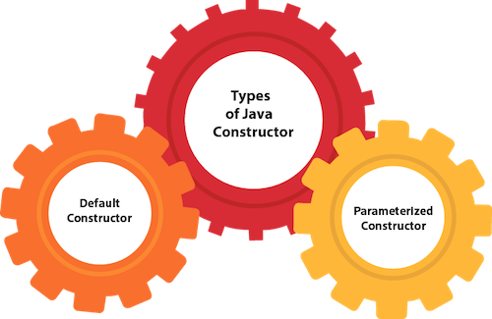
Types of Java constructors
There are two types of constructors in Java:
Default constructor (no-arg constructor)
Parameterized constructor

Slide 23
Java Default Constructor
A constructor is called "Default Constructor" when it doesn't have any parameter.
Syntax of default constructor:

Slide 24
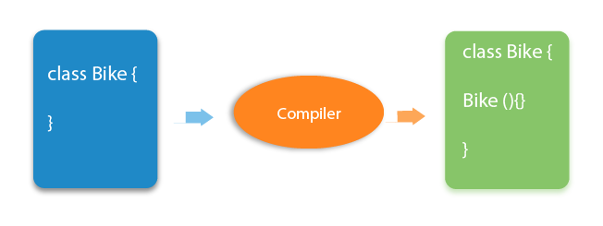
Java Default Constructor
What is the purpose of a default constructor?
The default constructor is used to provide the default values to the object like 0, null, etc., depending on the type.

Slide 25
Java Parameterized Constructor
A constructor which has a specific number of parameters is called a parameterized constructor.
Why use the parameterized constructor?
The parameterized constructor is used to provide different values to the distinct objects. However, you can provide the same values also.

Slide 26
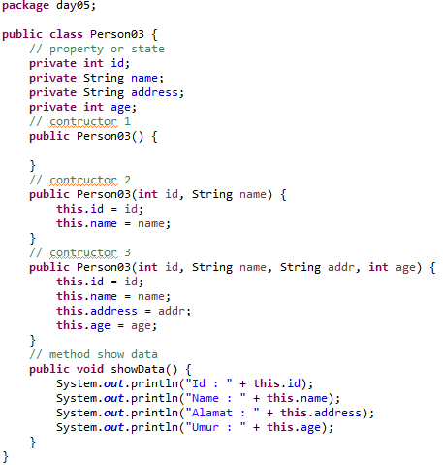
Constructor Overloading in Java
In Java, a constructor is just like a method but without return type. It can also be overloaded like Java methods.
Constructor overloading in Java is a technique of having more than one constructor with different parameter lists. They are arranged in a way that each constructor performs a different task. They are differentiated by the compiler by the number of parameters in the list and their types.

Slide 27
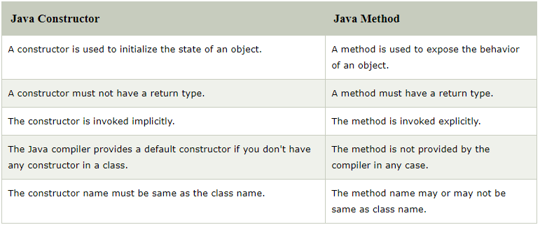
Constructor Vs Method

Slide 28
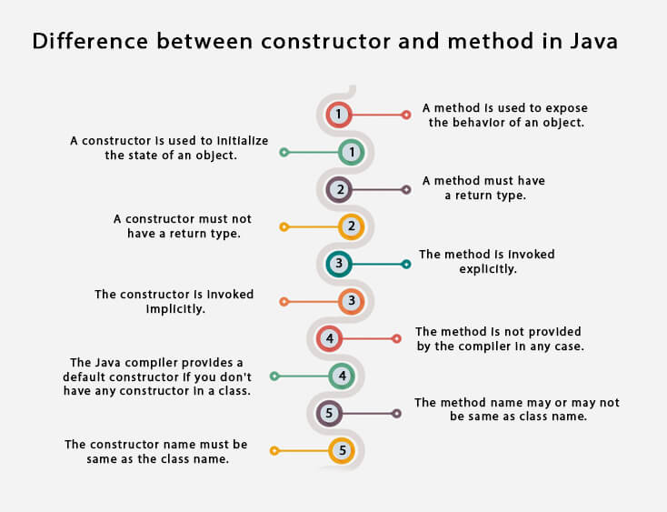
Constructor Vs Method

Slide 29
Day 05
5
static Keyword

Slide 30
Java static keyword
The static keyword in Java is used for memory management mainly. We can apply java static keyword with variables, methods, blocks and nested class. The static keyword belongs to the class than an instance of the class.
The static can be:
Variable (also known as a class variable)
Method (also known as a class method)
Block
Nested class

Slide 31
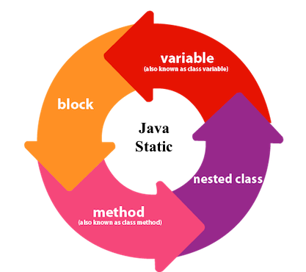
Java static variable
If you declare any variable as static, it is known as a static variable.
The static variable can be used to refer to the common property of all objects (which is not unique for each object), for example, the company name of employees, college name of students, etc.
The static variable gets memory only once in the class area at the time of class loading.

Slide 32
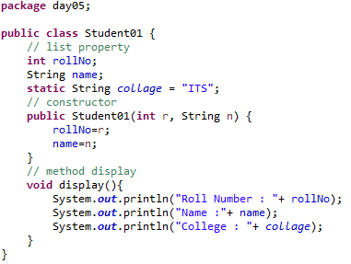
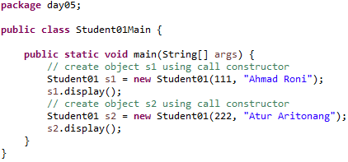
Java static variable - Example

Slide 33
Java static method
If you apply static keyword with any method, it is known as static method.
A static method belongs to the class rather than the object of a class.
A static method can be invoked without the need for creating an instance of a class.
A static method can access static data member and can change the value of it..

Slide 34
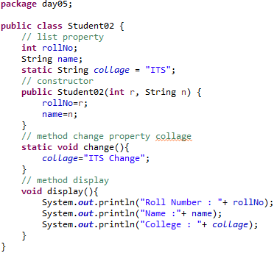
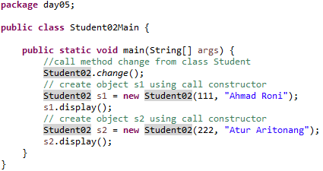
Java static method - Example

Slide 35
Restrictions for the static method
There are two main restrictions for the static method. They are:
The static method can not use non static data member or call non-static method directly.
this and super cannot be used in static context.
Why is the Java main method static?
It is because the object is not required to call a static method. If it were a non-static method, JVM creates an object first then call main() method that will lead the problem of extra memory allocation.

Slide 36
Java static block
Is used to initialize the static data member.
It is executed before the main method at the time of classloading.
Can we execute a program without main() method?
No, one of the ways was the static block, but it was possible till JDK 1.6. Since JDK 1.7, it is not possible to execute a java class without the main method.

Slide 37
Day 05
6
this Keyword

Slide 38
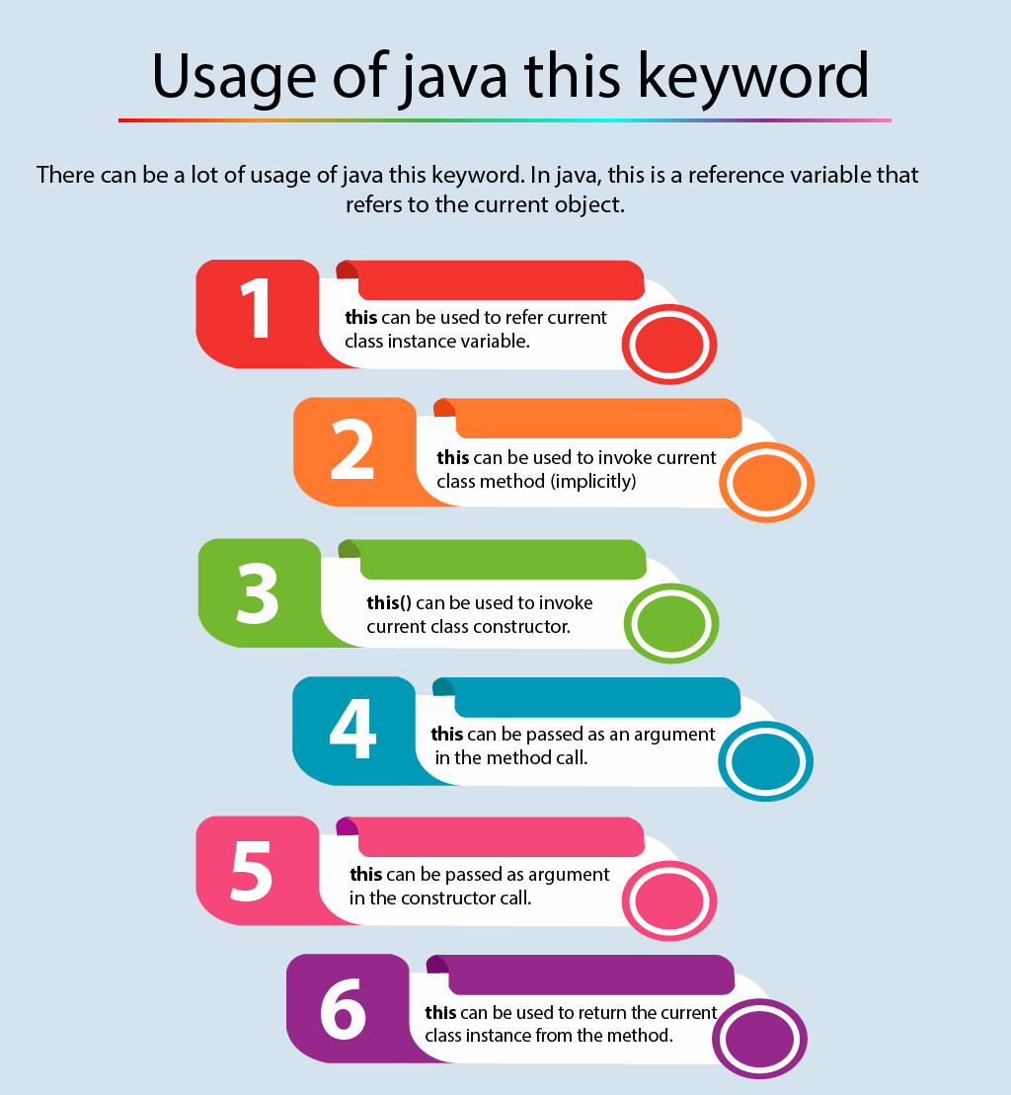
There can be a lot of usage of java this keyword. In java, this is a reference variable that refers to the current object.
Here is given the 6 usage of java this keyword:
this can be used to refer current class instance variable.
this can be used to invoke current class method (implicitly)
this() can be used to invoke current class constructor.
this can be passed as an argument in the method call.
this can be passed as argument in the constructor call.
this can be used to return the current class instance from the method.

Slide 39
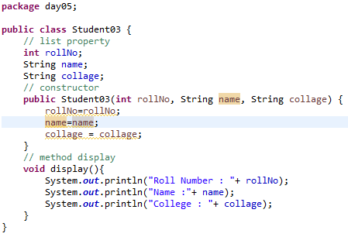
1. this: to refer current class instance variable
The this keyword can be used to refer current class instance variable. If there is ambiguity between the instance variables and parameters, this keyword resolves the problem of ambiguity.

Slide 40
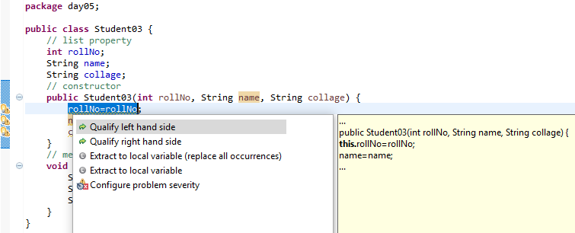
1. this: to refer current class instance variable

Slide 41
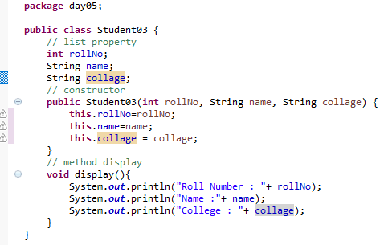
1. this: to refer current class instance variable

Slide 42
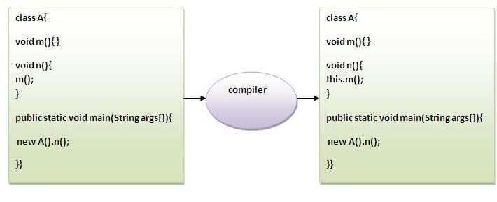
2) this: to invoke current class method
You may invoke the method of the current class by using the this keyword. If you don't use the this keyword, compiler automatically adds this keyword while invoking the method. Let's see the example

Slide 43
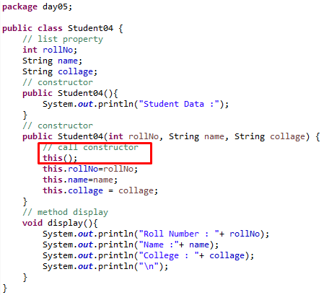
3) this() : to invoke current class constructor
The this() constructor call can be used to invoke the current class constructor. It is used to reuse the constructor. In other words, it is used for constructor chaining.

Slide 44
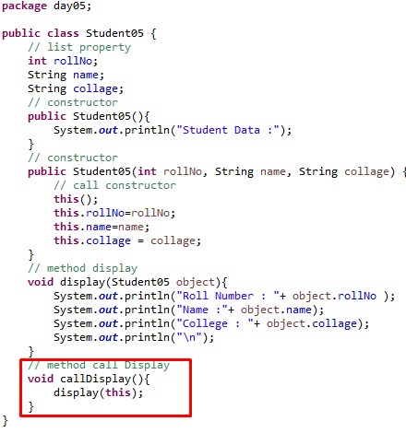
4) this: to pass as an argument in the method
The this keyword can also be passed as an argument in the method. It is mainly used in the event handling

Slide 45
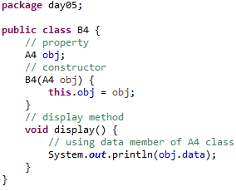
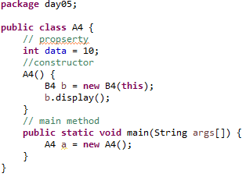
5) this: to pass as argument in the constructor call
We can pass the this keyword in the constructor also. It is useful if we have to use one object in multiple classes. Let's see the example:

Slide 46
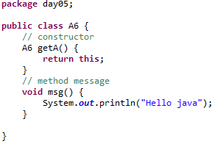
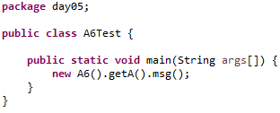
6) this keyword can be used to return current class instance
We can return this keyword as an statement from the method. In such case, return type of the method must be the class type (non-primitive). Let's see the example:

Slide 47
Day 05
7
Study Case

Slide 48
01. Correctness and the Loop Invariant
Loop Invariant
In computer science, you could prove it formally with a loop invariant, where you state that a desired property is maintained in your loop. Such a proof is broken down into the following parts:
Initialization: It is true (in a limited sense) before the loop runs.
Maintenance: If it's true before an iteration of a loop, it remains true before the next iteration.
Termination: It will terminate in a useful way once it is finished.

Slide 49


01. Correctness and the Loop Invariant
Insertion Sort's Invariant
Say, you have some InsertionSort code, where the outer loop goes through the whole array :
You could then state the following loop invariant:

Slide 50
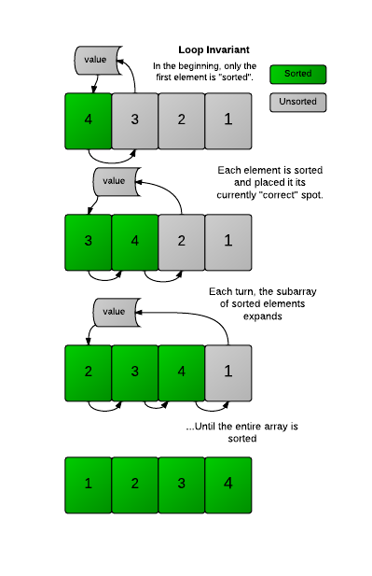
01. Correctness and the Loop Invariant
To prove Insertion Sort is correct, you will then demonstrate it for the three stages:
Initialization - The subarray starts with the first element of the array, and it is (obviously) sorted to begin with.
Maintenance - Each iteration of the loop expands the subarray, but keeps the sorted property. An element gets inserted into the array only when it is greater than the element to its left. Since the elements to its left have already been sorted, it means is greater than all the elements to its left, so the array remains sorted. (In Insertion Sort 2 we saw this by printing the array each time an element was properly inserted.)
Termination - The code will terminate after has reached the last element in the array, which means the sorted subarray has expanded to encompass the entire array. The array is now fully sorted.

Slide 51
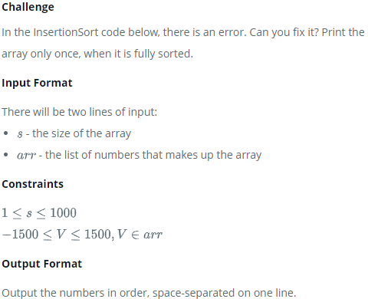
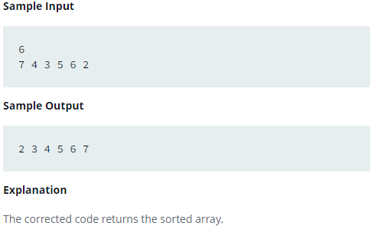
01. Correctness and the Loop Invariant

Slide 52
GOOD LUCK!

Slide 53
THANKS!
Any questions?
Contact Your Trainer

