Slide 1


Java – Logic Day 06
Ver. 0.1

Slide 2
Day 06
1
Goal Material

Slide 3
Goal Material
Inheritance
Agregation
Method Overloading
Method Overriding
Super Keyword
Instance initializer block
Final keyword
Dynamic Binding
Intanceof keyword

Slide 4
Day 06 - Inheritance
2
Inheritance

Slide 5
Inheritance in Java
Inheritance in Java is a mechanism in which one object acquires all the properties and behaviors of a parent object. It is an important part of OOPs (Object Oriented programming system).
The idea behind inheritance in Java is that you can create new classes that are built upon existing classes. When you inherit from an existing class, you can reuse methods and fields of the parent class. Moreover, you can add new methods and fields in your current class also.
Inheritance represents the IS-A relationship which is also known as a parent-child relationship.

Slide 6
Why use inheritance in java
For Method Overriding (so runtime polymorphism can be achieved).
For Code Reusability.

Slide 7
Terms used in Inheritance
Class: A class is a group of objects which have common properties. It is a template or blueprint from which objects are created.
Sub Class/Child Class: Subclass is a class which inherits the other class. It is also called a derived class, extended class, or child class.
Super Class/Parent Class: Superclass is the class from where a subclass inherits the features. It is also called a base class or a parent class.
Reusability: As the name specifies, reusability is a mechanism which facilitates you to reuse the fields and methods of the existing class when you create a new class. You can use the same fields and methods already defined in the previous class.

Slide 8
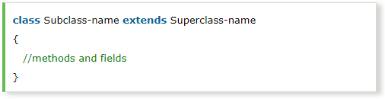
The syntax of Java Inheritance
The extends keyword indicates that you are making a new class that derives from an existing class. The meaning of "extends" is to increase the functionality.
In the terminology of Java, a class which is inherited is called a parent or superclass, and the new class is called child or subclass.

Slide 9
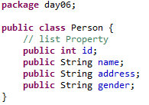
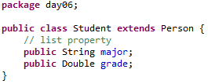

Slide 10
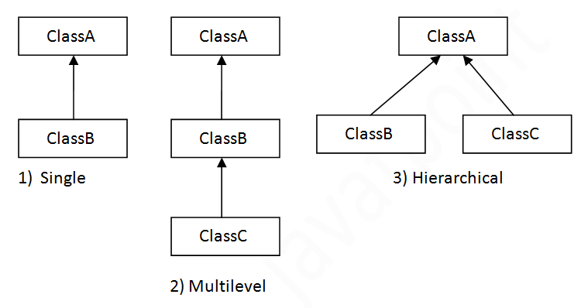
Types of inheritance in java
On the basis of class, there can be three types of inheritance in java: single, multilevel and hierarchical.
In java programming, multiple and hybrid inheritance is supported through interface only. We will learn about interfaces later.

Slide 11
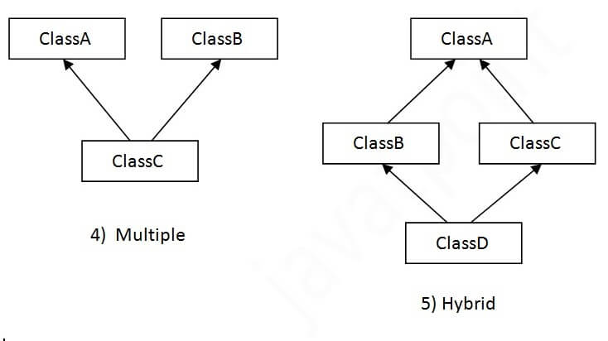
Types of inheritance in java
When one class inherits multiple classes, it is known as multiple inheritance. For Example:

Slide 12
Why multiple inheritance is not supported in java?
To reduce the complexity and simplify the language, multiple inheritance is not supported in java.
Consider a scenario where A, B, and C are three classes. The C class inherits A and B classes. If A and B classes have the same method and you call it from child class object, there will be ambiguity to call the method of A or B class.
Since compile-time errors are better than runtime errors, Java renders compile-time error if you inherit 2 classes. So whether you have same method or different, there will be compile time error.

Slide 13
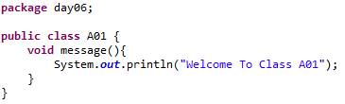
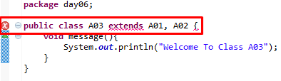
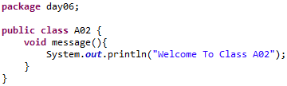
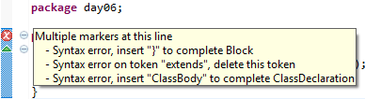
Why multiple inheritance is not supported in java?

Slide 14
Day 06 - Inheritance
3
Agregation

Slide 15
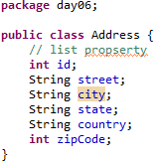
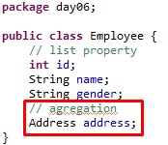
Aggregation in Java
If a class have an entity reference, it is known as Aggregation. Aggregation represents HAS-A relationship.
Consider a situation, Employee object contains many informations such as id, name, emailId etc. It contains one more object named address, which contains its own informations such as city, state, country, zipcode etc. as given below.
Why use Aggregation?
For Code Reusability.

Slide 16
When use Aggregation?
Code reuse is also best achieved by aggregation when there is no is-a relationship.
Inheritance should be used only if the relationship is-a is maintained throughout the lifetime of the objects involved; otherwise, aggregation is the best choice.

Slide 17
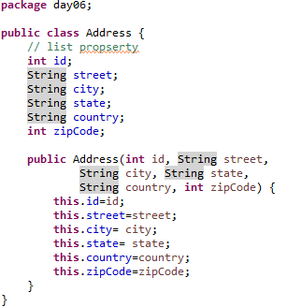
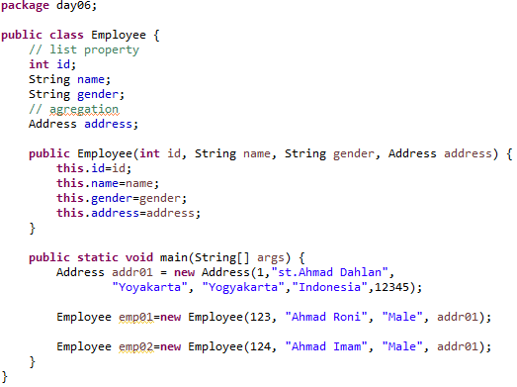
Aggregation Example

Slide 18
Day 06 - Polymorphism
4
Method Overloading

Slide 19
Method Overloading in Java
If a class has multiple methods having same name but different in parameters, it is known as Method Overloading.
If we have to perform only one operation, having same name of the methods increases the readability of the program.
Suppose you have to perform addition of the given numbers but there can be any number of arguments, if you write the method such as a(int,int) for two parameters, and b(int,int,int) for three parameters then it may be difficult for you as well as other programmers to understand the behavior of the method because its name differs.
So, we perform method overloading to figure out the program quickly.

Slide 20
Advantage of method overloading
Method overloading increases the readability of the program.
Different ways to overload the method
There are two ways to overload the method in java
By changing number of arguments
By changing the data type

Slide 21
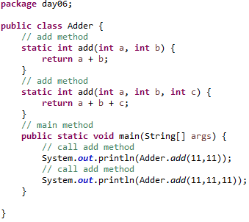
1) Method Overloading: changing no. of arguments
In this example, we have created two methods, first add() method performs addition of two numbers and second add method performs addition of three numbers.
In this example, we are creating static methods so that we don't need to create instance for calling methods.

Slide 22
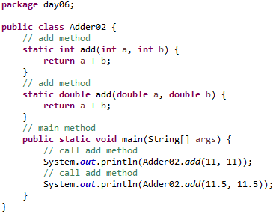
2) Method Overloading: changing data type of argumentsIn
this example, we have created two methods that differs in data type. The first add method receives two integer arguments and second add method receives two double arguments.

Slide 23
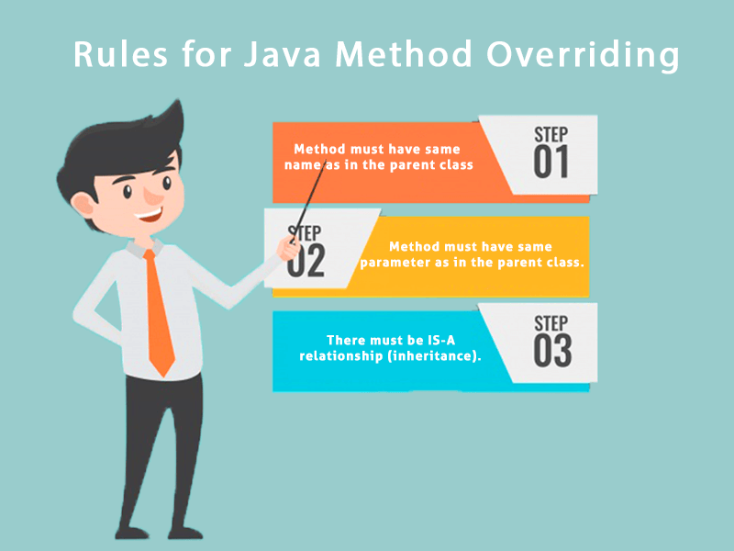
Rules for Java Method Overriding
The method must have the same name as in the parent class
The method must have the same parameter as in the parent class.
There must be an IS-A relationship (inheritance).

Slide 24
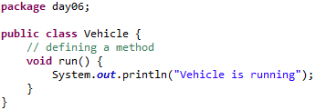
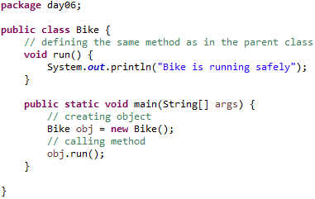
Example of method overriding
In this example, we have defined the run method in the subclass as defined in the parent class but it has some specific implementation. The name and parameter of the method are the same, and there is IS-A relationship between the classes, so there is method overriding.

Slide 25
Question and Answer
Can we override static method?
No, a static method cannot be overridden. It can be proved by runtime polymorphism, so we will learn it later.
Why can we not override static method?
It is because the static method is bound with class whereas instance method is bound with an object. Static belongs to the class area, and an instance belongs to the heap area.
Can we override java main method?
No, because the main is a static method.

Slide 26
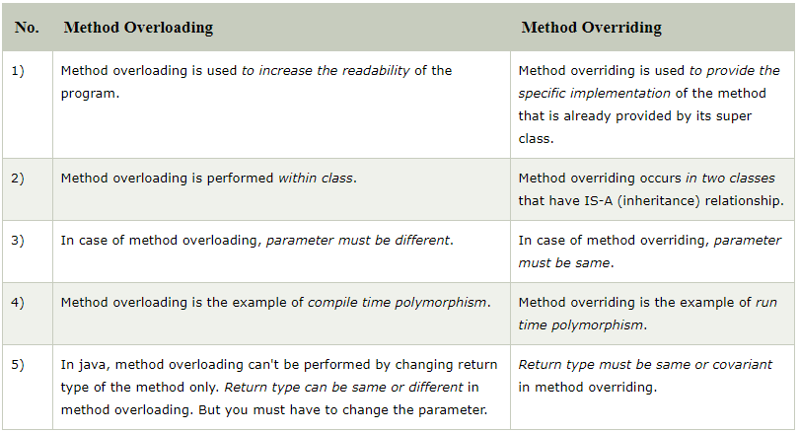
Method Overloading Vs. Method Overriding

Slide 27
Day 06 - Polymorphism
5
Method Overridding

Slide 28
Method Overriding in Java
If subclass (child class) has the same method as declared in the parent class, it is known as method overriding in Java.
In other words, If a subclass provides the specific implementation of the method that has been declared by one of its parent class, it is known as method overriding.
Usage of Java Method Overriding
Method overriding is used to provide the specific implementation of a method which is already provided by its superclass.
Method overriding is used for runtime polymorphism

Slide 29
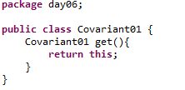
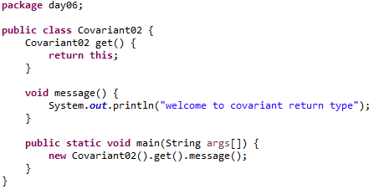
Covariant Return Type
The covariant return type specifies that the return type may vary in the same direction as the subclass.
Before Java5, it was not possible to override any method by changing the return type. But now, since Java5, it is possible to override method by changing the return type if subclass overrides any method whose return type is Non-Primitive but it changes its return type to subclass type. Let's take a simple example:

Slide 30
How is Covariant return types implemented?
Java doesn't allow the return type based overloading but JVM always allows return type based overloading. JVM uses full signature of a method for lookup/resolution. Full signature means it includes return type in addition to argument types. i.e., a class can have two or more methods differing only by return type. javac uses this fact to implement covariant return types.

Slide 31
Day 06 - Polymorphism
6
super Keyword

Slide 32
Super Keyword in Java
The super keyword in Java is a reference variable which is used to refer immediate parent class object.
Whenever you create the instance of subclass, an instance of parent class is created implicitly which is referred by super reference variable.

Slide 33
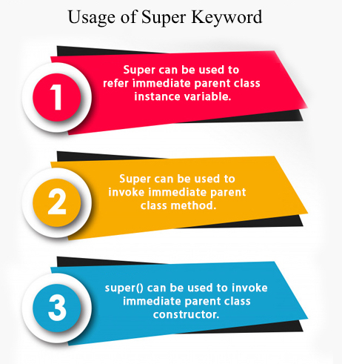
Super Keyword in Java
Usage of Java super Keyword
super can be used to refer immediate parent class instance variable.
super can be used to invoke immediate parent class method.
super() can be used to invoke immediate parent class constructor.

Slide 34
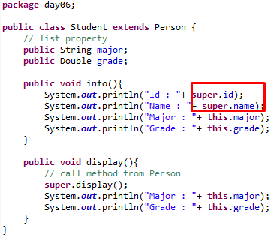
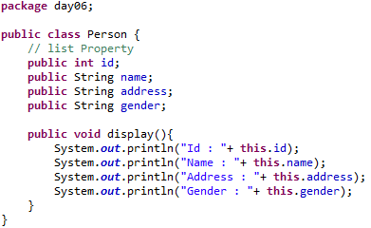
1) super is used to refer immediate parent class instance variable.
We can use super keyword to access the data member or field of parent class. It is used if parent class and child class have same fields.
Class Person :
Class Student :

Slide 35
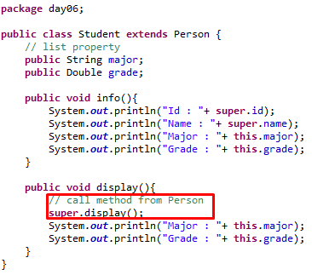
2) super can be used to invoke parent class method
The super keyword can also be used to invoke parent class method. It should be used if subclass contains the same method as parent class. In other words, it is used if method is overridden.
Class Person :
Class Student :

Slide 36
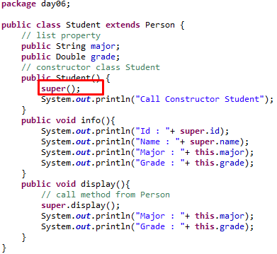
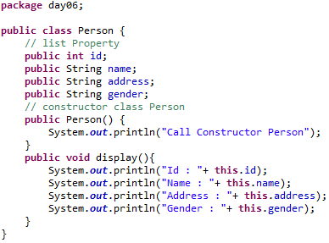
3) super is used to invoke parent class constructor.
The super keyword can also be used to invoke the parent class constructor. Let's see a simple example:
Class Person :
Class Student :

Slide 37
super example: real use
Let's see the real use of super keyword. Here, Emp class inherits Person class so all the properties of Person will be inherited to Emp by default. To initialize all the property, we are using parent class constructor from child class. In such way, we are reusing the parent class constructor.

Slide 38
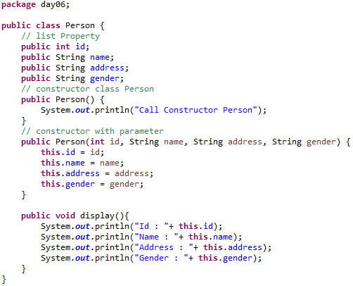
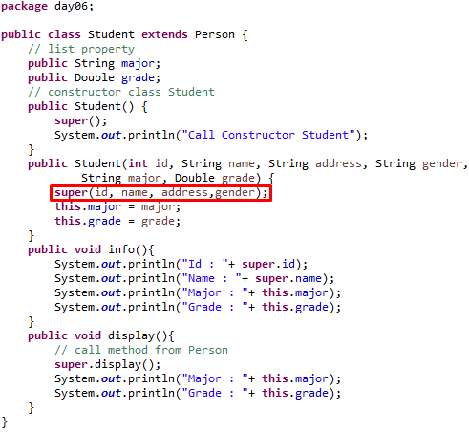
super example: real use

Slide 39
Day 06 - Polymorphism
7
Instance initializer block

Slide 40

Instance Initializer block
Instance Initializer block is used to initialize the instance data member. It run each time when object of the class is created.
The initialization of the instance variable can be done directly but there can be performed extra operations while initializing the instance variable in the instance initializer block.
What is the use of instance initializer block while we can directly assign a value in instance data member?

Slide 41
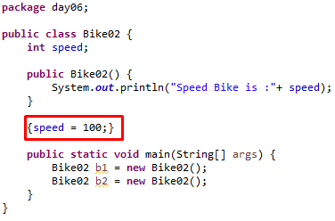
Why use instance initializer block?
Suppose I have to perform some operations while assigning value to instance data member e.g. a for loop to fill a complex array or error handling etc.

Slide 42
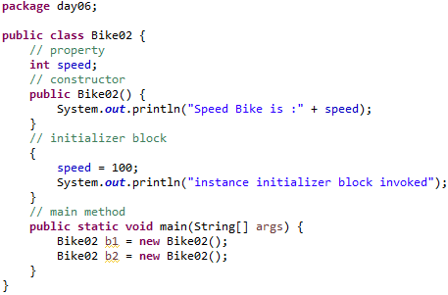
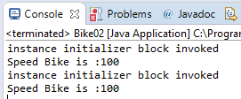
Instance Initializer block
There are three places in java where you can perform operations:
method
constructor
Block
What is invoked first, instance initializer block or constructor?

Slide 43
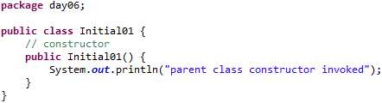
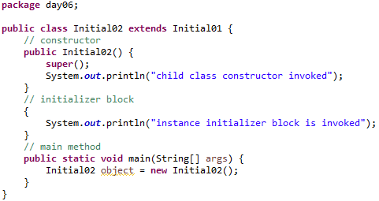
Rules for instance initializer block
There are mainly three rules for the instance initializer block. They are as follows:
The instance initializer block is created when instance of the class is created.
The instance initializer block is invoked after the parent class constructor is invoked (i.e. after super() constructor call).
The instance initializer block comes in the order in which they appear.

Slide 44
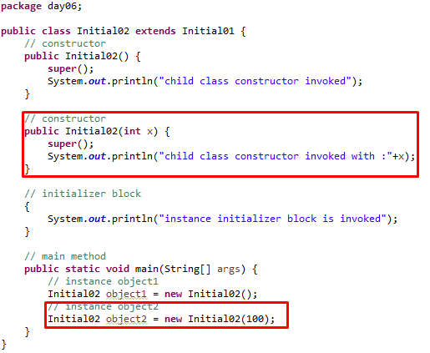
Another example of instance block

Slide 45
Day 06 - Polymorphism
8
final keyword

Slide 46
Final Keyword in Java
The final keyword in java is used to restrict the user. The java final keyword can be used in many context. Final can be:
variable
method
class
The final keyword can be applied with the variables, a final variable that have no value it is called blank final variable or uninitialized final variable. It can be initialized in the constructor only. The blank final variable can be static also which will be initialized in the static block only. We will have detailed learning of these. Let's first learn the basics of final keyword

Slide 47
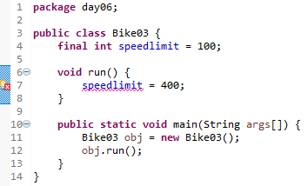
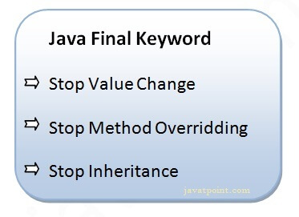
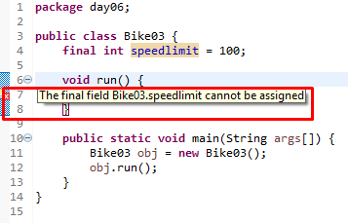
1) Java final variable
If you make any variable as final, you cannot change the value of final variable(It will be constant).
Example of final variable
There is a final variable speedlimit, we are going to change the value of this variable, but It can't be changed because final variable once assigned a value can never be changed.

Slide 48
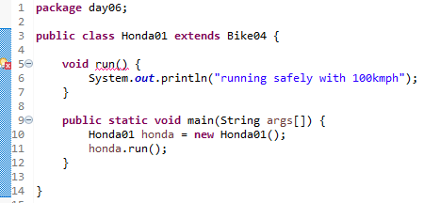
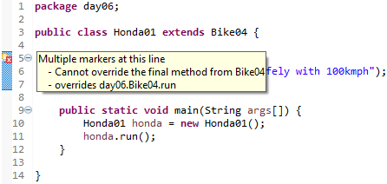
2) Java final method
If you make any method as final, you cannot override it.

Slide 49
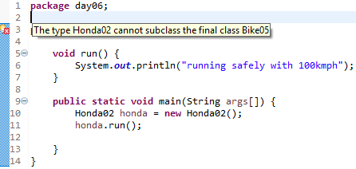


3) Java final class
If you make any class as final, you cannot extend it.

Slide 50
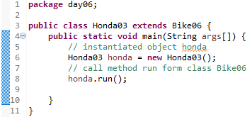
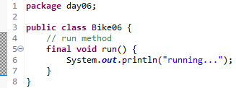
Q : Is final method inherited?
Answer : Yes, final method is inherited but you cannot override it. For Example:

Slide 51
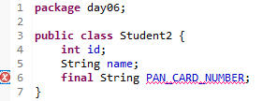
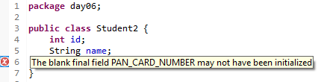
Q: What is blank or uninitialized final variable?
A final variable that is not initialized at the time of declaration is known as blank final variable.
If you want to create a variable that is initialized at the time of creating object and once initialized may not be changed, it is useful. For example PAN CARD number of an employee.
It can be initialized only in constructor.

Slide 52
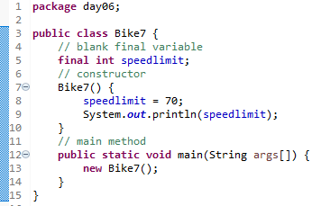
Q: Can we initialize blank final variable?
Answer: Yes, but only in constructor. For example:

Slide 53
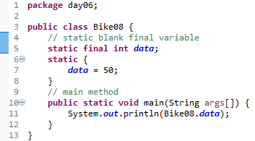
static blank final variable
A static final variable that is not initialized at the time of declaration is known as static blank final variable. It can be initialized only in static block.

Slide 54
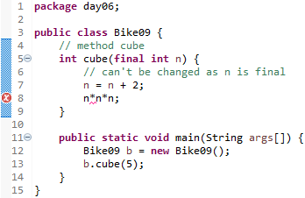
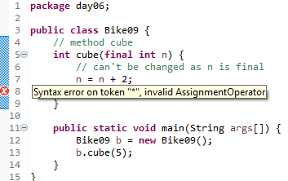
Q) What is final parameter?
Answer : If you declare any parameter as final, you cannot change the value of it.

Slide 55
Q) Can we declare a constructor final?
Answer : No, because constructor is never inherited.

Slide 56
Day 06 - Polymorphism
9
Runtime Polymorphism

Slide 57
Runtime Polymorphism in Java
Runtime polymorphism or Dynamic Method Dispatch is a process in which a call to an overridden method is resolved at runtime rather than compile-time.
In this process, an overridden method is called through the reference variable of a superclass. The determination of the method to be called is based on the object being referred to by the reference variable.
Let's first understand the upcasting before Runtime Polymorphism.

Slide 58
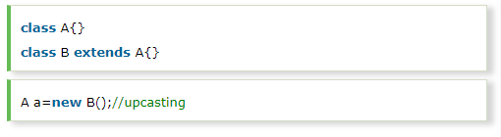


Upcasting
If the reference variable of Parent class refers to the object of Child class, it is known as upcasting. For example:
For upcasting, we can use the reference variable of class type or an interface type. For Example:

Slide 59

Example of Java Runtime Polymorphism
In this example, we are creating two classes Bike and Splendor. Splendor class extends Bike class and overrides its run() method. We are calling the run method by the reference variable of Parent class. Since it refers to the subclass object and subclass method overrides the Parent class method, the subclass method is invoked at runtime.
Since method invocation is determined by the JVM not compiler, it is known as runtime polymorphism.

Slide 60

Java Runtime Polymorphism with Data Member
A method is overridden, not the data members, so runtime polymorphism can't be achieved by data members.
In the example given below, both the classes have a data member speedlimit. We are accessing the data member by the reference variable of Parent class which refers to the subclass object. Since we are accessing the data member which is not overridden, hence it will access the data member of the Parent class always.

Slide 61



Java Runtime Polymorphism with Multilevel Inheritance
Let's see the simple example of Runtime Polymorphism with multilevel inheritance.

Slide 62
Day 06 - Polymorphism
10
Dynamic Binding

Slide 63

Static Binding and Dynamic Binding
Connecting a method call to the method body is known as binding.
There are two types of binding
Static Binding (also known as Early Binding).
Dynamic Binding (also known as Late Binding).

Slide 64


Understanding Type
Let's understand the type of instance.
1) variables have a type
Each variable has a type, it may be primitive and non-primitive.
2) References have a type
3) Objects have a type
An object is an instance of particular java class,but it is also an instance of its superclass.

Slide 65

static binding
When type of the object is determined at compiled time(by the compiler), it is known as static binding.
If there is any private, final or static method in a class, there is static binding.

Slide 66

Dynamic binding
When type of the object is determined at run-time, it is known as dynamic binding.
In this example object type cannot be determined by the compiler, because the instance of Dog is also an instance of Animal.So compiler doesn't know its type, only its base type.

Slide 67
Day 06 - Polymorphism
11
instanceof Operator

Slide 68

Java instanceof
The java instanceof operator is used to test whether the object is an instance of the specified type (class or subclass or interface).
The instanceof in java is also known as type comparison operator because it compares the instance with type. It returns either true or false. If we apply the instanceof operator with any variable that has null value, it returns false.
An object of subclass type is also a type of parent class. For example, if Dog extends Animal then object of Dog can be referred by either Dog or Animal class.

Slide 69

Another example of java instanceof operator

Slide 70

instanceof in java with a variable that have null value
If we apply instanceof operator with a variable that have null value, it returns false. Let's see the example given below where we apply instanceof operator with the variable that have null value.

Slide 71

Downcasting with java instanceof operator
When Subclass type refers to the object of Parent class, it is known as downcasting. If we perform it directly, compiler gives Compilation error. If you perform it by typecasting, ClassCastException is thrown at runtime. But if we use instanceof operator, downcasting is possible.
If we perform downcasting by typecasting, ClassCastException is thrown at runtime.

Slide 72

Possibility of downcasting with instanceof
Let's see the example, where downcasting is possible by instanceof operator.

Slide 73


Downcasting without the use of java instanceof
Downcasting can also be performed without the use of instanceof operator as displayed in the following example:
Let's take closer look at this, actual object that is referred by a, is an object of Dog class. So if we downcast it, it is fine. But what will happen if we write:

Slide 74



Understanding Real use of instanceof in java
Let's see the real use of instanceof keyword by the example given below.

Slide 75
Day 06
12
Study Case

Slide 76
GOOD LUCK!

Slide 77
THANKS!
Any questions?
Contact Your Trainer

