Slide 1


Java – Logic Day 08
Ver. 0.1

Slide 2
Day 08
1
Goal Material

Slide 3
Goal Material
Introduction SQL
Syntax
DDL

Slide 4
Day 08
2
Goal Material

Slide 5
What is SQL?
SQL stands for Structured Query Language
SQL lets you access and manipulate databases
SQL became a standard of the American National Standards Institute (ANSI) in 1986, and of the International Organization for Standardization (ISO) in 1987

Slide 6
What Can SQL do?
SQL can execute queries against a database
SQL can retrieve data from a database
SQL can insert records in a database
SQL can update records in a database
SQL can delete records from a database
SQL can create new databases
SQL can create new tables in a database
SQL can create stored procedures in a database
SQL can create views in a database
SQL can set permissions on tables, procedures, and views

Slide 7
SQL is a Standard - BUT....
Although SQL is an ANSI/ISO standard, there are different versions of the SQL language.
However, to be compliant with the ANSI standard, they all support at least the major commands (such as SELECT, UPDATE, DELETE, INSERT, WHERE) in a similar manner.

Slide 8
Using SQL in Your Web Site
To build a web site that shows data from a database, you will need:
An RDBMS database program (i.e. MS Access, SQL Server, MySQL)
To use a server-side scripting language, like PHP or ASP
To use SQL to get the data you want
To use HTML / CSS to style the page

Slide 9
RDBMS
RDBMS stands for Relational Database Management System.
RDBMS is the basis for SQL, and for all modern database systems such as MS SQL Server, IBM DB2, Oracle, MySQL, and Microsoft Access.
The data in RDBMS is stored in database objects called tables. A table is a collection of related data entries and it consists of columns and rows.
Every table is broken up into smaller entities called fields.
A record, also called a row, is each individual entry that exists in a table.
A column is a vertical entity in a table that contains all information associated with a specific field in a table.

Slide 10
Day 08
3
DDL

Slide 11
DDL(Data Definition Language)
DDL or Data Definition Language actually consists of the SQL commands that can be used to define the database schema. It simply deals with descriptions of the database schema and is used to create and modify the structure of database objects in database.

Slide 12
Examples of DDL commands
CREATE – is used to create the database or its objects (like table, index, function, views, store procedure and triggers).
DROP – is used to delete objects from the database.
ALTER-is used to alter the structure of the database.
TRUNCATE–is used to remove all records from a table, including all spaces allocated for the records are removed.
COMMENT –is used to add comments to the data dictionary.
RENAME –is used to rename an object existing in the database.

Slide 13
Database
The SQL CREATE DATABASE Statement
The CREATE DATABASE statement is used to create a new SQL database.
CREATE DATABASE testDB;
The SQL DROP DATABASE Statement
The DROP DATABASE statement is used to drop an existing SQL database.
DROP DATABASE testDB;

Slide 14
Table Create
The SQL CREATE TABLE Statement
The CREATE TABLE statement is used to create a new table in a database.
CREATE TABLE Persons (
PersonID int,
LastName varchar(255),
FirstName varchar(255),
Address varchar(255),
City varchar(255)
);
The PersonID column is of type int and will hold an integer.
The LastName, FirstName, Address, and City columns are of type varchar and will hold characters, and the maximum length for these fields is 255 characters.

Slide 15
Table Create
Create Table Using Another Table
A copy of an existing table can also be created using CREATE TABLE.
The new table gets the same column definitions. All columns or specific columns can be selected.
If you create a new table using an existing table, the new table will be filled with the existing values from the old table
Syntax
CREATE TABLE TestTable AS
SELECT customername, contactname
FROM customers;

Slide 16
Table Drop
The SQL DROP TABLE Statement
The DROP TABLE statement is used to drop an existing table in a database
DROP TABLE Shippers;
SQL TRUNCATE TABLE
The TRUNCATE TABLE statement is used to delete the data inside a table, but not the table itself.
TRUNCATE TABLE table_name;

Slide 17
SQL ALTER TABLE Statement
The ALTER TABLE statement is used to add, delete, or modify columns in an existing table.
The ALTER TABLE statement is also used to add and drop various constraints on an existing table.
ALTER TABLE - ADD Column
To add a column in a table, use the following syntax:
ALTER TABLE Customers ADD Email varchar(255);
ALTER TABLE - DROP COLUMN
To delete a column in a table, use the following syntax (notice that some database systems don't allow deleting a column):
ALTER TABLE Customers DROP COLUMN Email;

Slide 18
SQL ALTER TABLE Statement
ALTER TABLE - ALTER/MODIFY COLUMN
To change the data type of a column in a table, use the following syntax:
Ms. SQL Server :
ALTER TABLE table_name
ALTER COLUMN column_name datatype;
My SQL / Oracle (prior version 10G):
ALTER TABLE table_name
MODIFY COLUMN column_name datatype;
Oracle 10G and later:
ALTER TABLE table_name
MODIFY column_name datatype;
PostgreSQL:
ALTER TABLE table_name
ALTER COLUMN column_name

Slide 19
SQL Constraints
SQL constraints are used to specify rules for the data in a table.
Constraints are used to limit the type of data that can go into a table. This ensures the accuracy and reliability of the data in the table. If there is any violation between the constraint and the data action, the action is aborted.
Constraints can be column level or table level. Column level constraints apply to a column, and table level constraints apply to the whole table.

Slide 20
SQL Constraints
The following constraints are commonly used in SQL:
NOT NULL - Ensures that a column cannot have a NULL value
UNIQUE - Ensures that all values in a column are different
PRIMARY KEY - A combination of a NOT NULL and UNIQUE. Uniquely identifies each row in a table
FOREIGN KEY - Uniquely identifies a row/record in another table
CHECK - Ensures that all values in a column satisfies a specific condition
DEFAULT - Sets a default value for a column when no value is specified
INDEX - Used to create and retrieve data from the database very quickly

Slide 21
Day 08
4
Study Case

Slide 22
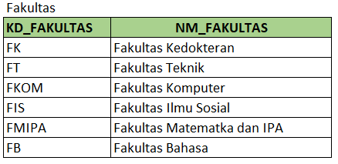
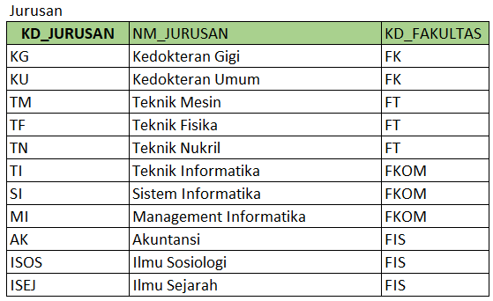
Study Case – Logic 08

Slide 23
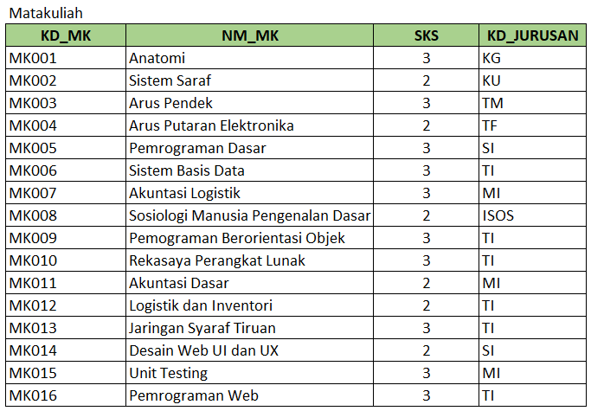
Study Case – Logic 08

Slide 24
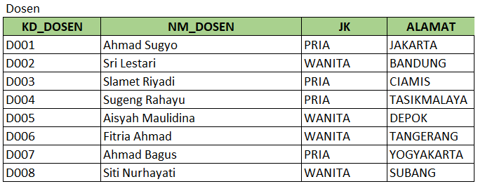
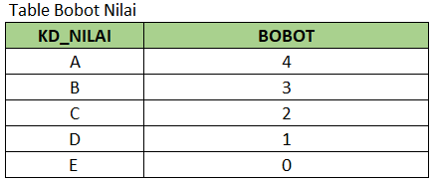
Study Case – Logic 08

Slide 25
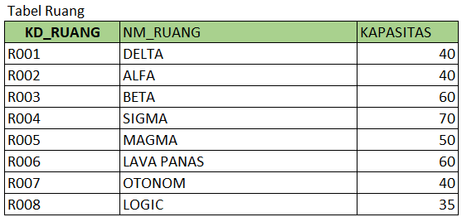
Study Case – Logic 08

Slide 26
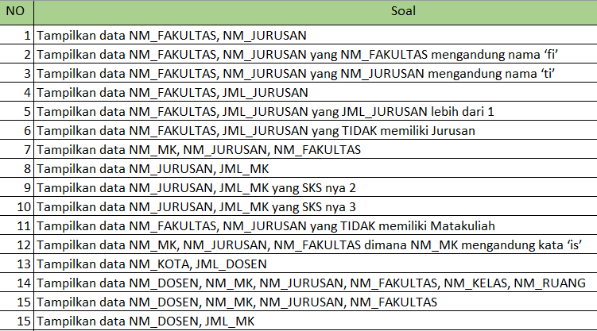
Study Case – Logic 08

Slide 27
GOOD LUCK!

Slide 28
THANKS!
Any questions?
Contact Your Trainer

