Slide 1


BootCamp ASP.Net 4.5.x MVC
Ver. 0.1

Slide 2
Goal
The participants will be able and understand about ASP.Net MVC .NetFramework 4.5.x :
FullStack Web Developer
Database Design
Solution Skeleton
MVC Web Application
Web Method: Get & Post
UI Bootstrap Framework
Jquery & AJAX Transaction

Slide 3
Environment
IDE
Visual Studio 2013/2015/2017
Or Latest
DBMS
Ms. SQL Server 2012/2014
Or Latest
Framework
.NetFramework 4.5.x
ORM
Entity Framework
UI
Bootstrap

Slide 4
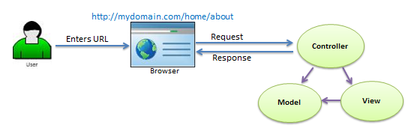
MVC Introduction
Model represents shape of the data and business logic. It maintains the data of the application. Model objects retrieve and store model state in a database.
View is a user interface. View display data using model to the user and also enables them to modify the data.
Controller handles the user request. Typically, user interact with View, which in-tern raises appropriate URL request, this request will be handled by a controller. The controller renders the appropriate view with the model data as a response.

Slide 5
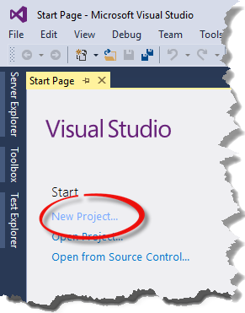
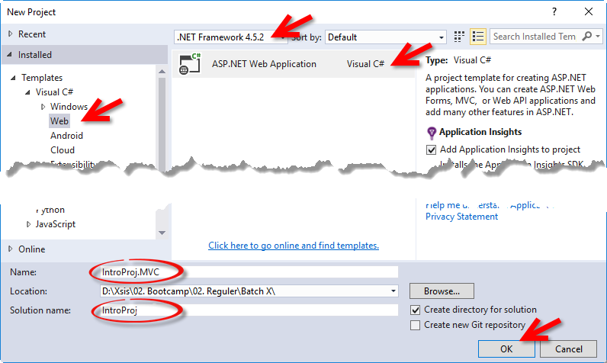
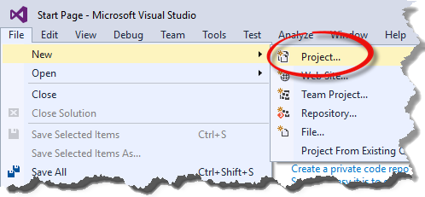
Introduce MVC – Create New Project

Slide 6
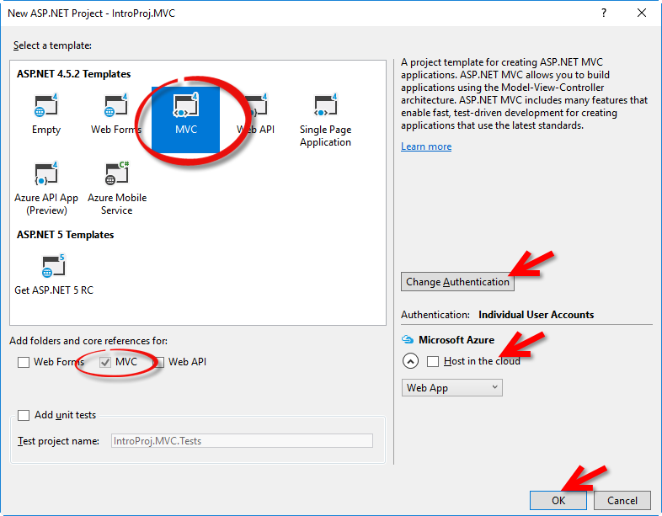
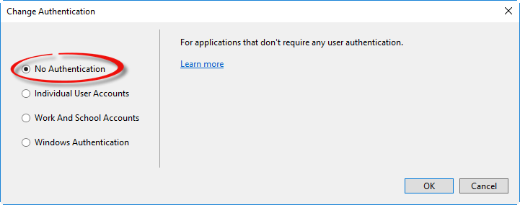
Introduce MVC – Select Template

Slide 7
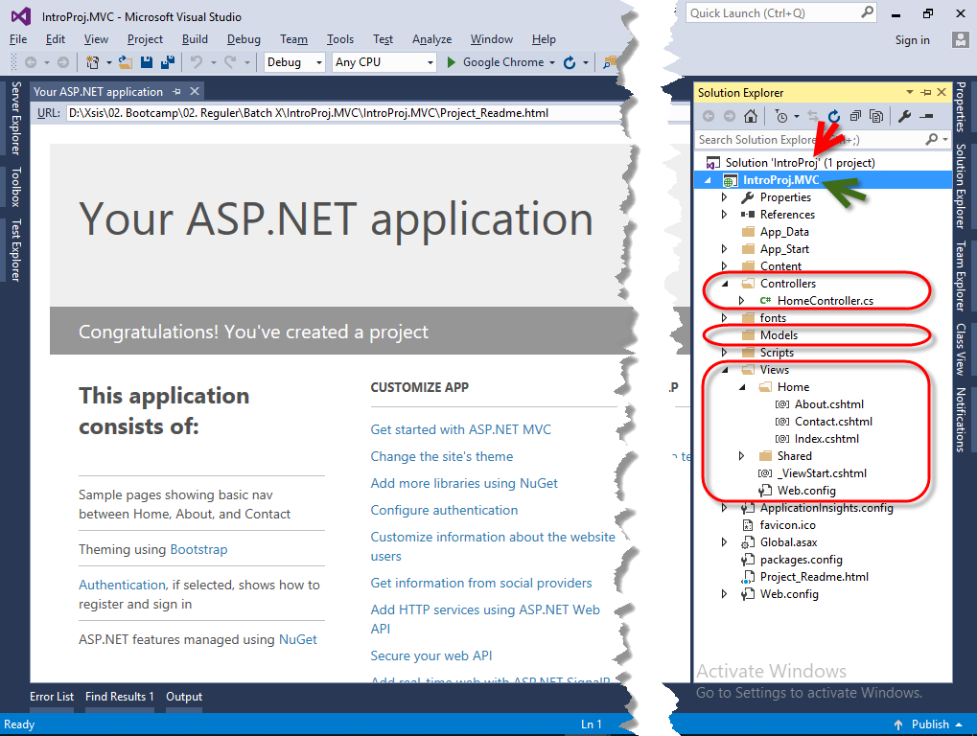
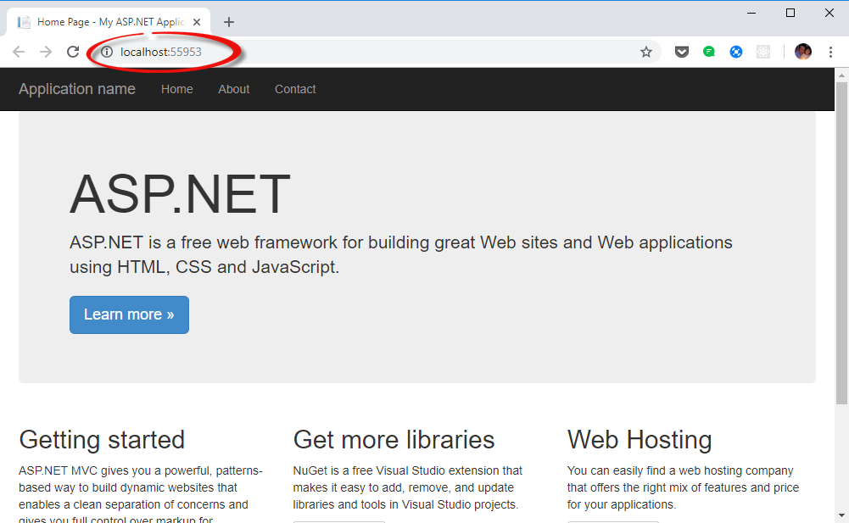
Introduce MVC – Running ASP.Net
Command: Ctrl-F5

Slide 8
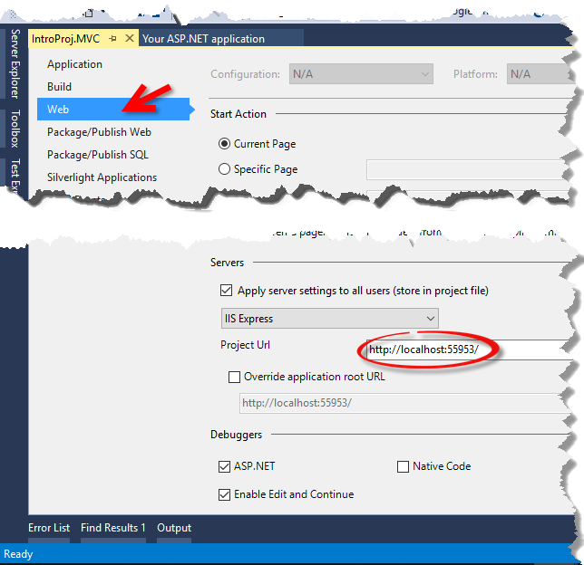
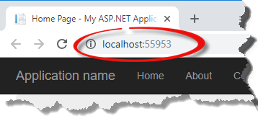
Introduce MVC – Project URL

Slide 9
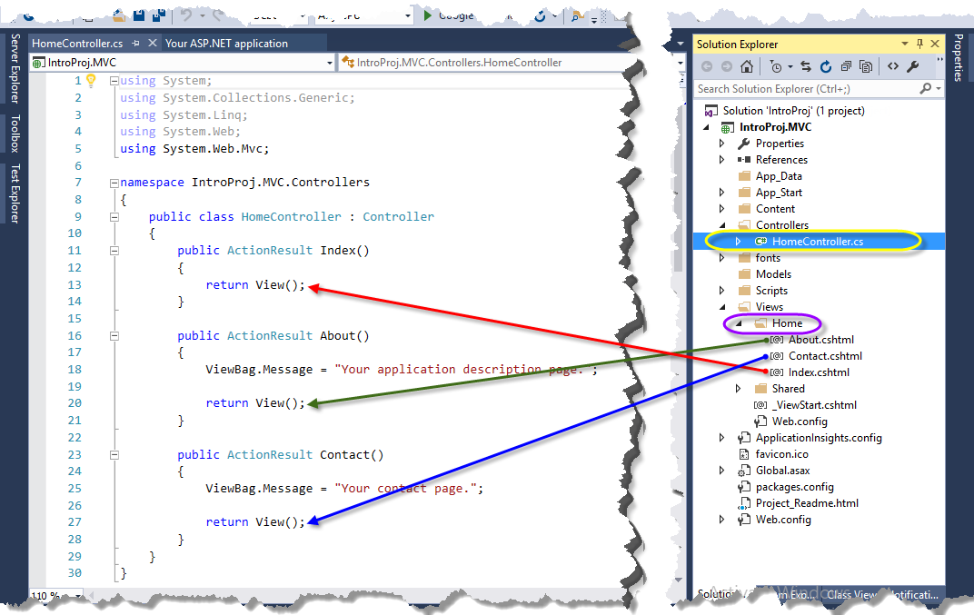
Introduce MVC – Views
View Name default is Action Name.

Slide 10
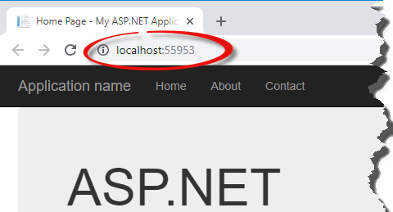
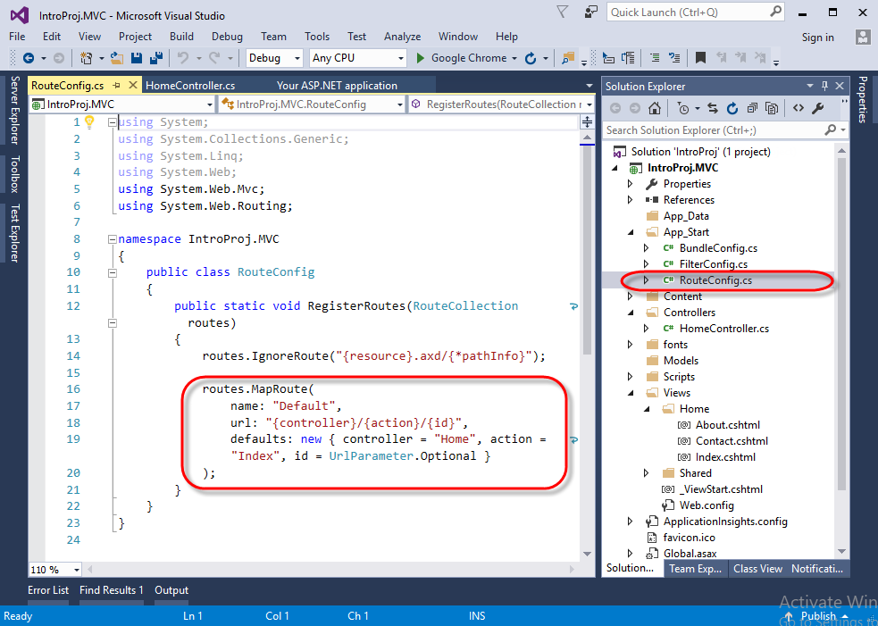
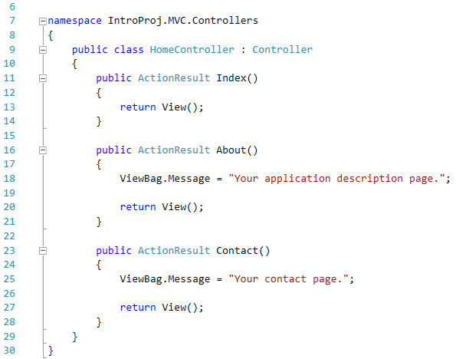
Introduce MVC – Route Configuration
HomeController.cs

Slide 11
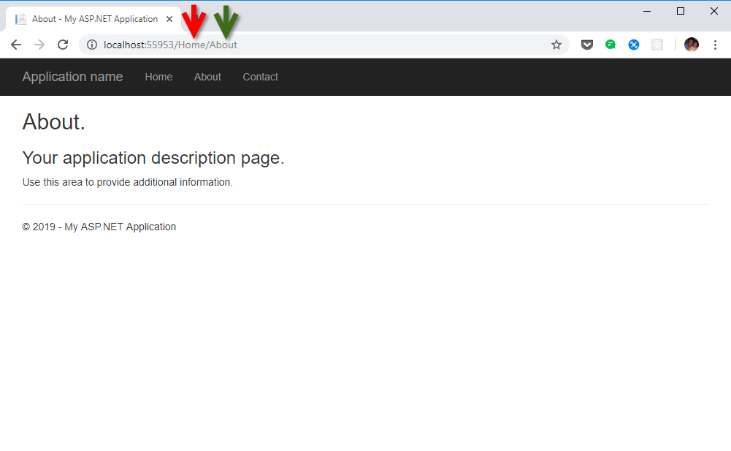
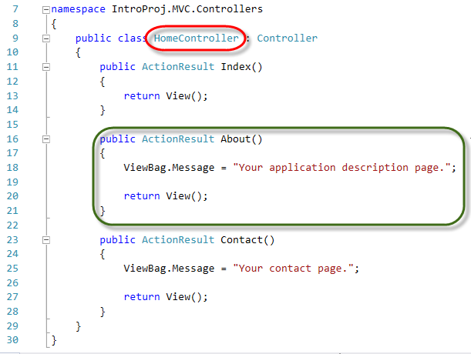
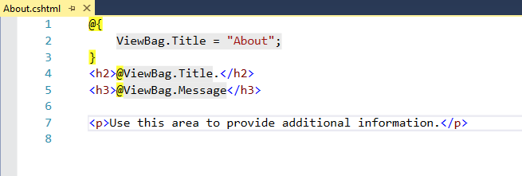
Introduce MVC – ViewBag
HomeController.cs

Slide 12
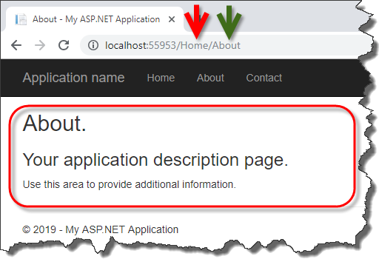
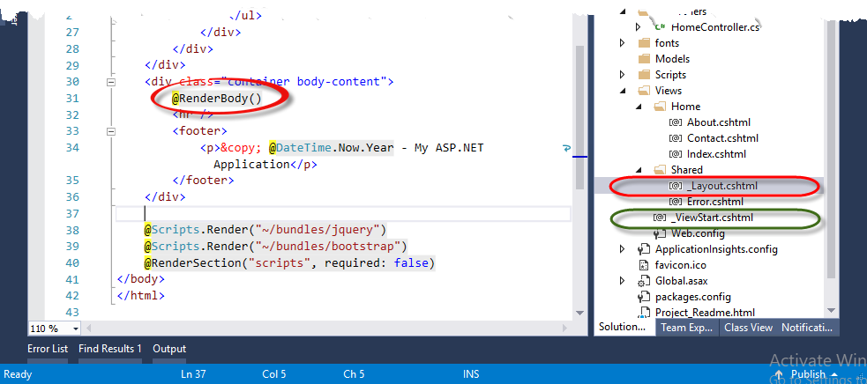
Introduce MVC – RenderBody
_ViewStart.cshtml
@{
Layout = "~/Views/Shared/_Layout.cshtml";
}
_Layout.cshtml
@RenderBody() where is view rendered.

Slide 13
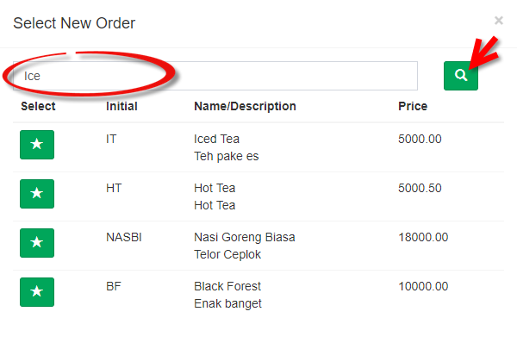
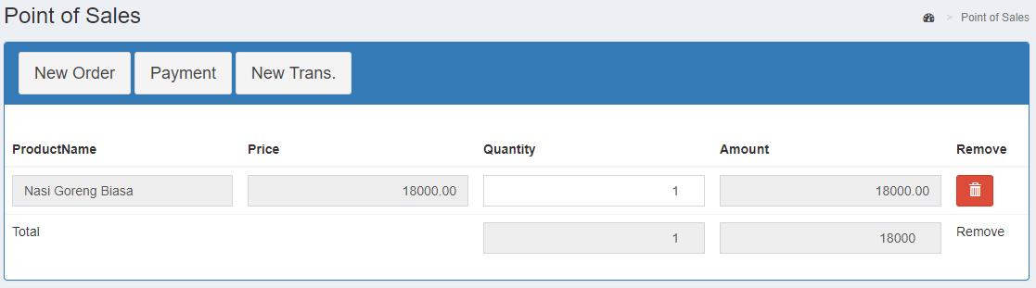
Case Study Master Detail – P.O.S
_ProductList.cshtml
New Order pop-up modal of List of Product.
Star Button to select product to add into list of Point of Sales.
Trash Button to remove an order.
_OrderByProduct.cshtml
Index.cshtml

Slide 14
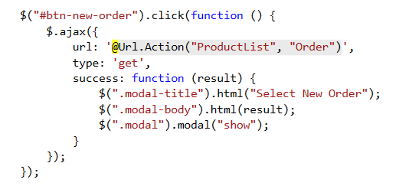
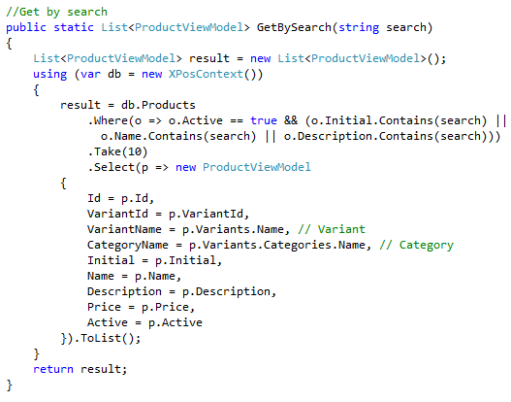
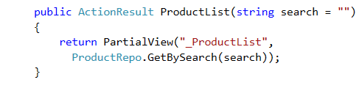
Case Study Master Detail – Product List Modal
Index.cshtml
ProductRepo.cshtml
1
4
2
_ProductList.cshtml
OrderController.cs
_ProductList.cshtml
3

Slide 15
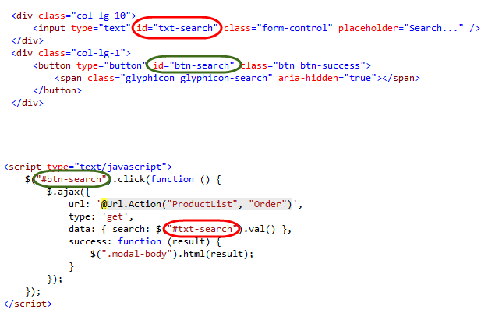
Case Study Master Detail – Product List Search
_ProductList.cshtml
ProductRepo.cshtml
4
1
2
OrderController.cs
_ProductList.cshtml
_ProductList.cshtml
3

Slide 16
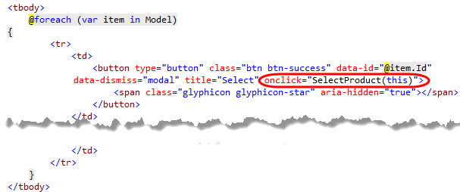
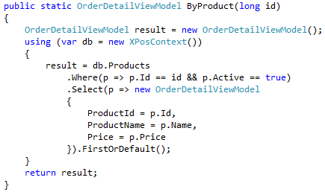
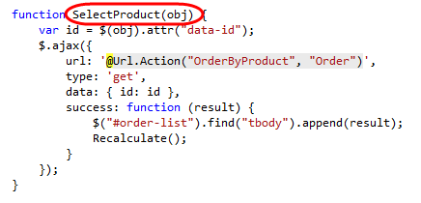

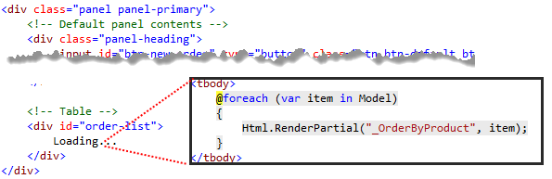
Case Study Master Detail – Select Product
_ProductList.cshtml
OrderRepo.cs
1
3
2
4
OrderController.cs
Index.cshtml
5
_List.cshtml

Slide 17
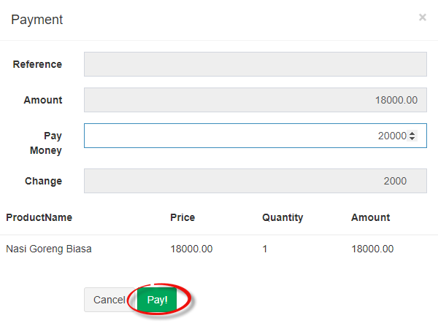
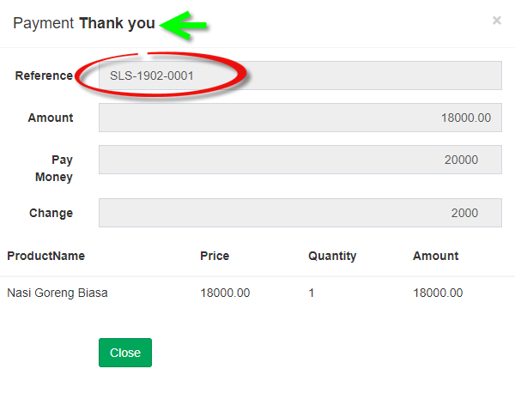
Case Study Master Detail – Payment
_Payment.cshtml
Payment to show pop-up modal of Payment.
Pay! to execute payment order and than Reference No. & ”Thank You” will be appeared.
Close to hide modal of payment and than new transaction.
Index.cshtml
_OrderByProduct.cshtml

Slide 18
Case Study Master Detail – Browser Inspact
<tbody>
<tr>
<td>
<input data-val="true" id="ProductId" name="ProductId" type="hidden" value="2">
<input class="form-control text-box single-line" id="ProductName" name="ProductName" readonly="readonly" type="text" value="Nasi Goreng Biasa">
</td>
<td>
<input class="form-control text-right text-box single-line" id="Price" name="Price" readonly="readonly" type="text" value="18000.00">
</td>
<td>
<input type="number" class="form-control text-right" id="Quantity" name="Quantity" value="1" onchange="ChangeQuantity(this)" onkeyup="ChangeQuantity(this)">
</td>
<td>
<input class="form-control text-right text-box single-line" id="Amount" name="Amount" readonly="readonly" type="text" value="18000.00">
</td>
<td>
<button type="button" class="btn btn-danger btn-remove" onclick="RemoveOrder(this)" title="Remove">
<span class="glyphicon glyphicon-trash" aria-hidden="true"></span>
</button>
</td>
</tr>
</tbody>

Slide 19
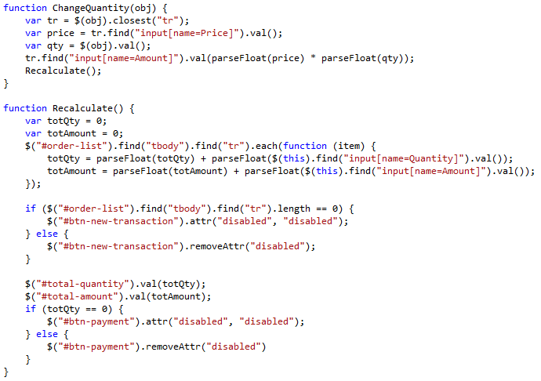
Case Study Master Detail – Recalculate
Index.cshtml
<input type="number" class="form-control text-right" id="Quantity" name="Quantity" value="1" onchange="ChangeQuantity(this)" onkeyup="ChangeQuantity(this)">
#order-list
input[name=‘Price’]
input[name=‘Quantity’]
input[name=‘Amount’]
#total-quantity
#total-amount

Slide 20
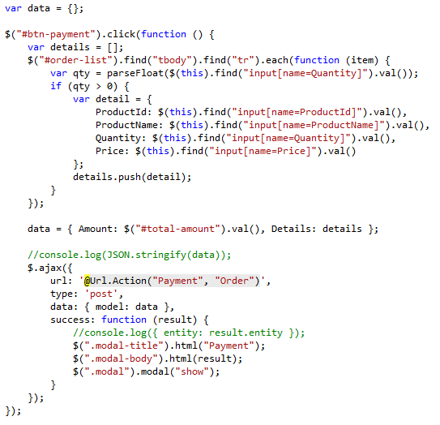
Case Study Master Detail – Get order list
#btn-payment
#order-list
input[name=‘Price’]
input[name=‘Quantity’]
input[name=‘Amount’]
#total-quantity
#total-amount

Slide 21
Environment
EDIT IN GOOGLE SLIDES
Click on the button under the presentation preview that says "Use as Google Slides Theme".
You will get a copy of this document on your Google Drive and will be able to edit, add or delete slides.
You have to be signed in to your Google account.
EDIT IN POWERPOINT®
Click on the button under the presentation preview that says "Download as PowerPoint template". You will get a .pptx file that you can edit in PowerPoint.
Remember to download and install the fonts used in this presentation (you’ll find the links to the font files needed in the Presentation design slide)
More info on how to use this template at www.slidescarnival.com/help-use-presentation-template
This template is free to use under Creative Commons Attribution license. You can keep the Credits slide or mention SlidesCarnival and other resources used in a slide footer.

Slide 22
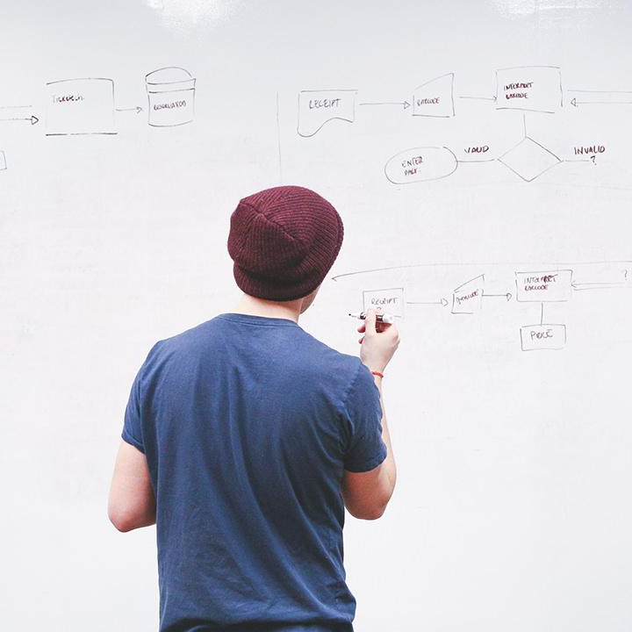
HELLO!
I am Jayden Smith
I am here because I love to give presentations.
You can find me at @username

Slide 23
TRANSITION HEADLINE
1
Let’s start with the first set of slides

Slide 24
Quotations are commonly printed as a means of inspiration and to invoke philosophical thoughts from the reader.

Slide 25
THIS IS A SLIDE TITLE
Here you have a list of items
And some text
But remember not to overload your slides with content
Your audience will listen to you or read the content, but won’t do both.

Slide 26
BIG CONCEPT
Bring the attention of your audience over a key concept using icons or illustrations

Slide 27
YOU CAN ALSO SPLIT YOUR CONTENT
White
Is the color of milk and fresh snow, the color produced by the combination of all the colors of the visible spectrum.
Black
Is the color of coal, ebony, and of outer space. It is the darkest color, the result of the absence of or complete absorption of light.

Slide 28
IN TWO OR THREE COLUMNS
Yellow
Is the color of gold, butter and ripe lemons. In the spectrum of visible light, yellow is found between green and orange.
Blue
Is the colour of the clear sky and the deep sea. It is located between violet and green on the optical spectrum.
Red
Is the color of blood, and because of this it has historically been associated with sacrifice, danger and courage.

Slide 29

A PICTURE IS WORTH A THOUSAND WORDS
A complex idea can be conveyed with just a single still image, namely making it possible to absorb large amounts of data quickly.

Slide 30

Want big impact?
USE BIG IMAGE

Slide 31
USE CHARTS TO EXPLAIN YOUR IDEAS
White
Gray
Black

Slide 32
AND TABLES TO COMPARE DATA
 | A | B | C
Yellow | 10 | 20 | 7
Blue | 30 | 15 | 10
Orange | 5 | 24 | 16

Slide 33
MAPS
OUR OFFICE

Slide 34
89,526,124
Whoa! That’s a big number, aren’t you proud?

Slide 35
89,526,124$
185,244 users
100%
That’s a lot of money
And a lot of users
Total success!

Slide 36
OUR PROCESS IS EASY
first
second
last

Slide 37
LET’S REVIEW SOME CONCEPTS
Yellow
Is the color of gold, butter and ripe lemons. In the spectrum of visible light, yellow is found between green and orange.
Blue
Is the colour of the clear sky and the deep sea. It is located between violet and green on the optical spectrum.
Red
Is the color of blood, and because of this it has historically been associated with sacrifice, danger and courage.
Yellow
Is the color of gold, butter and ripe lemons. In the spectrum of visible light, yellow is found between green and orange.
Blue
Is the colour of the clear sky and the deep sea. It is located between violet and green on the optical spectrum.
Red
Is the color of blood, and because of this it has historically been associated with sacrifice, danger and courage.

Slide 38
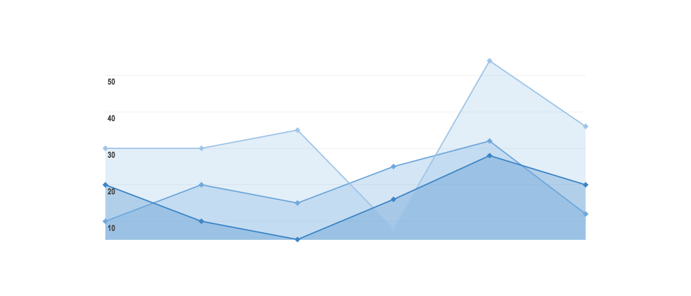
GRAPH TITLE
You can insert graphs from Google Sheets

Slide 39
Place your screenshot here
ANDROID PROJECT
Show and explain your web, app or software projects using these gadget templates.

Slide 40
iPHONE PROJECT
Show and explain your web, app or software projects using these gadget templates.
Place your screenshot here

Slide 41
Place your screenshot here
TABLET PROJECT
Show and explain your web, app or software projects using these gadget templates.

Slide 42
Place your screenshot here
DESKTOP PROJECT
Show and explain your web, app or software projects using these gadget templates.

Slide 43
THANKS!
Any questions?
You can find me at
@username & user@mail.me

Slide 44
CREDITS
Special thanks to all the people who made and released these awesome resources for free:
Presentation template by SlidesCarnival
Photographs by Startup Stock Photos

Slide 45
PRESENTATION DESIGN
This presentation uses the following typographies and colors:
Titles: Roboto Condensed
Body copy: Roboto Condensed
You can download the fonts on this page:
https://material.io/guidelines/resources/roboto-noto-fonts.html
Navy #3f5378 · Dark navy #263248 · Yellow #ff9800
You don’t need to keep this slide in your presentation. It’s only here to serve you as a design guide if you need to create new slides or download the fonts to edit the presentation in PowerPoint®

Slide 46
SlidesCarnival icons are editable shapes.
This means that you can:
Resize them without losing quality.
Change line color, width and style.
Isn’t that nice? :)
Examples:

Slide 47
😉
Now you can use any emoji as an icon!
And of course it resizes without losing quality and you can change the color.
How? Follow Google instructions https://twitter.com/googledocs/status/730087240156643328
✋👆👉👍👤👦👧👨👩👪💃🏃💑❤😂😉😋😒😭👶😸🐟🍒🍔💣📌📖🔨🎃🎈🎨🏈🏰🌏🔌🔑 and many more...

