Slide 1
Exploring Trajectory Prediction through Deep Learning Methods
Batch: CSEMPBNUM_L16

Slide 2
Contents
ABSTRACT
INTRODUCTION
EXISTING SYSTEM
PROPOSED SYSTEM
ADVANTAGES
SYSTEM ARCHITECTURE
SOFTWARE REQUIREMENTS
MODULES
UML DIAGRAMS
CONCLUSION
LITERATURE SURVEY
QUESTIONS

Slide 3
abstract
Human mobility prediction is of great importance in a wide range of modern applications in different fields such as personalized recommendation systems, the fifth-generation (5G) mobile communication systems, and so on.
For the applications including resource allocation and mobility management, it is essential to predict the positions of mobile users in the near future from dozens of seconds to a few minutes so as to make preparation in advance.
In this paper, with the particular focus on multi-user multi-step trajectory prediction, we first design a basic deep learning-based prediction framework, where the long short-term memory (LSTM) network is directly applied as the most critical component to learn user-specific mobility pattern from the user's historical trajectories and predict his/her movement trends in the future. Motivated by the related findings after testifying and analyzing this basic framework on a model-based dataset, we extend it to a region-oriented prediction scheme and propose a multi-user multi-step trajectory prediction framework by further incorporating the sequence-to-sequence (Seq2Seq) learning.
The experimental results on a realistic dataset demonstrate that the proposed framework has significant improvements on generalization ability and reduces error-accumulation effect for multi-step prediction.

Slide 4
Introduction
Increasing pervasive usage of smart-phones and location-based services around the world has contributed to vast and rapid growth in mobility data. The large size of mobility data provides new opportunities for discovering the characteristics of human mobility patterns and making mobility predictions. Practically, human mobility prediction is of great importance in a wide range of modern applications, ranging from personalized recommendation systems to intelligent transportation, urban planning, and mobility management in mobile communication system.
Generally, the prediction goal varies from different application scenarios. For the case of 5G mobile communications, it is essential to predict the positions of mobile users in the near future from dozens of seconds to a few minutes so as to prepare for mobility management and resource allocation . It is actually a trajectory prediction problem where the trajectory refers to a time series of positions with a fixed sampling time interval between each other.

Slide 5
Existing System
In this paper takes comprehensive investigation for the approaches to predict trajectories composed of continuous coordinates. Since it is actually a time series regression prediction problem, conventional regression algorithms such as linear regression and support vector regression (SVR) are candidate solutions.
However, the mobility trajectories are usually short sequences composed of two-dimensional coordinates reflecting geographic locations, making Linear Regression and SVR possibly not competent to the trajectory prediction problem.

Slide 6
Proposed System
Within the framework of deep learning, the work in applies LSTM to trajectory prediction for vehicles on highway. However, the proposed method is specifically designed for the highway scenario and requires complex external features, including position and velocity of surrounding vehicles, which restricts its general applicability. Hence, the proposed system is a social LSTM network for pedestrian trajectory prediction .
We propose a Deep learning model which combines the GRU network with the attention mechanism to predict future discrete locations from long-range and sparse trajectories. However, its prediction accuracy can only reach 59.3% .
Therefore, we assume the long- short term memory (LSTM) to predict the trend of user movements in each cell from trajectories composed of discrete cells and we evaluate the prediction performance of the proposed framework on a user’s trajectories from the model-based dataset.

Slide 7
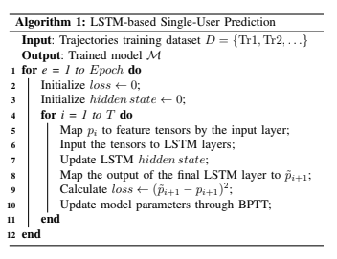
Algorithm

Slide 8
Modules
Importing Dataset Module: In this module, we import the trajectory model based dataset
Generating the model Module: In this module, we perform the generating of the LSTM model
Training the model: The LSTM model is trained with seq2seq.
Predicting Trajectory: This model presents a prompt which asks the latitude and longitude of the given user to try and predict the next location.

Slide 9
HARDWARE REQUIREMENTS
Operating System supported by
1. Windows 7
2. Windows XP
3 . Windows 8
Processor – Pentium IV or higher
RAM -- 256 MB

Slide 10
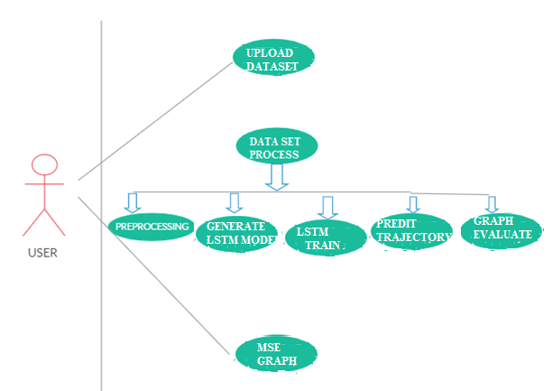
UML Diagrams
Use case Diagram:

Slide 11
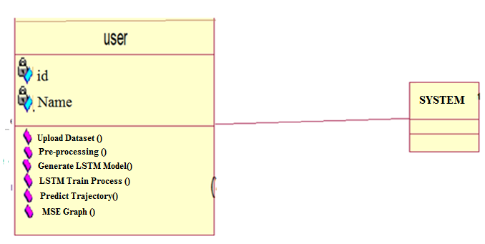
Class Diagram:

Slide 12
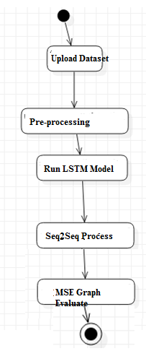
Activity Diagram:

Slide 13
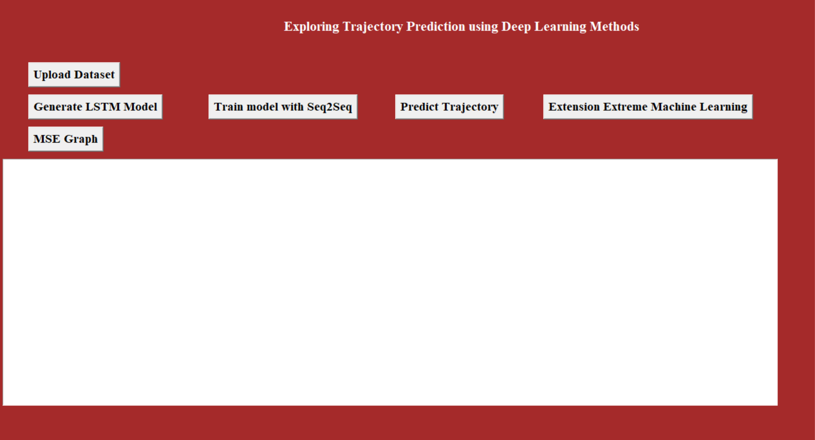
Screenshots
Initial Output Screen:

Slide 14
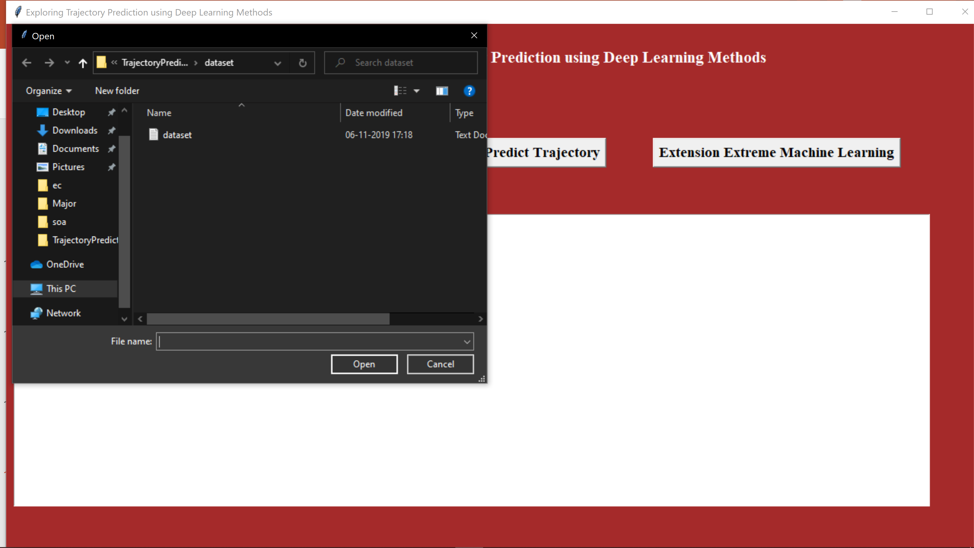
Importing Dataset:

Slide 15
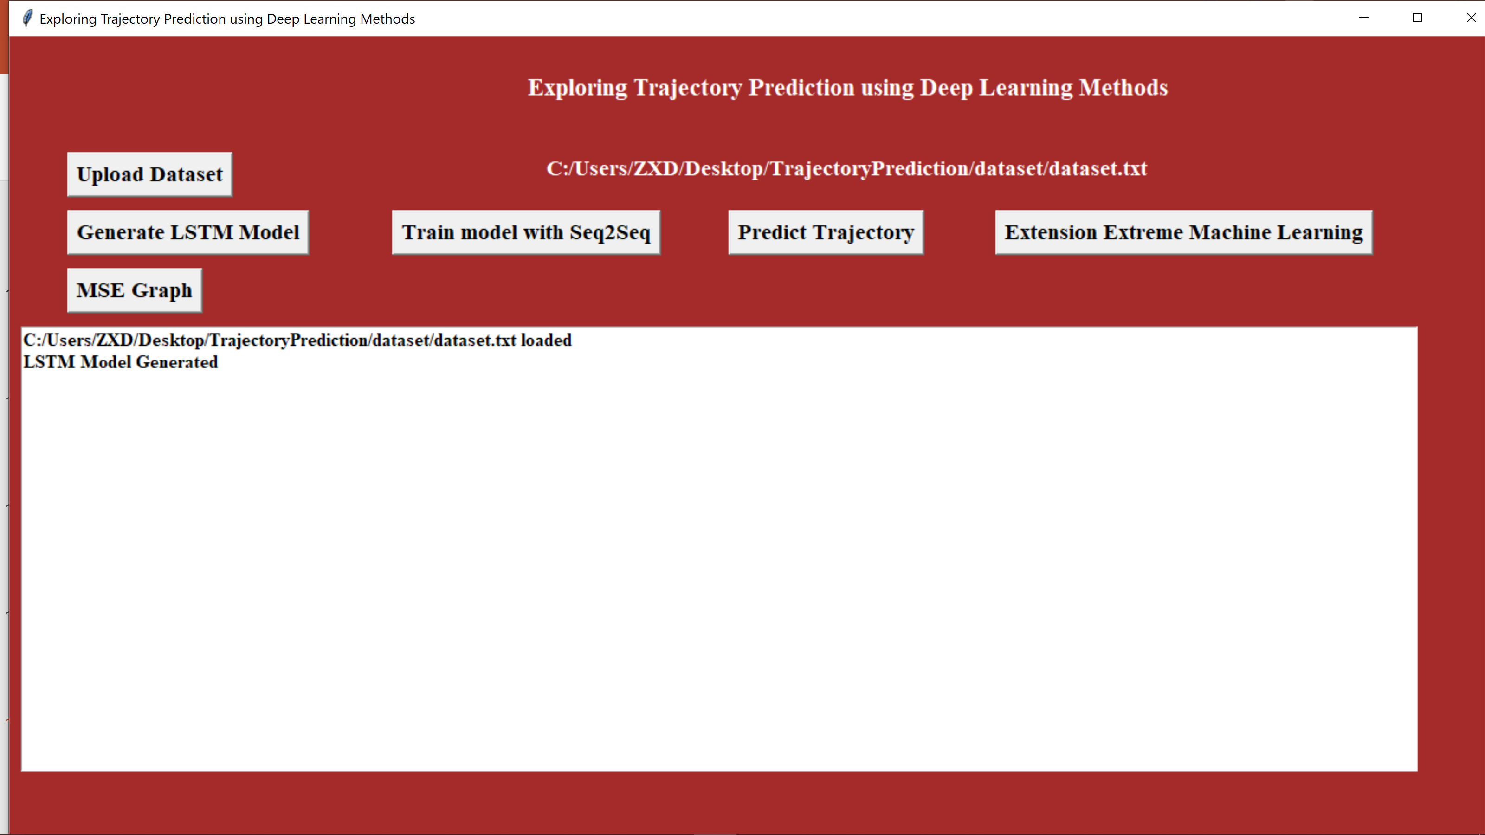
Screen showing LSTM model is generated:

Slide 16
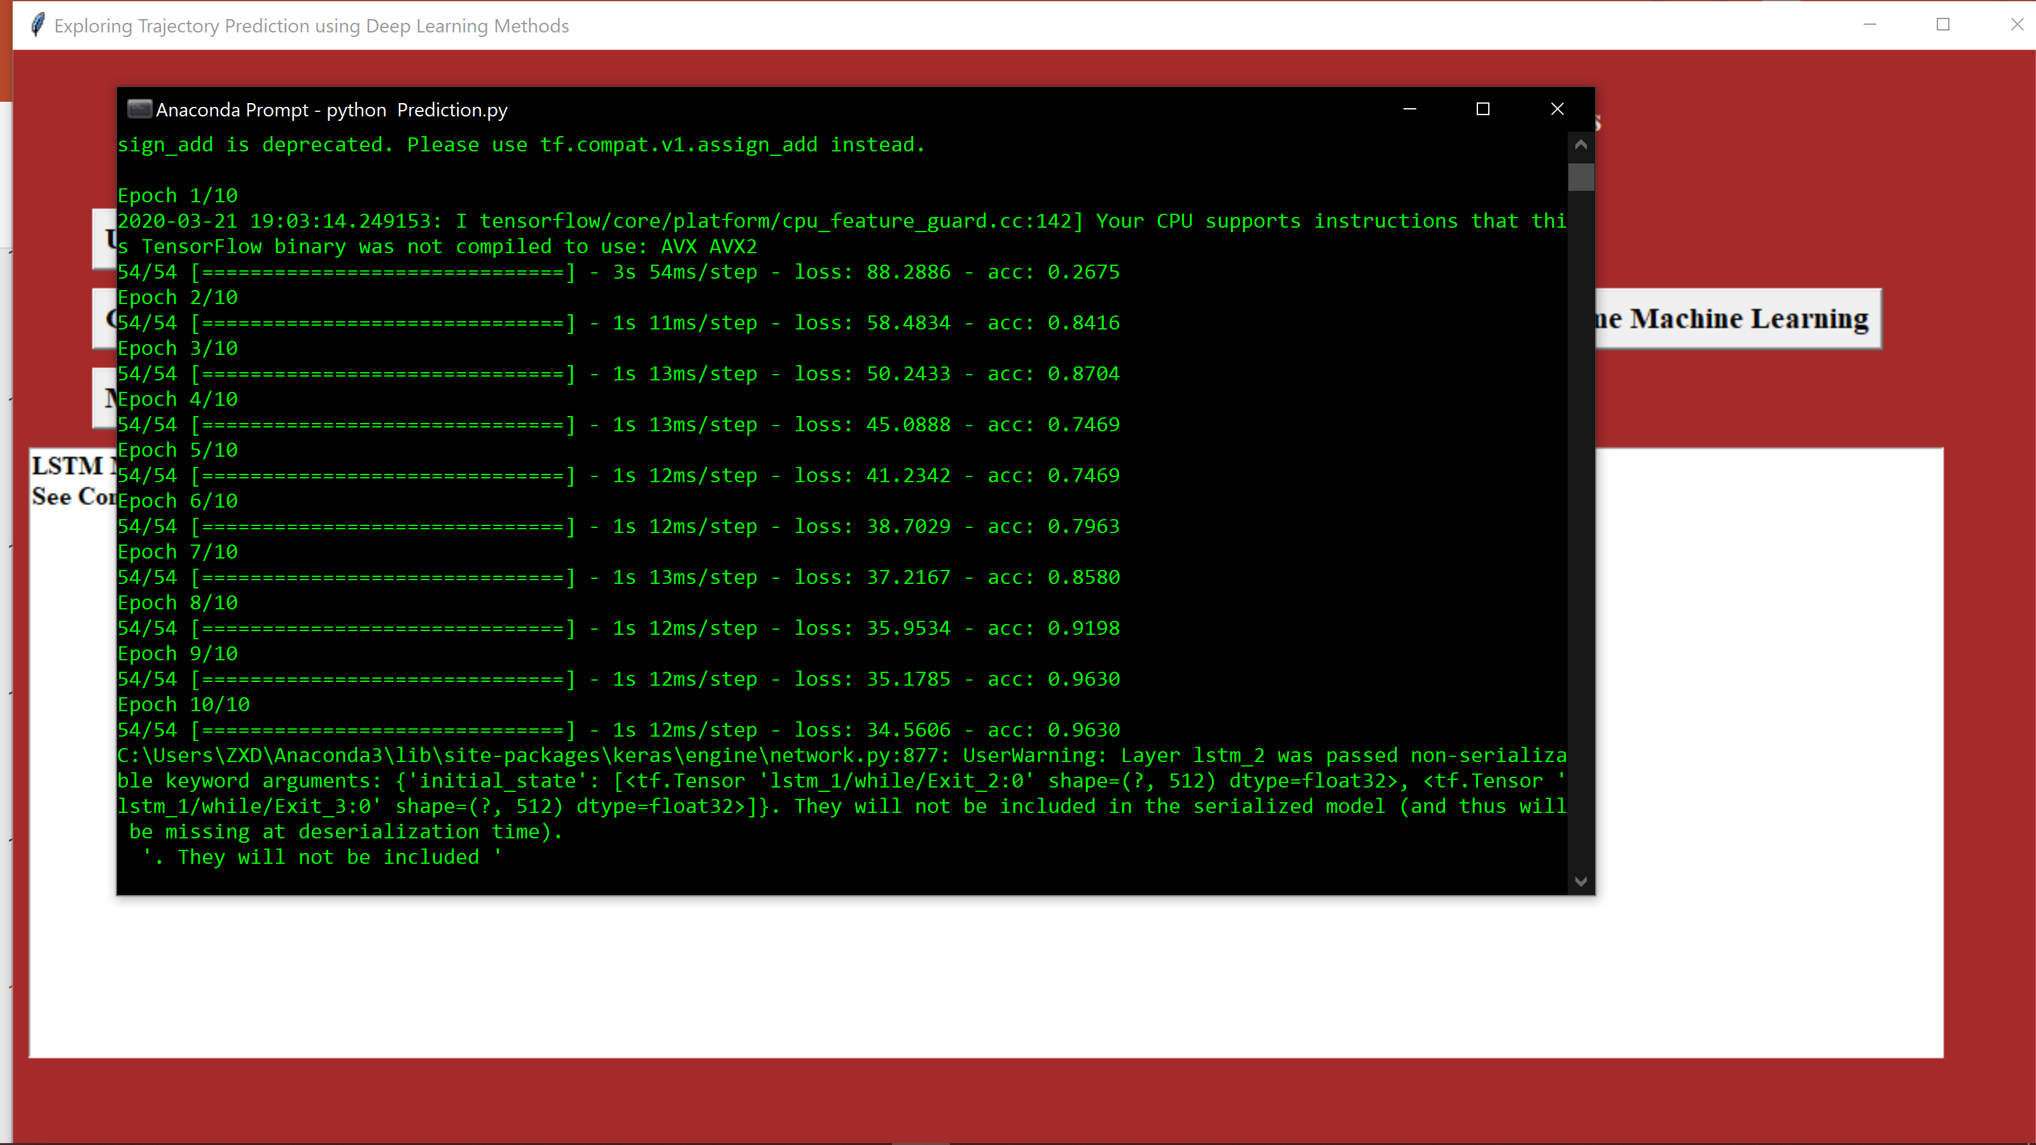
Training the LSTM Model:

Slide 17
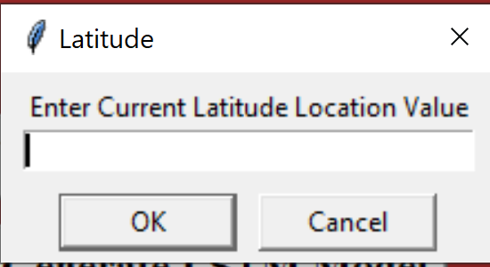
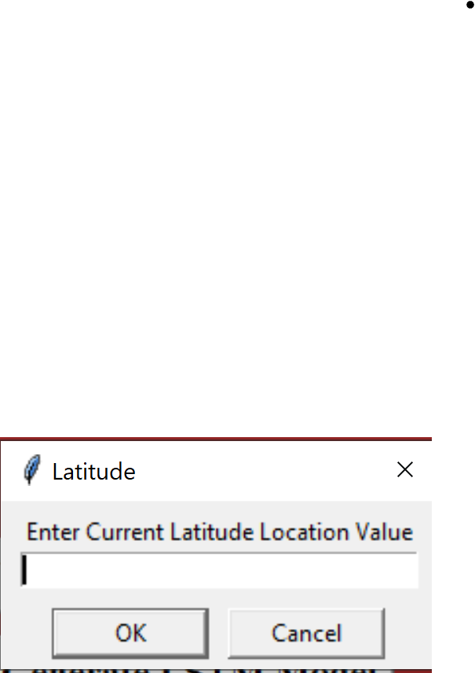
Enter Latitude for current location:
Enter Longitude of current location:

Slide 18
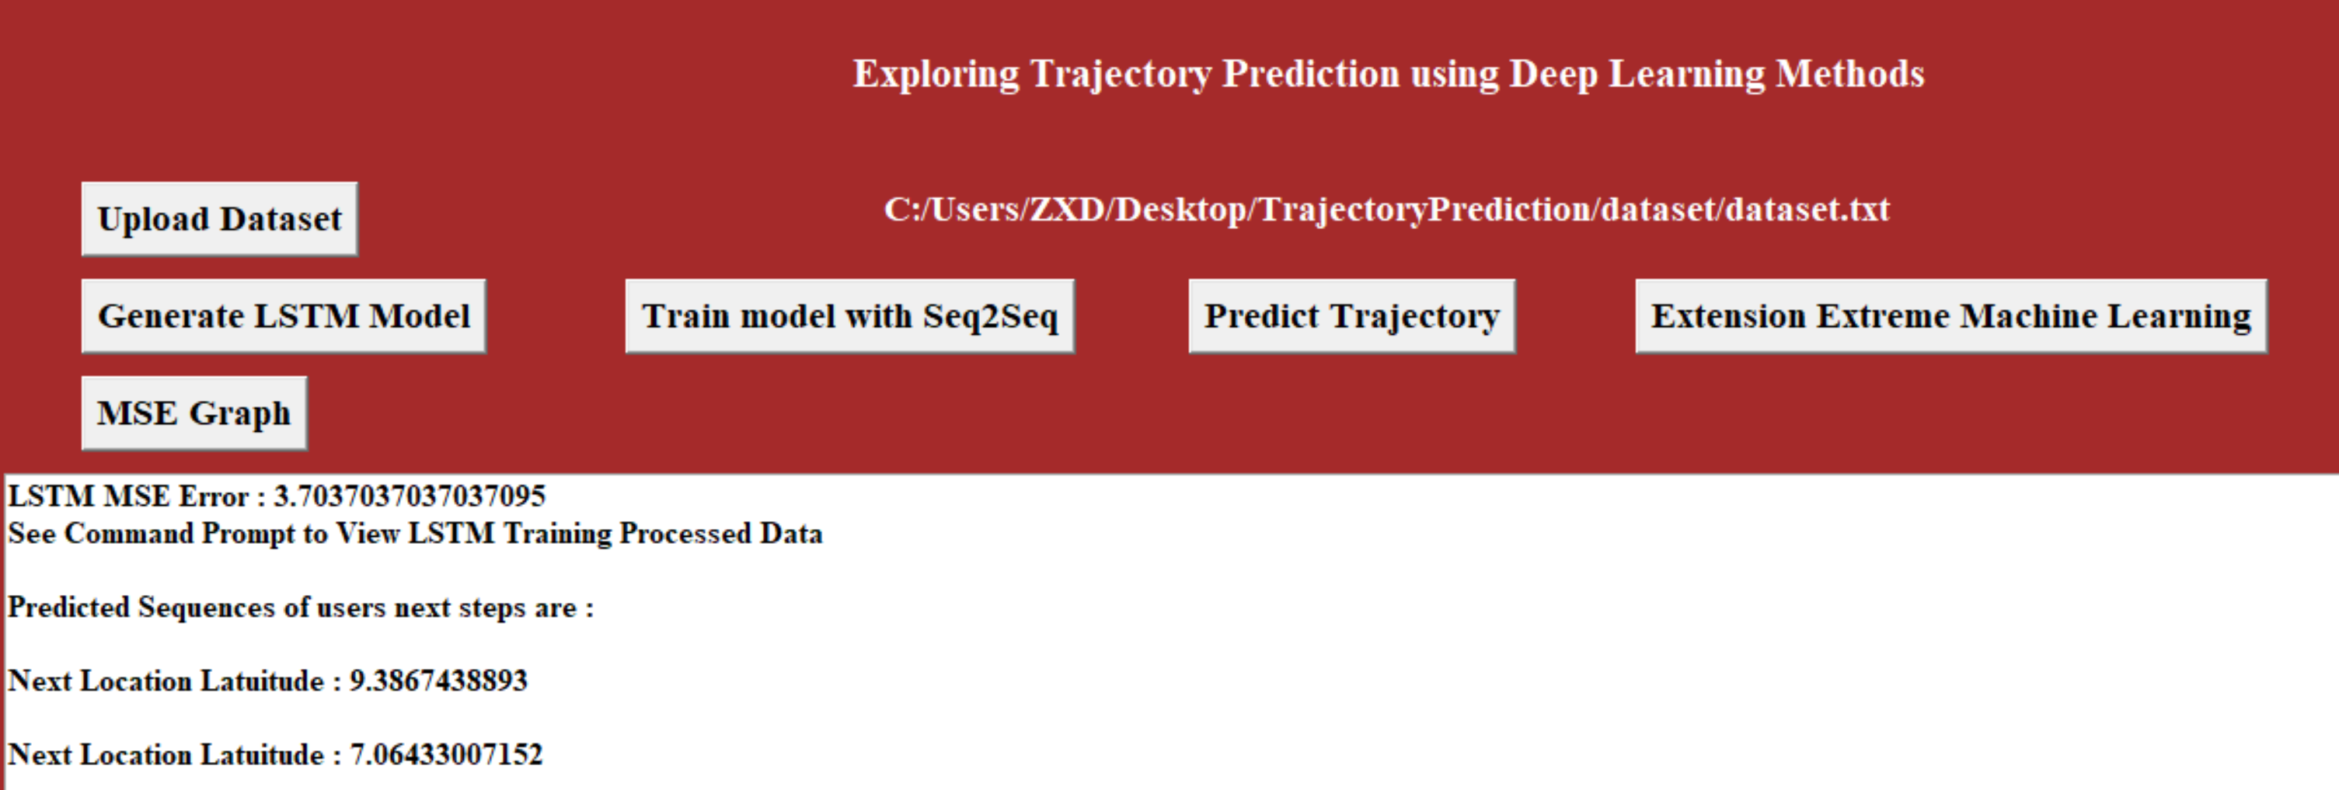
Output Screen:

Slide 19
Conclusion
In this paper, we investigate the significance of trajectory prediction and explore feasible approaches from both the single-user perspective and multi-user perspective. For single-user trajectory prediction, we propose a basic LSTM framework and experimental results on a model-based mobility dataset illustrate the superiority of LSTM to make predictions based on pre-learning of user-specific mobility patterns.
For multi-user multi-step prediction, we further propose a regionoriented prediction scheme and put forward an LSTM-based Seq2Seq framework with Extreme Machine Learning (ELM). Experiments on a realistic dataset show that the proposed framework outperforms the other competing approaches, which demonstrate its outstanding generalization ability for multi-user prediction as well as robustness and stability for multi-step prediction.

