Slide 1

Azure Redis Cache
An introduction by Kristofer Liljeblad, @krist00fer
“Kristofer is part of the Technical Evangelism & Development, TED, a globally spread team within DPE Corp and Microsoft. We are a team that builds and delivers world-class software – with all the specialties encompassed by that term (i.e., coding, UX design, PM, test, and operations). We are the customers we serve; we walk in their shoes, we build production solutions that matter to them as we show them how they can use Microsoft technologies to deliver value. We explore and learn and share and succeed and fail – just like our customers. There is no ‘us & them’ – we work across all TED teams and across Microsoft to share our passion for technology; we engage the best to get the job done.”

Slide 2
Who is Kristofer?
Senior Program Manager in Microsoft DX, TED
6 years at Microsoft
Helps strategic partners all around the world succeed on Microsoft’s platforms
Mainly focuses on gaming
Follow me on Twitter http://twitter.com/krist00fer
E-mail: kristol@microsoft.com

Slide 3
What is Redis Cache?
“Redis is an open source, BSD licensed, advanced key-value cache and store. It is often referred to as a data structure server since keys can contain strings, hashes, lists, sets, sorted sets, bitmaps and hyperloglogs”

Slide 4
Caching in Azure
 | Azure Redis Cache | Managed Cache Service | In-Role Cache | Azure Shared Caching
Available | Yes | Yes* | Yes* | No**
Based on | Redis Cache | AppFabric Cache | AppFabric Cache | N/A
Managed by Microsoft | Yes | Yes | No*** | N/A
Manageable with portal | Yes | No | No*** | N/A
Manageable with PowerShell | Yes | Yes | No*** | N/A
Tiers/Offerings | Basic, Standard | Basic, Standard & Premium | No*** | N/A
Cache Size | 250MB – 53GB | 128MB – 150GB | Same as VMs*** | N/A
Master/Slave, 99.9% SLA | Yes | No | Configurable | N/A
Features | Key-value store, highly performant data types, atomic operations on types, pub/sub, Lua scripting, keys with TTL … | Key-value store | Key-value store | N/A
Client Languages | .NET, C, C++, Clojure, D, Dart, Erlang, Fancy, Go, Haskell, haXe, Io, Java, Lua, Lisp, Nimrod, Node.js, Objective-C, Perl, PHP, Prolog, Python, Ruby, Rust, Scala, Scheme, Smalltalk, Tcl, VCL … | .NET | .NET | N/A
*) | Available but Microsoft recommends all new development to target Azure Redis Cache
**) | Retired on September 1st 2014
***) | Deployed as part of Cloud Service with Worker/Web Roles hence, managed and scaled as such

Slide 5
Azure Redis Cache Pricing
 |  | Basic |  | Standard
Name | Size | $/hour | ~$/month | $/hour | ~$/month
C0 | 0,25 GB | $0,02 | $16 | $0,06 | $40
C1 | 1,00 GB | $0,06 | $40 | $0,14 | $99
C2 | 2,80 GB | $0,09 | $65 | $0,23 | $162
C3 | 6,00 GB | $0,18 | $130 | $0,45 | $324
C4 | 13,00 GB | $0,21 | $151 | $0,53 | $378
C5 | 26,00 GB | $0,42 | $302 | $1,05 | $756
C6 | 53,00 GB | $0,84 | $605 | $2,10 | $1 512
Basic – A single cache node (ideal for development/test and non-critical workloads).
Standard –A replicated cache in a two-node Primary/Secondary configuration. We manage automatic replication between the two nodes, and we will offer a high-availability SLA once the service becomes generally available.

Slide 6
Redis on your dev machine
Download an install Redis directly from redis.io or …
Use packet managers like:
Chocolatey (win) C:\> choco install redis
Scoop (win) C:\> scoop install redis
Homebrew (OSX) $ brew install redis
APT (various Linux) $ sudo apt-get install redis-server
Start server with:
> redis-server
Test and debug with:
> redis-cli

Slide 7
Commands
APPEND, AUTH, BGREWRITEAOFAsynchronously, BGSAVEAsynchronously, BITCOUNT, BITOP, BITPOS, BLPOP, BRPOP, BRPOPLPUSH, CLIENT, CLIENT, CLIENT, CLIENT, CLIENT, CLUSTER, COMMANDGet, COMMAND, COMMAND, COMMAND, CONFIG, CONFIG, CONFIG, CONFIG, DBSIZEReturn, DEBUG, DEBUG, DECR, DECRBY, DEL, DISCARDDiscard, DUMP, ECHO, EVAL, EVALSHA, EXECExecute, EXISTS, EXPIRE, EXPIREAT, FLUSHALLRemove, FLUSHDBRemove, GET, GETBIT, GETRANGE, GETSET, HDEL, HEXISTS, HGET, HGETALL, HINCRBY, HINCRBYFLOAT, HKEYS, HLEN, HMGET, HMSET, HSET, HSETNX, HVALS, INCR, INCRBY, INCRBYFLOAT, INFO, KEYS, LASTSAVEGet, LINDEX, LINSERT, LLEN, LPOP, LPUSH, LPUSHX, LRANGE, LREM, LSET, LTRIM, MGET, MIGRATE, MONITORListen, MOVE, MSET, MSETNX, MULTIMark, OBJECT, PERSIST, PEXPIRE, PEXPIREAT, PFADD, PFCOUNT, PFMERGE, PINGPing, PSETEX, PSUBSCRIBE, PUBSUB, PTTL, PUBLISH, PUNSUBSCRIBE, QUITClose, RANDOMKEYReturn, RENAME, RENAMENX, RESTORE, ROLEReturn, RPOP, RPOPLPUSH, RPUSH, RPUSHX, SADD, SAVESynchronously, SCARD, SCRIPT, SCRIPT, SCRIPT, SCRIPT, SDIFF, SDIFFSTORE, SELECT, SET, SETBIT, SETEX, SETNX, SETRANGE, SHUTDOWN, SINTER, SINTERSTORE, SISMEMBER, SLAVEOF, SLOWLOG, SMEMBERS, SMOVE, SORT, SPOP, SRANDMEMBER, SREM, STRLEN, SUBSCRIBE, SUNION, SUNIONSTORE, SYNCInternal, TIMEReturn, TTL, TYPE, UNSUBSCRIBE, UNWATCHForget, WATCH, ZADD, ZCARD, ZCOUNT, ZINCRBY, ZINTERSTORE, ZLEXCOUNT, ZRANGE, ZRANGEBYLEX, ZREVRANGEBYLEX, ZRANGEBYSCORE, ZRANK, ZREM, ZREMRANGEBYLEX, ZREMRANGEBYRANK, ZREMRANGEBYSCORE, ZREVRANGE, ZREVRANGEBYSCORE, ZREVRANK, ZSCORE, ZUNIONSTORE, SCAN, SSCAN, HSCAN, ZSCAN
Currently 167 Commands
Some key commands:
PING
SET key value [EX seconds] [PX milliseconds] [NX|XX]
EX seconds – Set the specified expire time, in seconds
PX milliseconds – Set the specified expire time, in milliseconds
NX – Only set the key if it does not already exist
XX – Only set the key if it already exists
GET key
DEL key [key ...]

Slide 8
Demo
PING, SET, GET, DEL

Slide 9
redis-server
[30420] 26 Nov 21:10:25.375 # Warning: no config file specified, using the default config.
In order to specify a config file use
C:\Users\Kristofer\appdata\local\scoop\apps\redis\2.8.4\redis-server.exe /path/to/redis.conf
_._
_.-``__ ''-._
_.-`` `. `_. ''-._ Redis 2.8.4 (00000000/0) 64 bit
.-`` .-```. ```\/ _.,_ ''-._
( ' , .-` | `, ) Running in stand alone mode
|`-._`-...-` __...-.``-._|'` _.-'| Port: 6379
| `-._ `._ / _.-' | PID: 30420
`-._ `-._ `-./ _.-' _.-'
|`-._`-._ `-.__.-' _.-'_.-'|
| `-._`-._ _.-'_.-' | http://redis.io
`-._ `-._`-.__.-'_.-' _.-'
|`-._`-._ `-.__.-' _.-'_.-'|
| `-._`-._ _.-'_.-' |
`-._ `-._`-.__.-'_.-' _.-'
`-._ `-.__.-' _.-'
`-._ _.-'
`-.__.-'
[30420] 26 Nov 21:10:25.385 # Server started, Redis version 2.8.4
[30420] 26 Nov 21:10:25.386 * DB loaded from disk: 0.001 seconds
[30420] 26 Nov 21:10:25.386 * The server is now ready to accept connections on port 6379
PS C:\dev>

Slide 10
PS C:\>
127.0.0.1:6379>
PONG
127.0.0.1:6379>
OK
127.0.0.1:6379>
"Hello World!"
127.0.0.1:6379>
(integer) 1
127.0.0.1:6379>
(nil)
127.0.0.1:6379>
redis-cli
PING
SET msg "Hello World!"
GET msg
DEL msg
GET msg

Slide 11
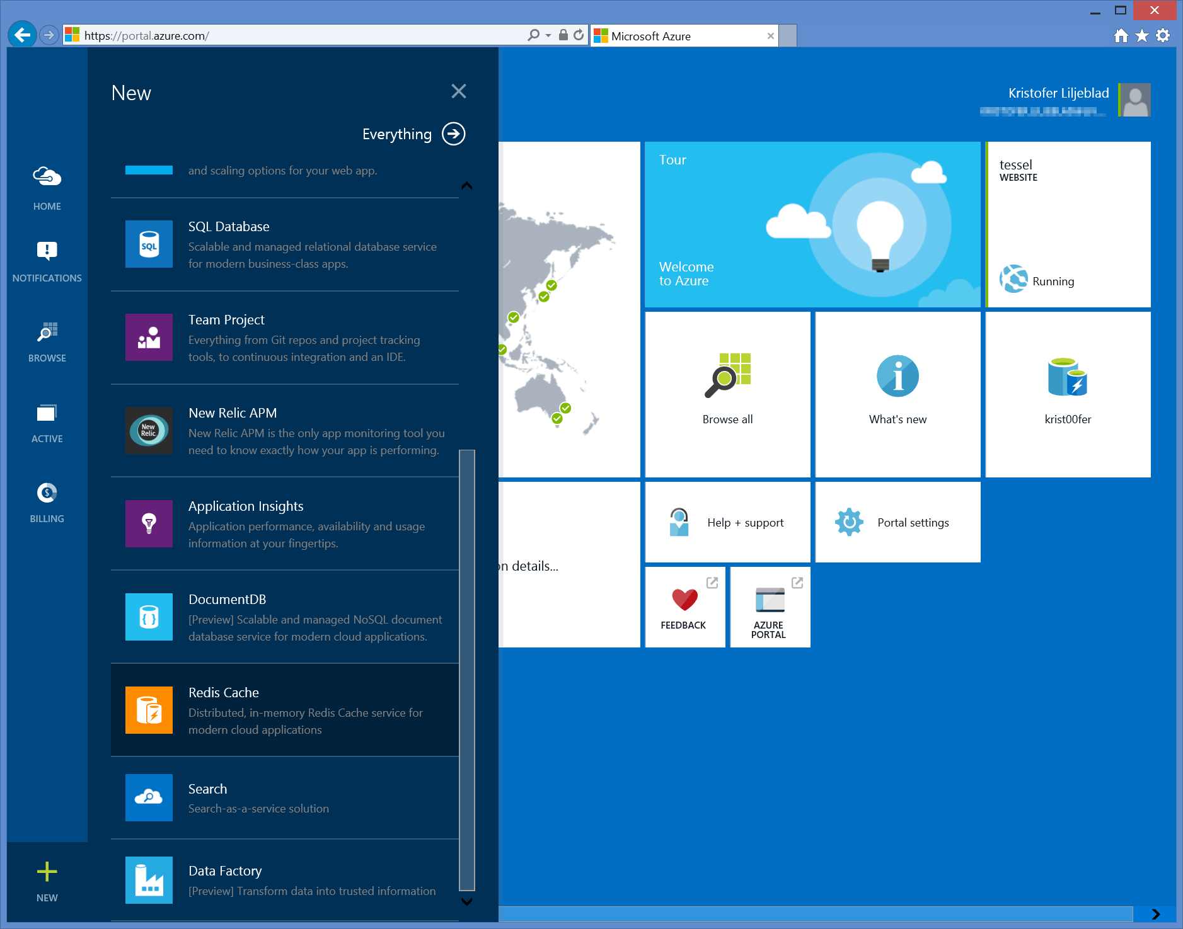
Azure Redis Cache
Create http://portal.azure.com
Configure
Monitor
Currently scaling is not possible while service is running

Slide 12
Demo
Create and Connect to Azure Redis Cache

Slide 13
PS C:\>
krist00fer.redis.cache.windows.net:6379>
OK
krist00fer.redis.cache.windows.net:6379>
"Go to London!"
krist00fer.redis.cache.windows.net:6379>
(nil)
krist00fer.redis.cache.windows.net:6379>
redis-cli -h krist00fer.redis.cache.windows.net -a CMwYYbUF7e2ZyYZcXK0JR65XRrqBpCzbDrNwi1bHH5k=
SET agent47:mission "Go to London!" EX 15
GET agent47:mission
GET agent47:mission

Slide 14
Deeper dive into some more complex types
Redis is more than a key-value store
Lists
Remember last number of …
Implementation of queues, etc.
Hashes
Often used to represent objects with fields/properties

Slide 15
Lists (1 of 2)
LPUSH key value [value ...]
Insert all the specified values at the head of the list stored at key
RPUSH key value [value ...]
Insert all the specified values at the tail of the list stored at key.
LRANGE key start stop
Returns the specified elements of the list stored at key.

Slide 16
Lists (2 of 2)
LTRIM key start stop
Trim an existing list so that it will contain only the specified range of elements specified
LPOP key
Removes and returns the first element of the list stored at key
RPOP key
Removes and returns the last element of the list stored at key
BLPOP / BRPOP
Blocking versions of LPOP and RPOP

Slide 17
Demo
Lists

Slide 18
krist00fer.redis.cache.windows.net:6379>
(integer) 1
krist00fer.redis.cache.windows.net:6379>
1) "Stockholm"
krist00fer.redis.cache.windows.net:6379>
(integer) 2
krist00fer.redis.cache.windows.net:6379>
1) "Copenhagen"
2) "Stockholm"
krist00fer.redis.cache.windows.net:6379>
(integer) 3
krist00fer.redis.cache.windows.net:6379>
1) "Copenhagen"
2) "Stockholm"
3) "Oslo"
krist00fer.redis.cache.windows.net:6379>
(integer) 6
krist00fer.redis.cache.windows.net:6379>
1) "Copenhagen"
2) "Stockholm"
3) "Oslo"
4) "Paris"
5) "London"
6) "Milan"
krist00fer.redis.cache.windows.net:6379>
LPUSH destinations Stockholm
LRANGE destinations 0 -1
LPUSH destinations Copenhagen
LRANGE destinations 0 -1
RPUSH destinations Oslo
LRANGE destinations 0 -1
RPUSH destinations Paris London Milan
LRANGE destinations 0 -1

Slide 19
LPOP destinations
LRANGE destinations 0 -1
RPOP destinations
LRANGE destinations 0 -1
LTRIM destinations 0 1
LRANGE destinations 0 -1
krist00fer.redis.cache.windows.net:6379>
"Copenhagen"
krist00fer.redis.cache.windows.net:6379>
0 -1
1) "Stockholm"
2) "Oslo"
3) "Paris"
4) "London"
5) "Milan"
krist00fer.redis.cache.windows.net:6379>
"Milan"
krist00fer.redis.cache.windows.net:6379>
0 -1
1) "Stockholm"
2) "Oslo"
3) "Paris"
4) "London"
krist00fer.redis.cache.windows.net:6379>
OK
krist00fer.redis.cache.windows.net:6379>
1) "Stockholm"
2) "Oslo"
krist00fer.redis.cache.windows.net:6379>

Slide 20
Demo
Blocking Operations on Lists

Slide 21
Redis Hashes
Often used to represent objects
Each “field” can be changed individually
Key hash commands:
HMSET key field value [field value ...]
HGET key field
HMGET key field [field ...]
HGETALL key

Slide 22
Demo
Redis Hashes

Slide 23
krist00fer.redis.cache.windows.net:6379>
OK
krist00fer.redis.cache.windows.net:6379>
1) "birthyear"
2) "1960"
3) "birthplace"
4) "sweden"
5) "clonenumber"
6) "47"
7) "weight"
8) "85.5 kg"
krist00fer.redis.cache.windows.net:6379>
"sweden"
krist00fer.redis.cache.windows.net:6379>
(integer) 0
krist00fer.redis.cache.windows.net:6379>
"1960"
krist00fer.redis.cache.windows.net:6379>
(integer) 1964
krist00fer.redis.cache.windows.net:6379>
1) "birthyear"
2) "1964"
3) "birthplace"
4) "romania"
5) "clonenumber"
6) "47"
7) "weight"
8) "85.5 kg"
krist00fer.redis.cache.windows.net:6379>
HMSET agent:47 birthyear 1960 birthplace sweden clonenumber 47 weight "85.5 kg"
HGETALL agent:47
HGET agent:47 birthplace
HSET agent:47 birthplace romania
HGET agent:47 birthyear
HINCRBY agent:47 birthyear 4
HGETALL agent:47

Slide 24
Usage from applications
C# and Node.js Sample

Slide 25
Connecting from C#
Several clients available, pick your favorite
This sample uses StackExchange.Redis nuget package
install-package StackExchange.Redis
var connection = ConnectionMultiplexer.Connect(
"krist00fer.redis.cache.windows.net,ssl=true,password=CMwYYbUF7e2ZyYZcXK0JR65XRrqBpCzbDrNwi1bHH5k=");
var cache = connection.GetDatabase();
cache.StringSet("gametitle", "Hitman");
var entries = cache.HashGetAll("agent:47");
foreach (var entry in entries)
{
Console.WriteLine("{0}: {1}", entry.Name, entry.Value);
}

Slide 26
Connecting from Node.js
Several Node.js packages available, pick your favorite
This sample uses module ’redis’
npm install --save redis
var redis = require("redis"),
client = redis.createClient(6379, 'krist00fer.redis.cache.windows.net', {
auth_pass: 'CMwYYbUF7e2ZyYZcXK0JR65XRrqBpCzbDrNwi1bHH5k='
});
client.on("error", function (err) {
console.log("Error:", err);
});
client.set("barcode", "640509 - 040147", redis.print);

Slide 27
Demo
Connect using C# and Node.js

Slide 28
“Things” that uses Redis automagically
ASP.NET Session State
install-package Microsoft.Web.RedisSessionStateProvider
http://blogs.msdn.com/b/webdev/archive/2014/05/12/announcing-asp-net-session-state-provider-for-redis-preview-release.aspx
ASP.NET Output Cache
http://msdn.microsoft.com/en-us/library/azure/dn798898.aspx
Socket.io with package socket.io-redis
npm install --save socket.io-redis
http://azure.microsoft.com/da-dk/documentation/articles/web-sites-nodejs-chat-app-socketio/
SignalR
install-package Microsoft.AspNet.SignalR.Redis
http://www.asp.net/signalr/overview/performance/scaleout-with-redis
…

Slide 29
Demo
Socket.io scaled out with Azure Redis

Slide 30
Questions?
http://msdn.microsoft.com/en-us/library/azure/dn690523.aspx

Slide 31
The End
Follow me on Twitter http://twitter.com/krist00fer
Find all this on https://github.com/krist00fer/redis-sample
(I’ll replace the private keys really soon ☺)
Thank you!

