Slide 1
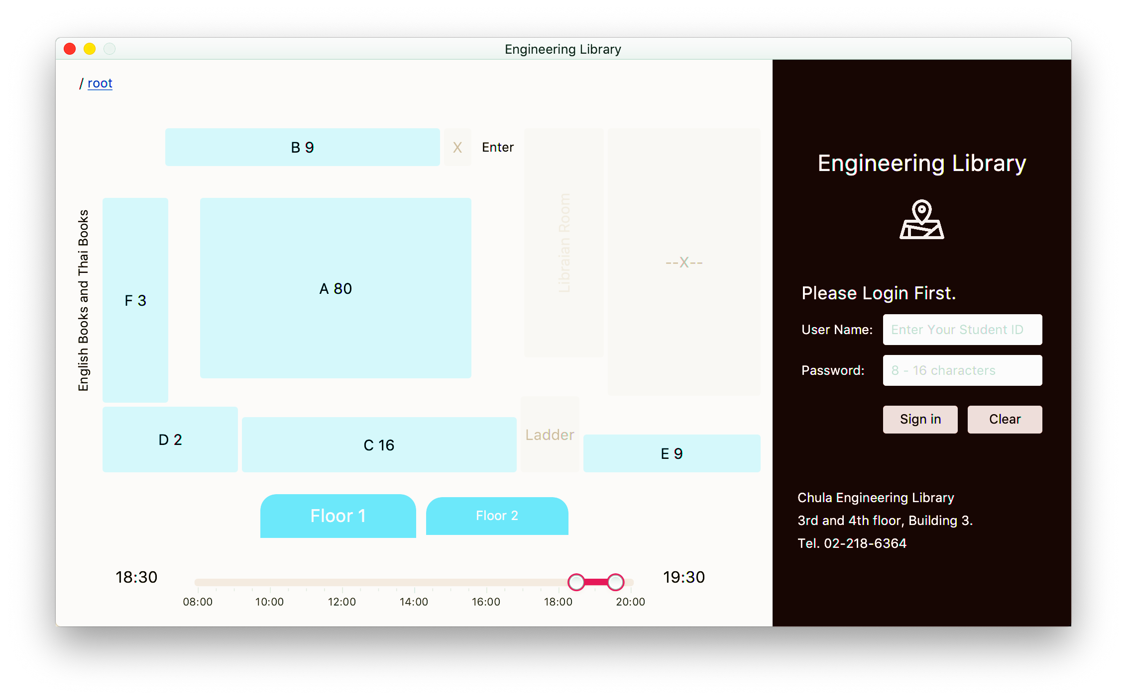
Main
PositionSelector
ControlPane
FirstFl + SecondFl QuietRoom
History

Slide 2
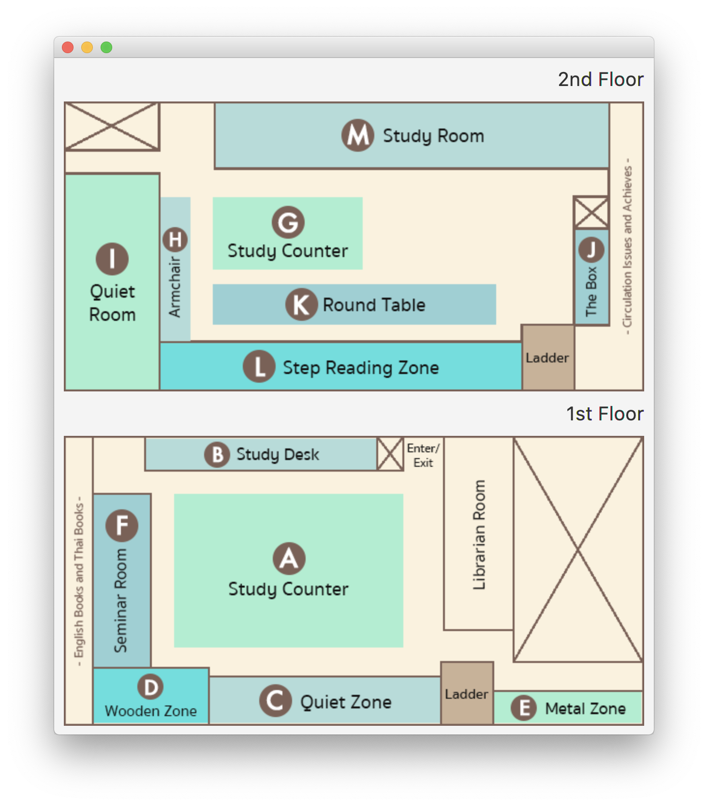
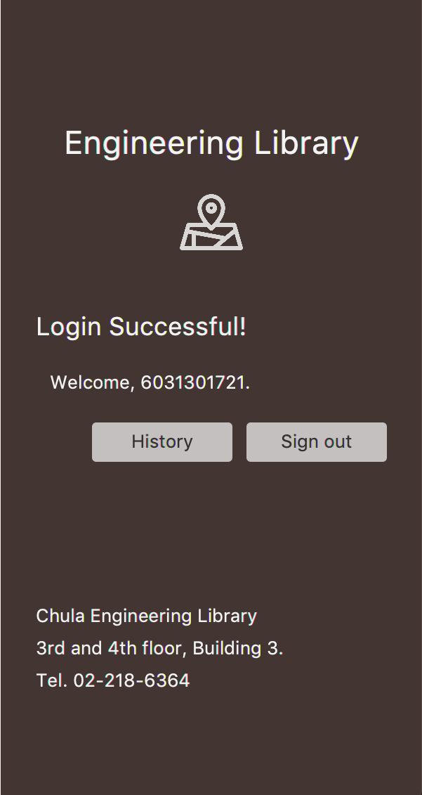
FullMapPopup
Login Pane
ContactPane

Slide 3
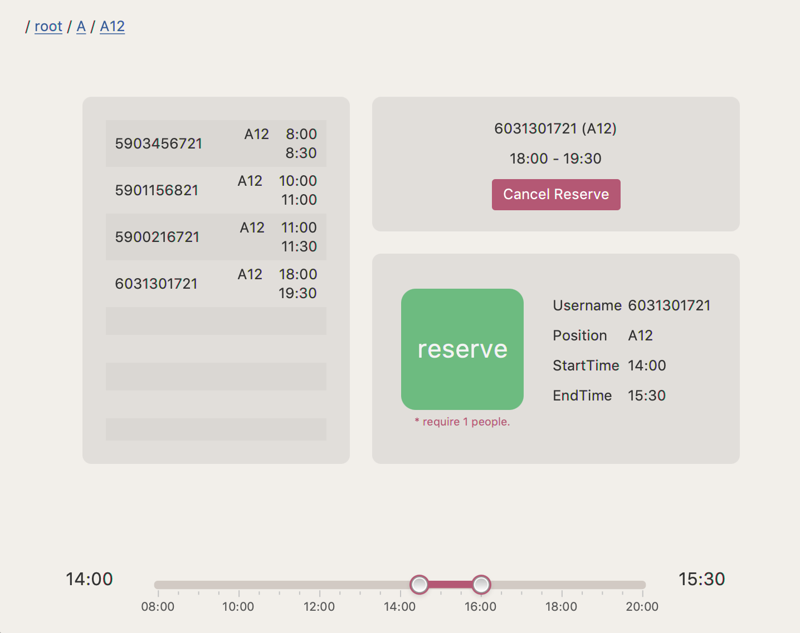
History
RightDetail
HistoryLog
Records
ReservePane
TimePicker

