Slide 1
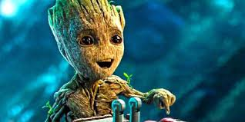
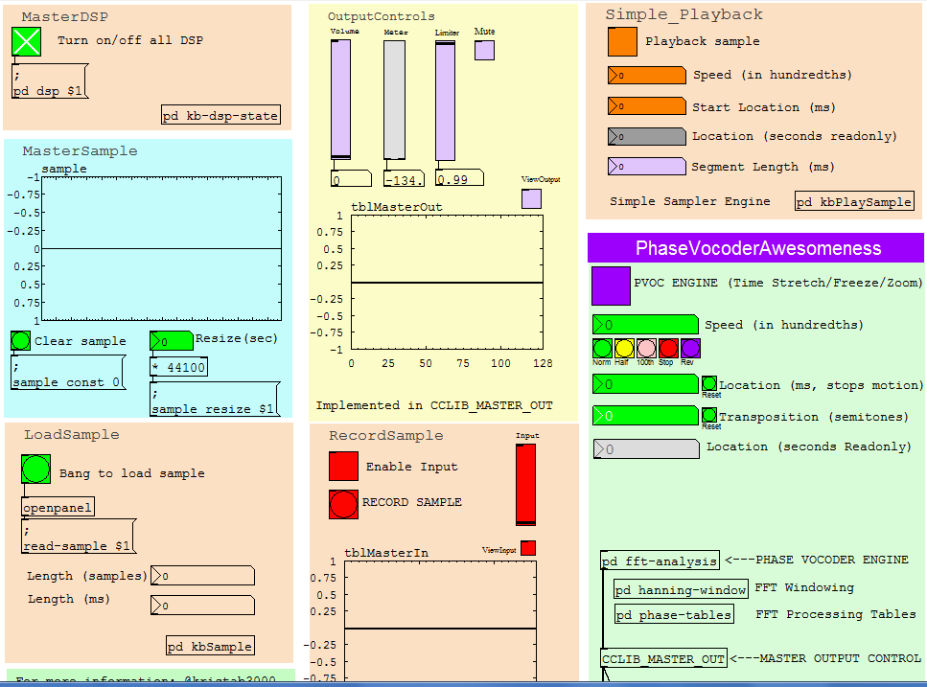
Building an Audio Microscope
Exploring the Microcosm Inside a Snapshot of Sound
Vol. 2
Krista Campbell
Managing Architect, ICC
kcampbell@icct.com
Notes:
My experience, start, focus areas
ICC
Remember to prep your video clip before presentation.
Switch to kbPVoc Patch and show waveform letting audience listen while they are walking in.
Turn Down
Will try to make this interesting and different.
Not solving business probs, writing apps, being good little scrumasters
Instead will be working with audio signal data.

Slide 2
Listen….

Slide 3
What sets audio data apart from business data?

Slide 4
Audio data…

Slide 5
Audio data…
is an EXERPIENCE
Notes:
Regardless of the toolset, the meaning of the data isn’t something that relates necessarily to a particular problem to solve,
Or even language itself
Audio data – the pure data itself translates eventually to sensory impulses in our mind and it is something we FEEL. Not something interpret or read.

Slide 6
What are experiencing right now?
Notes:
Take guesses as to what we are listening to – turn up volume again.
Then play at full speed.

Slide 7
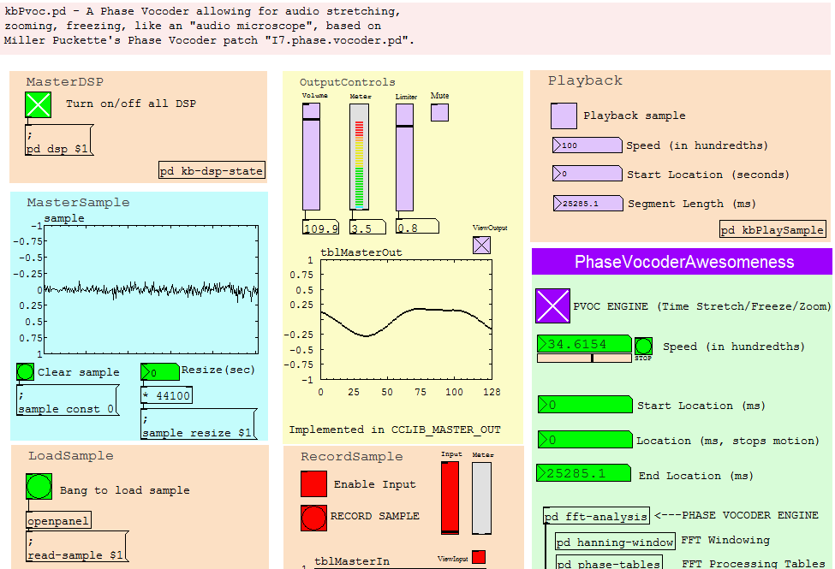
How can we do that?
Notes:
Show PVOC – and speed up
This is being updated in real time, the original file is saved but the manipulation in real time.
Not flashy visually or UX because we don’t care about that in this scope of this presentation – if you’re looking for flashy tools, this is NOT it, we care about the data itself-in it’s purest form and we are using an environment which is called just that PureData. More on that in a bit.
In the course of this presentation I’ll help you understand how we can use that environment

Slide 8
How to build an Audio Microscope
Concerned with the audio data, not the UX
We’ll talk about all kinds of stuff…..
The physics of sound and why audio data is different
Physiology and psychoacoustics of how we experience sound
Signal Processing Math to manipulate the data
Real-time environment to implement it
Notes:
Again – not concerned with UX, but with the tool and the audio processing

Slide 9
How to build an Audio Microscope
And all software we work with today will be downloadable and should (I know, yikes!) be functional on Windows, LINUX, and Mac
Oh, and hopefully have a little playtime too ☺
Notes:
Again – not concerned with UX, but with the tool and the audio processing

Slide 10
Theory of sound
A bit of physics…..(don’t be scared!)

Slide 11
Theory of Sound
A bit about acoustics, the physics of sound
Why is audio data different than Video?
Let’s look at a video clip….
Notes:
Play a video clip
Preferably something hilarious.
Such as
http://www.nbc.com/saturday-night-live/video/motivational-speaker/n10432?snl=1
Goto 4:00 to start
Pause it – why do we still see the picture but can’t hear the sound ?

Slide 12
Theory of Sound
Why can we continue to see the image of the clip when we pause it but not the sound?
Because video is essentially a series of still images
But sound is MOVEMENT

Slide 13
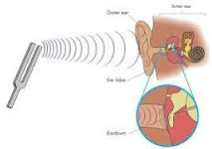
Theory of Sound
Specifically it’s the movement of air molecules,
Vibration of sound waves,
Moving our eardrum
Notes:
Show tuning fork and explain

Slide 14
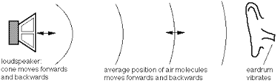
Theory of Sound
How about from a speaker?
Voltage charges magnet, moving the speaker surface, moving air, moving our eardrum

Slide 15
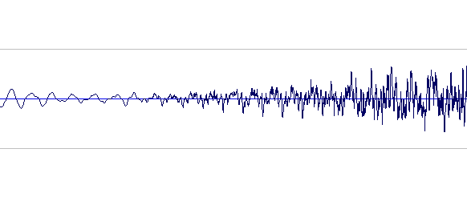
Theory of Sound
Sound waves we are used to seeing is that voltage differential , causing that speaker head to move forward or backward
Distance from the center = loudness
How close waves are = frequency
Notes:
Voltage corresponds to speaker movement

Slide 16
Theory of Sound
These values are stored in a table and playback simply reads them at the same rate they were written.
Let’s try something else - changing how fast we read that table.
Why does the pitch drop?
Why does the sound stop at zero?

Slide 17
Theory of Sound
To do this we are going to look at our example patch kbPvoc.pd
More on the details in a bit but for now we can load a sound
And then do simple playback, and control how fast it reads the samples….
Notes:
Use PVOC example
Intro duce the kbPvoc “audio microscope” or phase vocoder
to play example sample then slow down the speed to zero so you can hear it stop and the pitch drop
Pitch drops because the frequency is getting slower – you can show this with the output window

Slide 18
Theory of Sound
We want to make sure that the sound keeps playing and that the pitch doesn’t drop when we stop moving through the sample.
We want to be able to look at a small part of the sample microscopically.
And we want to hear the sound as if it just froze in that place.
This will require a bit of another area of science.

Slide 19
Psychoacoustics & physiology of hearing
A bit about how our brains process sound

Slide 20
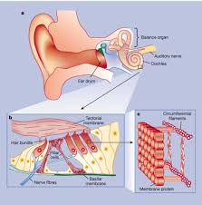
Physiology and Psychoacoustics
Our ears don’t process waveforms like a speaker, but like thousands of little specific speakers
This is inside the inner ear in the Organ of Corti

Slide 21
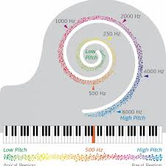
Physiology and Psychoacoustics
Each hair in the Organ of Corti picks up an individual frequency
Our brain then puts those frequencies together to make unified sounds.
So we need to make sure we are able to continue stimulation of those hairs as they were in the moment we want to “view” in our microscope

Slide 22
Physiology and Psychoacoustics
How do we make use of this information ?
For that we have to look at a bit of math…..

Slide 23
Audio Signal processing
Okay a bit of complex math, but it’s cool…..Don’t Panic

Slide 24
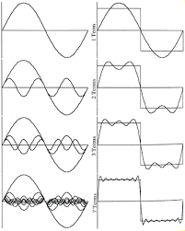
Audio Signal Processing (The math)
19th Century Joseph Fourier
Fourier Theorem: all complex waves can be made up of a series of simple waves if you know their amplitude (loudness) and phase (where they start)
Notes:
Explain the square wave example – that it can be decomposed into individual sine waves added together

Slide 25
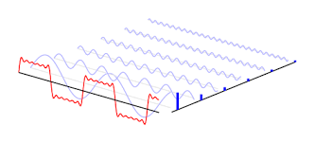
Audio Signal Processing (The math)
How do we use this?
A fancy thing called a Fourier Transform takes a little snippet of time and gives you the amplitude and phase of each of its component frequencies
Notes:
Explain the view on the closest right axis is the result of the fourier transform

Slide 26
Audio Signal Processing (The math)
Fourier transform goes from the “Time Domain” to the “Frequency Domain”
Time domain is a table of voltages to move speaker heads
Frequency Domain is a pair of tables, one which is the amplitude of each frequency band and one which is the phase (starting point) of each frequency band.

Slide 27
Audio Signal Processing (The math)
What if we can do a fourier transform in real time
Use that to figure out the amplitude and phase of each frequency in a moment of time.
Then use that to synthesize the sound at that moment of time
We just have to figure out how to KEEP PLAYING THAT same frequency, amplitude, and phase.
That is the Phase Vocoder and that is FINALLY something we can build!!!!

Slide 28
the audio microscope (The Phase vocoder)
Finally!!! We are actually going to look at some code-y kinds of things…..

Slide 29
Introducing PureData
PureData is a patcher language created by Miller Puckette over 20 years ago at IRCAM in Paris
Basis for several other tools, such as Max/MSP
Is essentially a visual programming language of objects represented by boxes connected by lines
The boxes represent variables or code
The lines represent variable assignment or function calls or audio signals

Slide 30

Introducing PureData
PureData is free
And it is VAST
But it is extremely well documented and a great way to learn is to read MSP’s book
PureData Download and InfoHub: http://puredata.info/
Miller Puckette’s Companion Book (best source to get started):http://msp.ucsd.edu/techniques.htm

Slide 31
Implementing the Audio Microscope
PD has hundreds of audio operations implemented including the FFT and IFFT, the Fast Fourier Transform and Inverse Fast Fourier Transform
And in his examples, MSP has shown how to use it to build a Phase Vocoder, and THIS is exactly what we need to use as the engine of our microscope!

Slide 32
Getting Setup
Download latest version of PD from here: Http://puredata.info
Download my patch and libraries from my github here: https://github.com/kristab33/CM2017-AudioMicro
Update the kbStartPvoc.bat file with the path to your PD (whereever you installed it) and KBLib folders (should be okay as is), respectively.
Double click kbStartPVoc.bat!

Slide 33
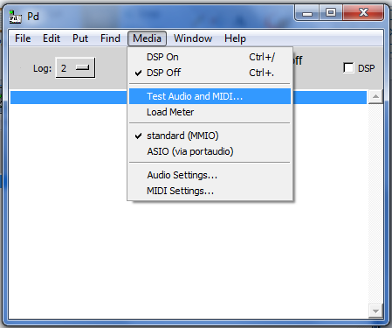
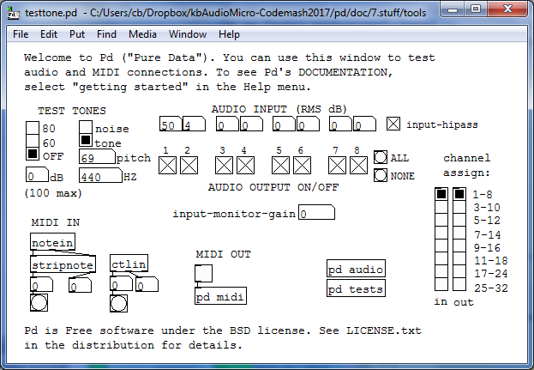
PD Message Window, Config, and Test

Slide 34
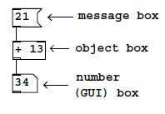
PD Essentials: Messages, Objects, Numbers

Slide 35
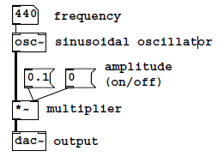
PD Essentials: Audio Processing

Slide 36
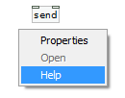
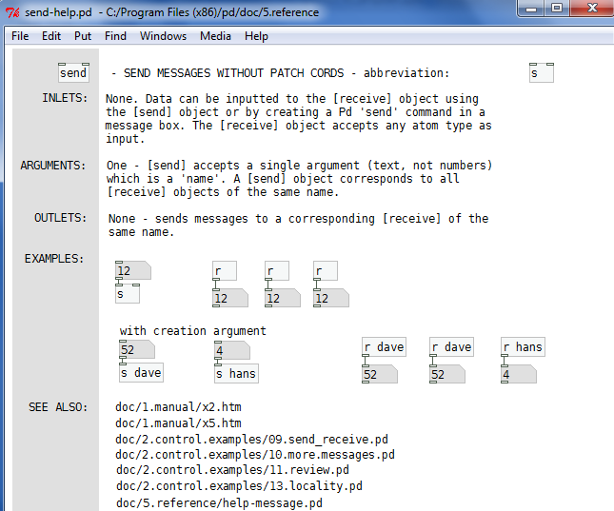
PD Essentials: Help & Send/Receive

Slide 37
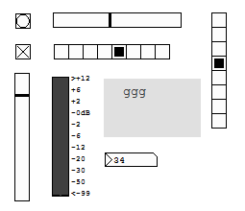
PD Essentials: GUI Objects

Slide 38
kbPVoc.pd – Phase Vocoder Based Audio Microscope
The patch, all controls, and all “kb” subpatches, and kb/cc libraries are by me (Krista) including the main control screen.
Notes:
DEMO!!!!

Slide 39
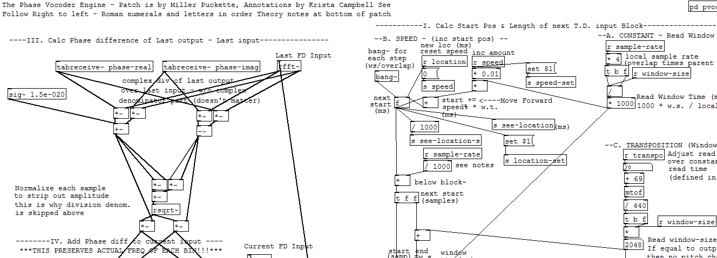
kbPVoc.pd – Phase Vocoder Based Audio Microscope
The engine in the fft-analysis subpatcher is by Miller Puckette. Annotations in the engine are also Krista – Ordered from Right to Left, grouped by Roman numerals and then letters.
Notes:
DEMO!!!!

Slide 40
kbPVoc.pd – Phase Vocoder Based Audio Microscope
DSP / Output
Master Sample
Load / Record
Simple Playback Controls
Phase Vocoder (Micrcoscope) Controls
Engine
Notes:
DEMO!!!!

Slide 41
Now let’s dig into it!
Notes:
DEMO!!!!

Slide 42
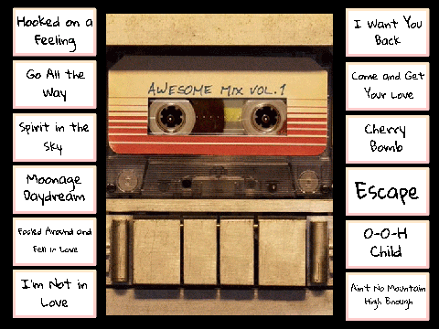
Audio Microscope: Awesome Mix Edition
Krista Campbell ~ kcampbell@icct.com

Slide 43
Thank you!!! ☺
Krista Campbell
kcampbell@icct.com

Slide 44
For more information……
Patch posted on GitHub: kristab33
PureData Download and InfoHub: http://puredata.info/
Miller Puckette’s Companion Book (best source to get started):http://msp.ucsd.edu/techniques.htm
Max/MSP (Commercial Version): https://cycling74.com/
Max for Live (Ableton Live Hosted Version): https://www.ableton.com/en/live/max-for-live/
IRCAM (one of the coolest places on the planet and where most of this originated from) : https://www.ircam.fr/
Email me: kcampbell@icct.com

