Slide 1
Build Up
Chris&Krista

Slide 2
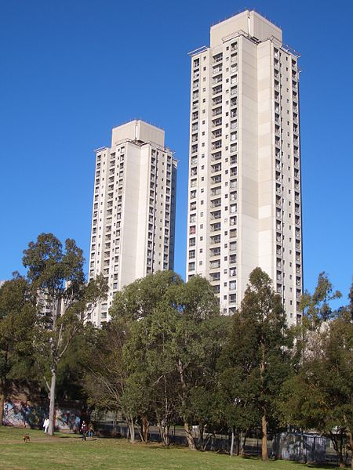
High rise buildings
Charm of them?
Picture: J Bar, CC BY 2.5

Slide 3
High rise buildings
Charm of them?
View that you can’t get from the ground
Picture: J Bar, CC BY 2.5

Slide 4
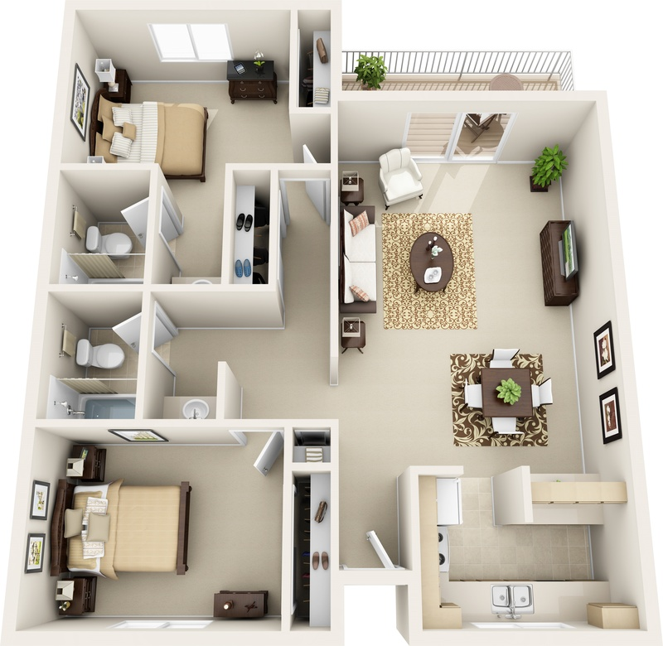
What we normally give for customers
Picture: ArlieRighos, CC BY 4.0

Slide 5
What we normally give for customers
But building is always tied to it’s surroundings…..
Picture: ArlieRighos, CC BY 4.0

Slide 6
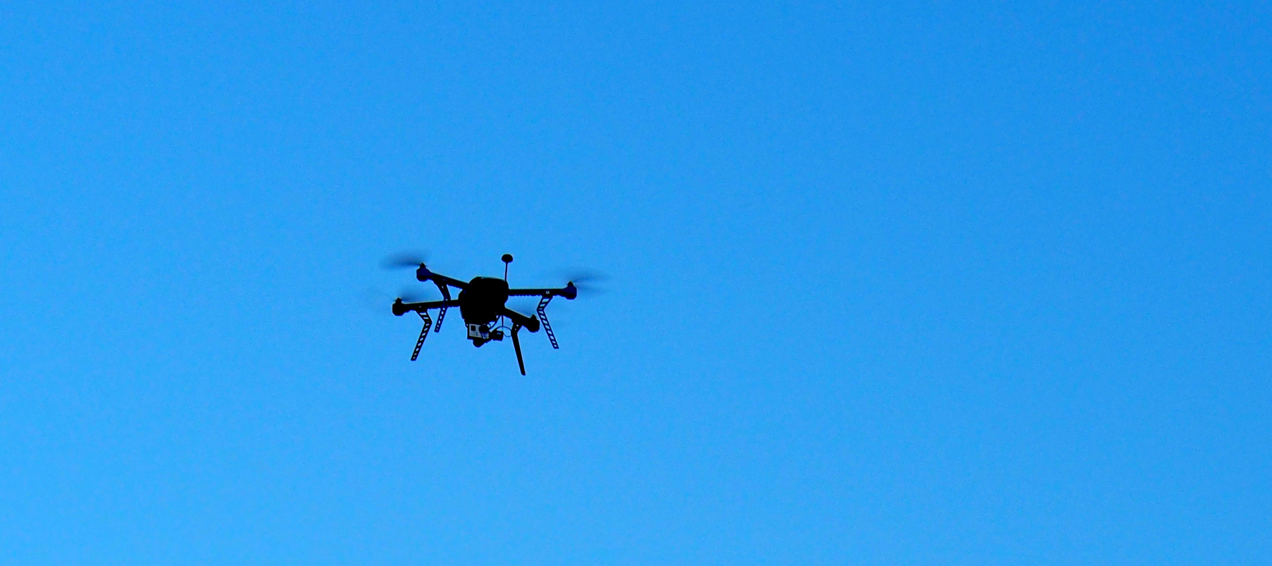
REVIT My Drone
Previous AEC project to intergrate Autodesk Revit API for controlling drones.
Picture: http://revitmydrone.com/

Slide 7
REVIT My Drone
Previous AEC project to intergrate Autodesk Revit API for controlling drones.
Drones for marketing
Picture: http://revitmydrone.com/

Slide 8
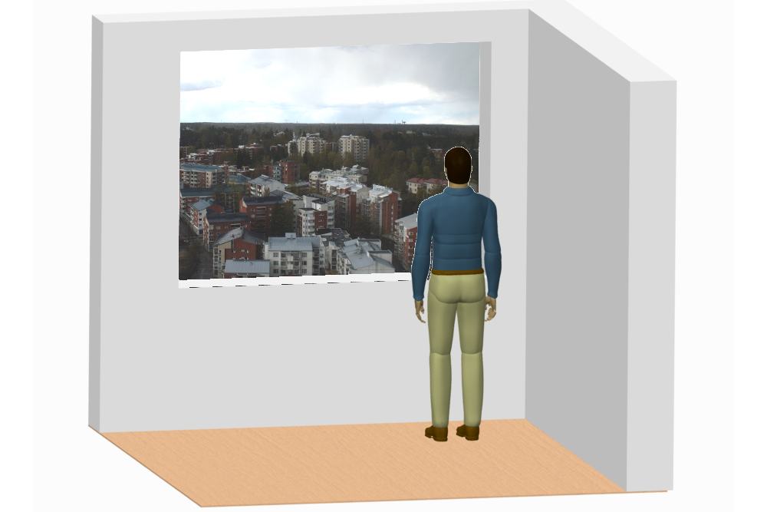
Use with 3D models, Hololens…

Slide 9
Demo….

