Slide 1







Survey Responses
Krista A.
16 Nov 2024

Slide 2



OUTLINE
Executive Summary
Introduction
Methodology
Results
Visualization – Charts
Dashboard
Discussion
Findings & Implications
Conclusion
Appendix

Slide 3

EXECUTIVE SUMMARY
Most Common Languages worked with were Bash and other shells, C#, HTMP/CSS, C, Assembly and Java.
Most Common Databases worked with were Firebase, MS SQL Server, MongoDB, MariaDB, and MySQL
Most Common Areas Desired to work with
Languages – JavaScript, HTML/CSS, Python, SQL
Databases – PostgreSQL, MongoDB, Redis, MySQL
Platforms – Linux, Docker, AWS, Windows, Android
Education Levels - Most Masters Degrees were achieved between ages 21-26.

Slide 4

INTRODUCTION
This study uses data collected and cleaned from a survey conducted by Stack Overflow. It is intended to show management what trends are for future Languages, Databases, Platforms, and Web Frames, as the respondents answered they would like to learn. The graphs and charts below show the data in readable and summarized form. The data includes Demograhpics and the following for both Current work and Desired Future Learning for:Most Common Languages worked with were Bash and other shells, C#, HTMP/CSS, C, Assembly, and Java.
Most Common Databases worked with were Firebase, MS SQL Server, MongoDB, MariaDB, and MySQL
Most Common Areas Desired to work with
Languages – JavaScript, HTML/CSS, Python, SQL
Databases – PostgreSQL, MongoDB, Redis, MySQL
Platforms – Linux, Docker, AWS, Windows, Android
Web Frames – React.js, Vue.js, Angular.js, Asp.net, and jQuery
Education Levels - People who had Masters Degrees got them mostly between ages 21-26

Slide 5

METHODOLOGY
Data was collected from StackOverflow Survey about Current and Future Languages, Databases, Platforms, Demographics, etc.
Data was uploaded to IBM Cognos Analytics.
Bar charts and other graphs or plots show the data.
Additional data was analyzed for Job Posting by Location
Additional data was analyzed for Languages by Salary

Slide 6
RESULTS
The most common languages that are already known are:
Bash or other shell, C# and HTML / CSS, and C, followed by Assembly and Java. If Java and JavaScript are combined, they would rank 4th, just below C.
The most common databases already worked with are Firebase, MS SQL Server, MongoDB, MariaDB and MySQL. If MS SQL Server and MySQL are combined, they would take first place.
Desired languages are JavaScript, HTML / CSS, Python, SQL and TypeScript. Desired databases are close, but at the top are PostgreSQL, MongoDB, Redis, MySQL and Elasticsearch.
The most popular platforms to work on are Linux, Docker, AWS, Windows, and Android.

Slide 7
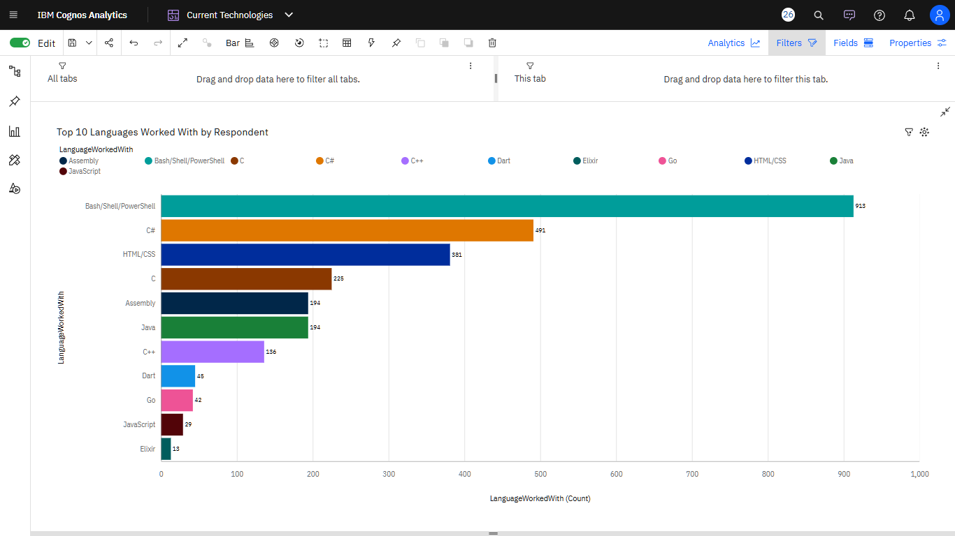
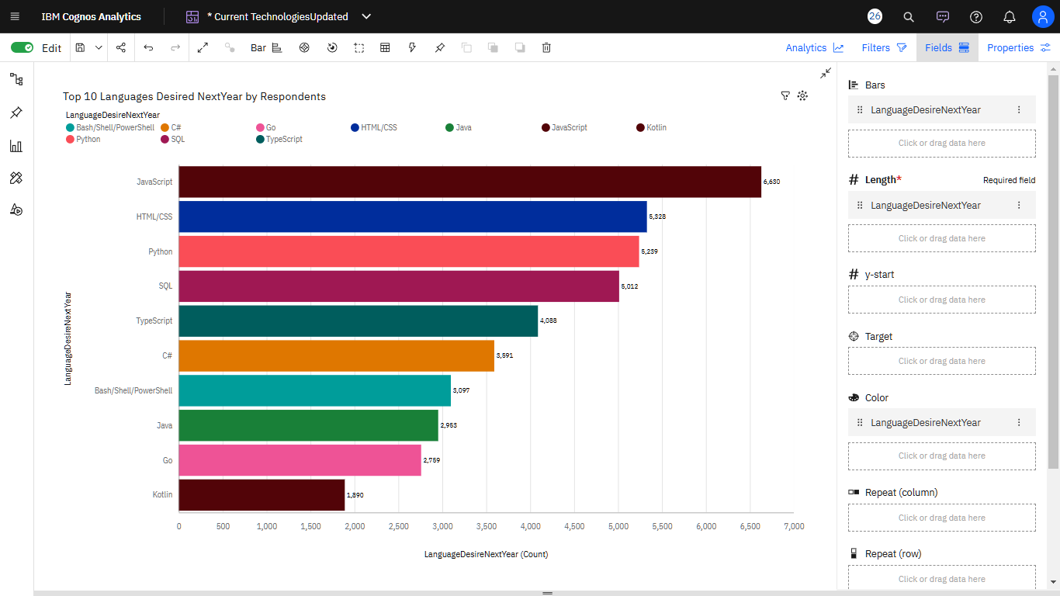
PROGRAMMING LANGUAGE TRENDS
Current Year
Next Year
< Bar chart of top 10 programming languages for the next year goes here.>

Slide 8
PROGRAMMING LANGUAGE TRENDS - FINDINGS & IMPLICATIONS
Users are interested in learning JavaScript.
Bash and other shell languages have dropped to rank 7.
HTML and CSS remain high on the list of languages.
Python is becoming more popular, at rank 3.
To attract excellent people, training in JavaScript could be offered as an incentive.
Shell scripts could be converted to JavaScript or Python to remain competive.
HTML and CSS programs can remain unchanged.
Python could replace some shell scripts and is more secure.

Slide 9
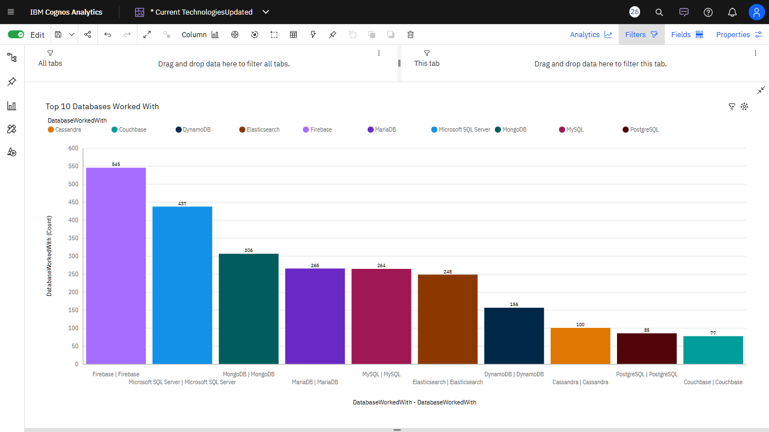
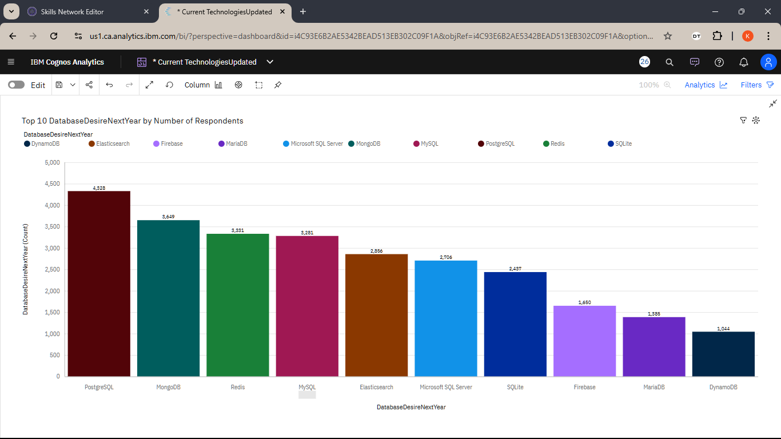
DATABASE TRENDS
Current Year
Next Year
< Bar chart of top 10 databases for the current year goes here >
< Bar chart of top 10 databases for the next year goes here.>

Slide 10
DATABASE TRENDS - FINDINGS & IMPLICATIONS
While Firebase and MS SQL Server were clearly most used last year, this year other DBs are seen as having an advantage.
PostgreSQL is desired
MongoDB, Redis, and MySQL are also desired, but there is not too much difference.
It would be good for products using Firebase or MS SQL Server to support PostgreSQL also.
Most responders chose PostgreSQL or MongoDB as a desired DB.
However, about 7 databases are found as possibly popular in the future.

Slide 11

DASHBOARD
Cognos Program with Graphs and Charts

Slide 12
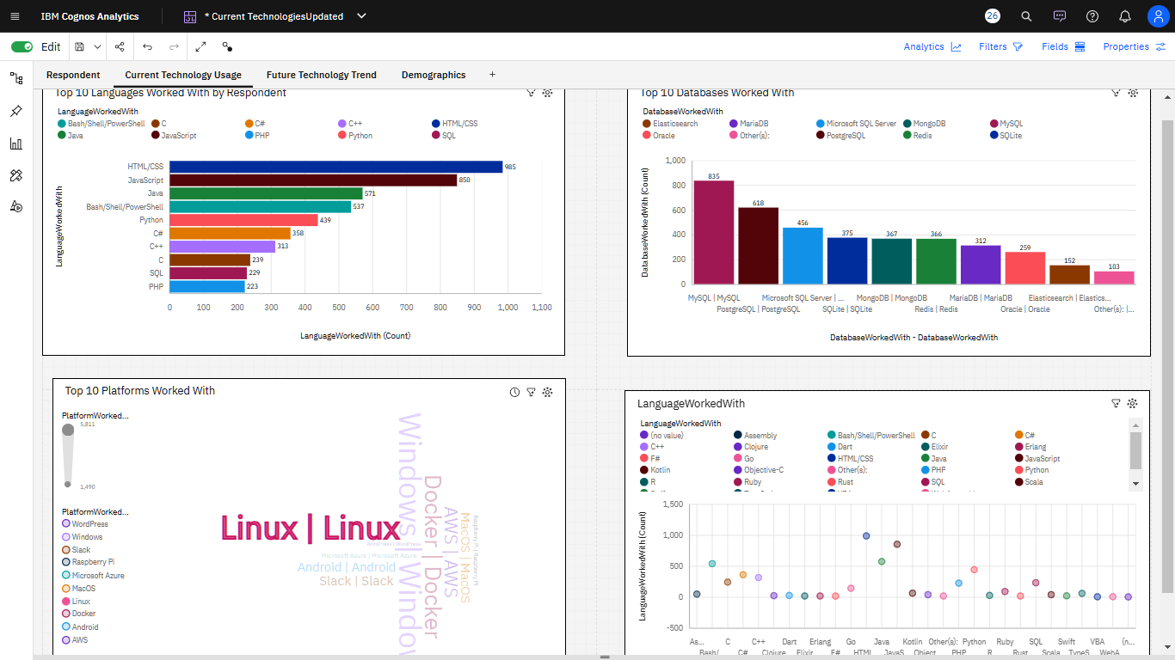
DASHBOARD TAB 1
Screenshot of dashboard tab 1 goes here

Slide 13
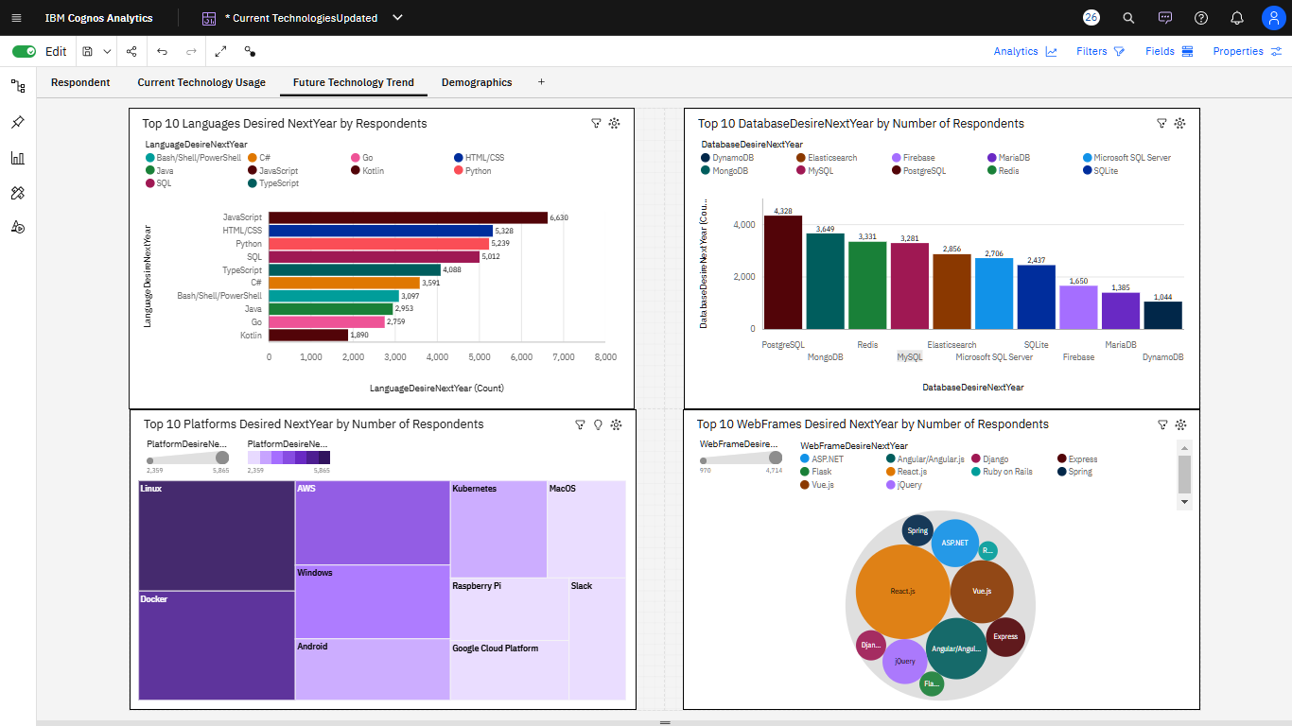
DASHBOARD TAB 2
Screenshot of dashboard tab 2 goes here

Slide 14
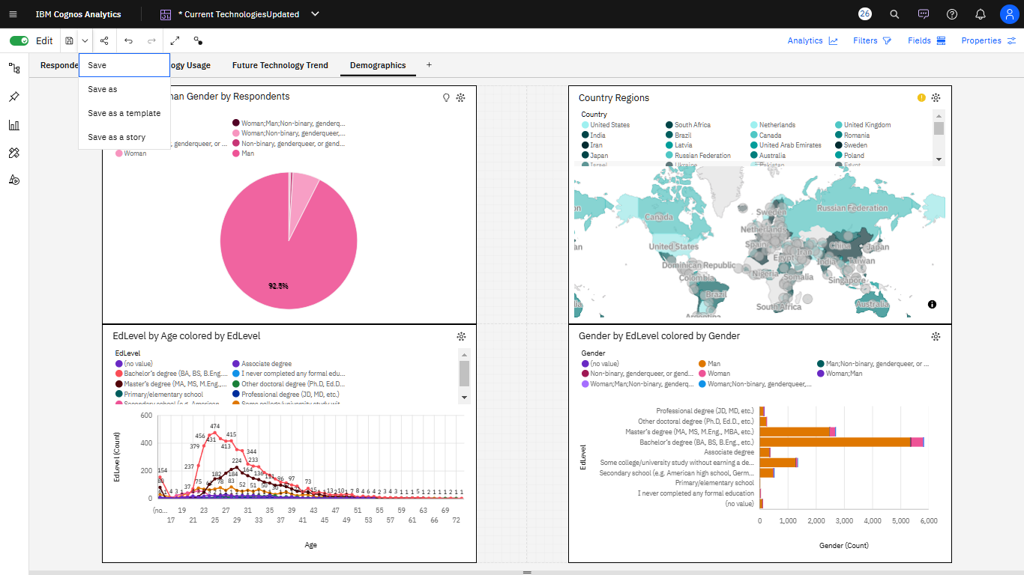
DASHBOARD TAB 3
Screenshot of dashboard tab 3 goes here

Slide 15
DISCUSSION
Would it be worth it for the product to support the future languages and databases that respondents say they would like to learn?
Would it be worth it to provide such training for them?

Slide 16
OVERALL FINDINGS & IMPLICATIONS
Respondents are eager to learn new languages and databases.
JavaScript is the number 1 language people want to learn.
PostgreSQL is the number 1 database people want to learn.
If responses reflect which languages and databases are popular next year, then it is worth it to further study the pros and cons of the favored languages and databases.
It's possible that JavaScript is the best language for web or other developers.
It's possible that PostgreSQL is a great database for future applications.
It's worth further study to see if there are correlations with current job and job in search of.

Slide 17

CONCLUSION
A study is recommended to determine correlations, if any, between respondents' current jobs and demographics and what interests them in the next year.
A study is recommended to learn pros and cons of the most desired languages and databases.

Slide 18

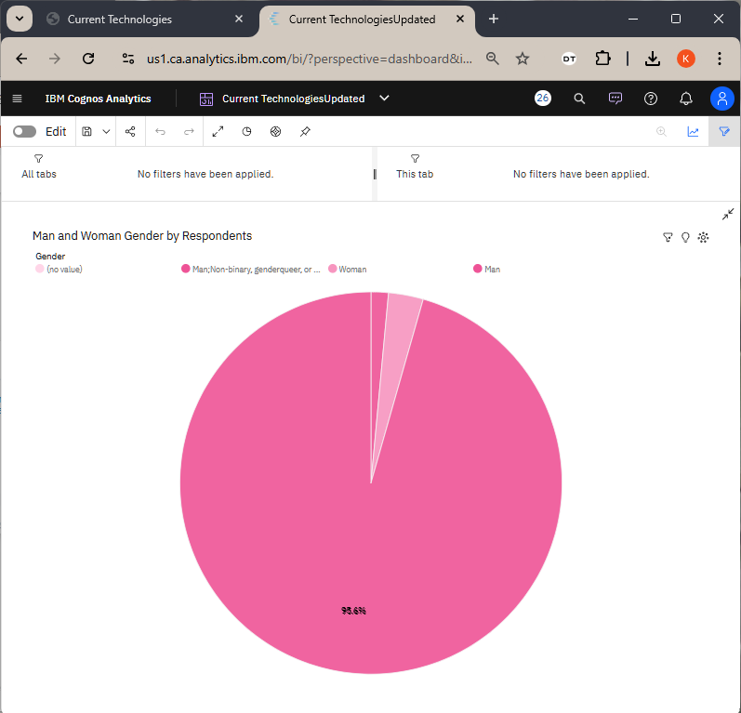
APPENDIX
Include any relevant additional charts, or tables that you may have created during the analysis phase.

Slide 19
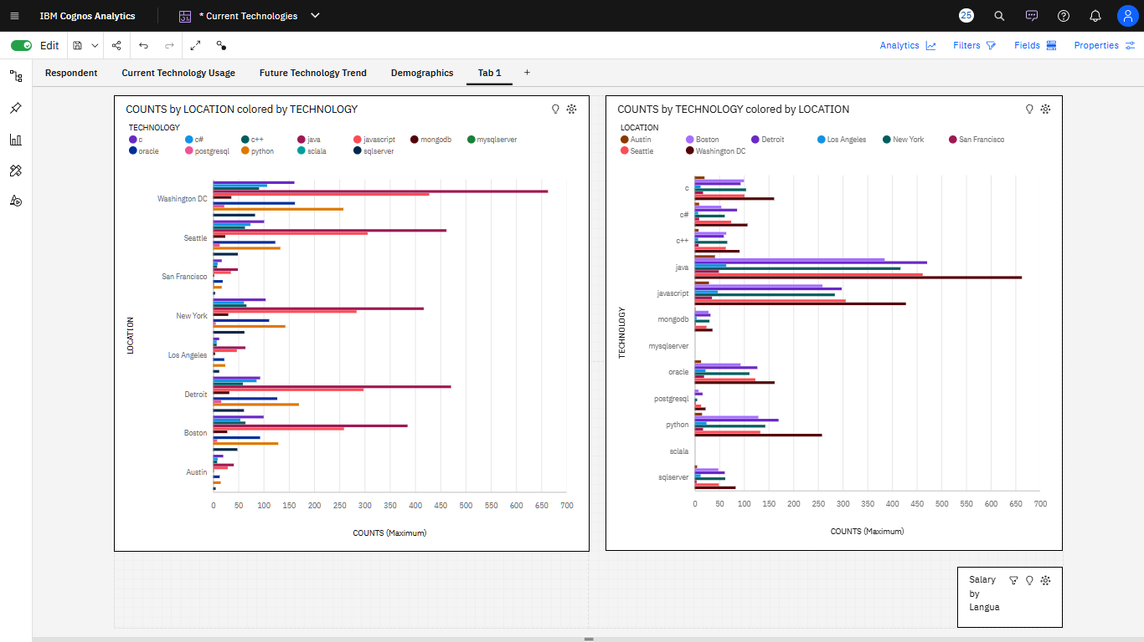
JOB POSTINGS
I

Slide 20
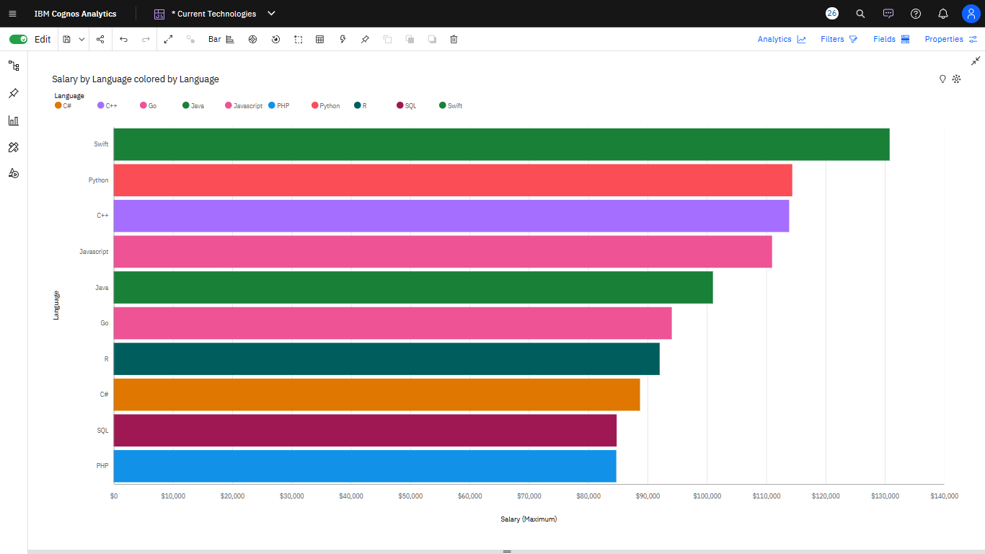
POPULAR LANGUAGES

Slide 21
Appendix
1. The Cognos project illustrates both Location by Technology counts but also Technology by Location. It is above.
2. A pivot table in Excel is used to show totals for Job Postings:
https://github.com/kristajan/IBMDACapstoneProject/blob/be83c401d481e240450fc98e7aa3cba95ea5ace5/job-postingsPT.xlsx

Slide 22
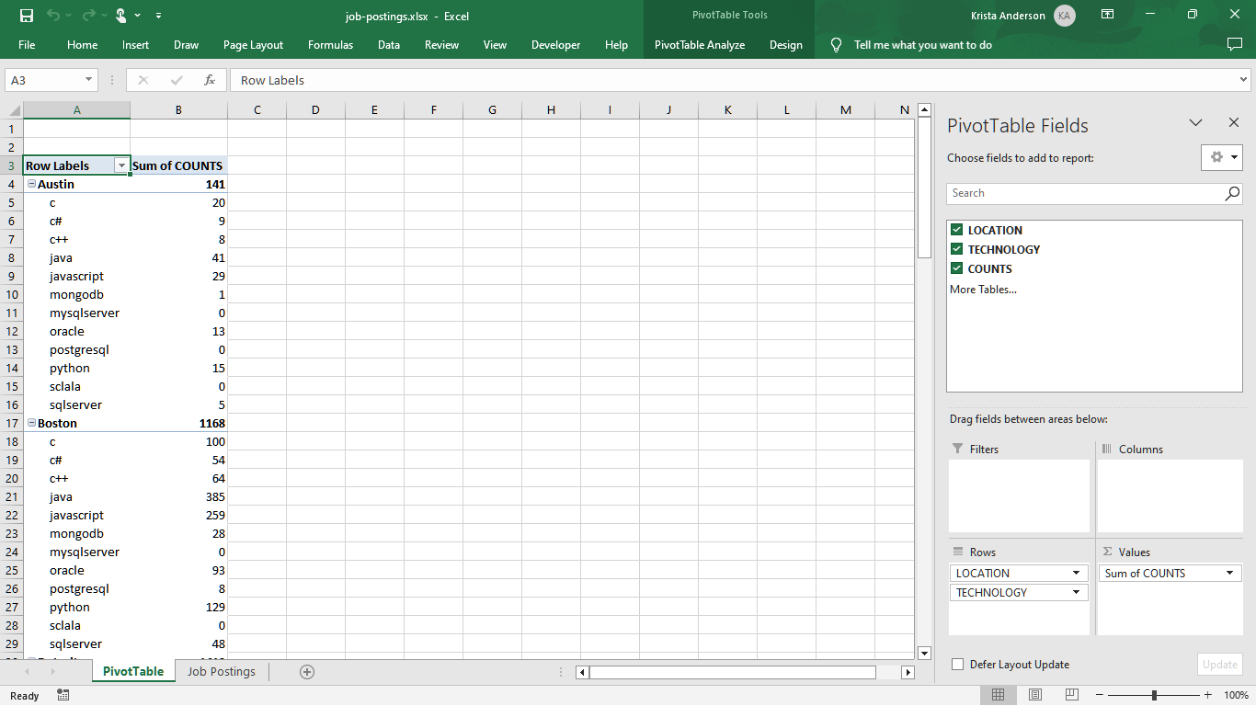
Pivot Table in Excel

