Slide 1
Accessibility test automation
accessibility-developer-tools (ADT)
Selenium
Scala
Cucumber & Gherkin
Notes:
Accessibility test automation

Slide 2
What is Web Accessibility ?
Web accessibility means that people with disabilities can use the Web.
to w3.org for full description
Notes:
What is Web Accessibility ?

Slide 3
Why Web Accessibility is important ?
The Web is an increasingly important resource in many aspects of life;
An accessible Web can help people with disabilities more actively participate in society.
to w3.org for full description
Notes:
Why Web Accessibility is important ?

Slide 4
Is Web Accessibility expensive ?
Many accessibility features are easily implemented if they are planned from the beginning of Web site development or redesign;
Fixing inaccessible Web sites can require significant effort.
to w3.org for full description
Notes:
Is Web Accessibility expensive ?

Slide 5
Testing the Accessibility of a Web Site
There are evaluation tools that help with evaluation (one of which is ADT);
However, no tool alone can determine if a site meets accessibility guidelines;
Knowledgeable human evaluation is required to determine if a site is accessible.
to w3.org for full description
Notes:
Testing the Accessibility of a Web Site

Slide 6
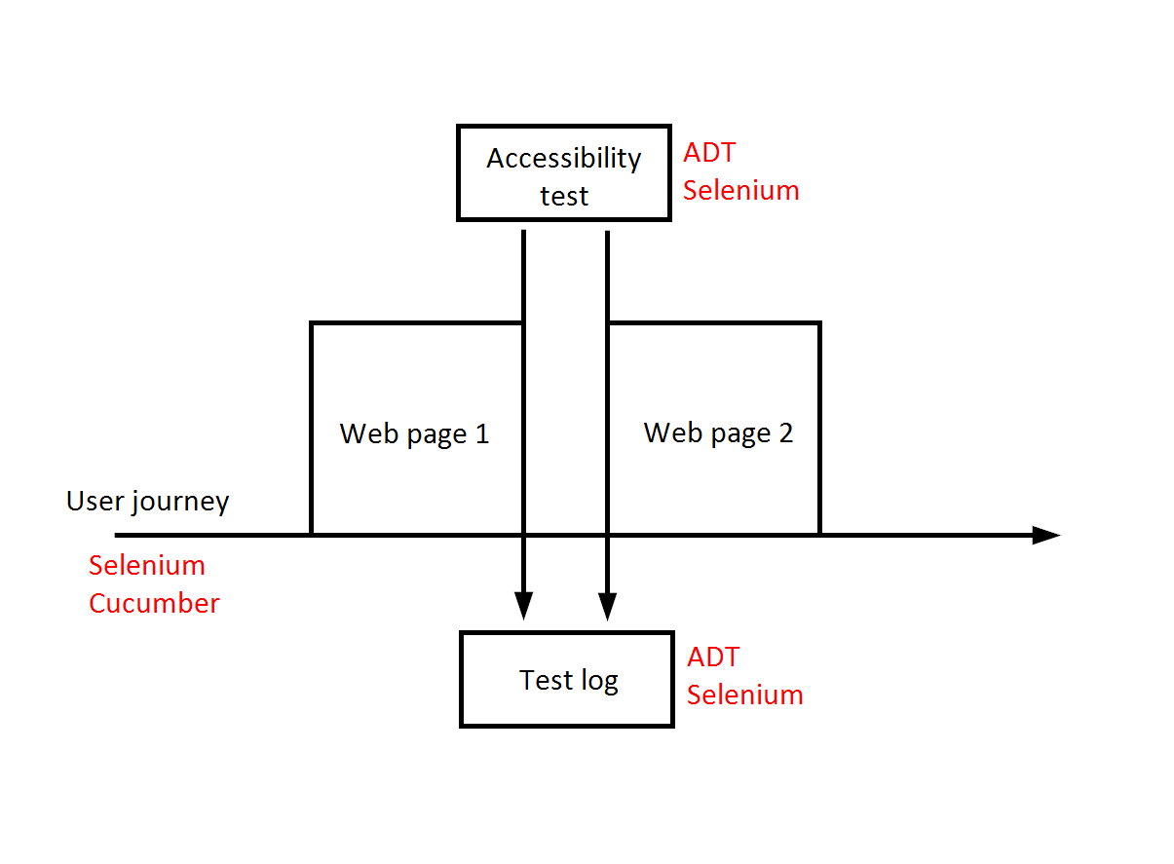
Accessibility test automation example
Notes:
Accessibility test automation example

Slide 7
Tools used in this example
ADT (to GitHub);
Selenium (to seleniumhq.org);
Scala (to scala-lang.org);
Cucumber (to cucumber.io).
Notes:
Tools used in this example

Slide 8
What we need from accessibility-developer-tools
As written in the readme, ADT is: “…a library of accessibility-related testing and utility code.”
The library and utility code from the project is compiled into a single executable JavaScript file:
axs_testing.js
(to axs_testing.js raw content)
Notes:
What we need from accessibility-developer-tools

Slide 9
What we need from Selenium
We use a library of audit rules compiled into a single JavaScript. From Selenium we need a mechanism for executing JavaScript.
Therefore we can use:
JavascriptExecutor Interface
(to selenium.googlecode.com)
Notes:
What we need from Selenium

Slide 10
What we need from Scala
To use Selenium we must use a programming language that is supported by Selenium;
Scala is not listed, but Scala is compatible with Java. Scala classes are Java classes, and vice versa (to more information).
Notes:
What we need from Scala

Slide 11
What we need from Cucumber
It is optional to use Cucumber as you can achieve similar results by writing Scala code for Selenium; Cucumber is used in this example to organise the test suite and make the user journey readable by a larger audience.
Notes:
What we need from Cucumber

Slide 12
Checklist for Implementation
User journey
Code for journey
Code for test execution
Code for logs
Notes:
Checklist for Implementation

Slide 13
User journey
A user journey/story/feature would look like: @suite
Feature: Accessible user journey
As a tester
I want to test a web page for accessibility
So that I can be sure that it does not contain critical accessibility issues
Scenario: Test accessibility for Google.com
Given user navigates to 'http://google.com' web page
Then accessibility test is executed on the open page
Notes:
User journey

Slide 14
Code for journey
Our journey consists of a step that opens the given URL in a browser:
Given( """^user navigates to '(.*)' web page$""") {
(userUrl: String) =>
withCurrentDriver { implicit webDriver =>
webDriver.get(userUrl)
}
}
Notes:
Code for journey

Slide 15
Code for test execution
Tests are executed with the help of JavascriptExecutor:
Then( """^accessibility test is executed on the open page$""") {
() => withCurrentDriver { implicit webDriver =>
val cache = collection.mutable.Map[String, String]()
val jse = webDriver.asInstanceOf[JavascriptExecutor]
def getUrlSource(arg: String): String = cache get arg match {
case Some(result) => result
case None =>
val result: String = scala.io.Source.fromURL(arg).mkString
cache(arg) = result
result
}
jse.executeScript(getUrlSource("https://raw.githubusercontent.com/GoogleChrome/" +
"accessibility-developer-tools/stable/dist/js/axs_testing.js"))
val report = jse.executeScript("var results = axs.Audit.run();return axs.Audit.createReport(results);")
println(report)
}
}
Notes:
Code for test execution

Slide 16
Code for logs
The report is generated with the help of a JavaScript code which is held within axs_testing.js (snippet visible in the previous slide as well): val report = jse.executeScript("var results = axs.Audit.run();return axs.Audit.createReport(results);")
println(report)
Notes:
Code for logs

Slide 17
Demo
Demo
Notes:
Demo

Slide 18
Thank you
Extra bits:
Accessibility-driver repo on GitHub (driver that piggybacks on existing journeys)
Accessibility-developer-tools wiki on GitHub
(detailed info about each error type from logs)
Presenter: Kristaps Melderis
Notes:
Extra info

