Slide 1

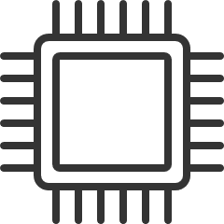


#43
PROJECT #43
RECONFIGURABLE NEURAL PROCESSING UNIT (NPU) FOR ENERGY-EFFICIENT AI AT THE EDGE
Pratham Chhabra | Kristelle Sampang
Page 01
Notes:
Introduce ourselves and say the title of the project

Slide 2


#43
BACKGROUND
MOTIVATION
Nowadays, Machine Learning (ML) is integrated everywhere, especially in embedded systems and edge devices.
ML inferencing in typical everyday computers is not computationally efficient.
Requires a hardware accelerator to reduce power consumption and increase energy efficiency.
Page 02
Notes:
- how machine learning has now integrated into the world of embedded systems like objection recognition
- specifically looking into edge device which are resource limited
- current implementations for ML inference in typical everyday computer are not powerful enough
- we want a hardware accelerator to reduce the power used and increase energy-efficiency
Nowadays AI and ML is everywhere, especially in embedded systems on edge devices. ML is very popular in cases such as object recognition, tracking. However deploying these algorithms on edge devices is challenging due to limited hardware resources.
Traditional CPUs and GPUs are not optimised for these workloads at the edge, which is why specialised hardware such as a Neural Processing Units (NPU) are being explored to increase energy efficiency and maintain a higher performance during inference.

Slide 3

#43
BACKGROUND
MOTIVATION
PE
PE
PE
As ML models evolve, we want a hardware accelerator to adapt to different ML model requirements.
A popular architecture in present research demonstrates the use of systolic arrays.
Like a heart, data flows through an array of processing elements to execute MAC operations for ML inferencing.
Due to the interconnections, data is passed on without having to access memory
PE
PE
PE
PE
PE
PE
Page 03
Notes:
- As ML continue to develop and evolve, we want to create a reconfigurable hardware accelerator that can adapt to many types of models
- From the literature, we have found that systolic arrays are a popular choice to be used as the datapath of the NPU.
- so what is a systolic array?
- The way systolic array works is like a heart.
- When a heart beats, it fills up with blood and propagates through the vessels
- With a systolic array, the vessels are the processing elements.
- The blood is the input data and weights.
- And with every pump - or clock cycle - data moves onto the next processing element.
- This version of the systolic array has data flowing horizontally and vertically
- this is a big advantage as it can pass data without needing to access memory
- because of this structured data flow, the workload is efficient especially dense matrices

Slide 4
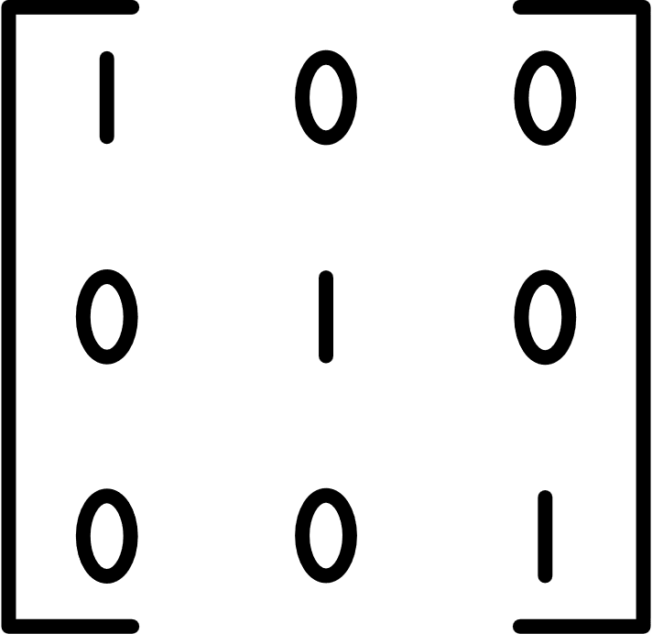
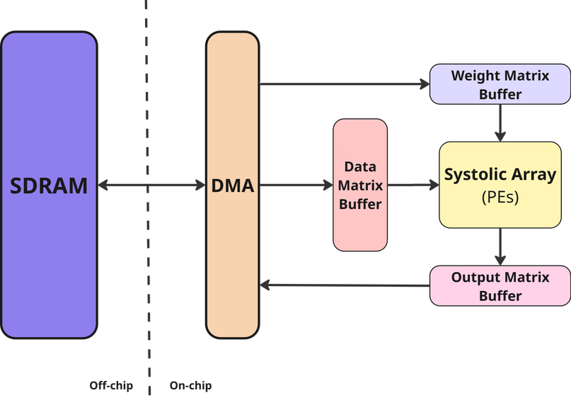
#43
GAPS & HYPOTHESIS
Gaps:
Systolic arrays are efficient for dense matrices but inputs from ML are sparse.
2. Frequent memory accesses cause a higher consumption of energy.
Hypothesis:
Design a reconfigurable systolic array-based NPU controlled by a softcore processor to dynamically adapt the accelerator to different model requirements, data sparsity and application needs.
Page 04
Notes:
!! HALF THIS PL, reached 5 mins by the end of this slide
-the outputs of the trained ML models can give sparse matrices,
- doing MAC operations on zeros is just computiopnally useless because everything times zero is zero
- So as part of our research, it is important to understand how sparsity impacts the performance and efficiency of systolic areas due to techniques such as the ReLU activation and weight pruning.
- As we know, accessing memory is computationally resourceful
- Frequent memory accesses cause a higher consumption of energy, more than the computations from the systolic array.
Hypothesis:
Based upon these issues, we must design a reconfigurable systolic array-based NPU controlled by a softcore processor to dynamically adapt the accelerator to different model requirements, data sparsity and application needs.

Slide 5
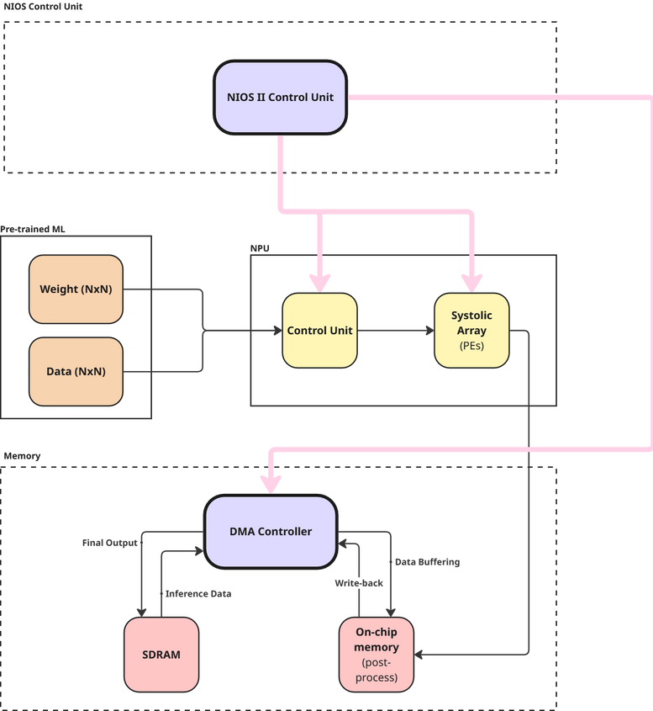
#43
CURRENT IMPLEMENTATION
Page 05

Slide 6
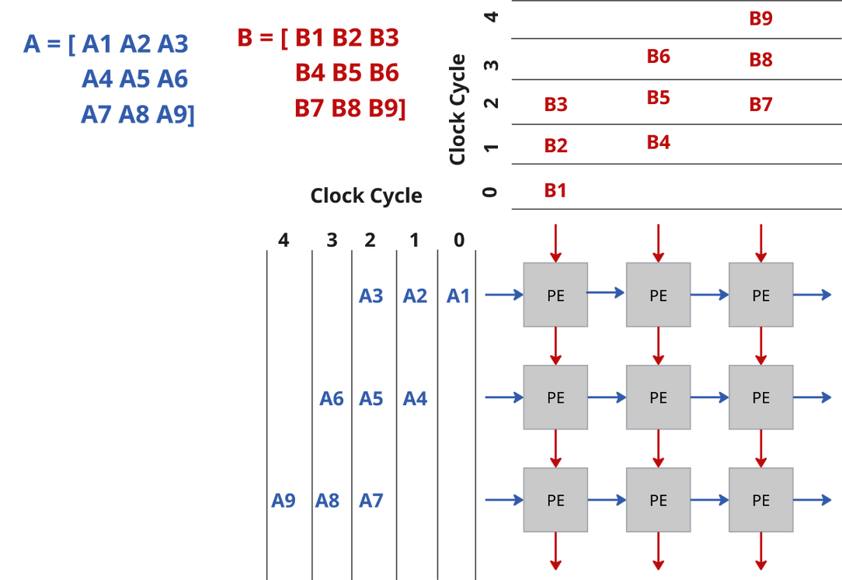
#43
CURRENT IMPLEMENTATION
Page 06
Notes:
- So what does the NPU actually do?
- Well, to do inferencing, it needs to do some matrix multiplication
- The purpose of each PE is to perform a multiply and accumulate operation that we can do a matrix multiplication on A*B
- But we need a way to input data so that it makes sense mathematically
- we need to find a way to control this! this is what the control unit is for
- So, we have a staggered input
- not all the PEs will start with data, we start filling in from the top left PE
- then at every clock cycle the data will propogate shown by the arrows that act simliarly to a wave
- so after each mac operation, the inputs will move across the systolic array

Slide 7
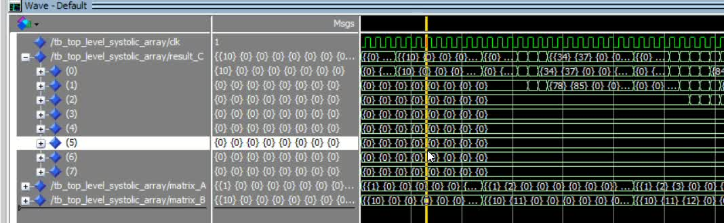

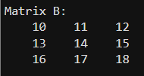

#43
CURRENT IMPLEMENTATION
X
=
Page 07
Notes:
This video demonstration illustrates that the systolic array supports input sizes ranging from 1×1 to 3×3.
It clearly shows the multiply-accumulate (MAC) operation being performed, followed by the data being passed to the next processing element.
The input data is staggered, consistent with the expected systolic flow.
Each MAC operation is completed in exactly one clock cycle.
To verify the correctness of the simulation, a reference test case was calculated in MATLAB.
The simulation results closely match the MATLAB output, confirming the accuracy of the implementation.

Slide 8
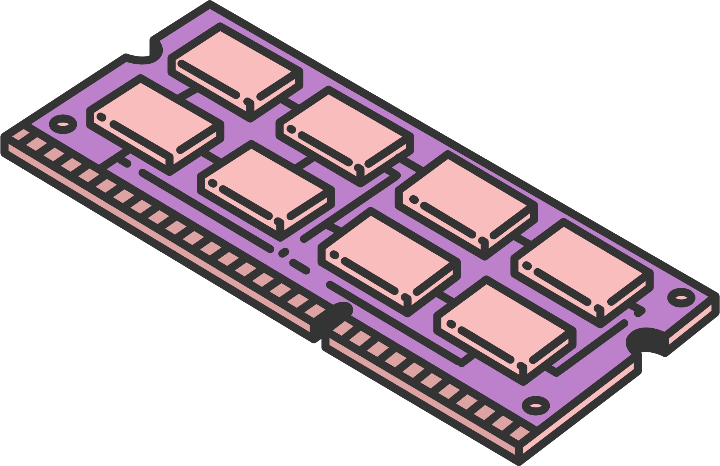
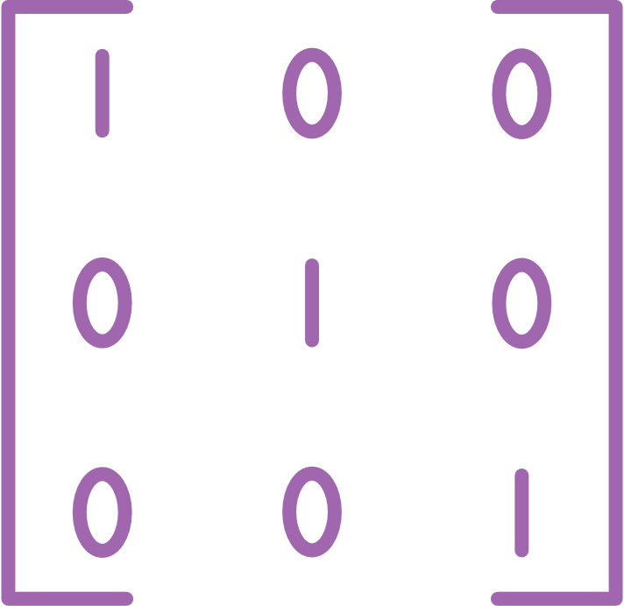
#43
FUTURE IMPLEMENTATION
NIOS II CONTROL UNIT
MEMORY
SPARSE MATRIX HANDLER
Input/output movement coordination
Interface with the main accelerator
Loading matrices into shared memory
Programming the DMA
Handling the reconfigurability
parameters
DMA controller to reduce NIOS II overhead
Better for transferring between memory and hardware accelerator
System needs to accommodate for sparsity exploitation
Pruning can be applied at pre-processing stage
Eliminate the zeroes and compress matrix with non-zero elements
Page 08
Notes:
The next major milestone involes a softcore processor such as NIOS II into the design, coordinating the inputs and outputs movement throughout the design, handling reconfigurability commands and managaging the sequence and scheduling during runtime. The processor will interface with the hardware-accelerated systolic array through a memory-mapped interface, allowing high-level software programs to be written, potentially in C using custom hardware abstraction layer APIs.
For example it can be used for loading matrices into the shared memory, like loading weights from external memory to the on-chip memory. The buffers would preload the weights and feed them column by column. NIOS is simply programming the DMA to do all this without the need for CPU intervention and the currently implemented shift registers in the datapath pipeline will take care of the rest.
And lastly, to handle our main gap and to meet the aim of the reconfigurable NPU, the system will be designed to accommodate a sparsity exploitation method. During our pre-processing stage, pruning can be applied to eliminate the insignificant weights and activations, reducing the number of actual computations required. A Compressed formatting technique can also be utilised to represent the nonzero elements. This is where the main controller can schedule only the valid computation pairs into the systolic array, avoiding the zero values.

Slide 9
#43
CONCLUSION
Explored literature to address sparsity and frequency memory access issues.
Simulated a systolic array that performs MAC operations in 1 clock cycle
Next Steps:
Integrate NIOS II for control and memory management
Add hardware memory support
Apply sparsity mitigation techniques
Page 09
Notes:
- In conclusion, we have delved into literature to find methods on closing the sparsity and frequency memory access issues.
- so far we have simulated a basic systolic array that does correct MAC operations within 1 clock cycle
- And from now, we want to
1. use NIOS II for control and memory management
2. real memory integration
3. mitigate the sparsity in the matrices
to hopefully create a reconfigurable NPU for energy-efficient AI at edge

Slide 10
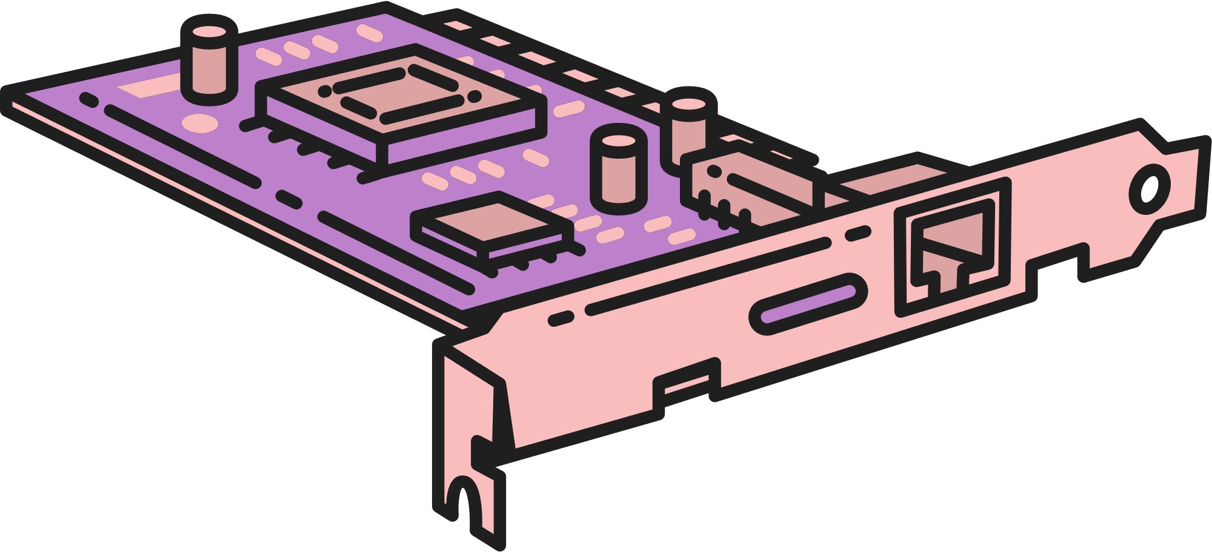
#43
THANK YOU
Page 10

