Slide 1
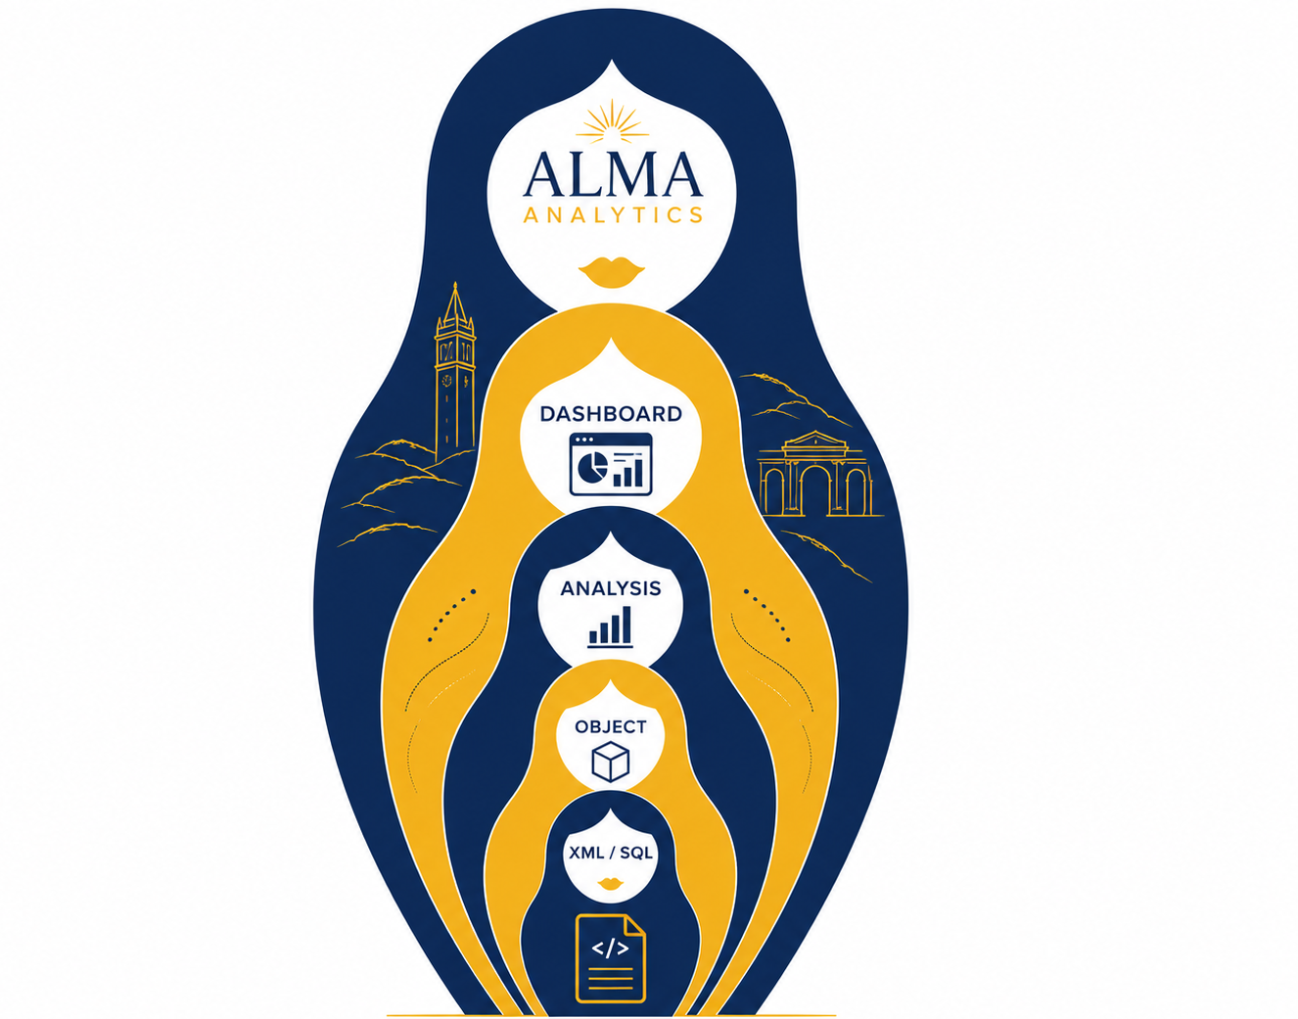
PROJECT OVERVIEW
Alma Analytics
.catalog file parser
project
From opaque catalog XML to reviewable rules, dependencies, and campus documentation
Notes:
This project makes an Alma Analytics catalog understandable outside the Alma interface. A catalog file is really a bundle of XML objects: reports, saved columns, saved filters, dashboards, and related metadata. The parser turns that bundle into a set of inspectable, spreadsheet-friendly outputs while retaining the complete XML for deeper analysis. In the next five minutes, I’ll show the problem it solves, how the pipeline works, what the current example produces, and where human review fits before campus documentation is published.
[Sources]
- README.md — project purpose and documented workflow (local repository).
- data/examples/annual_stats_fy_2025_2026.catalog — representative source archive (local repository).
[/Sources]

Slide 2
PROJECT OVERVIEW
✨ Parse-y & the Pipelines ✨
Parsey gets the data out.
Pipelines create reports.
People make it publishable.
Notes:
Serving structured data, one .catalog file at a time.
(Is this a rock band??)
This project makes an Alma Analytics catalog understandable outside the Alma interface. A catalog file is really a bundle of XML objects: reports, saved columns, saved filters, dashboards, and related metadata. The parser turns that bundle into a set of inspectable, spreadsheet-friendly outputs while retaining the complete XML for deeper analysis. In the next five minutes, I’ll show the problem it solves, how the pipeline works, what the current example produces, and where human review fits before campus documentation is published.
[Sources]
- README.md — project purpose and documented workflow (local repository).
- data/examples/annual_stats_fy_2025_2026.catalog — representative source archive (local repository).
[/Sources]

Slide 3


What is ALMA Analytics?
Ex Libris Alma Analytics is the reporting and data-analysis component of Alma, Ex Libris’s cloud-based library services platform.
UC Libraries use Alma Analytics to query and analyze data from Alma related to areas such as acquisitions, cataloging, circulation, electronic resources, and users.
Alma Analytics allows UC Libraries to turn this data into reports, tables, charts, and dashboards to support reporting, assessment, and decision-making.
https://knowledge.exlibrisgroup.com/Alma/Product_Documentation/010Alma_Online_Help_(English)/080Analytics
02

Slide 4
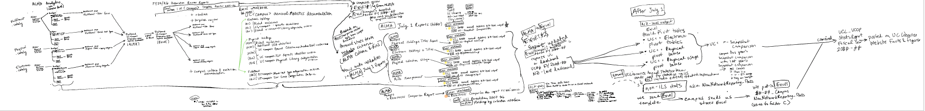
Parse-y and the Pipelines
01
Parse-y
02
Pipelines
03
People
Extract and normalize reusable evidence
Move the parsed data into reporting objects within the ALMA system and in Google Sheets/ Excel
Generate one workbook per UC worksheet for campus review and assign meaning to hard-to-read criteria
06
Notes:
This year, we created a large number of reports in Alma Analytics, using a combination of saved objects, filters, and other criteria to build the reporting we needed. The challenge was that the criteria were embedded across individual reports and objects, so getting a complete picture meant opening reports one by one and piecing the logic together.
We wanted a faster way to see that structure at scale—what criteria exist, where they are used, what objects they reference, and where there are gaps or unresolved dependencies. That became the motivation for Parsey & Pipelines: parse the Alma Analytics catalog once, preserve the relationships, and turn that underlying logic into something people can review and interpret.

Slide 5
How much reporting logic in the 2026 Annual Statistics Process?
308
761
315
450
catalog objects
column records
filter records
dependencies
Reports, saved objects, dashboards, and other XML-backed items
Inline columns, saved references, and standalone definitions
Inline filters, saved references, and standalone definitions
Distinct report-to-saved-column or saved-filter paths
150,880
individual values extracted from long IN and NOT IN filter lists
04
Notes:
This year, we built a substantial collection of reports, objects, and filters in Alma Analytics. As that collection grew, so did the challenge of seeing all the criteria and relationships behind it.

Slide 6
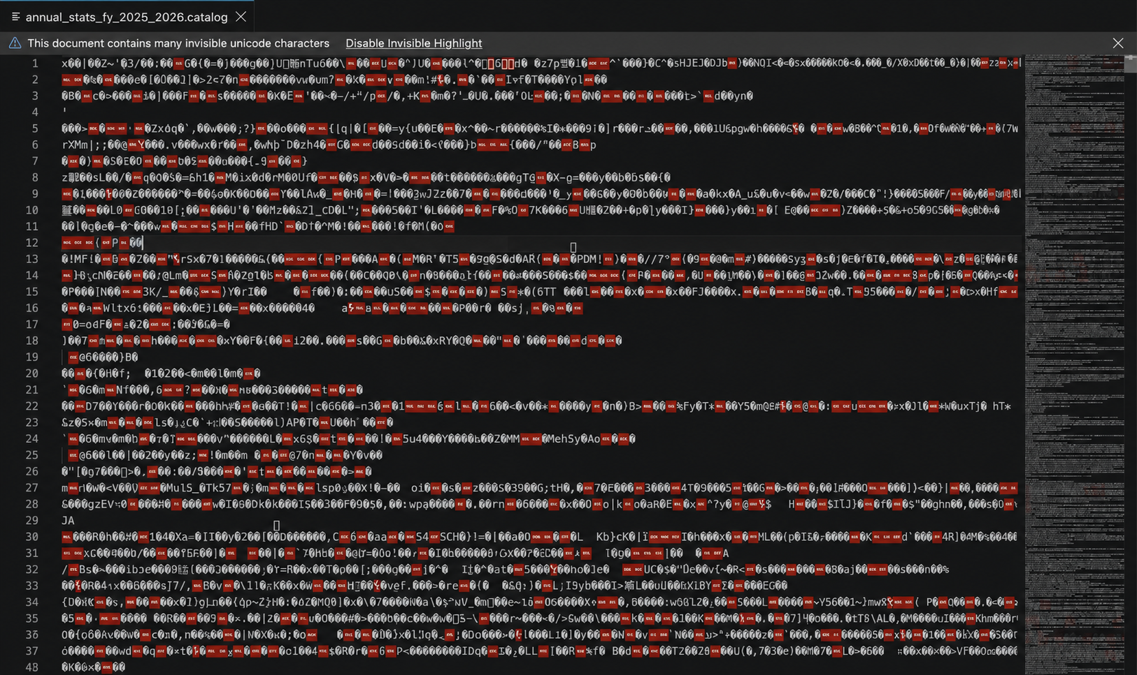
What is a .catalog file in ALMA Analytics?
Alma Analytics .catalog files are not easily readable as plain-text XML.
.catalog files contain XML-based ALMA Analytics objects, and file structures, Opening it directly in a text editor displays binary content rather than usable report definitions.
The parser decompresses the archive, finds the embedded XML objects, aligns them with their catalog metadata, and converts their definitions into reviewable datasets. The appearance shown above is expected and does not mean that the .catalog file is corrupted.
02

Slide 7
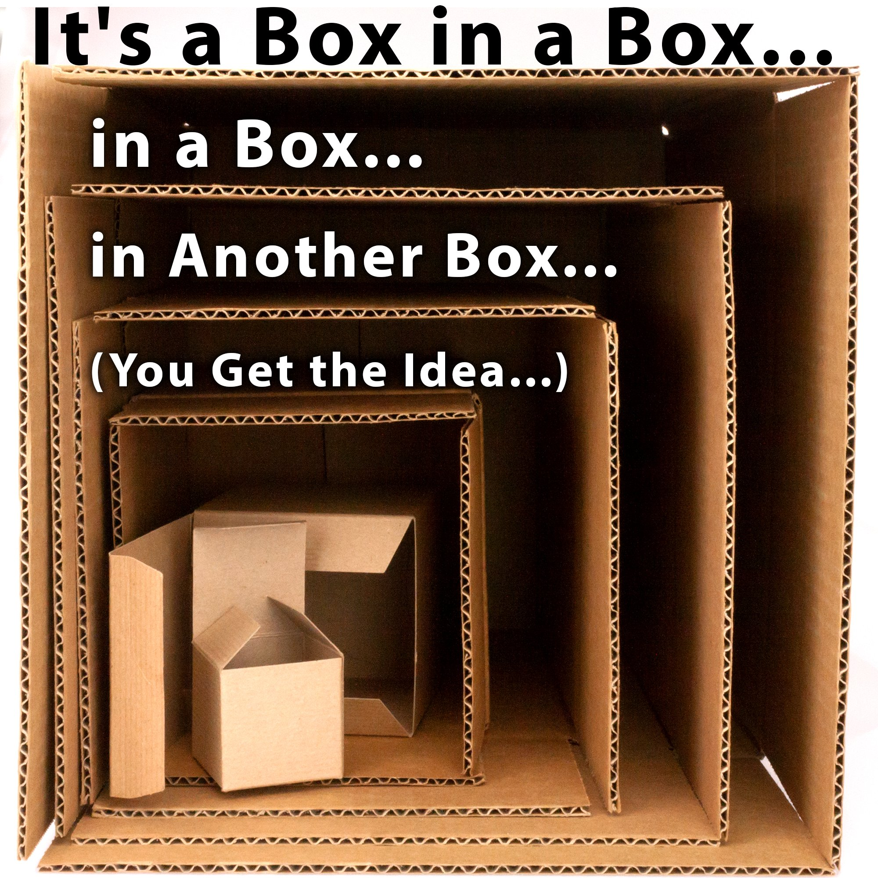
What is a .catalog file in ALMA Analytics?
However, another way of looking at it is that it is a box within a box within a box.
.catalog file— the outermost box that contains the catalog’s overall relational structure.
Analysis / Report — the outer box that organizes the information being analyzed or reported.
Object — the box within the analysis/report that represents the subject being analyzed.
Criteria — the box within the object that specifies which records or data are included, as described in Alma Analytics.
02

Slide 8
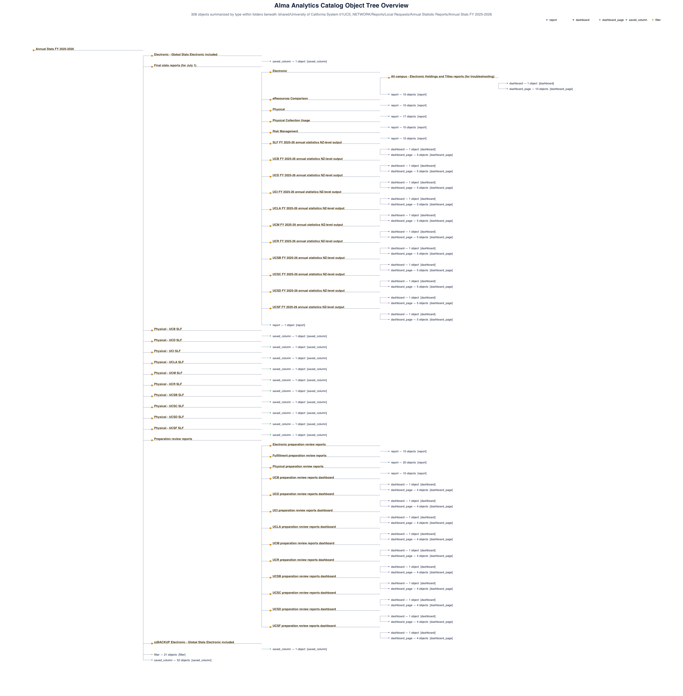
Making Hidden .catalog Relationships Visible
Alma .catalog files combine metadata, hierarchy, XML definitions, and cross-object references.
The Parse-y project aligns each object’s XML with its title, path, type, ownership, and timestamps—then exposes the result in formats people can query and review.
02
Notes:
The core problem is opacity. Inside Alma, a report may reference saved objects that live elsewhere in a shared catalog tree, and the underlying rules can be buried in nested XML. That makes it difficult to answer simple governance questions: Which objects exist? Which reports depend on which saved definitions? What does a filter or binned column actually do? The project starts by reading every object and aligning its XML with catalog metadata such as title, path, type, ownership, and timestamps. It preserves folder context, but excludes folder-only rows so the working dataset stays focused on executable or inspectable objects.
[Sources]
- README.md — shared extraction and catalog object tree sections.
- R/io/read_catalog_file.R and R/io/read_catalog_metadata.R — catalog/XML readers.
- documentation/images/catalog_object_tree.png — repository-generated hierarchy visual.
[/Sources]

Slide 9
From manual copy-and-paste to automated criteria extraction
Criteria Export: Before
(without Parse-y)
Criteria Export: After
(with Parse-y)
02

Slide 10
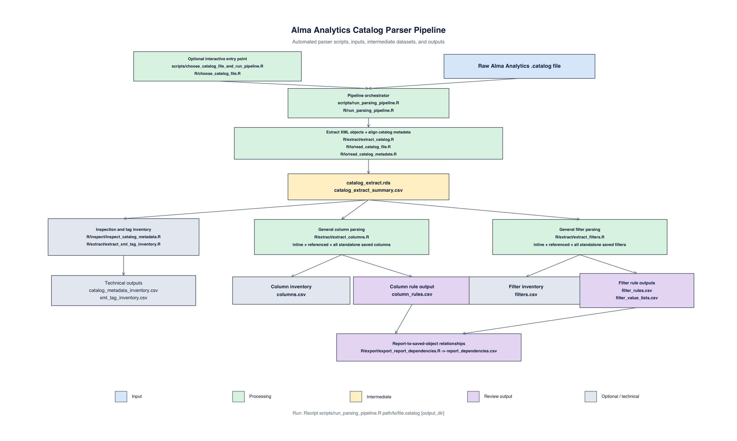
Parse Once. Branch as Needed.
Shared extract
Metadata + full XML become the foundation for every branch.
Conditional
Columns, filters, and dependencies run only when relevant objects are present.
RStudio + Codex + VSCode
03
Notes:
The automated parser is intentionally a single pipeline with reusable stages. A command-line script or an optional RStudio file chooser selects a dot-catalog file. Shared extraction creates an RDS file containing metadata plus full XML, and a CSV summary without the large XML text. Inspection branches inventory metadata patterns and XML tags. The two main parsing branches then normalize columns and filters. Finally, the dependency exporter links reports to referenced saved columns and saved filters and records whether each target resolves inside the same extract. Branches are conditional, so catalogs without a relevant object type skip outputs they do not need.
[Sources]
- R/run_parsing_pipeline.R — orchestration and conditional branches.
- scripts/run_parsing_pipeline.R and scripts/choose_catalog_file_and_run_pipeline.R — entry points.
- documentation/images/run_parser_pipeline_diagram.png — repository-generated pipeline visual.
[/Sources]

Slide 11
PROJECT OVERVIEW
Now time for the
✨Pipelines ✨ part
Parsey gets the data out.
Pipelines create reports.
People make it publishable.

Slide 12
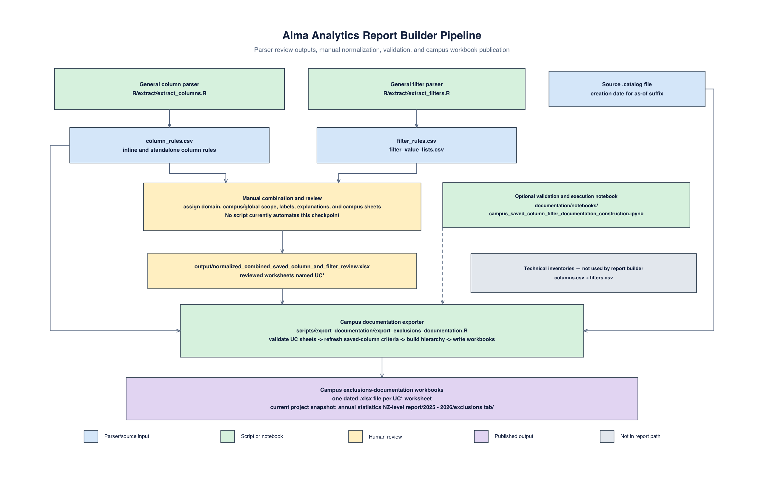
Parse-y Parses, then Humans Prepare
06
Notes:
The automated parser stops at general-purpose evidence. Publication is a separate, reviewed workflow. A normalized workbook combines saved-column and filter rules with human-maintained fields such as domain, campus scope, review labels, explanations, and campus-specific selection. The publication exporter refreshes saved-column criterion text from the latest parser output, while preserving those manual decisions. It then creates one exclusions-documentation workbook for each worksheet whose name begins with UC. This boundary is deliberate: code handles repeatable extraction and formatting, while subject-matter reviewers remain responsible for classification and interpretation.
[Sources]
- README.md — reviewed publication workflow.
- scripts/export_documentation/export_exclusions_documentation.R — campus workbook publication logic.
- documentation/images/run_report_builder_pipeline_diagram.png — repository-generated publication workflow visual.
[/Sources]

Slide 13
Upstream and Downstream (EDIT)))
01
Automate
02
Review
03
Publish
Extract and normalize reusable evidence
Add campus scope, labels, and explanations
Generate one workbook per UC worksheet for campus review
06
Notes:
The automated parser stops at general-purpose evidence. Publication is a separate, reviewed workflow. A normalized workbook combines saved-column and filter rules with human-maintained fields such as domain, campus scope, review labels, explanations, and campus-specific selection. The publication exporter refreshes saved-column criterion text from the latest parser output, while preserving those manual decisions. It then creates one exclusions-documentation workbook for each worksheet whose name begins with UC. This boundary is deliberate: code handles repeatable extraction and formatting, while subject-matter reviewers remain responsible for classification and interpretation.
[Sources]
- README.md — reviewed publication workflow.
- scripts/export_documentation/export_exclusions_documentation.R — campus workbook publication logic.
- documentation/images/run_report_builder_pipeline_diagram.png — repository-generated publication workflow visual.
[/Sources]

Slide 14
PROJECT OVERVIEW
Now time for the
✨People ✨ part
Parsey gets the data out.
Pipelines create reports.
People make it publishable.

Slide 15
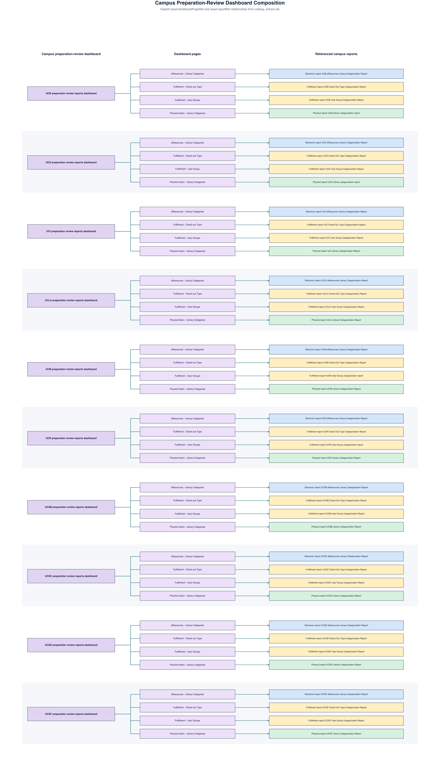
Connecting Campus Reports to Analytics Objects
The name people used for a report did not always match the name of the Alma Analytics object behind it. A report might be known by a familiar operational or local name, while its underlying Analytics object had a different title or lived under a different name in the shared catalog.
Inline logic
stays attached to its ALMA Analytics report
Saved columns/ filters
remain present even when unreferenced in campus deliverables
Dependency rows
record target path and connection status
05
Notes:
A key design choice is to preserve references instead of flattening everything. Report rows identify inline logic and references to saved objects. Standalone saved columns and saved filters remain in the outputs even when no report currently references them. When a report does reference a saved definition, the dependency export records the path and whether a matching object was found in the catalog. This makes unresolved references visible and avoids duplicating a saved rule into every consuming report. The same extract can also reveal explicit dashboard-to-page-to-report relationships, complementing the folder hierarchy with actual object references.
[Sources]
- README.md — column, filter, dependency, and dashboard relationship behavior.
- R/extract/extract_columns.R, R/extract/extract_filters.R, and R/export/export_report_dependencies.R — implementation.
- documentation/images/preparation_review_dashboard_relationships.png — repository-generated relationship visual.
[/Sources]

Slide 16
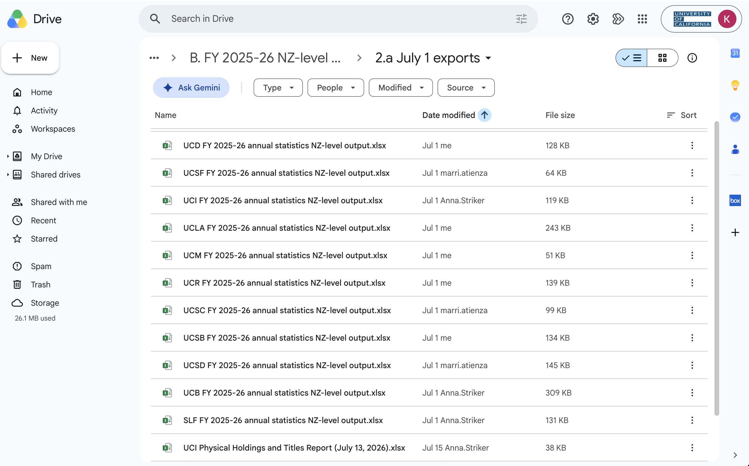
Humans importing and reviewing historical data
The Alma Analytics technical team had to import historical July 1 data and analyze it alongside current data to support meaningful year-over-year comparisons.
  Physical Collection Usage
  Snapshot comparison
  Risk Management
  eResources comparison - the collections themselves change over time, making it necessary to account for differences in what was available from year to year.
05
Notes:
The Alma Analytics technical team had to import historical data and analyze it alongside current data to support meaningful year-over-year comparisons.

Slide 17
THE TAKEAWAY
Parsey gets the data out.
Pipelines create reports.
People make it publishable.
Run
Review
Publish
Parse a new .catalog archive
Check rules and unresolved references
Create campus-specific workbooks
Notes:
In short, the project provides three durable capabilities. First, it preserves a faithful machine-readable extract of the catalog. Second, it translates column, filter, and dependency logic into tables that people can review and test. Third, it supports a controlled handoff from automated evidence to campus-specific documentation. The current base-R fixture assertions pass, providing a lightweight verification path even when the optional testthat package is unavailable. The practical next step is to run the parser on a new catalog, review unresolved references and normalized rules, and only then publish the campus workbooks.
[Sources]
- README.md — documented operating workflow and outputs.
- tests/testthat.R — fallback test runner; base-R fixture assertions observed passing on 2026-08-11.
[/Sources]

