Slide 1
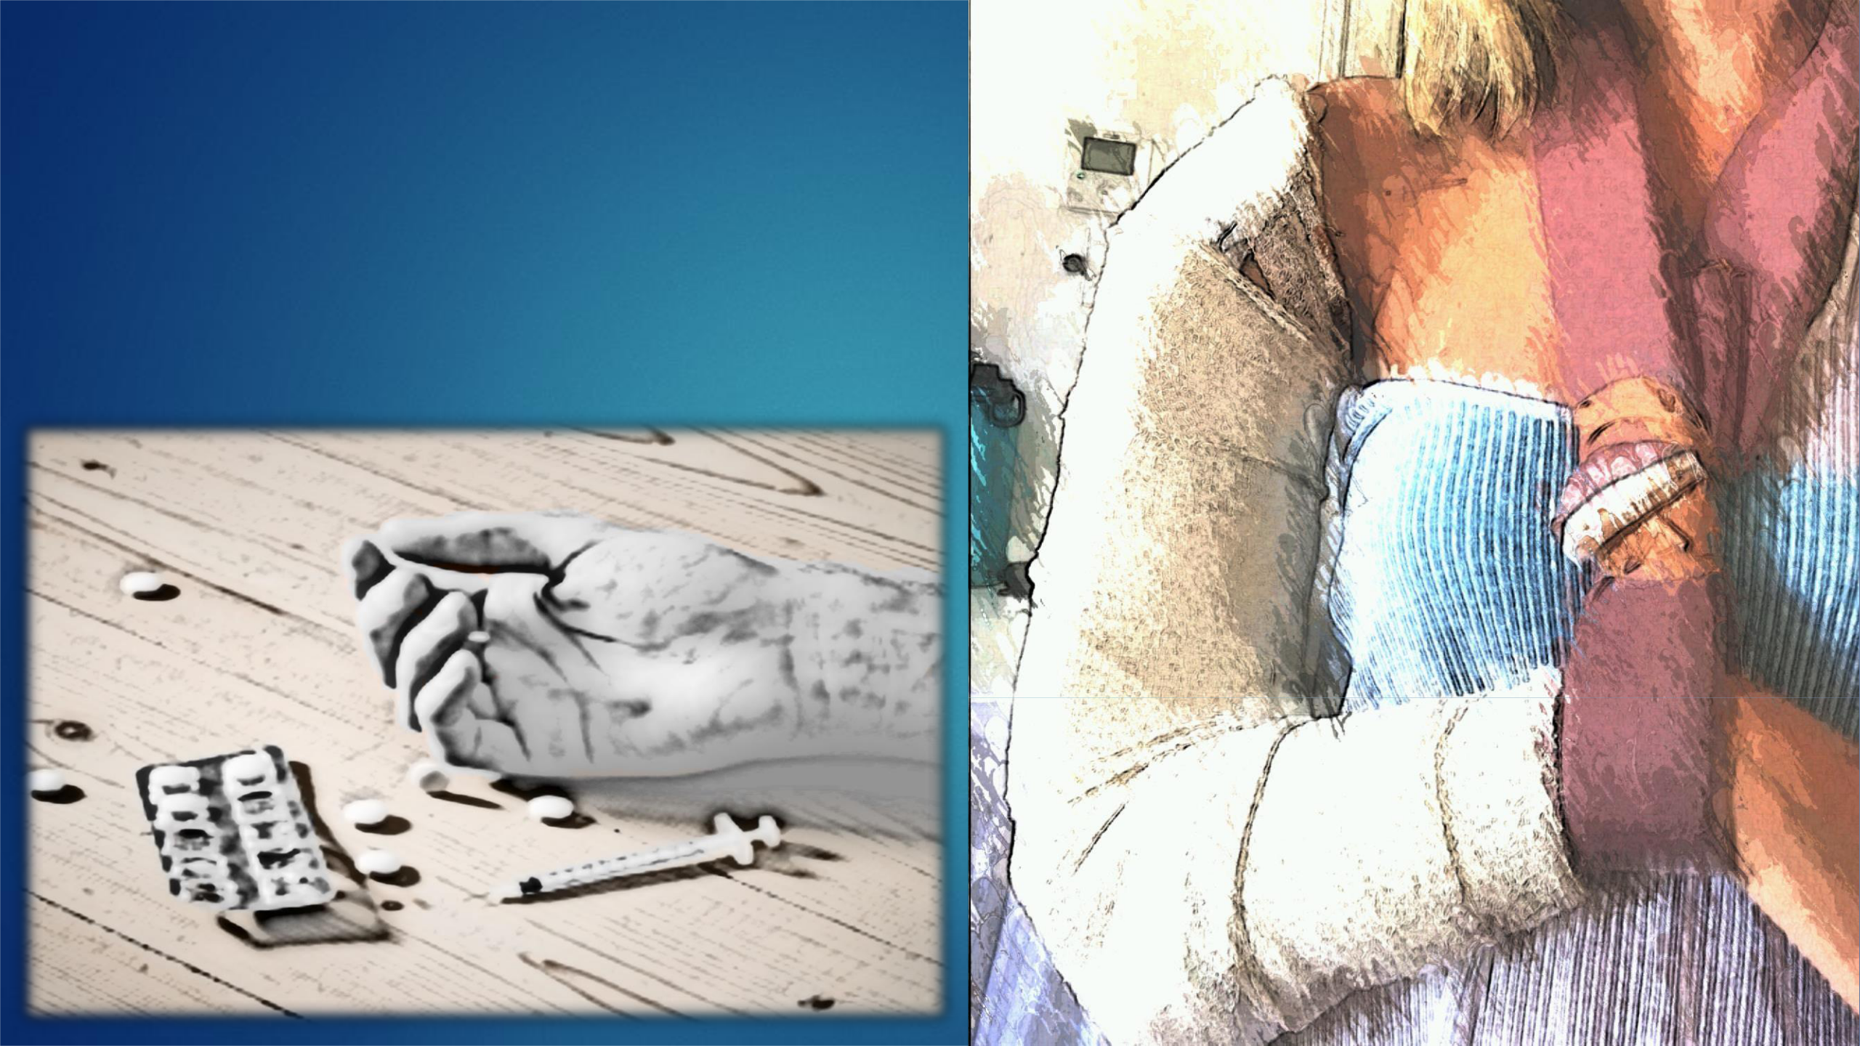
Codiene , Tramadol, Morphine, Fentanyl, Buprenorphine etc
Over 4000 people died from opioid poisoning in 2018
GPs prescribed 23.8m opioids in 2018 ie 2700 pack/hour
Pain killers are prescribed 4x more in N/England than London
Drowsiness, Respiratory depression, Pinpoint pupils, Falls etc
OPIOIDS CAN KILL TOO
Source: www.practicalpainmanagement.com

