Slide 1
Demo End-to-End Deep Learning Pipeline
Enhao Gong
07-13-2017

Slide 2

Frameworks and Repositary
We are using Keras in this demo which uses TensorFlow as backend on Longo
PyTorch is another framework that becomes more and more popular
Repositaries
Super-Resolution with GAN using Keras: https://github.com/titu1994/Super-Resolution-using-Generative-Adversarial-Networks
Super-Resolution with GAN using TF: https://github.com/david-gpu/srez
Super-Resolution using py-torch: https://github.com/pytorch/examples/tree/master/super_resolution
Fast-Neural-Style using py-torch: https://github.com/jcjohnson/fast-neural-style https://github.com/bengxy/FastNeuralStyle
cycle-GAN from Junyan Zhu at Berkeley: https://github.com/junyanz/pytorch-CycleGAN-and-pix2pix
ML/DL for MRI from Peng Cao at UCSF: https://github.com/peng-cao/mripy

Slide 3
Summary
Copy the demo folder on Longo: /data/enhaog/data_lowdose/
Include dataset and script
Run from directory: /data/enhaog/data_lowdose/scripts
Deep Learning framework: Keras + TF
Input/Output:
Low-dose and Normal-dose PET
DICOM→NIfTi→ using dicom2nifti and nibabel
https://github.com/icometrix/dicom2nifti
http://nipy.org/nibabel/nifti_images.html
Input and output volumes are normalized by norm and re-scaled
Network structure
Encoder-Decoder with by-passes
Control number of poolings and convolution layers between poolings
Control input size, 8x augmentations and number of epochs

Slide 4
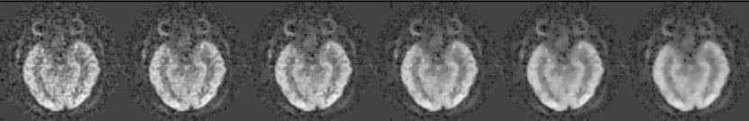
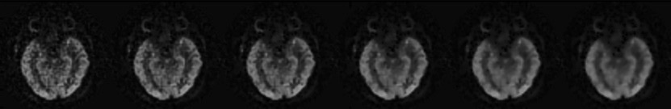
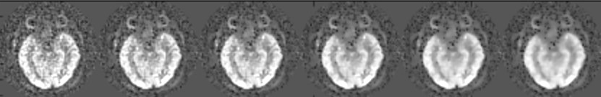
network structure
3x3 Conv-BN-ReLU
2x2 Max-Pooling
C
Concatenate (by-pass connection)
by-pass connection
2x2 Up-Sampling
1x1 Conv
+
Add
+
Feature
Map#
16+32 32 32
2
16 16 16
C
1
1
32 32 32
64+32 32 32
C
64 64 64
64+128 64 64
C
128 128 128
Raw
Input
Multi-
contrast
Encoder Layers
Decoder Layers
Predicted
Residual
Predicted
Output

Slide 5
Code Structure
Modules
Compute image metrics: Cafndl_metrics.py
Define network structures: Cafndl_network.py
Define fileio with nifti: Cafndl_fileio.py,
Utility functions (e.g. augmentations): Cafndl_utils.py
Scripts
Script_demo_train.py:
train on 1 dataset 256x256 with 89 slices and x8 augmentations
Network weights 409729
Train on 640 samples, validate on 72 samples
100 epochs w.r.t. L1 loss, taking 30min on Longo
Save optimal network weights to checkpoint file, export figure and json file for loss evolution
Script_demo_test.py:
test on 2 datasets, 256x256 each with 89 slices, no augmentations
predict on data size (178, 256, 256, 1) using time 0:00:02.464291
Export image comparison for testing slices and export error to json file
Notes:
rain model:', '../ckpt/model_demo_0001.ckpt')
('parameter count:', 409729)
model load from../ckpt/model_demo_0001.ckpt
predict on data size (178, 256, 256, 1) using time 0:00:02.464291
({'psnr': 31.183662092903507, 'ssim': 0.90931757893042342, 'score_ismrm': 9845.8792026182691, 'rmse': 1.4314661005946721}, {'psnr': 37.24171026439636, 'ssim': 0.93120771235885713, 'score_ismrm': 9979.1728652186848, 'rmse': 0.71265388844505706})
sample #0, input PSNR 31.1837, SSIM 0.9093, predict PSNR 37.2417, SSIM 0.9312
({'psnr': 36.23487050384928, 'ssim': 0.94283289575688012, 'score_ismrm': 9949.7605777533554, 'rmse': 0.88745766045962593}, {'psnr': 41.464044630517314, 'ssim': 0.96810491875837401, 'score_ismrm': 9999.0187612842456, 'rmse': 0.48605894086667306})
sample #1, input PSNR 36.2349, SSIM 0.9428, predict PSNR 41.4640, SSIM 0.9681
({'psnr': 37.160331265379703, 'ssi

Slide 6
Specify for training
filename_checkpoint = '../ckpt/model_demo.ckpt’
filename_init = ””
list_dataset_train =
[
{'input':'/data/enhaog/data_lowdose/GBM_Ex1496/DRF100_nifti/803_.nii.gz',
'gt':'/data/enhaog/data_lowdose/GBM_Ex1496/DRF001_nifti/800_.nii.gz’}
]

Slide 7
Specify for testing
filename_checkpoint = '../ckpt/model_demo.ckpt’
list_dataset_test =
[
{ 'input':'/data/enhaog/data_lowdose/GBM_Ex1496/DRF100_nifti/803_.nii.gz', 'gt':'/data/enhaog/data_lowdose/GBM_Ex1496/DRF001_nifti/800_.nii.gz'},
{ 'input':'/data/enhaog/data_lowdose/GBM_Ex842/DRF100_nifti/803_.nii.gz', 'gt':'/data/enhaog/data_lowdose/GBM_Ex842/DRF001_nifti/800_.nii.gz'}
]
filename_results = '../results/result_demo_0001'

Slide 8
Data format
Conversion from DICOM to NIFTI
$ mkdir DRF100_nifti
$ dicom2nifti DRF100 DRF100_nifti
Conversion from .mat to NIFTI
http://www.mathworks.com/matlabcentral/fileexchange/8797-tools-for-nifti-and-analyze-image
https://sites.google.com/site/kittipat/mvpa-for-brain-fmri/convert_matlab_nifti

Slide 9
Dependencies
import numpy as np
import os
import datetime
from cafndl_fileio import *
from cafndl_utils import *
from cafndl_network import *
from keras.callbacks import ModelCheckpoint
From keras.optimizers import Adam

Slide 10
Augmentation
'''augmentation''’
list_augments = []
num_augment_flipxy = 2
num_augment_flipx = 2
num_augment_flipy = 2
num_augment_shiftx = 1
num_augment_shifty = 1

Slide 11
Network setup
'''setup parameters''’
# related to model
num_poolings = 3
num_conv_per_pooling = 3
# related to training
lr_init = 0.001
num_epoch = 100
batch_size = 4
ratio_validation = 0.1
# default settings
num_channel_input = data_train_input.shape[-1]
num_channel_output = data_train_gt.shape[-1]
img_rows = data_train_input.shape[1]
img_cols = data_train_gt.shape[1]
# Be nice to not use all GPU resources
keras_memory = 0.4
keras_backend = 'tf’
with_batch_norm = True
1st: Just run with specified input and output NIFTI filepaths using default parameters
2nd: (if want to explore more) setup these parameters to change model complexity
3rd: (Optionally) Setup these parameters to change model training

Slide 12
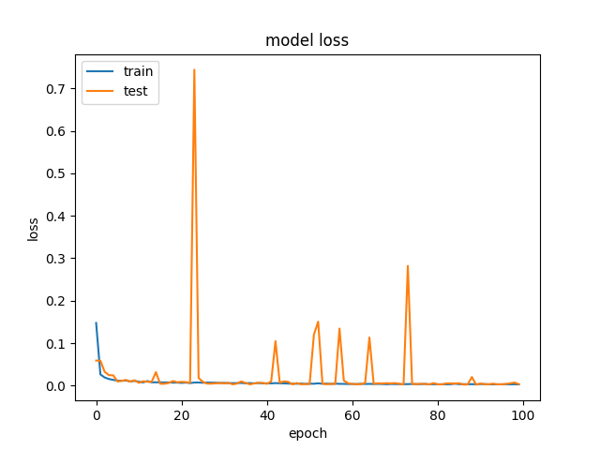
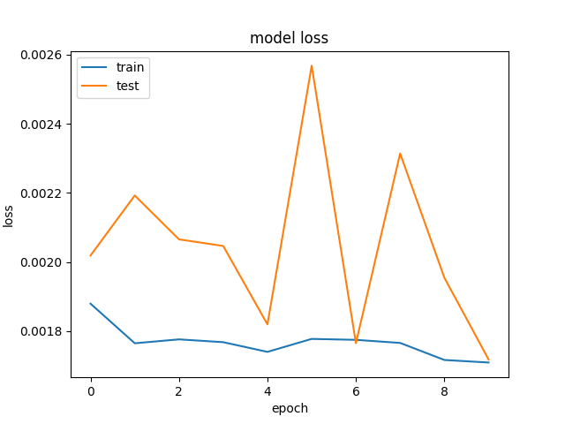
Error Evolution

Slide 13
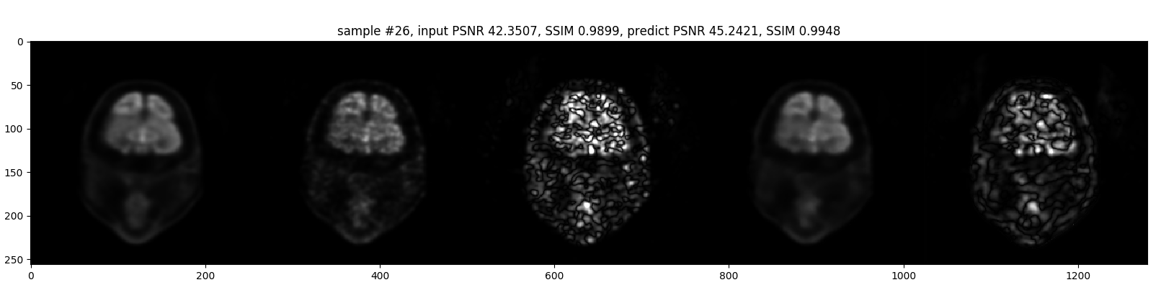
Image Comparison
Full-dose
1% Dose
10xError
DL Recon
10xError

Slide 14
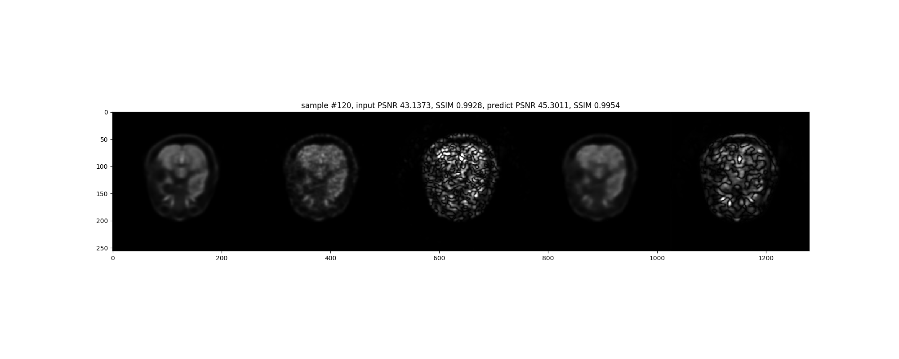
Image Comparison
Full-dose
1% Dose
10xError
DL Recon
10xError

Slide 15
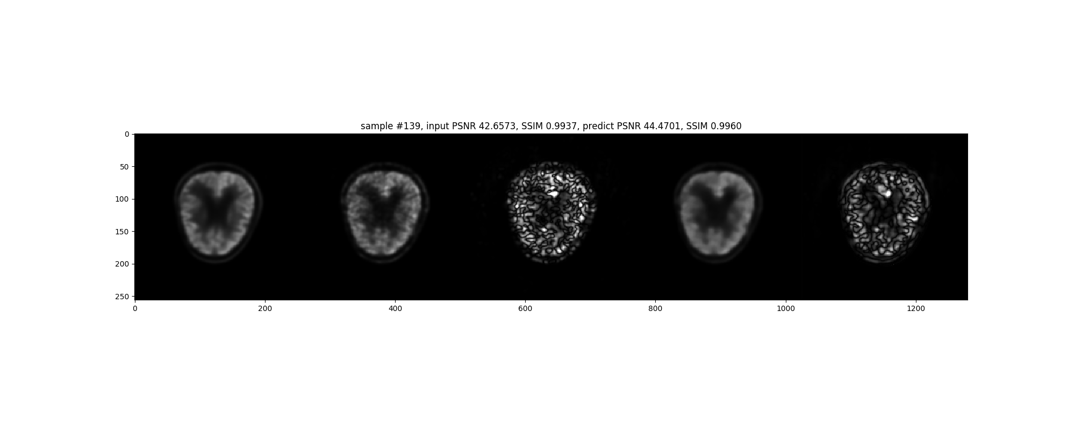
Full-dose
1% Dose
10xError
DL Recon
10xError

Slide 16
Metrics: 3dB PSNR gain, 40% RMSE reduction
 | Raw Input | DL Output
PSNR | 49.5dB | 52.4dB
SSIM | 0.9912 | 0.9954
RMSE | 81.65% | 47.92%
err=json.load(open('../results/result_demo_0713_error.json','r'))
>>> np.mean([x['psnr'] for x in err['err_input']])
49.504403889841711
>>> np.mean([x['psnr'] for x in err['err_pred']])
52.427994401663852
>>> np.mean([x['ssim'] for x in err['err_pred']])
0.99537973032124527
>>> np.mean([x['ssim'] for x in err['err_input']])
0.9912470852512274
>>> np.mean([x['rmse'] for x in err['err_input']])
0.81647482010468753
>>> np.mean([x['rmse'] for x in err['err_pred']])
0.47915047153748297

Slide 17
Next release
Input with multi-contrast and NLM feature augmentation
More CPU memory friendly Patch augmentation
Consider masking for sampling and error metrics
Better interfaces to set parameters from commend-line

Slide 18
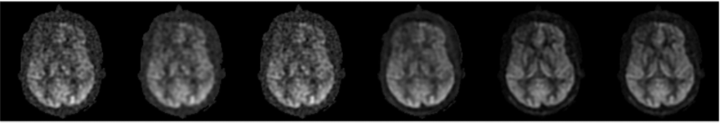
updates
ASL paper
Patient datasets
TGV
Low-contrast
86 datasets, nifti pipeline, co-registration
Low-dose
2.5D, cost functions, networks

