Slide 1

2nd Training Session on High-Performance Computing (HPC)
Presentation covers
Accessing to the Kristiania-HPC server
Job scheduling and submission procedures
File transfer methods
Intro to Kristiania-HPC specification
Accessing software resources
PPT
Demonstration
Presented By:
Guru Bhandari

Slide 2
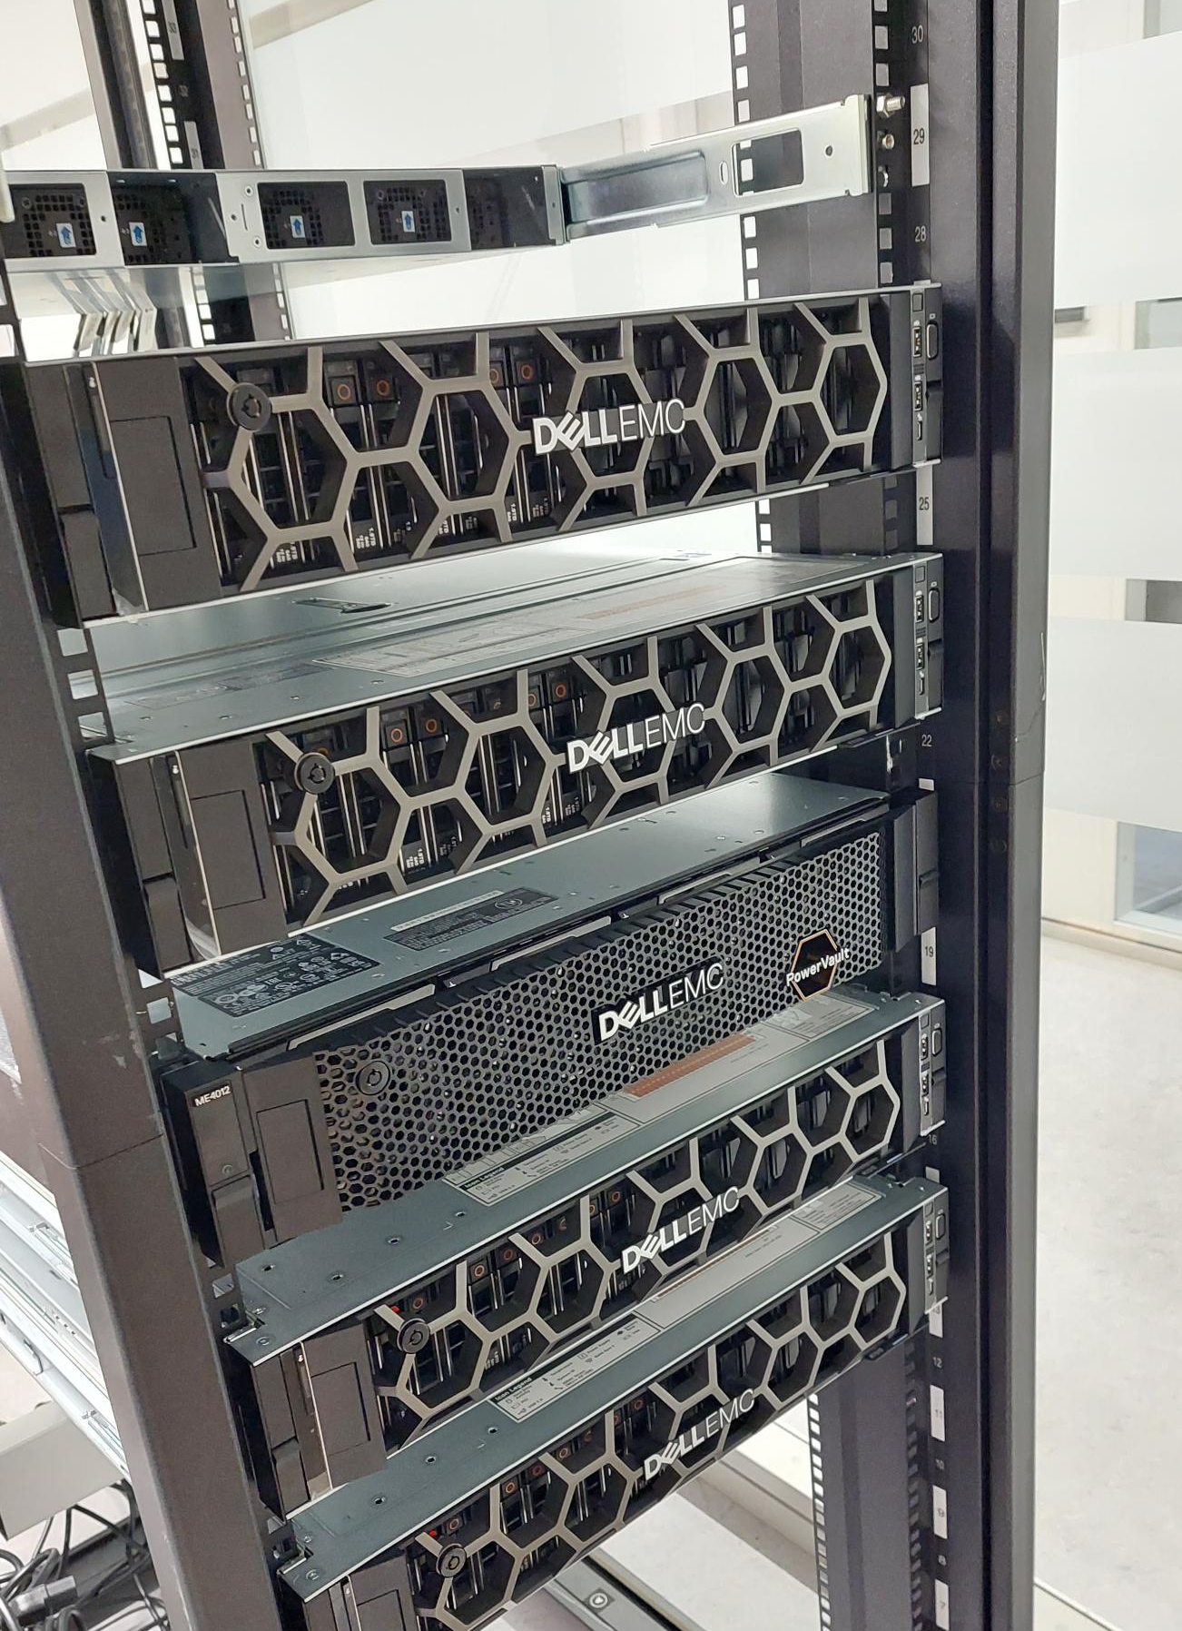
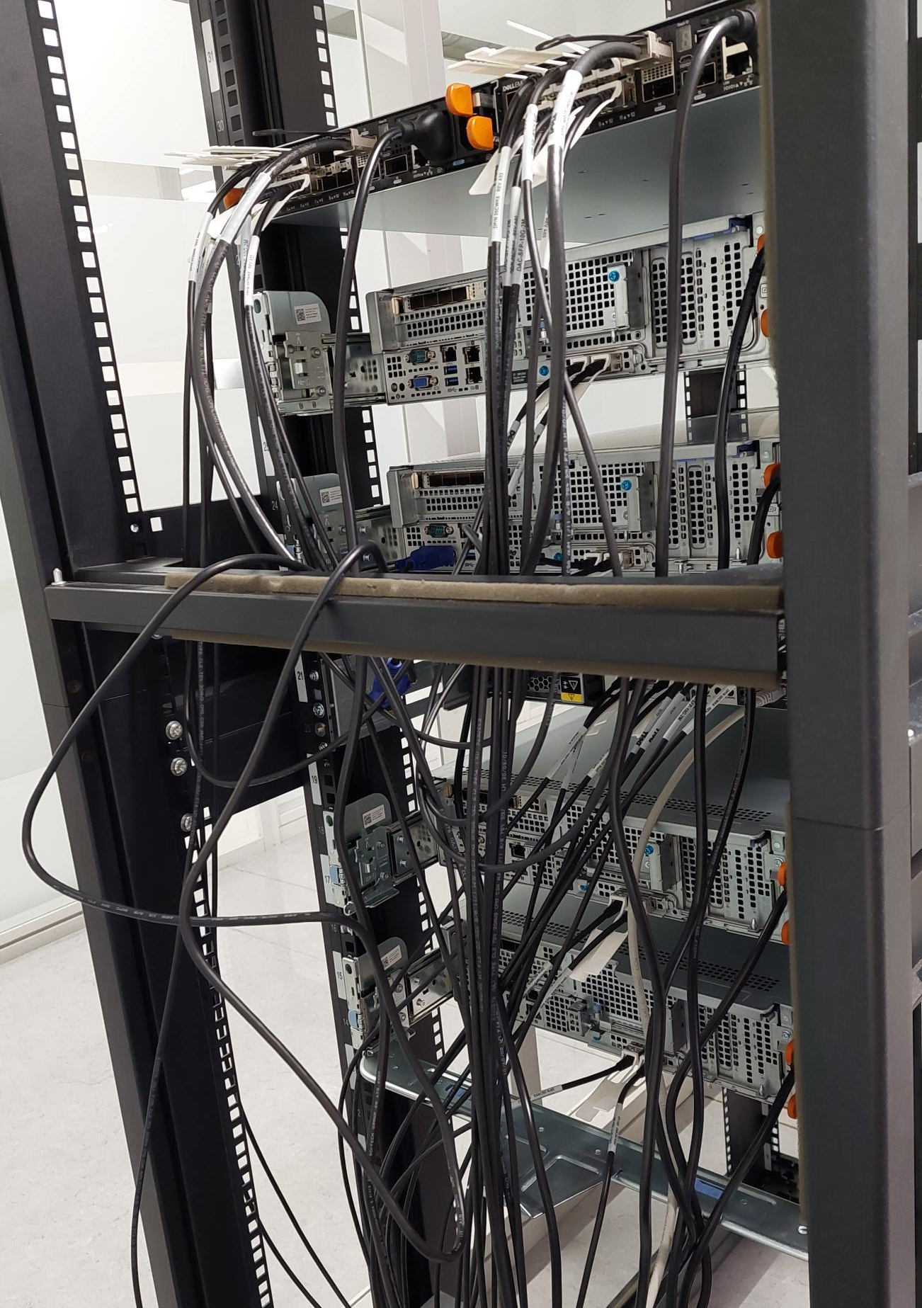
Physical Location:
Kirkegata-17, 3rd floor – a dedicated place for HPC

Slide 3
Benefits of using HPC:
Big data analysis
Sequential and parallel computationally expensive tasks
Collaborating in research projects
Storage and sharing of big data
Utilization of high bandwidth
Low consumption of the power ☺
Increase the life span of your PC/laptop ☺
Time saving
Security

Slide 4
Kristiania towards High-Performance Computing (HPC)
Storage
Server1
Server3
Server2
Server4
4 servers
Dell PowerEdge R7515
AMD 7542 2.9PGz, 32C/64T128M, 225W, 3200
24TB SAS/SATA storage (upto 192TB)
256 GB memory
1 Persistent Storage
Dell EMC ME4012 Storage Array
192TB hard drives
2 Switches
Dell EMC S4112
Switch1
Switch2
Prepared By:
Guru Bhandari

Slide 5
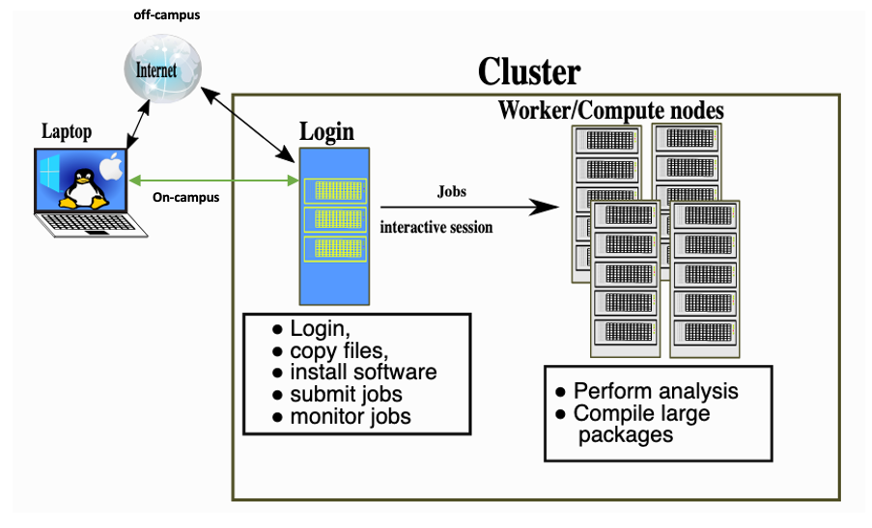
Workload management
Source: https://training.pages.sigma2.no/tutorials/hpc-intro/index.html

Slide 6
Resource Sharing Strategy
HPC Cluster
4 hosts/1TB memory
Storage
192 TB
Virtual to login
100 GB HDD
Employee1
Virtual to login
100 GB HDD
Employee2
Virtual to login
100 GB HDD
Student1
Virtual to login
100 GB HDD
Student2
Virtual to login
100 GB HDD
Student2
…..
…
Host OS/Ubuntu
Server OS
FIFO/SJF
Resource Scheduler
Type: open
Open to all
Big jobs
Restricted
CPU/GPU-centric
No versioning
Less persistent
Backfill scheduling
Small Job First (SJF)

Slide 7
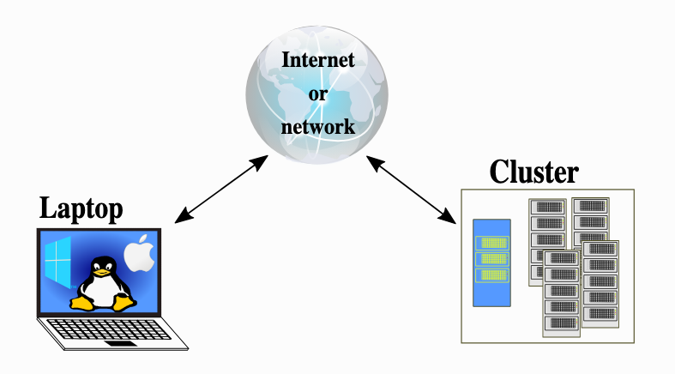
Off-campus access
On-campus access
Available at Student/EGMS network
For students:
Follow https://www.kristiania.no/en/for-students/it-support/vpn/
Go to https://vpnstudent.kristiania.no
Download and install ‘global protect’ app
Go to the app and enter ‘vpnstudent.kristiania.no’ in the portal address
Click ‘connect’
Enter username and password and login
Done!
For employee (PhD too):
https://www.kristiania.no/for-ansatte/it/vpn-ansatt/
Download and install ‘global protect’ app
Go to the app and enter ‘saml-intern.kristiania.no’ in the portal address
4 to 6 same as student
Notes: Linux user: https://docs.paloaltonetworks.com/globalprotect/5-1/globalprotect-app-user-guide/globalprotect-app-for-linux

Slide 8
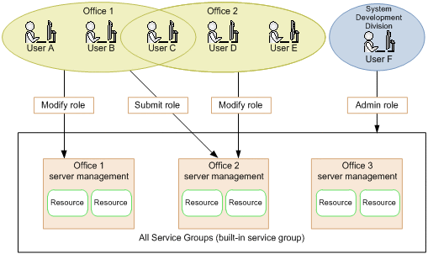
Users, groups, and access control configuration
Users: Graduate students, PhD students, researchers, and employees
Groups: admins, SEIT, department, projects, external users?
Home Dir: 100 GB
Project Dir: 1TB

Slide 9

Doing list…
Ticketing tool for HPC support system
Note: IT department uses service-now.com, and it is a nice ticketing tool that can also be used for HPC support for submitting enquires and tracking the status.
A separate email address for HPC- hpc@kristiania.no. --- granted
HPC site- https://kristiania-hpc.github.io/.
A short description and link of the HPC site to Kristiania’s research portal (or IT portal?).
An HPC team for internal communication at Microsoft Teams to discuss HPC-related topics and announce updates/upgrades to the system.

Slide 10
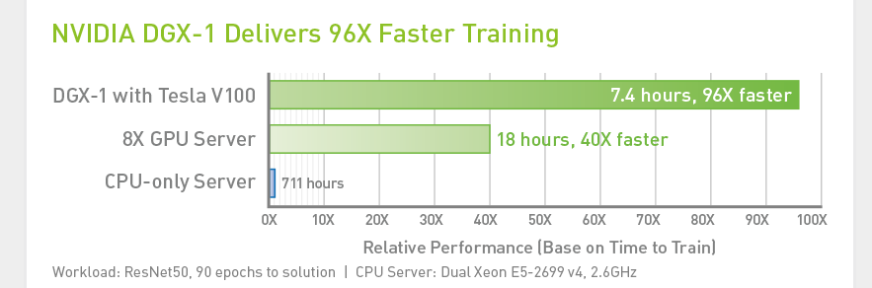
Additional Hardware Items
Graphics Processing Unit (HPC), since it is essential for executing multiple parallel jobs like matrix multiplication of neural networks that can be done very fast with GPUs.
UPS for HPC cluster
Why GPU?
Iterate and innovate faster
High-performance training accelerates your productivity, which means faster time to insight and faster time to market.

Slide 11
Recurrent meetings and trainings:
Meeting once every next month
updates/upgrades, announcements, current status, and management policies.
Training on HPC to the researchers/graduates
once every six months (or twice).
Proposed By:
Guru Prasad Bhandari
System Engineer/Researcher
Kristiania University College

Slide 12
How to use Kristiania-HPC cluster?
https://kristiania-hpc.github.io/
https://github.com/kristiania-hpc/examples
https://training.pages.sigma2.no/tutorials/hpc-intro/episodes/12-cluster.html

Slide 13
Demo
Question???

