Slide 1
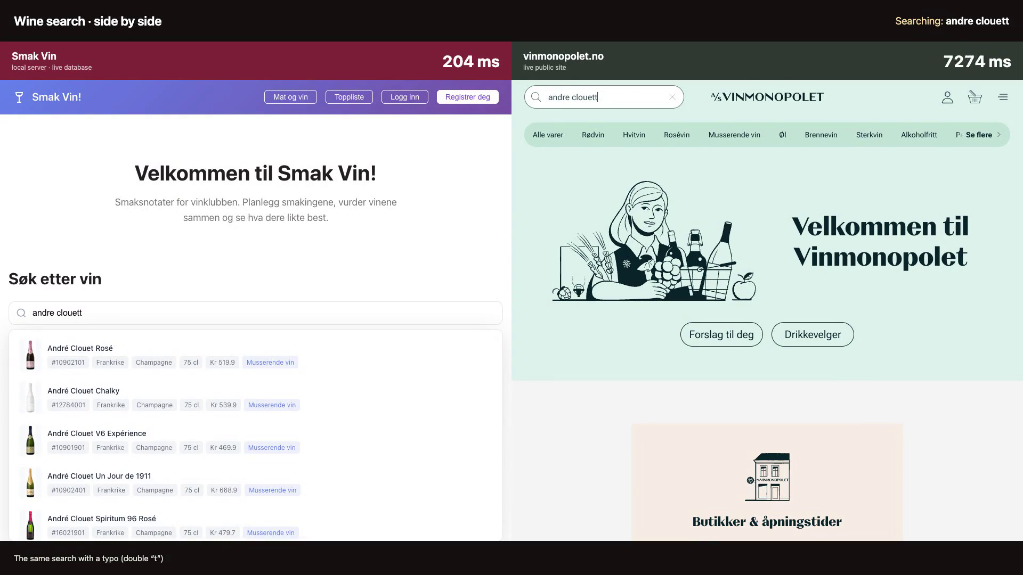
Fairer scoring of tasting notes
Champagne tasting, 13 May 2026 · Champagne Aubry Premier Cru Brut · aroma (lukt)
SAME WINE · SAME OFFICIAL NOTE · ONLY THE TASTER DIFFERS
WHAT VINMONOPOLET WROTE
AND: WINE SEARCH, SIDE BY SIDE
“Litt utviklet og mineralsk, preg av gule epler, steinfrukt, kjeks, litt sitrus, røde bær og flint.”
Tasters are now credited for the aromas they name. Aromas they leave out are ignored, and vague or wrong guesses cost them.
Taster A
REWARDED
“Rødt eple sitrus mineralsk”
BEFORE
NOW
71
→
93
eple — named in the wine
sitrus — named in the wine
+22
mineral — named in the wine
Taster B
CORRECTED
Click to play · 37 seconds
“Mineral. Frukt. Nøtt. Krydder”
BEFORE
NOW
Smak Vin
vinmonopolet
83
→
55
mineral — named in the wine
andre clouet
173 ms
441 ms
frukt — right family, but vague
-28
andre clouett (typo)
204 ms
no results
nøtt — not in this wine
krydder — not in this wine
10902101 (product id)
127 ms
no results
Our page runs on a local server; theirs is the live site. Both search over the internet.
Also new: “brioche” now counts — the official taste note says “bakverk”, and both come from ageing on the lees. That note went 72 → 93.
The old score ranked these backwards. Taster B's vaguer note scored higher (83 vs 71). Now the accurate note wins, 93 to 55.

