Slide 1
Q-learning vs Double Q-learning
Kristian Angeli Pajanonot

Slide 2
Reinforcement Learning
Overview
Agent
Observation,
Reward
Actions
Environment
Reinforcement Learning
One large challenge in reinforcement learning is the exploration-exploitation dilemma.
- The agent should exploit known actions in order to maximize its total reward
- The agent should explore unknown actions in order to discover actions that are more rewarding than the ones it already knows
$ε$-greedy method – to balance between exploration and exploitation

Slide 3
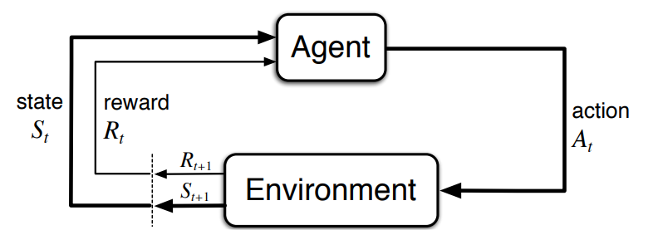
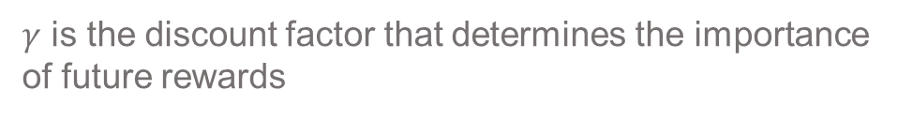

Reinforcement Learning
Markov Decision Process
Many reinforcement learning problems can be mathematically formalized as finite Markov decision processes
The agent–environment interaction in a Markov decision process
Consider episodic problems: During an episode, the agent tries to maximize the total expected discounted return
$$G_{t}=R_{t+1}+ γR_{t+2}+ γ^{2}R_{t+3}+ …$$
(1)
$γ$ is the discount factor that determines the importance of future rewards
Image Source: Sutton and Barto, 2018

Slide 4
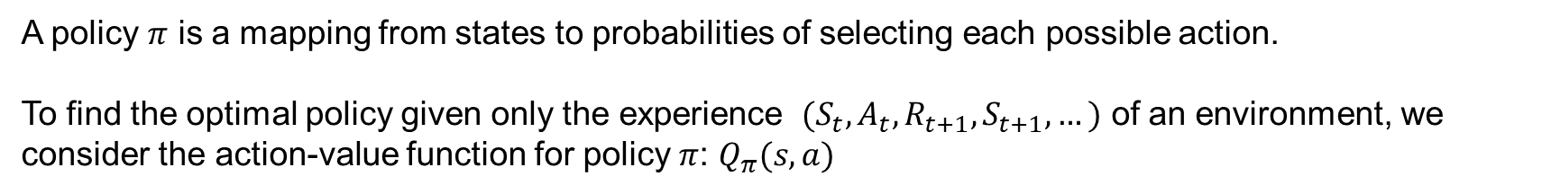


Reinforcement Learning
Markov Decision Process
A policy $π$ is a mapping from states to probabilities of selecting each possible action.
To find the optimal policy given only the experience ${ (S}_{t},A_{t},R_{t+1},S_{t+1}, …)$ of an environment, we consider the action-value function for policy $π$: $Q_{π}(s,a)$
$$Q_{π}\left(s,a\right)= E_{π}\left[G_{t}\right|S_{t}=s, A_{t}=a]$$
(2)
Once one finds the optimal value $Q^{∗}\left(s,a\right)$:
$$Q^{∗}\left(s,a\right)=E[R_{t+1} +γ \max_{a^{′}}Q^{∗}\left(S_{t+1}, a^{′}\right)|S_{t}=s,A_{t}=a]$$
(3)
The optimal policy is easily found just by taking the action that maximizes it.
$$π^{∗}\left(a,s\right)={argmax}_{a}Q^{∗}\left(s,a\right)$$
(4)

Slide 5
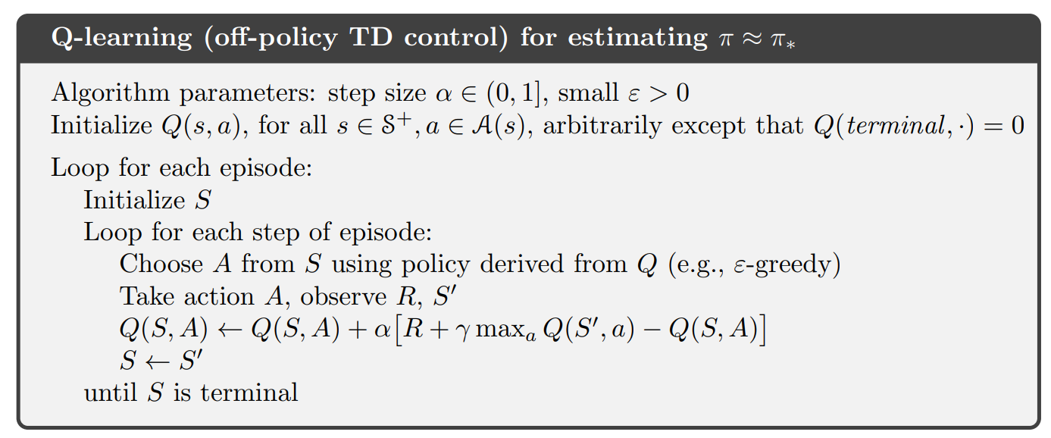
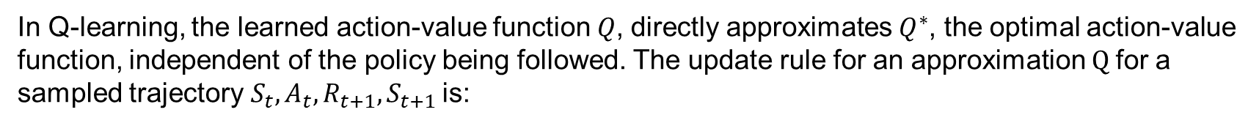

Q-learning
Algorithm
In Q-learning, the learned action-value function $Q$, directly approximates $Q^{∗}$, the optimal action-value function, independent of the policy being followed. The update rule for an approximation $Q$for a sampled trajectory${ S}_{t},A_{t},R_{t+1},S_{t+1}$ is:
$α$ is the step size
Image Source: Sutton and Barto, 2018

Slide 6
Maximization (Overestimation) Bias
Problem with Q-learning
The overestimation bias occurs since the $\max_{a} Q(S_{t+1},a)$ is used in the Q-learning update.
In Q-learning, the maximum over estimated values is used as an estimate of the maximum of the true values. To see why:
Consider the case that there is some source of random approximation error, such as stochastic rewards. Therefore, for all actions $a$, we have:
$$Q\left(S_{t+1},a\right)=Q^{∗}\left(S_{t+1},a\right)+ e(S_{t+1},a)$$
(5)
||
0
$e(S_{t+1},a)$is a positive or negative noise term
The estimated values $Q\left(S_{t+1},a\right)$ are uncertain and distributed some above and some below zero
The maximum of the true values is zero, but the maximum of the estimates is positive, a positive bias – maximization bias

Slide 7
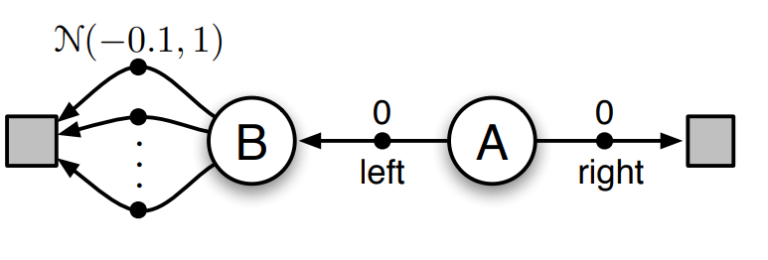
Maximization Bias: Example
Problem with Q-learning
C
D
An episodic finite Markov decision process to highlight the problems caused by overestimation bias
A and B are non-terminal states. A is the starting state. C and D are terminal states.
The agent can take two actions: left and right
Reward from taking the actions:
A to B = 0
A to D = 0
B to C = normal distribution with mean -0.1 and variance 1.0
Example from Sutton and Barto, 2018

Slide 8
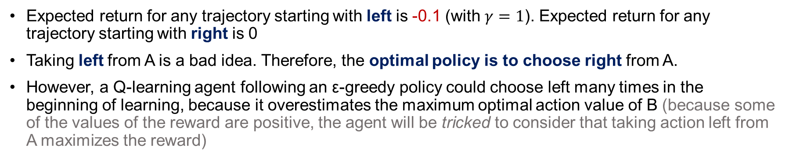
Maximization Bias: Example
Problem with Q-learning
C
D
An episodic finite Markov decision process to highlight the problems caused by overestimation bias
Expected return for any trajectory starting with left is -0.1 (with $γ=1$). Expected return for any trajectory starting with right is 0
Taking left from A is a bad idea. Therefore, the optimal policy is to choose right from A.
However, a Q-learning agent following an ε-greedy policy could choose left many times in the beginning of learning, because it overestimates the maximum optimal action value of B (because some of the values of the reward are positive, the agent will be tricked to consider that taking action left from A maximizes the reward)
Example from Sutton and Barto, 2018

Slide 9
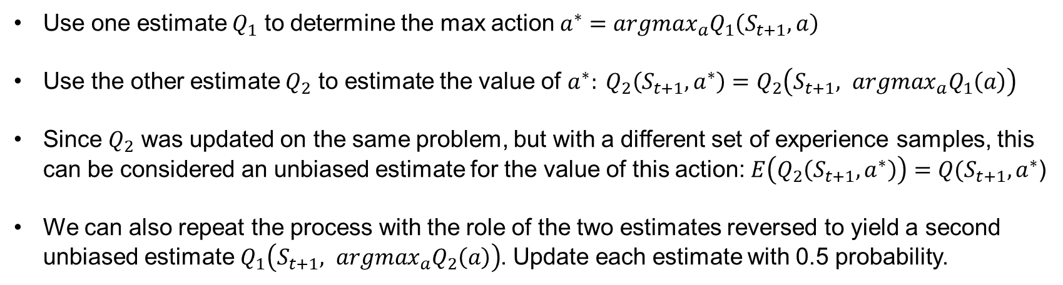
Double Q-learning
Algorithm to avoid maximization bias
In Q-learning, there will be a maximization bias if we use the maximum of the estimates as an estimate of the maximum of the true values.
$$\max_{a} Q\left(S_{t+1},a\right)=Q\left(S_{t+1},\arg{\max_{a}{Q\left(S_{t+1},a\right)}}\right)$$
Use same values to select the maximizing action, and to estimate its value
Instead, decouple selection and evaluation, and have two action-value functions: $Q_{1}\left(S_{t+1},a_{1}\right), Q_{2}\left(S_{t+1}, a_{2}\right)$
Use one estimate $Q_{1}$ to determine the max action $a^{∗}={argmax}_{a}Q_{1}\left(S_{t+1}, a\right)$
Use the other estimate $Q_{2}$ to estimate the value of $a^{∗}: Q_{2}\left(S_{t+1},a^{∗}\right)=Q_{2}\left(S_{t+1}, {argmax}_{a}Q_{1}\left(a\right)\right)$
Since $Q_{2}$ was updated on the same problem, but with a different set of experience samples, this can be considered an unbiased estimate for the value of this action: $E\left(Q_{2}\left(S_{t+1},a^{∗}\right)\right)=Q(S_{t+1},a^{∗}$)
We can also repeat the process with the role of the two estimates reversed to yield a second unbiased estimate $Q_{1}\left(S_{t+1}, {argmax}_{a}Q_{2}\left(a\right)\right)$. Update each estimate with 0.5 probability.

Slide 10
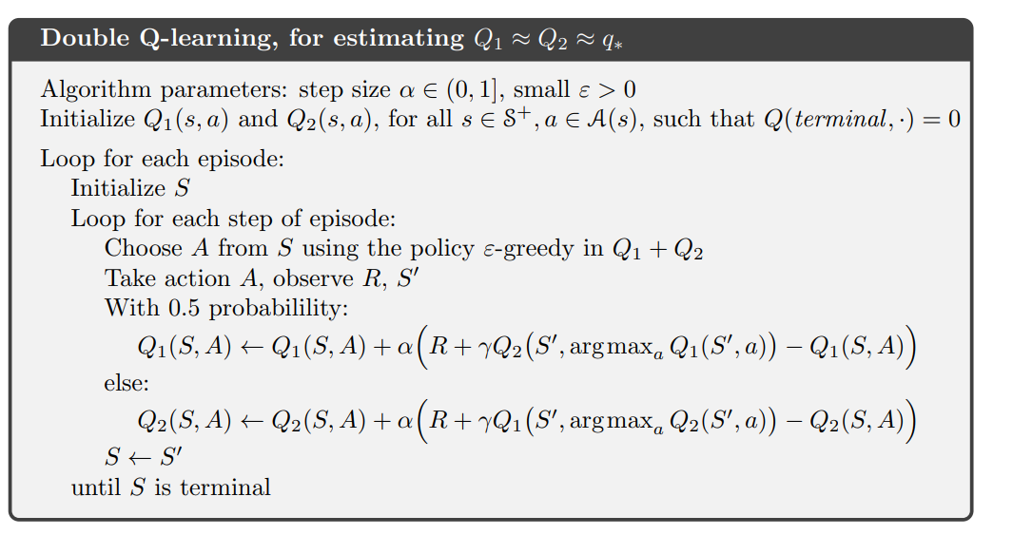
Double Q-learning
Algorithm
Image Source: Sutton and Barto, 2018

Slide 11
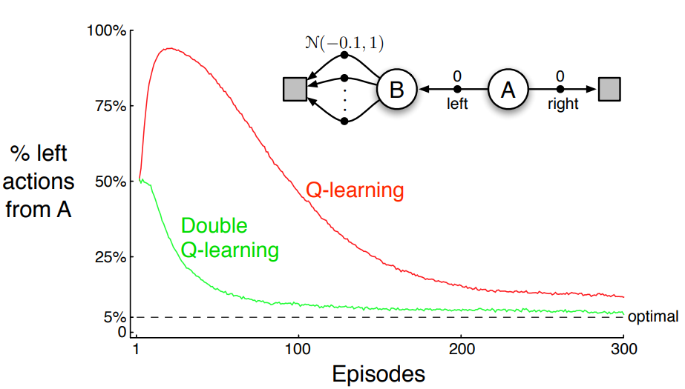
Q-learning vs Double Q-learning
Example
Comparison of Q-learning and Double Q-learning on a simple episodic MDP
Due to the maximization bias, Q-learning spends much more time selecting suboptimal actions than double Q-learning
Image Source: Sutton and Barto, 2018

Slide 12
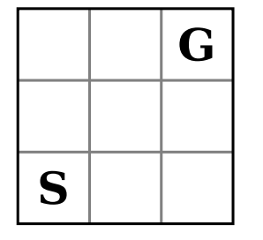
Q-learning vs Double Q-learning
Grid World
Each state has 4 actions, corresponding to the directions the agent can go (agent can move up, down, left, right).
The starting state (S) is in the lower left position and the goal state (G) is in the upper right.
Each time the agent selects an action that walks off the grid, the agent stays in the same state.
For each non-terminating step, the agent receives a random reward of −12 or +10 with equal probability.
Once it arrives to a goal state it gets a reward +5 and ends an episode.
Grid World
Image Source: van Hasselt, 2010

Slide 13
Optimal Policy, Reward
Grid World
The optimal policy ends an episode after 5 steps
The sum of average reward per state after an episode is +1
G
G
-1
-1
+5
-1
-1
-1
S
S
-1
-1
-1
Grid World
Path the agent can take to go from S to G
Average reward per state

Slide 14
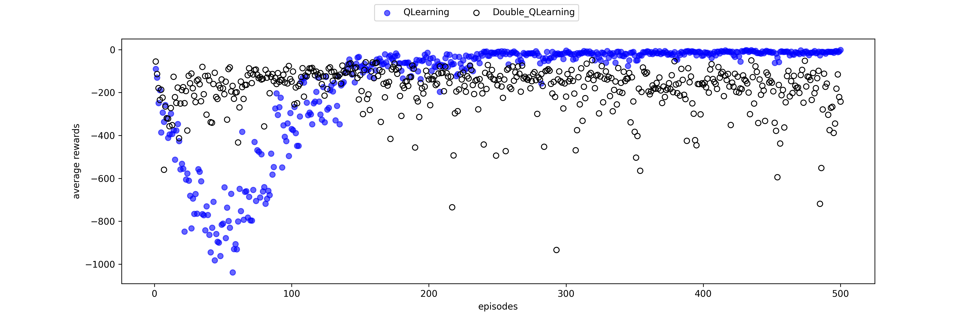




Sum of rewards per episode (averaged over number of experiments)
Results: 500 episodes
Parameters:
$$ε=\frac{1}{\sqrt{n(s)}}$$
$$α=\frac{1}{{n\left(s,a\right)}^{0.8}}$$
$$γ=0.95$$
$$number of trials=200$$
$$n\left(s\right)=number of times state s has been visited$$
$$n\left(s,a\right)=number of updates for each state, action$$
Sum of rewards per episode
Episodes
Result in grid world for Q-learning and Double Q-learning: Sum of rewards per episode (averaged over number of experiments)
Double Q-learning as measured in (average) sum of rewards per episode performs better than that of Q-learning in the first few episodes in this setting.

Slide 15
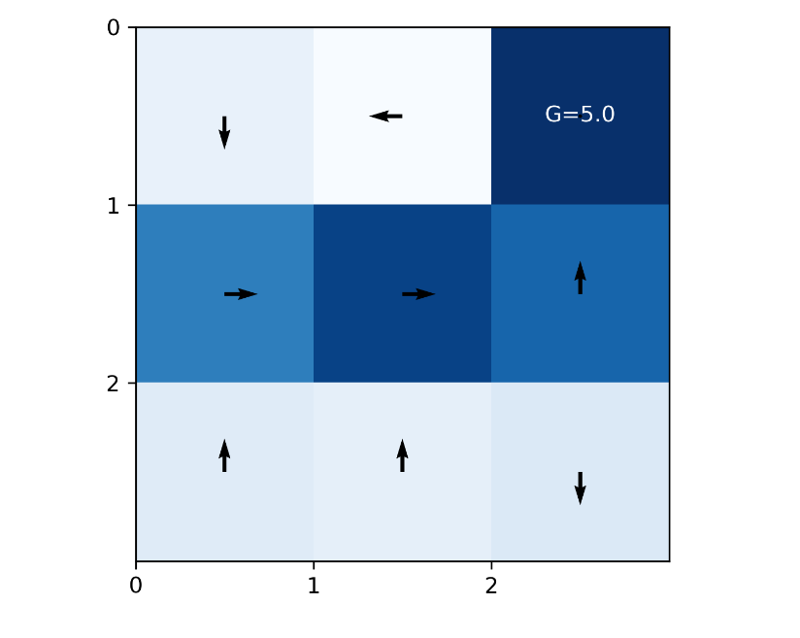
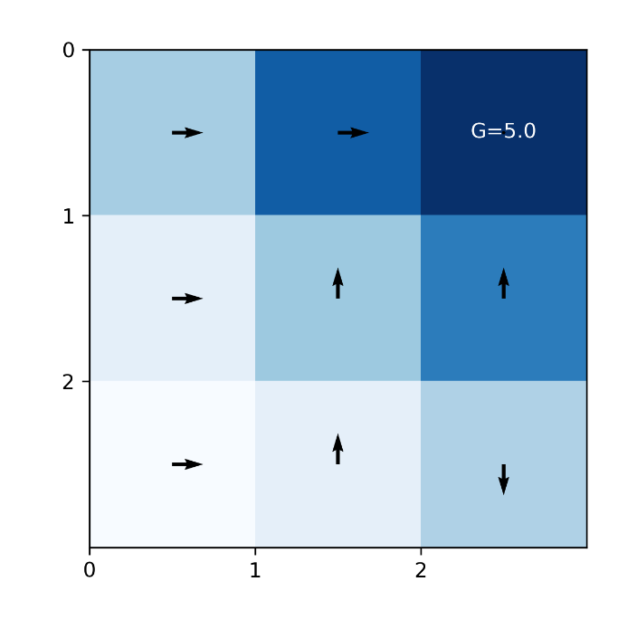
Snapshot of a Policy
Results: 500th episode
G
S
Q-learning
Double Q-learning
Action from the starting state(S) for both algorithms is up or right action

Slide 16
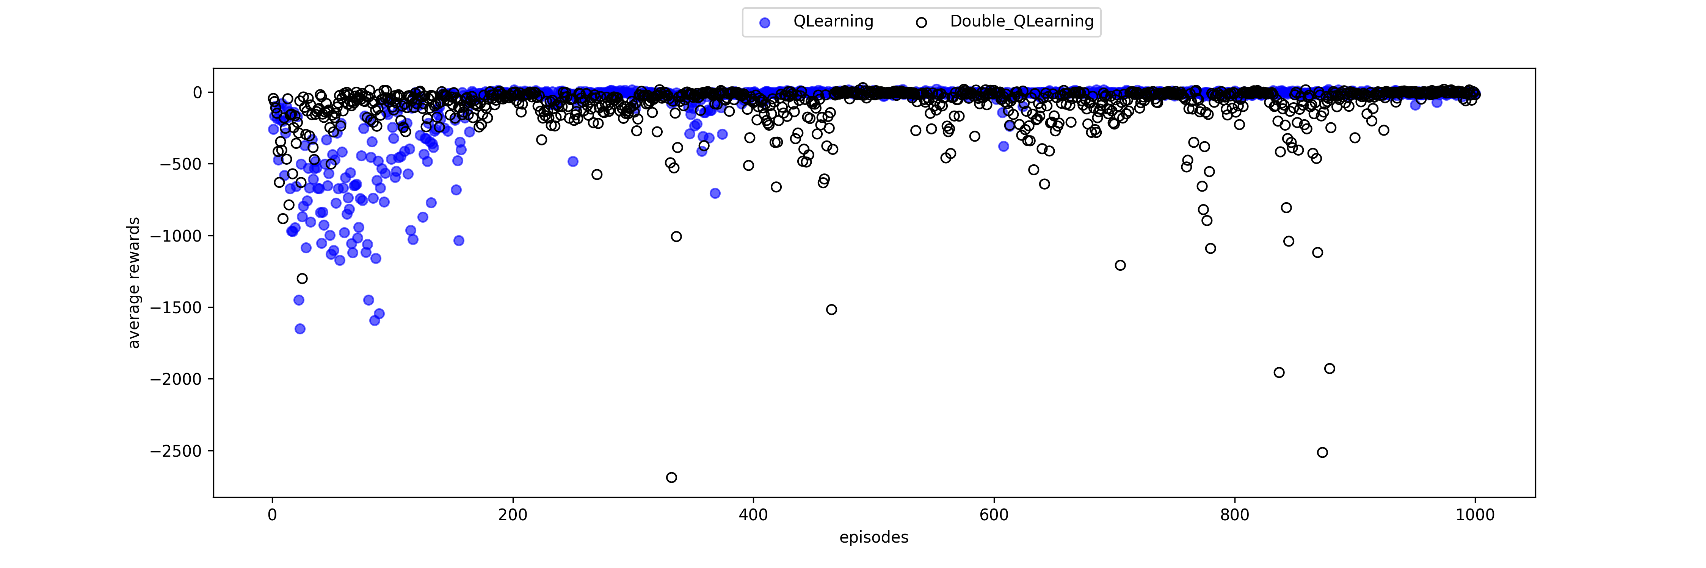

Sum of rewards per episode (averaged over number of experiments)
Results:1000 episodes
Parameters:
$$ε=\frac{1}{\sqrt{n(s)}}$$
$$α=\frac{1}{{n\left(s,a\right)}^{0.8}}$$
$$γ=0.95$$
$$number of trials=100$$
$$n\left(s\right)=number of times state s has been visited$$
$$n\left(s,a\right)=number of updates for each state, action$$
Sum of rewards per episode
Episodes
Result in grid world for Q-learning and Double Q-learning: Sum of rewards per episode (averaged over number of experiments)
Double Q-learning as measured in (average) sum of rewards per episode performs better than that of Q-learning in the first few episodes in this setting.

Slide 17
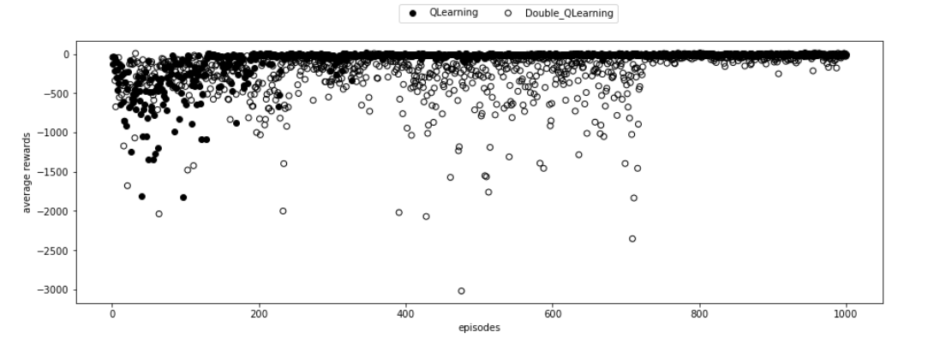
Sum of rewards per episode (averaged over number of experiments)
Results:1000 episodes
Parameters:
$$ε=\frac{1}{\sqrt{n(s)}}$$
$$α=\frac{1}{{n\left(s,a\right)}^{0.8}}$$
$$γ=0.95$$
$$number of trials=100$$
$$n\left(s\right)=number of times state s has been visited$$
$$n\left(s,a\right)=number of updates for each state, action$$
Sum of rewards per episode
Episodes
Result in grid world for Q-learning and Double Q-learning: Sum of rewards per episode (averaged over number of experiments)
Double Q-learning as measured in (average) sum of rewards per episode performs better than that of Q-learning in the first few episodes in this setting.

Slide 18
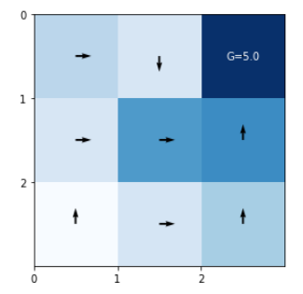
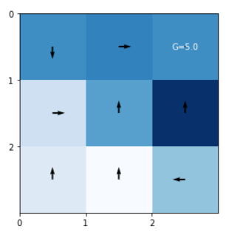
Snapshot of a Policy
Results: 1000th episode
G
S
Q-learning
Double Q-learning
Action from the starting state(S) for both algorithms is up or right action

Slide 19
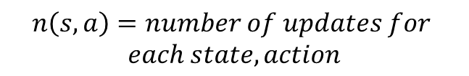

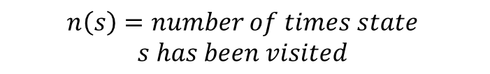
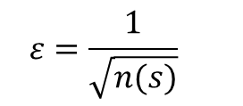
Grid World
Parameters
Explore more and take larger steps (larger $ε$ and $α$) at the beginning, but as time goes by, we want to explore less and take smaller steps because we will be focusing more close to the goal
1
Constant $ε$ for $ε$-greedy policies is not good
2
Constant learning rate $α$ is not good
$$ε=\frac{1}{\sqrt{n(s)}}$$
$$α=\frac{1}{{n\left(s,a\right)}^{0.8}}$$
$$n\left(s\right)=number of times state$$
$$s has been visited$$
$$n\left(s,a\right)=number of updates for$$
$$each state, action$$

Slide 20
Conclusion
Q-learning can sometimes perform poorly for problems in which multiple actions yield stochastic, overlapping rewards.
Double Q-learning can be used as an alternative for Q-learning, since it can perform quite well in settings in which Q-learning suffers from overestimations.

Slide 21
References
Sutton, R. S., & Barto, A. G. (2018). Reinforcement learning: An introduction. MIT press.
Hasselt, H. (2010). Double Q-learning. Advances in neural information processing systems, 23.

