Slide 1
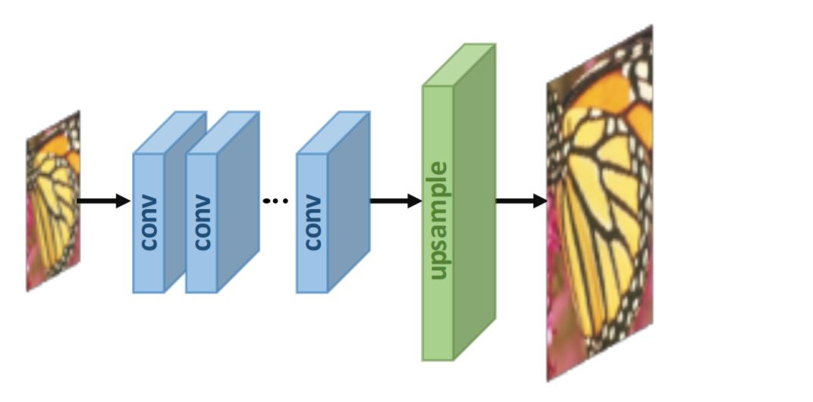
INTRODUCTION
State-of-the-art
Dictionary-based Super Resolution
Neighbor embedding – lowering the number of image patches
Sparse coding – find sparse code for input patches
Super Resolution Convolutional Neural Network
Very Deep Super Resolution
This Project
SRCNN architecture
VDSR architecture
DIV2K dataset
PSNR metric

Slide 2
DESCRIPTION & METHODOLOGY
SRCNN & VDSR architectures
Original version SRCNN – 3-layer CNN, with specific hyper-parameters in each layer
Original version VDSR - large number (10-20) of identical convolution layers.
Convolution 1 | Convolution 2 | Convolution 3
• In-channels: 3 • Kernel-size: 9x9 • Padding: 4 • Stride: 1 • Out-channels: 64 | • In-channels: 64 • Kernel-size: 1x1 • Padding: 0 • Stride: 1 • Out-channels: 32 | • In-channels: 32 • Kernel-size: 5x5 • Padding: 2 • Stride: 1 • Out-channels: 3
First Convolution | 10-20 identical layers | Last Convolution
• In-channels: 1 • Kernel-size: 3x3 • Padding: 1 • Stride: 1 • Out-channels: 64 | • In-channels: 64 • Kernel-size: 3x3 • Padding: 1 • Stride: 1 • Out-channels: 64 | • In-channels: 64 • Kernel-size: 3x3 • Padding: 1 • Stride: 1 • Out-channels: 1

Slide 3
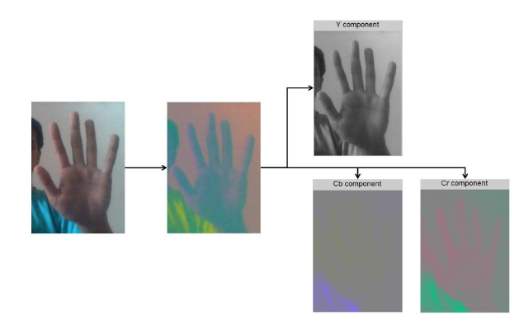
DESCRIPTION & METHODOLOGY
VDSR - Residual model
The model learns the residual image, containing the fine details missing in the low-resolution image.
This model converges faster and provide better results (PSNR)
This approach is used in my model.
VDSR – color-space change
Change in color-space from RGB to YCbCr
YCbCr format is composed of:
Y represents the luma component (grey scale version)
Cb, Cr represent the color components of the image

Slide 4
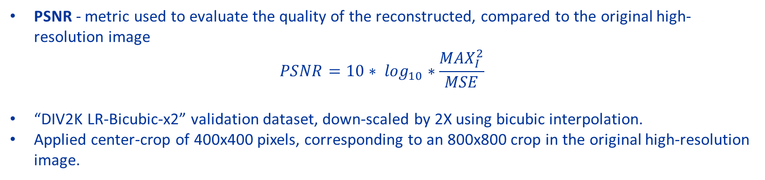
RESULTS & DISCUSSIONS
PSNR
Bicubic Interpolation
Scaled up from 400x400 to 800x800
Average PSNR – 29.49
Same value every time the same image is scaled using bicubic interpolation (uses math)

Slide 5
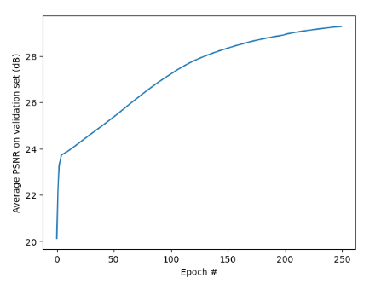
RESULTS & DISCUSSIONS
SRCNN model
Epochs: 250
Center-crop: scaling from 400x400 on the low resolution to 800x800
Average PSNR: 29.24
Description of the graph:
The average PSNR at the start of training is below the value obtained for Bicubic Interpolation.
After 250 epochs, PSNR still lower than the value obtained in Bicubic Interpolation.

Slide 6
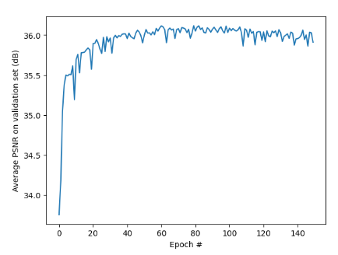
RESULTS & DISCUSSIONS
VDSR model
Training: On the same dataset
Epochs: 140
Center-crop: scaling from 400x400 on the low resolution to 800x800
Average PSNR: 35.78
Description of the graph:
The average PSNR starts at a much higher value ( no need to learn from scratch)
Learns more quickly
Converging at epoch 60
higher PSNR than SRCNN model and Bicubic Interpolation.

Slide 7




RESULTS & DISCUSSIONS
Ground truth
VDSR model
SRCNN model
Model input

Slide 8




RESULTS & DISCUSSIONS
Ground truth
VDSR model
SRCNN model
Model input

Slide 9
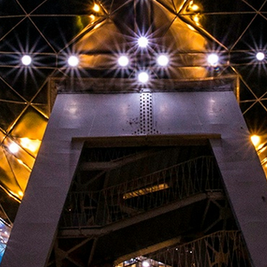
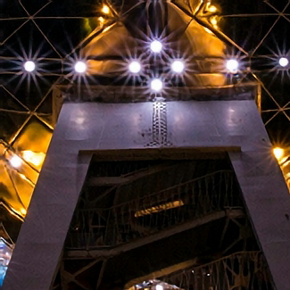
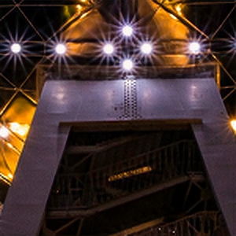

RESULTS & DISCUSSIONS
Ground truth
VDSR model
SRCNN model
Model input

Slide 10
Conclusions
RESULTS & DISCUSSIONS
Overview of results
 | BICUBIC | SRCNN | VDSR
avg. PSNR on validation | 29.49 | 29.24 | 35.78

Slide 11

CONCLUSIONS
Two separate model architectures were implemented and trained to scale images by a factor of 2 in both dimensions.
The residual VDSR model trains faster than the SRCNN model and performs better than both SRCNN and Bicubic Interpolation.
The trained VDSR model, resulted in an average PSNR of 35.78 on an unseen validation dataset, significantly outperforming Bicubic Interpolation (PSNR of 29.49 on the validation dataset).
FUTURE RESEARCH
Using larger dataset.
Fine-tune the hyper parameters and learning parameters during training.
Allow the model to support different arbitrary scaling factors.

