Slide 1
Senior Design Project
Kristin Miyamoto

Slide 2
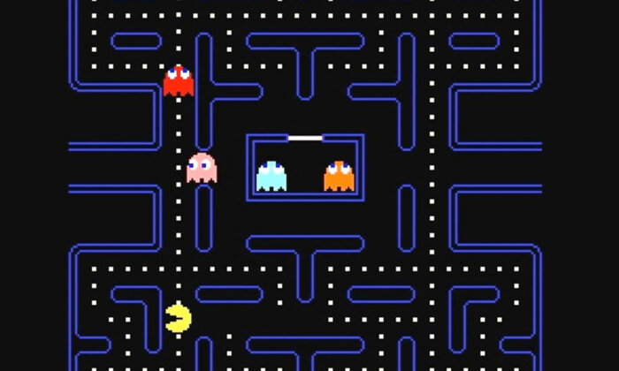
Project Description
Create a version of pacman in C++ with collision checking, and rudimentary ghost movement
What is Pacman?
to collect as many points by eating pellets(10 pts) and Energizes (50 pts) while avoiding ghosts

Slide 3
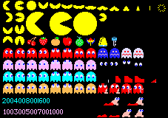
Project Accomplishments
Rudimentary Ghost Movement
scatter, chase, and frightened mode
Basic Collision Checking
Scoring System
when
Basic graphics and animation
textured using size and coordinates on sprite sheet
animation timer

Slide 4

Challenges
Ghost movement
ghosts being able to exit the ghosts house in a time efficient way
affected how the ghosts behaved in frightened mode
having the different color of ghosts movement be noticeably different
getting the timer to switch between the modes
Learning how to use SFML
Debugging with SFML

Slide 5
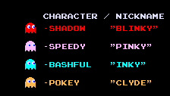
Things I would have done differently/Improve
Better Designed Starting Base
Better Time Management
Things I would like to improve
multiple lives
better/move accurate ghost movement
sound
more appealing start menu, game over, and you win screen layouts
serialization
Fix Bugs
there is a chance that a ghost can enter the ghost house without being sent there from frightened mode

Slide 6
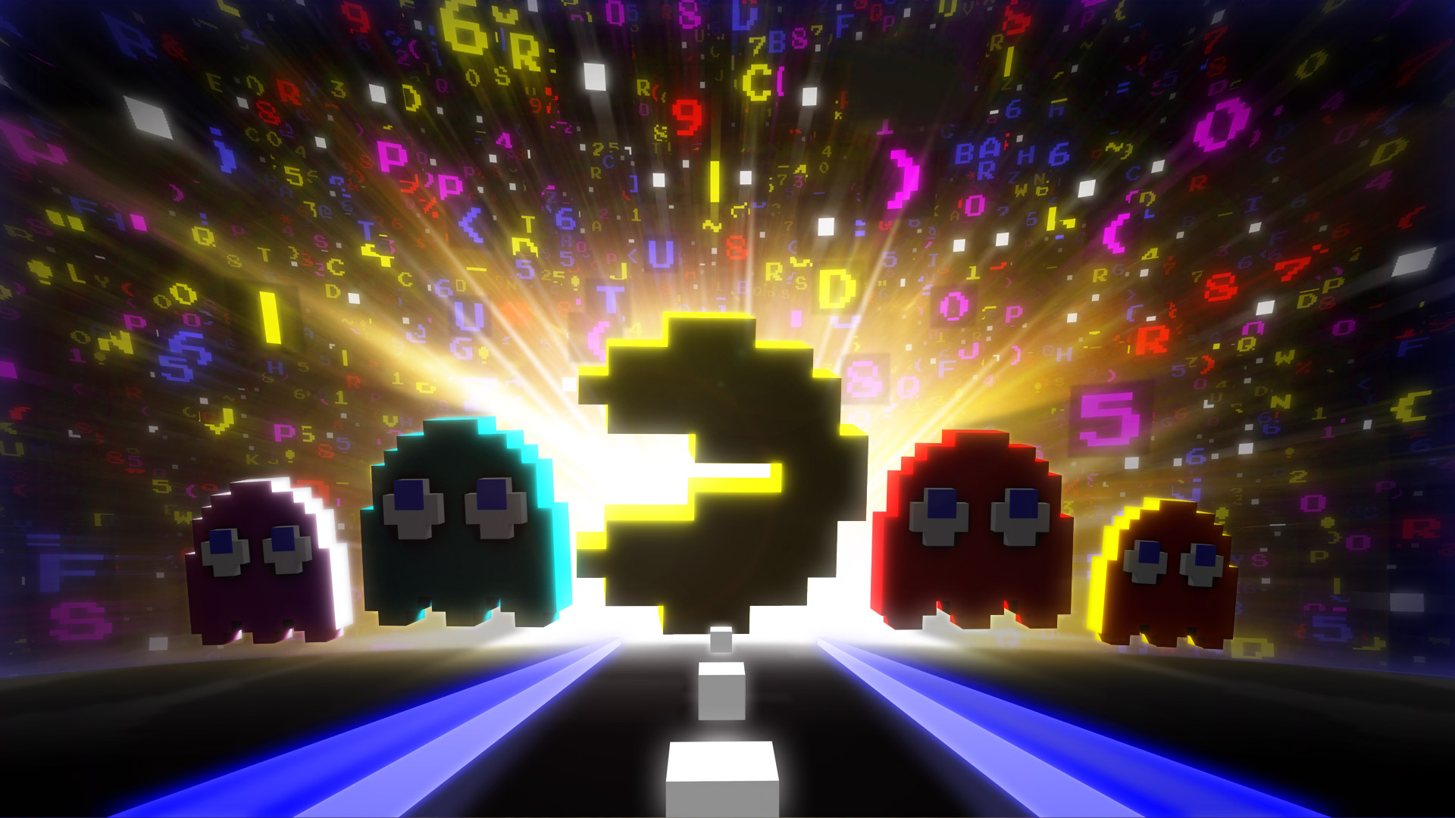
Areas of Computer Science
Software Design
pre designed the program before actually coding
had a specific workflow or a function/class priority hierarchy list
Game Development

Slide 7
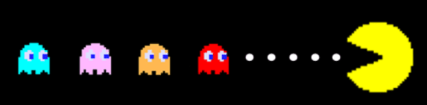
Takeaways
To use SFML with C++ to make a graphical interface
Simple Animation (SFML)
Improved C++ skills
array class
understanding when it’s better to use the array class over the vector class
enumeration types
ternary operators
The importance of time management is and starting with a well designed base!

