Slide 1
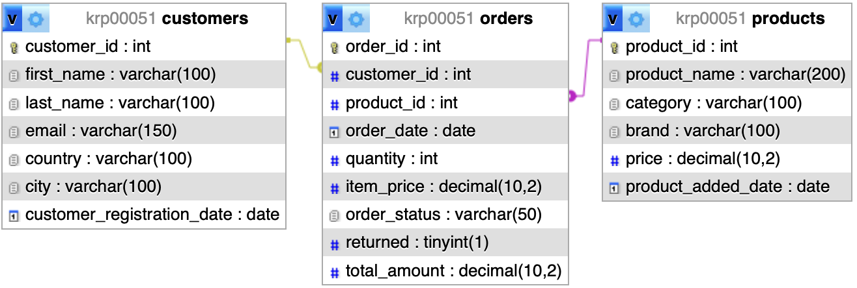
ER – diagram
Customers
1
M
Orders
M
M
Products
One Customer can have many Orders (1 – to – Many Relationship)
One Order belongs to one Customer (Many – to – 1 Relationship)
One Order can contain many Products (Many – to – Many Relationship)
One Product can be in many Orders (Many – to – Many Relationship)
Database Schema
1. How many clients register each month in each country
For e-commerce companies (such as Amazon), this is one of the most important questions to analyse business and market growth. If the number is growing, the business is attracting more users. If it is falling, there may be problems: poor advertising, competitors, website issues.
By adding a country, we can understand in which markets the company is growing faster. Besides, if a company launches an ad, for example in Germany in March, and customer registrations increase sharply in March; this means the campaign is working.
Moreover, more customers mean more orders, more warehouse load, more delivery. Therefore, it is important to know where the market is growing to decide if there is a nee to open a new warehouse, increase logistics, etc.

Slide 2
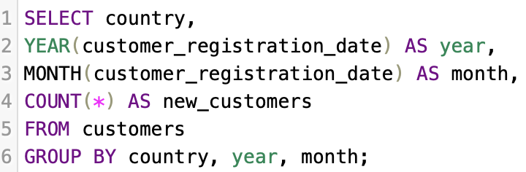
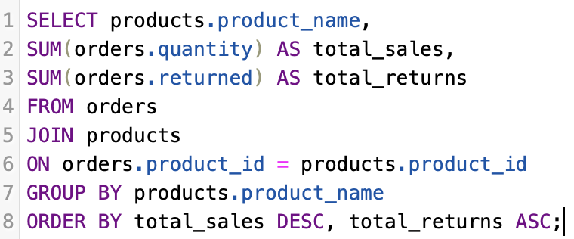
2. The products with the most sales and the fewest returns
Products with the highest sales and the lowest returns are the best products for business.
They demonstrate, that customers are satisfied with the product, the product matches the description and returns and logistics costs are minimal.
Such products should be actively promoted by the company, kept in large quantities in stock and featured in recommendations.
This helps increase profits.
To find the products with the most sales and the fewest returns, use the following tables: orders and products
JOIN combines orders and products
SUM(orders.quantity) counts total sales
SUM(orders.returned) counts returns
GROUP BY groups by product
ORDER BY: best-selling first, then least returned

