Slide 1
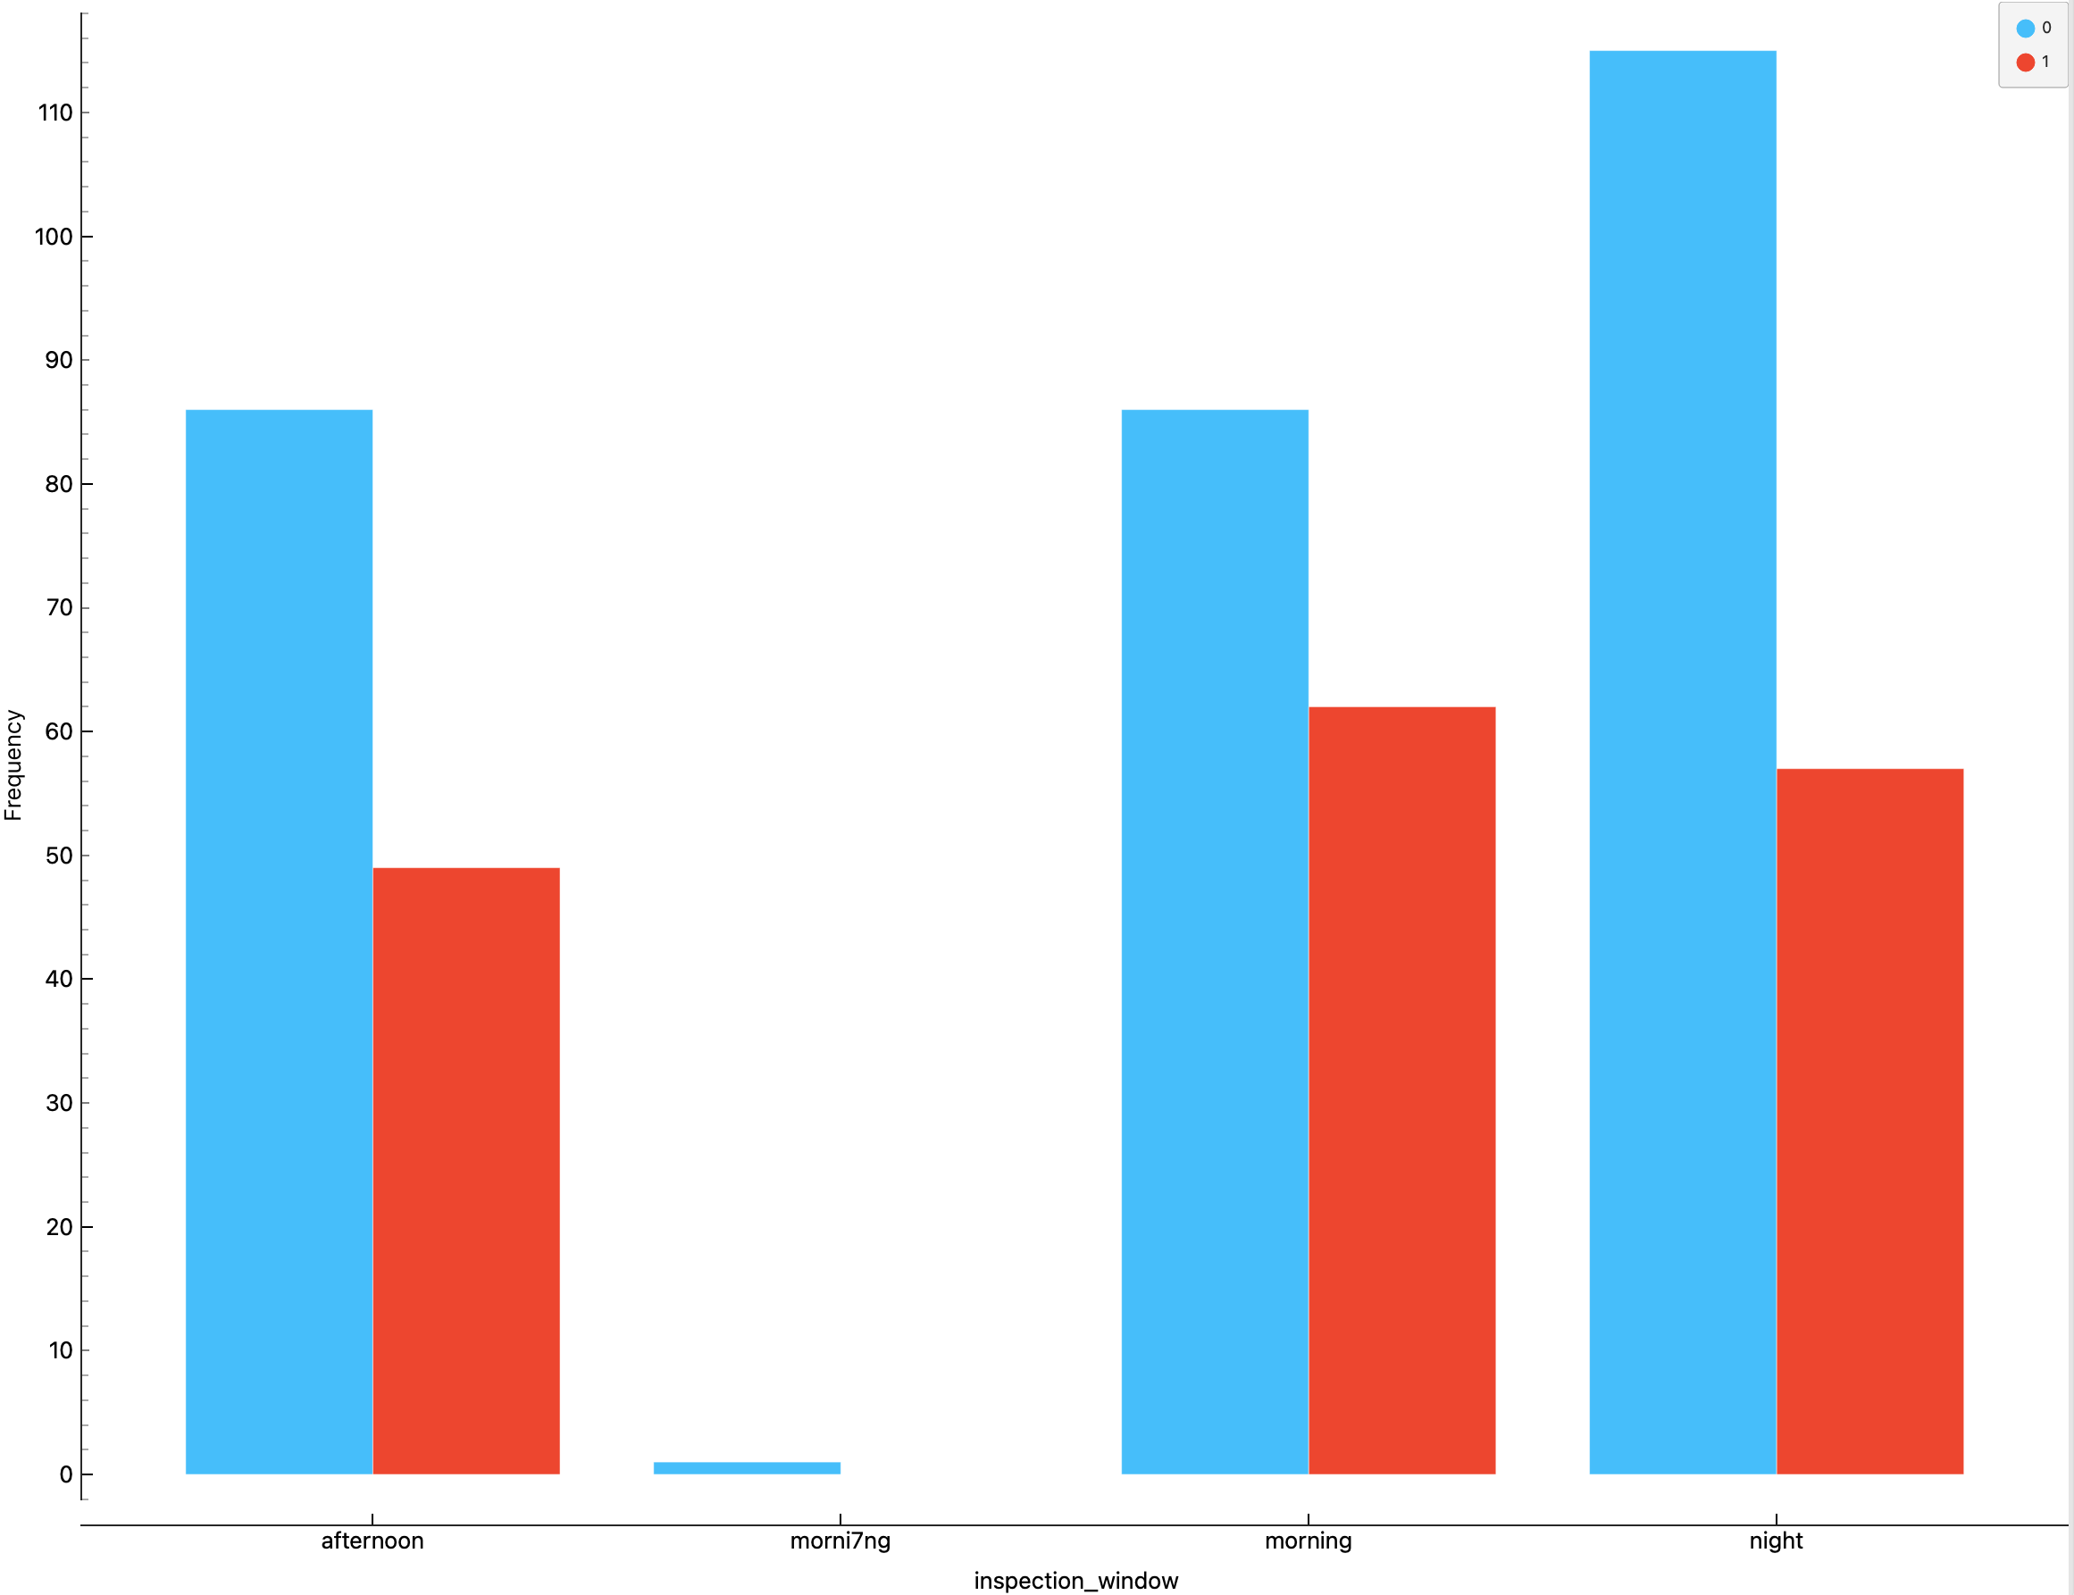
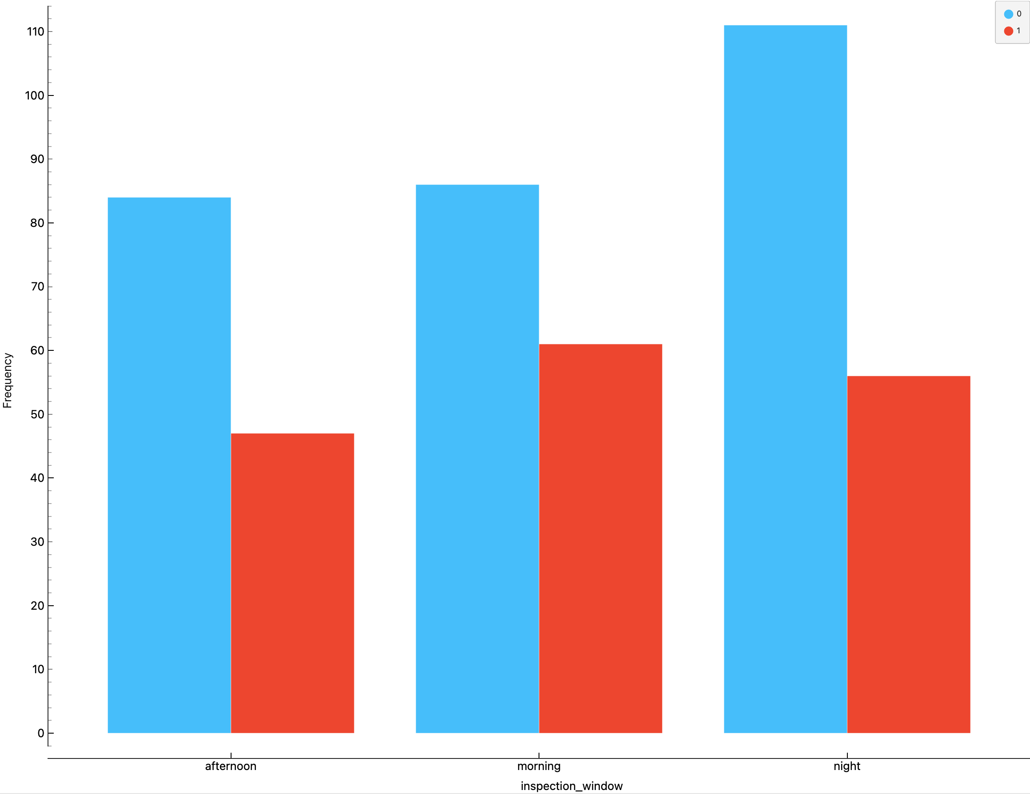
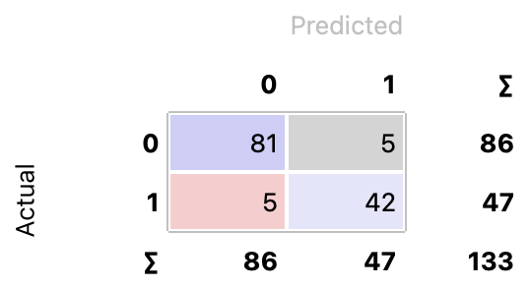
ITNPBD6 Assignment 1. Student Number xxxxxx
3. Variables
Almost all input variables are continuous numeric features; only two variables (inspection_season and inspection_window) are categorical and were encoded using one-hot encoding for Logistic Regression and Neural Network models.
Additionally, there is one discrete numerical variable – inspector_id, - which identifies an inspector and not contain information about infrastructure, so it has almost nothing to do with failure. This variable adds unnecessary dimension to the model, increase its complexity, and introduces more noise. Thus, it was removed from the dataset.
During the Feature Selection stage, inspection_window, inspection_season=autumn, inspection_season=spring, and vibration_exposure were deleted due to their very low predictive value. This improved model performance by reducing dimensionality, model complexity and noise.
4. Data Preparation
The inspection_window variable before and after cleaning.
5. Model Training and Hyperparameters
A number of models were built using different hyperparameter settings. A systematic approach was applied, where only one hyperparameter was varied at a time. Each model was evaluated using 5-fold cross-validation.
The optimal hyperparameter configuration was selected based on maximising Recall, with AUC used as a secondary performance metric.
6. Final Model & Results
After incorporating Feature Selection as part of the model optimisation process, Logistic Regression achieved the best performance, with the highest recall (Recall = 0.935, AUC = 0.972), and was therefore selected as the final model. This makes it a suitable for this task, where minimising false negatives is critical.
Confusion Matrix shows the following:
• True Negatives (TN) = 81
(correctly predicted no failure);
• False Positives (FP) = 5
(predicted a failure when none occurred);
• False Negatives (FN) = 5
(the model missed a failure case);
• True Positives (TP) = 42
(correctly detected failure cases).
Recall = TP / (TP + FN) = 42 / (42 + 5) ≈ 0.894
This means that the model correctly identifies about 89.4% of all failure cases.
The Recall obtained from the confusion matrix differs slightly from the cross-validation result, as it is calculated on a single test split rather than averaged across 5 folds. Cross-validation provides a more robust assessment of model performance, while the confusion matrix reflects performance on a specific dataset.
Overall, the relatively low number of false negatives indicates that the model is effective at identifying high-risk cases.
Model | Hyperparameters | Validation Metric
1. Logistic Regression | • L1-regularisation (Lasso), C : 0.001, 0.01, 0.05, 0.1, 0.2, 1, 10, 100, 1000; • L2-regularisation (Ridge), C : 0.001, 0.01, 0.05, 0.1, 0.2, 1, 10, 100, 1000 The best result was achieved at L2, C = 0.05 and class balancing. | Recall = 91.9% AUC = 97.1%
2. Neural Network | • Neurons in hidden layers: 10, 20, 50, 100, 200, 300; • Activation functions: ReLu, tanh, logistic; • Solver: Adam, L-BFGS, SGD; • Regularisation: 0.0001, 0.001, 0.01, 0.1, 1, 2, 3, 4, 5, 6, 7, 8, 10, 15; • Max iterations: 50, 100, 200, 300, 400, 500, 700, 800, 1000. The best result was achieved at 50 neurons in the hidden layer, a tanh activation function, the SGD solver and 200 epochs. | Recall = 92.8% AUC = 96.5%
3. Decision Tree | • Minimum number of instances in leaves: 2, 5, 10, 20; • Split subsets: 5, 10, 20, which did not have any effect on the results; • Maximum tree depth: 2, 5, 8, 10. The best result was achieved at 10 instances in leaves, 5 split subsets and a maximum tree depth of 10. | Recall = 88.9% AUC = 93.8%
7. Insight about data or models gained
Features such as surface_debris, structural_mass_ratio, recent_precipitation, infrastructure_age, moisture_stress have a significant impact on infrastructure failure, with higher values associated with an increased probability of failure. In contrast, features such as inspection_window, inspection_season = autumn, inspection_season = spring, and vibration_exposure showed almost no predictive value and were therefore removed during feature selection.
The analysis also indicates a clear environmental influence, with failures occurring more frequently during the summer period. This suggests that weather conditions play an important role.
Overall, infrastructure failure depends on both structural characteristics and external environmental factors (e.g., weather and level of infrastructure usage). No strong model bias was observed; however, some seasonal variation is present in the data.
Logistic Regression was selected as the final model due to its strong performance and interpretability. Its coefficients indicate the direction and strength of the relationship between each feature and the probability of failure, helping to understand which factors lead to failure, it is fast (learns and predicts quickly), simple to tune (few hyperparameters), and practical for real-world decision-making. This demonstrates that simpler, interpretable models can achieve both high performance and practical value in real-world applications.

