Slide 1

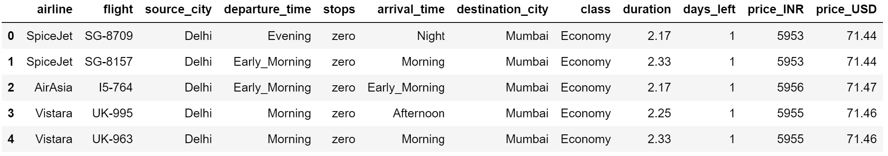
Group Project Flight Data Analysis
Purpose: This project aims to analyze a flight booking dataset obtained from the "Ease My Trip" website and perform
various statistical hypothesis tests to extract meaningful information. As a popular online platform for booking flight tickets,
"Easemytrip" serves as a valuable resource for potential passengers. By conducting a thorough analysis of the data,
this project seeks to uncover valuable insights that will greatly benefit passengers.
Dataset: In total, 300,261 distinct flight booking options were extracted during a 50-day period, ranging from February 11th
to March 31st, 2022. comprises information on flight booking options from the Easemytrip website, specifically for flights
between India's top 6 metro cities. After cleaning the data, the final dataset consists of 300,261 data points and includes 11
features. Such as class, Arrival time, Departure time, Price in INR and USD:

Slide 2
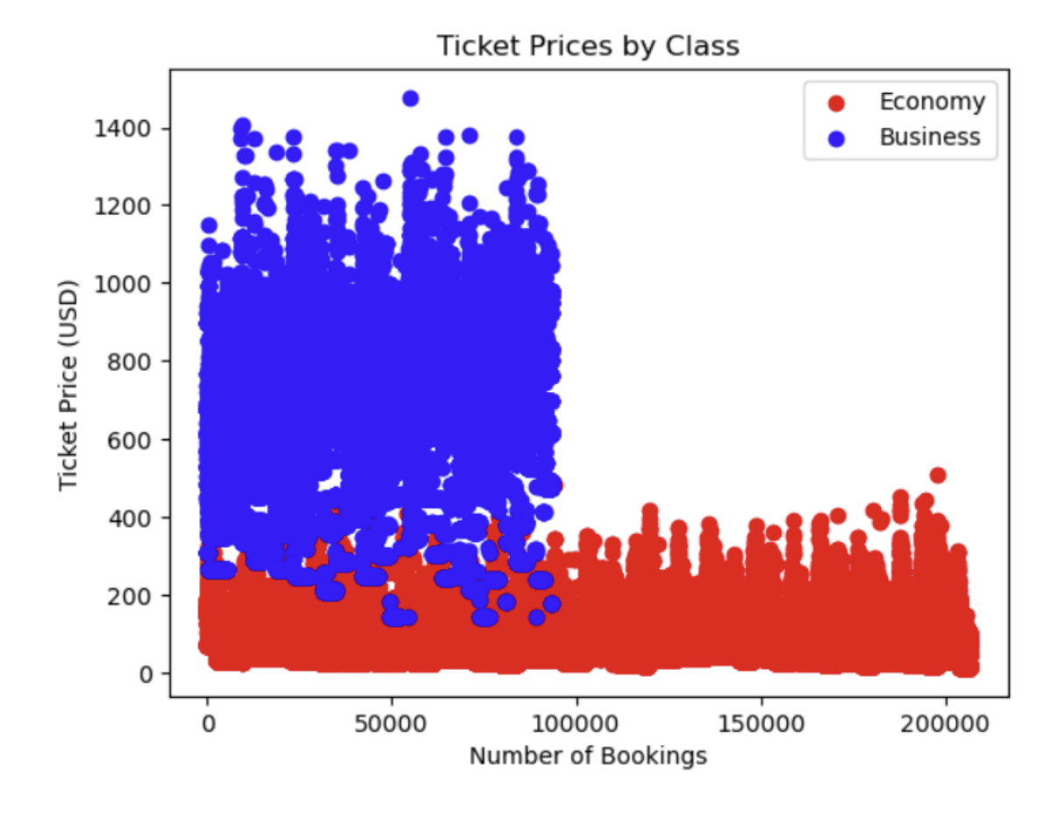
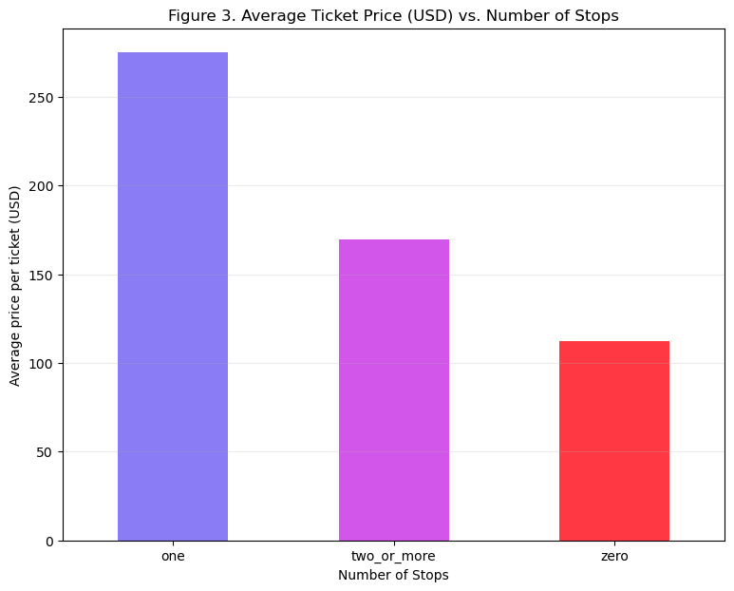
Section 1.1 Correlation between price and class
Analysis: Scatter plot visualizing Average price per ticket
vs. the Number of booking
Observations: The bookings for Economy class was more
as compared to business class.
The cost of tickets is almost 6 times more than the
Economy class.

Slide 3
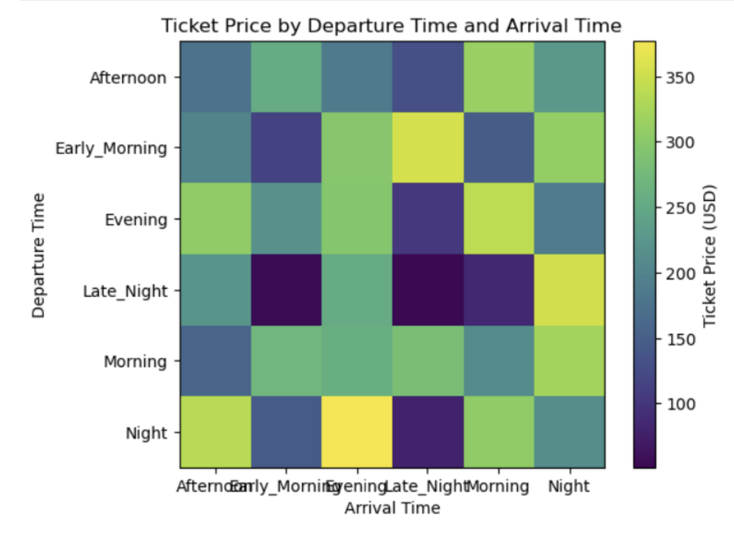
Section 1.2 Correlation between price and arrival/departure times
Analysis: Color map visualizing Average price per ticket
vs. Departure and Arrival time combinations
Observations: The ticket price is highest during evening arrival time
and night departure time.
Lowest when the departure time is late night and arrival time
is early morning.

Slide 4
Section 2.1 Correlation between price and number of stops
Expectations: Flights with less stops are more expensive
Analysis: Bar graph visualizing Average price per ticket
vs. the Number of stops
Observations: As per the graph, the most expensive tickets
are with 1 stop, while 0 stops tickets are cheapest. Why?

Slide 5
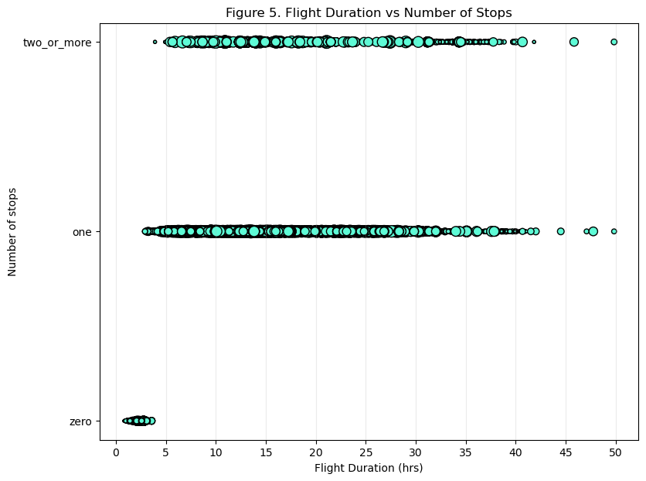
Section 2.1 Correlation between price and number of stops
Analysis: Scatter plot to see the distribution of data
with Flight Duration and Number of Stops variables
Observations: As per the graph, Flights with 0 stops are
mostly short-distanced (duration up to 4 hrs),
while flight data with 1 and 2+ stops have minimum duration closer to 3hrs and up to 50 hrs.
Conclusion: No correlation between these two variables.

Slide 6
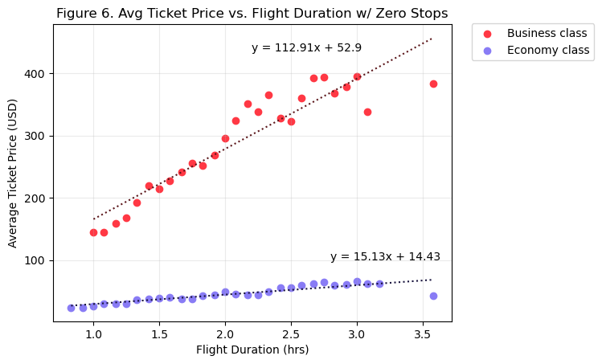
Section 2.2 Correlation between price and flight duration
Zero Stops Analysis:
Analysis: Scatter plot of Flight Duration and
Average ticket prices (per class)
Observation:
Business Class: The correlation between both factors is 0.93
Economy Class: The correlation between both factors is 0.88
Conclusion:
STRONG correlation between Avg Ticket price and Flight Duration in Business class;
STRONG correlation between Avg Ticket price and Flight Duration in Economy class;

Slide 7
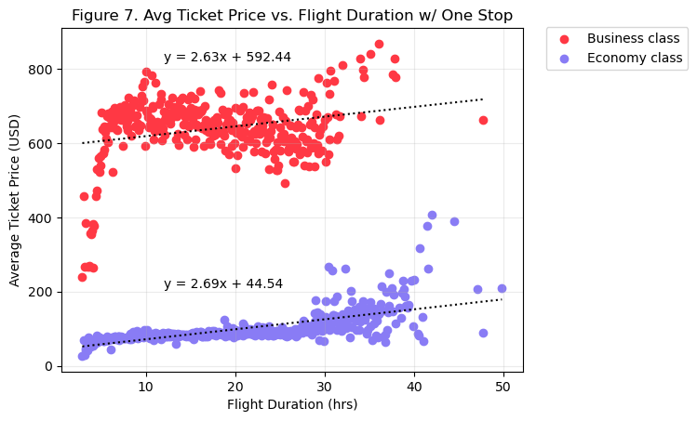
Section 2.2 Correlation between price and flight duration
One Stop Analysis:
Analysis: Scatter plot of Flight Duration and
Average ticket prices (per class)
Observation:
Business Class: The correlation between both factors is 0.26
Economy Class: The correlation between both factors is 0.66
Conclusion:
VERY WEAK correlation between Avg Ticket price and Flight Duration in Business class;
MODERATE correlation between Avg Ticket price and Flight Duration in Economy class;

Slide 8
Section 2.2 Correlation between price and flight duration
Two+ Stops Analysis:
Analysis: Scatter plot of Flight Duration and
Average ticket prices (per class)
Observation:
Business Class: The correlation between both factors is -0.16
Economy Class: The correlation between both factors is 0.45
Conclusion:
NO correlation between Avg Ticket price and Flight Duration in Business class;
WEAK correlation between Avg Ticket price and Flight Duration in Economy class;

Slide 9
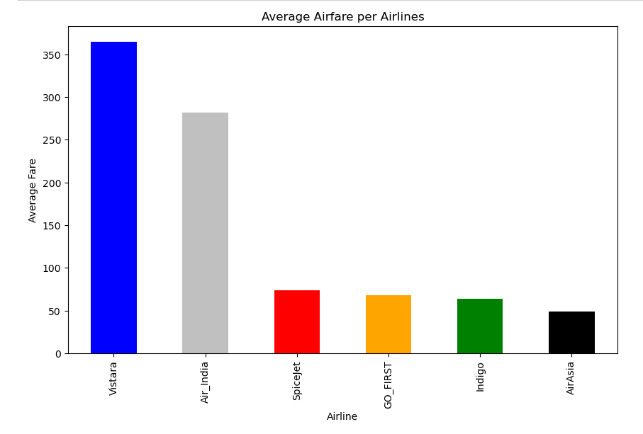
Section 3.1 Which airlines company’s average fare is the highest and lowest?
Analysis: Bar plot of Airline Company and
Average ticket prices (per class)
Observation:
The highest airfare is Vistara
The lowest airfare is Air Asia

Slide 10
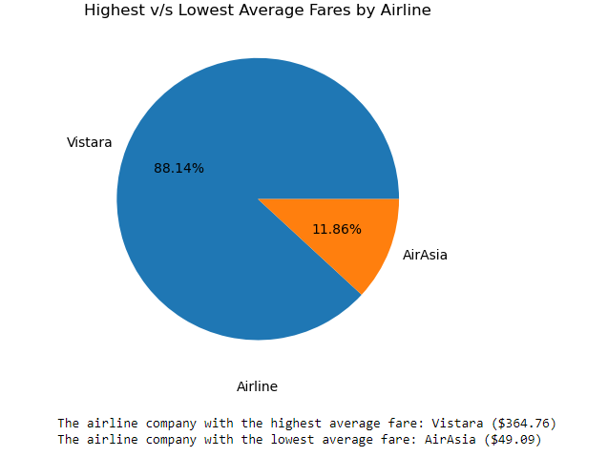
Section 3.2 Which airlines company’s average fare is the highest and lowest value?

Slide 11
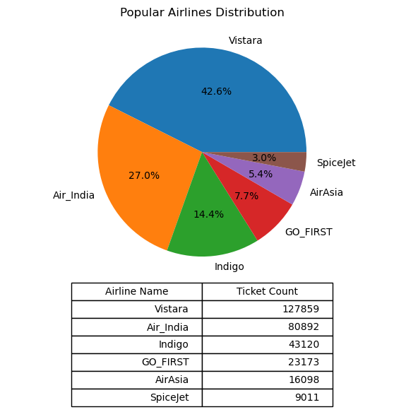
Section 3.3 Which airlines company’s average fare is most popular

Slide 12
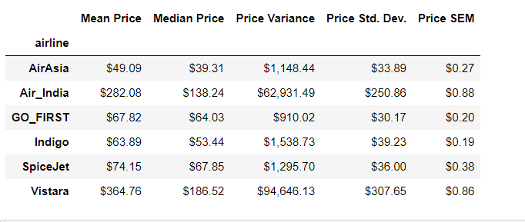
Section 3.4 Airfare and Airline Statistics
Mean Price: The highest airline average (Vistara $364.76) and The lowest average airline (Air Asia $49.09)
Median: The central tendency is 67.85.
Price Variance Air India has higher Price Variance of $62,931.49, Air Asia has low price variance of $910.02.
Price Std Dev. Vistara has the highest std $307.65. deviation and go first has low std deviation 30.17.
Price SEM: Air India has a higher SEM of $0.88 compared to the other airlines,

Slide 13
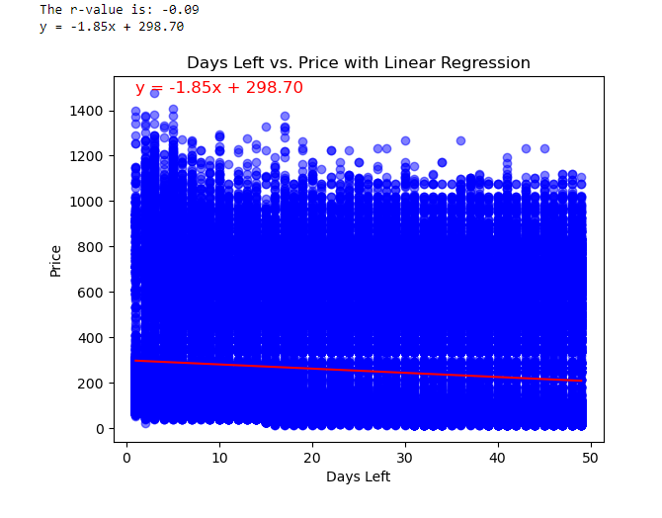
Section 3.5 How is the price affected when tickets are bought in just 1 or 2 days before departure? Linear Regression
The correlation coefficient(r-value) is -0.09 is a weak negative linear relationship. Since the R-value is close to zero and negative there is very weak relationship between the days left and price. There is very low predictive power between days left and price.

Slide 14
Group Project Conclusion
Conclusion: Our analysis of the Flight Price Prediction dataset reveals that purchasing tickets earlier than 20 days results in lower prices, while buying tickets only 5 days before the departure leads to higher prices. Therefore, it is advisable to plan and book flights well in advance to take advantage of lower ticket prices.
Thank you for your attention!

