Slide 1
Бази от данни - практикум
Екип 3 - Хотел
Веселина Чотрева, Кристина Цекова и Соня Стоянова

Slide 2
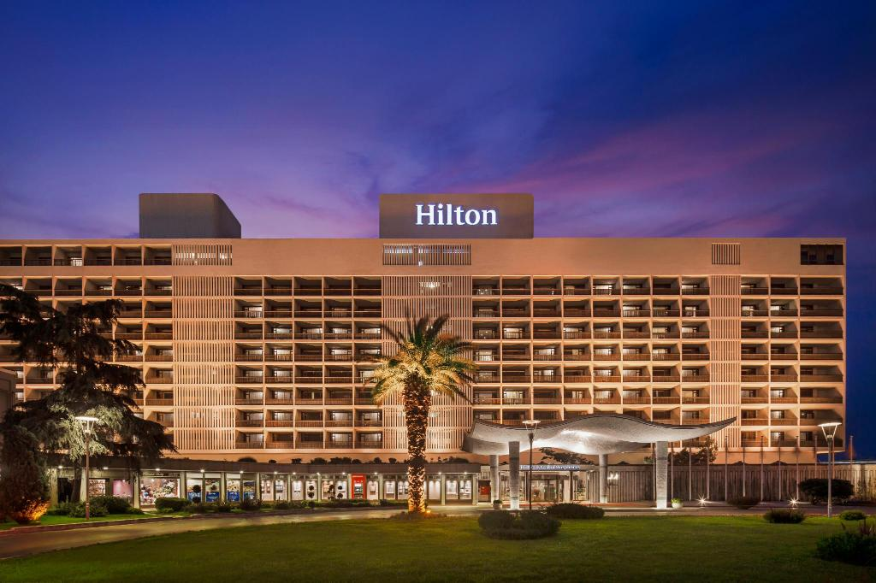
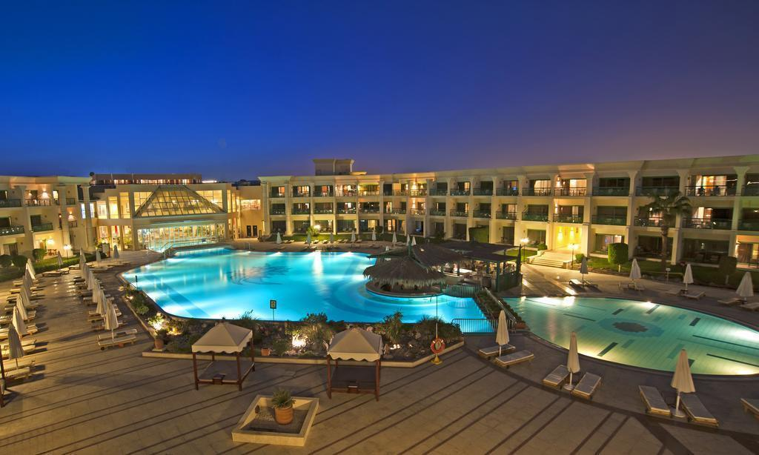
Идеята на проекта
Базата от данни за хотел съхранява информация за данните за служителите, гостите и направените регистрации в хотела –„ ХилТест“.
Хотелът разполага с леглова база от 48 легла, разпределени в 24 стаи на 4 етажа.

Slide 3
Описание на множествата същности
Rooms - roomNumber , roomType и pricePerNight;
Staff – ID, name, salary, bonuses, hireDate, phoneNumber, email;
Manager
Receptionists – education;
Attendants - worked hours и moneyPerHour;
Guests - EGN, name, age и phoneNumber;
Registrations - ID, accomodationDate, leavingDate, payment и days.

Slide 4
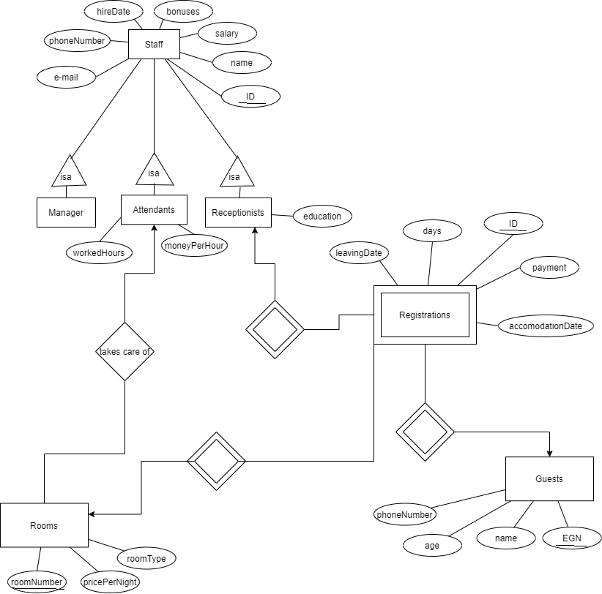
E/R модел

Slide 5

Релационни схеми
Rooms (roomNumber, pricePerNight, roomType, attendantID)
Guests (EGN, name, age, phoneNumber)
Registrations (ID, payment, accomodationDate, days, leavingDate, roomsNumber, guestEGN, receptionistID)

Slide 6


Manager (ID, name, salary, bonus, emplDate, phoneNumber, e-mail)
Receptionists (ID, name, salary, bonuses, emplDate, phoneNumber, e-mail, education, managerID)
Attendants (ID, name, salary, bonuses, emplDate, phoneNumber, e-mail, workedHours, moneyPerHour, managerID)

Slide 7
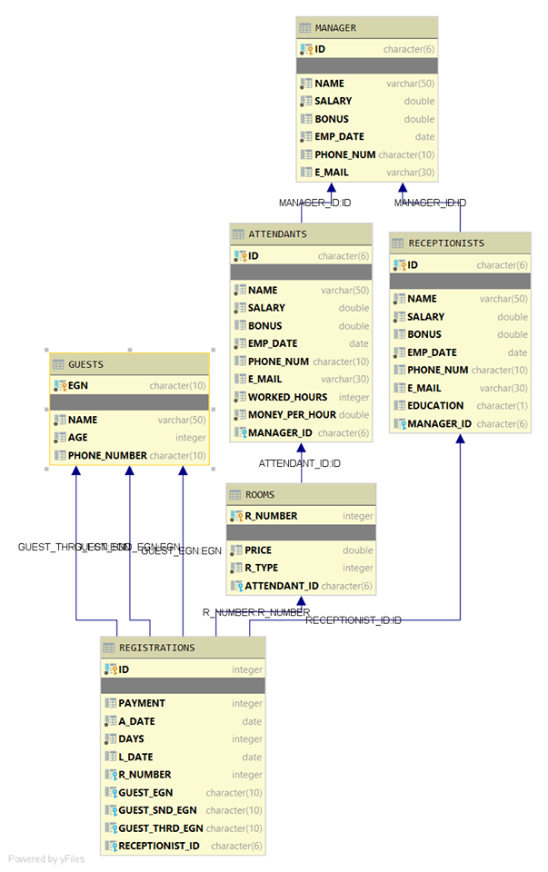
Изглед на релационния модел

Slide 8
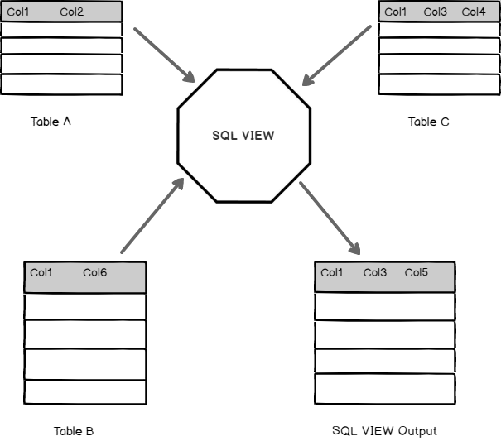
Описание на изгледите

Slide 9
Views
Изглед MANAGERS_BEFORE_2017
Изглед RECEPTIONISTS_REGISTERED_ON_3_FLOOR
Изглед REGISTRATION_CURR_YEAR

Slide 10
Изглед TWO_GUESTS_ROOMS
Изглед ATTENT_PHONE_BONUS
Изглед GUESTS_AGE_NAME

Slide 11
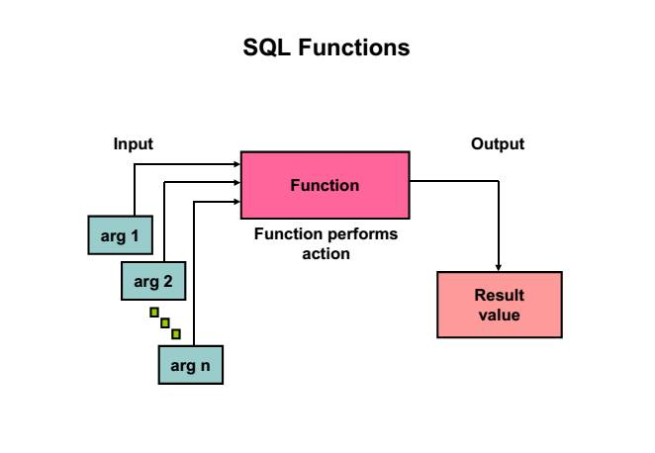
Описание на функциите

Slide 12
Скаларни функции в БД
Функция GET_ROOM_TYPE
CREATE FUNCTION GET_ROOM_TYPE(R_NUM INTEGER) RETURNS INTEGER RETURN SELECT R_TYPE FROM ROOMS WHERE R_NUMBER = R_NUM;
VALUES FN71840.GET_ROOM_TYPE(201); SELECT FN71840.GET_ROOM_TYPE(R_NUMBER) AS R_NUM, PRICE AS R_PRICE FROM ROOMS;
Функция GET_REG_DATE
CREATE FUNCTION GET_REG_DATE(REG_ID INTEGER) RETURNS DATE RETURN SELECT A_DATE FROM REGISTRATIONS WHERE ID = REG_ID; VALUES FN71840.GET_REG_DATE(3); SELECT FN71840.GET_REG_DATE(ID) AS REG_A_DATE, L_DATE AS REG_L_DATE FROM REGISTRATIONS;

Slide 13
Функцията - GET_MANAGER_EMAIL
CREATE FUNCTION GET_MANAGER_EMAIL(MNG_ID CHARACTER(6)) RETURNS VARCHAR(30) RETURN SELECT E_MAIL FROM MANAGER WHERE ID = MNG_ID;
VALUES FN71840.GET_MANAGER_EMAIL('MNG205');
SELECT NAME AS MNG_NAME, FN71840.GET_MANAGER_EMAIL(ID)
AS MNG_EMAIL
FROM MANAGER;
Функцията - GET_ATT_NAME
CREATE FUNCTION GET_ATT_NAME(ATT_ID CHARACTER(6)) RETURNS VARCHAR(50) RETURN SELECT NAME FROM ATTENDANTS WHERE ID = ATT_ID;
VALUES FN71840.GET_ATT_NAME('ATT133');
SELECT FN71840.GET_ATT_NAME(ID) AS ATT_NAME FROM ATTENDANTS;

Slide 14

Функцията – GET_GUEST_PHONE
CREATE FUNCTION GET_GUEST_PHONE(G_EGN CHARACTER(10)) RETURNS CHARACTER(10) RETURN SELECT PHONE_NUMBER FROM GUESTS WHERE EGN = G_EGN ;
VALUES FN71840.GET_GUEST_PHONE('7801235465');
SELECT FN71840.GET_GUEST_PHONE(EGN) AS G_EGN FROM GUESTS;

Slide 15
Таблични функции в БД
Функция - REGISTRATION_DETAILS
Функция - MANAGER_INFO
CREATE FUNCTION MANAGER_INFO(MNG_ID CHARACTER(6)) RETURNS TABLE(M_NAME VARCHAR(50), M_SALARY DOUBLE, M_BONUS DOUBLE, M_EMAIL VARCHAR(30)) RETURN SELECT NAME, SALARY, BONUS, E_MAIL FROM MANAGER WHERE ID = MNG_ID;
SELECT * FROM TABLE(FN71840.MANAGER_INFO('MNG205')) T;
CREATE FUNCTION REGISTRATION_DETAILS(R_ID INTEGER) RETURNS TABLE(ADATE DATE, LDATE DATE, RNUM INTEGER) RETURN SELECT A_DATE, L_DATE, R_NUMBER FROM REGISTRATIONS WHERE ID = R_ID;SELECT * FROM TABLE (FN71840.REGISTRATION_DETAILS(1)) R;

Slide 16
Функция - RECEPTIONIST_INFO
CREATE FUNCTION RECEPTIONIST_INFO(REC_ID CHARACTER(6)) RETURNS TABLE(R_NAME VARCHAR(50), R_SALARY DOUBLE, R_BONUS DOUBLE) RETURN SELECT NAME, SALARY, BONUS FROM RECEPTIONISTS WHERE ID = REC_ID;
SELECT * FROM TABLE(FN71840.RECEPTIONIST_INFO('REC621')) T;
Функция - GUEST_DETAILS
CREATE FUNCTION GUEST_DETAILS(G_EGN CHARACTER(10)) RETURNS TABLE(G_NAME VARCHAR(50), G_AGE INT, G_MOBILE CHAR(10)) RETURN
SELECT G.NAME, G.AGE, G.PHONE_NUMBER FROM GUESTS G WHERE G.EGN = G_EGN;
SELECT * FROM TABLE(FN71840.GUEST_DETAILS('7801235465')) G;

Slide 17
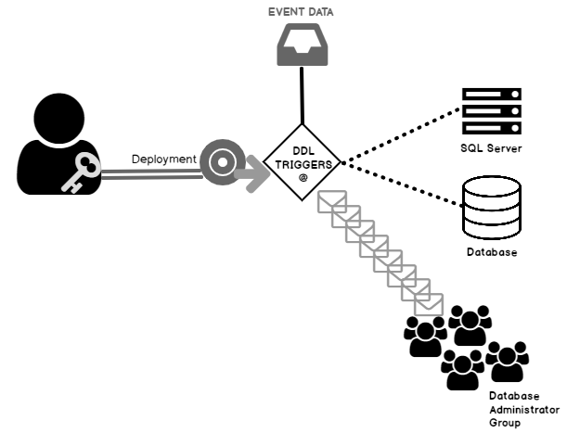
Описание на тригерите

Slide 18
After triggers
Тригер TRIG_NEW_REG CREATE TABLE REGISRATIONS_NEW LIKE REGISTRATIONS; -- Insert into copied table INSERT INTO REGISRATIONS_NEW SELECT * FROM REGISTRATIONS; -- Create table CREATE TABLE AUDIT_REG(CTIME_REG TIMESTAMP, TEXT VARCHAR(200)); -- Create the trigger CREATE TRIGGER TRIG_NEW_REG AFTER UPDATE OF DAYS ON REGISRATIONS_NEW REFERENCING OLD AS OLD_REG NEW AS NEW_REG FOR EACH ROW WHEN (OLD_REG.DAYS != NEW_REG.DAYS) BEGIN DECLARE V_TEXT VARCHAR(200); SET V_TEXT = ' REG_NO = ' || OLD_REG.ID || ' OLD DAYS = ' || INT(OLD_REG.DAYS) || ' NEW DAYS = ' || INT(NEW_REG.DAYS); INSERT INTO AUDIT_REG VALUES(CURRENT_TIMESTAMP, V_TEXT); END; UPDATE REGISRATIONS_NEW SET DAYS = DAYS + 5 WHERE ID = 10;

Slide 19
Тригер TRIG_NEW_ROOM
CREATE TABLE MY_ROOMS_NEW LIKE ROOMS; -- Insert into copied table INSERT INTO MY_ROOMS_NEW SELECT * FROM ROOMS; -- Create table CREATE TABLE AUDIT_ROOM(CTIME_REG TIMESTAMP, TEXT VARCHAR(200)); -- Create the trigger CREATE TRIGGER TRIG_NEW_ROOM AFTER UPDATE OF PRICE ON MY_ROOMS_NEW REFERENCING OLD AS OLD_ROOM NEW AS NEW_ROOM FOR EACH ROW WHEN (OLD_ROOM.PRICE != NEW_ROOM.PRICE) BEGIN DECLARE V_TEXT VARCHAR(200); SET V_TEXT = ' ROOM_NO = ' || OLD_ROOM.R_NUMBER || ' OLD ROOM PRICE = ' || INT(OLD_ROOM.PRICE) || ' NEW ROOM PRICE = ' || INT(NEW_ROOM.PRICE); INSERT INTO AUDIT_ROOM VALUES(CURRENT_TIMESTAMP, V_TEXT); END;
UPDATE MY_ROOMS_NEW SET PRICE = PRICE + 20 WHERE R_TYPE = 3;

Slide 20
Тригер TRIG_UPD_MNG
CREATE TABLE MANAGER_COPY LIKE FN71840.MANAGER; -- Insert into copied table INSERT INTO MANAGER_COPY SELECT * FROM FN71840.MANAGER; -- Create table CREATE TABLE AUDIT_MNG(C_TIME TIMESTAMP, TEXT VARCHAR(200)); --Create trigger CREATE TRIGGER TRIG_UPD_MNG AFTER UPDATE OF SALARY ON MANAGER_COPY REFERENCING OLD AS O NEW AS N FOR EACH ROW WHEN (O.SALARY != N.SALARY) BEGIN DECLARE V_TEXT VARCHAR(200); SET V_TEXT = ' MANAGER ID = ' || O.ID || ' OLD SALARY = ' || CHAR(O.SALARY) || ' NEW SALARY = ' || CHAR(N.SALARY); INSERT INTO AUDIT_MNG VALUES(CURRENT_TIMESTAMP, V_TEXT); END; SELECT NAME, SALARY, BONUS FROM MANAGER_COPY WHERE ID = 'MNG221'; UPDATE MANAGER_COPY SET SALARY = SALARY + 0.2 * SALARY WHERE ID = 'MNG221';

Slide 21
Тригер TRIG_UPD_REC
CREATE TABLE RECEPTIONISTS_COPY LIKE FN71840.RECEPTIONISTS; -- Insert into copied table INSERT INTO RECEPTIONISTS_COPY SELECT * FROM FN71840.RECEPTIONISTS; -- Create table CREATE TABLE AUDIT_REC(C_TIME TIMESTAMP, TEXT VARCHAR(200)); --Create trigger CREATE TRIGGER TRIG_UPD_REC AFTER UPDATE OF BONUS ON RECEPTIONISTS_COPY REFERENCING OLD AS O NEW AS N FOR EACH ROW WHEN (O.BONUS != N.BONUS) BEGIN DECLARE V_TEXT VARCHAR(200); SET V_TEXT = ' RECEPTIONIST ID = ' || O.ID || ' OLD BONUS = ' || INT(O.BONUS) || ' NEW BONUS = ' || INT(N.BONUS); INSERT INTO AUDIT_REC VALUES(CURRENT_TIMESTAMP, V_TEXT); END; SELECT NAME, SALARY, BONUS, EMP_DATE FROM RECEPTIONISTS_COPY WHERE ID = 'REC621'; UPDATE RECEPTIONISTS_COPY SET BONUS = BONUS / 2 WHERE ID = 'REC621';

Slide 22
Тригер TRIG_NEW_ATT
CREATE TABLE ATTENDANTS_NEW LIKE ATTENDANTS; -- Insert into copied table INSERT INTO ATTENDANTS_NEW SELECT * FROM ATTENDANTS; -- Create table CREATE TABLE AUDIT_ATT(CTIME TIMESTAMP, TEXT VARCHAR(200)); SELECT * FROM AUDIT_ATT; CREATE TRIGGER TRIG_NEW_ATT AFTER UPDATE OF BONUS ON ATTENDANTS_NEW REFERENCING OLD AS O NEW AS N FOR EACH ROW WHEN (O.BONUS != N.BONUS) BEGIN DECLARE V_TEXT VARCHAR(200); SET V_TEXT = ' ATT_NO = ' || O.ID || ' OLD BONUS = ' || INT(O.BONUS) || ' NEW BONUS = ' || INT(N.BONUS); INSERT INTO AUDIT_ATT VALUES(CURRENT_TIMESTAMP, V_TEXT); END; SELECT NAME, SALARY, BONUS FROM ATTENDANTS_NEW WHERE ID = 'ATT233'; UPDATE ATTENDANTS_NEW SET BONUS = BONUS + 300 WHERE ID = 'ATT233';

Slide 23
Before triggers
Тригер TRIG_ROOM_NEW
CREATE TABLE ROOMS_NEW LIKE ROOMS; -- before trigger CREATE TRIGGER TRIG_ROOM_NEW BEFORE INSERT ON ROOMS_NEW REFERENCING NEW AS N FOR EACH ROW WHEN (N.PRICE IS NOT NULL) SET N.PRICE = N.PRICE + 50; -- Insert into copied table INSERT INTO ROOMS_NEW SELECT * FROM ROOMS;
Тригер TRIG_REC_NEW
CREATE TABLE RECEPTIONISTS_NEW LIKE FN71840.RECEPTIONISTS; --Create trigger CREATE TRIGGER TRIG_REC_NEW BEFORE INSERT ON RECEPTIONISTS_NEW REFERENCING NEW AS N FOR EACH ROW WHEN (N.BONUS IS NOT NULL) SET N.BONUS = N.BONUS + 100; -- Insert into copied table INSERT INTO RECEPTIONISTS_NEW SELECT * FROM RECEPTIONISTS;

Slide 24
Тригер TRIG_GUESTS_NEW
CREATE TABLE GUESTS_NEW LIKE GUESTS; CREATE TRIGGER TRIG_GUESTS_NEW BEFORE INSERT ON GUESTS_NEW REFERENCING NEW AS N FOR EACH ROW WHEN (N.AGE IS NOT NULL) SET N.AGE = N.AGE + 1; -- Insert into copied table INSERT INTO GUESTS_NEW SELECT * FROM GUESTS;
Тригер TRIG_ATT_OTHER
CREATE TABLE ATT_OTHER LIKE ATTENDANTS; CREATE TRIGGER TRIG_ATT_OTHER BEFORE INSERT ON ATT_OTHER REFERENCING NEW AS N FOR EACH ROW WHEN (N.SALARY IS NOT NULL) SET N.SALARY = N.SALARY + 500; INSERT INTO ATT_OTHER SELECT * FROM ATTENDANTS;

Slide 25
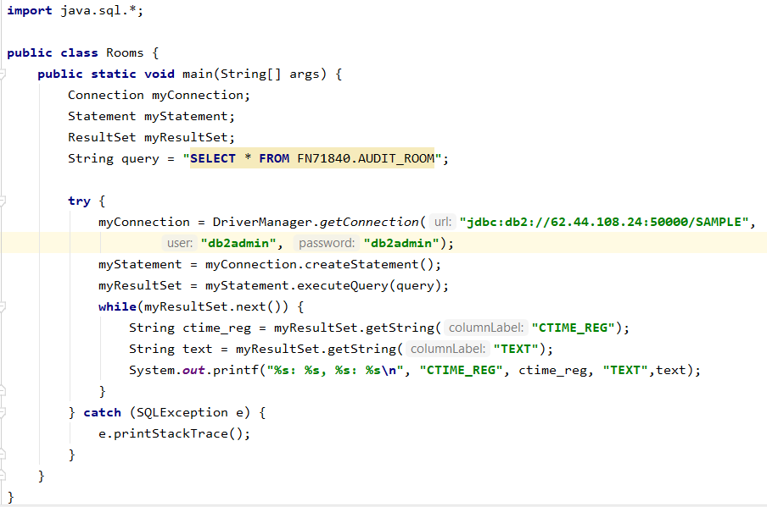
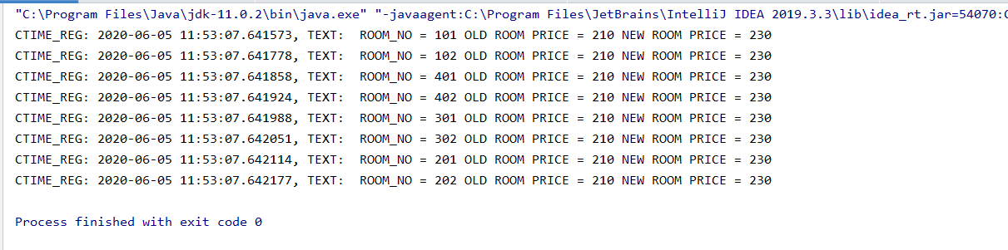
Описание на приложението за достъп с резултатите от заявката
Достъп до таблицата GUESTS.

Slide 26
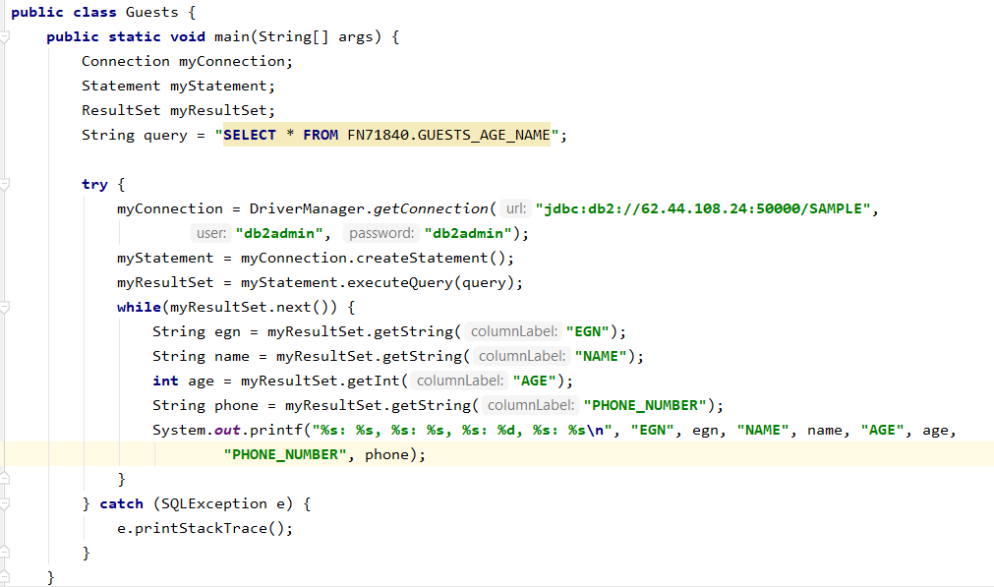
Достъп до таблицата AUDIT_ROOM

Slide 27


