Slide 1

Kristina joksimović 1805

Slide 2
Sadržaj
Šta je Kubernetes?
Zašto?
Minikube vs Docker Desktop
Control Plane i Nodes
Pods, ReplicaSets, Deployments, DaemonSets
Service, labele i selektori
Skaliranje i rolling updates
StatefulSets/Reliable Singletons + PV/PVC
Monitoring i zdravlje
ConfigMaps i Secrets
Primer: Beverage Service

Slide 3

Šta je Kubernetes?
Platforma za orkestraciju kontejnera
Planira, pokreće, nadgleda
Deklarativna konfiguracija: YAML -> Željeno stanje
Samoizlečivost, otkrivanje servisa, skaliranje

Slide 4
Zašto?
Visoka dostupnost, perzistencija, skaliranje
Compose: jednostavan, 1 host, bez scheduler-a, bez prob-a/rollout-a.
K8s: klaster, rolling update/rollback, probes, service discovery, storage.

Slide 5
Minikube vs Docker Desktop
Minikube
Docker desktop
Lokalni K8s (VM)
Više podešavanja
Najjednostavnije lokalno
Vrlo laka integracija sa Dockerom

Slide 6
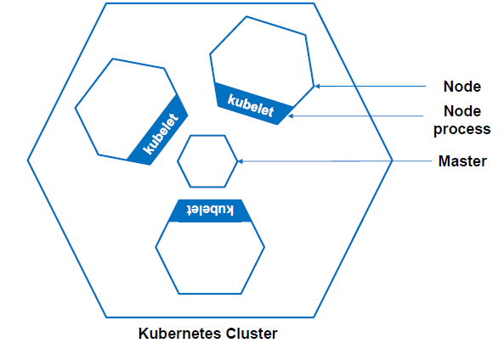
Control Plane i Nodes
API Server, Scheduler, Controller Manager
Node: kubelet, container runtime, VM ili fizički računar
Master/ Control Plane

Slide 7
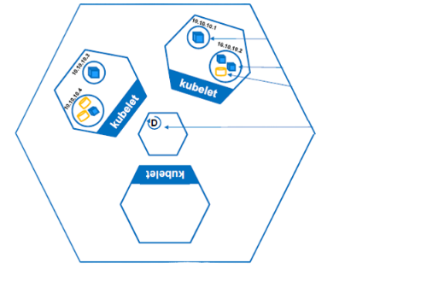
Pods, ReplicaSets, Deployments, DaemonSets
Kubernetes Cluster
Pod
Pod – najmanja jedinica
ReplicaSet – održava N replika podova
Deployment
DaemonSet – 1 pod po nodu
Containerized app
Volume
Deployment

Slide 8
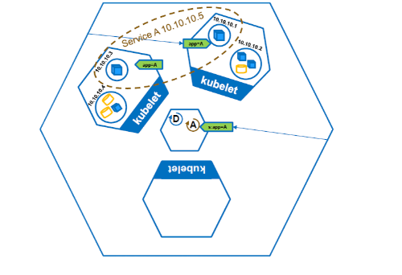
Service, labele i selektori
Kubernetes Cluster
Label
ClusterIP – interni IP/ DNS
NodePort – otvara port na hostu (30081)
Labele i selektori
Label Selector

Slide 9
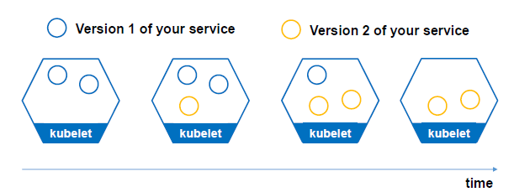
Skaliranje i rolling updates
kubectl scale ... --replicas=2
kubectl set image ... + kubectl rollout status

Slide 10
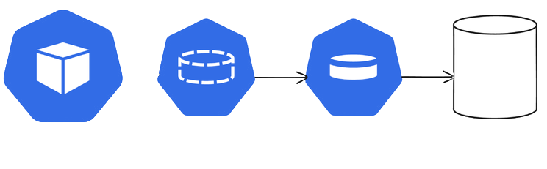
StatefulSets/Reliable Singletons + PV/PVC
Pod
PVC
PV
Storage
StatefulSet – headless service
Reliable Singleton – 1 replika komponente + storage
PV/ PVC

Slide 11
Monitoring i zdravlje
readinessProbe
livenessProbe

Slide 12
ConfigMaps i Secrets
ConfigMap: nginx.conf, APP_NAME.
Secret: MONGO_USERNAME, MONGO_PASSWORD

Slide 13
Primer: Beverage Service

