Slide 1



Kristina_Juskeviciene_Baigiamasis_darbas
View in Power BI
Last data refresh:
15/11/2023 17:44:34 UTC
Downloaded at:
16/01/2024 13:12:41 UTC

Slide 2
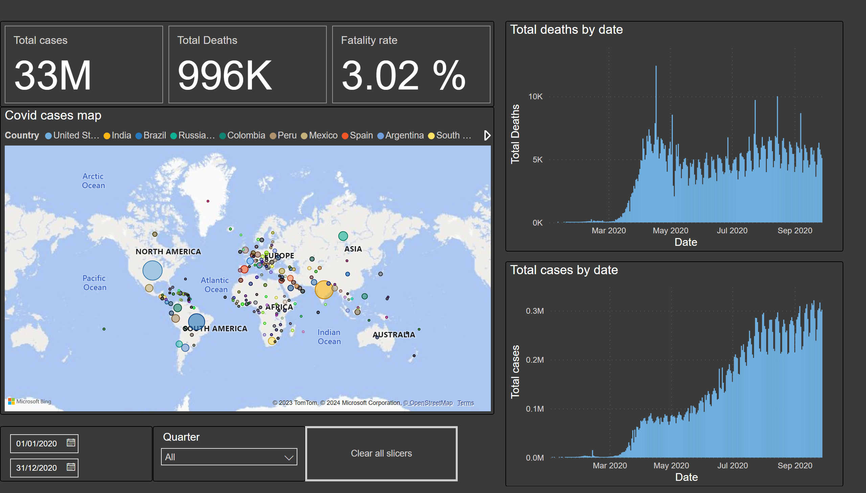
Global overview
Notes:
cardVisual
No alt text provided
slicer
No alt text provided
slicer
No alt text provided
Total cases by date
No alt text provided
Total deaths by date
No alt text provided
actionButton
No alt text provided
Covid cases map
No alt text provided

Slide 3
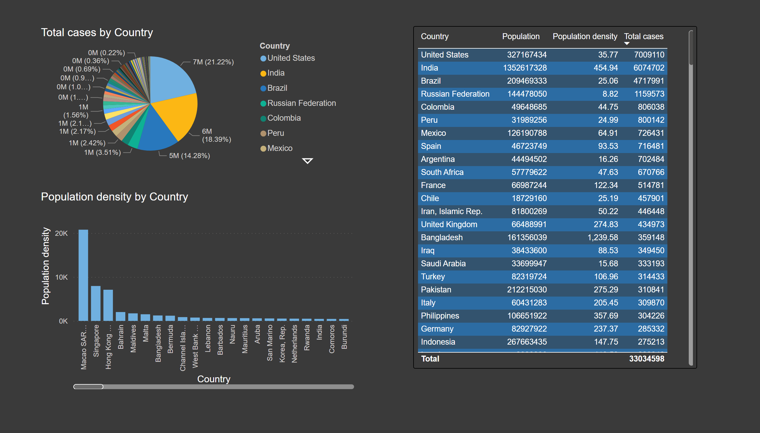
Populiation
Notes:
tableEx
No alt text provided
pieChart
No alt text provided
columnChart
No alt text provided

Slide 4
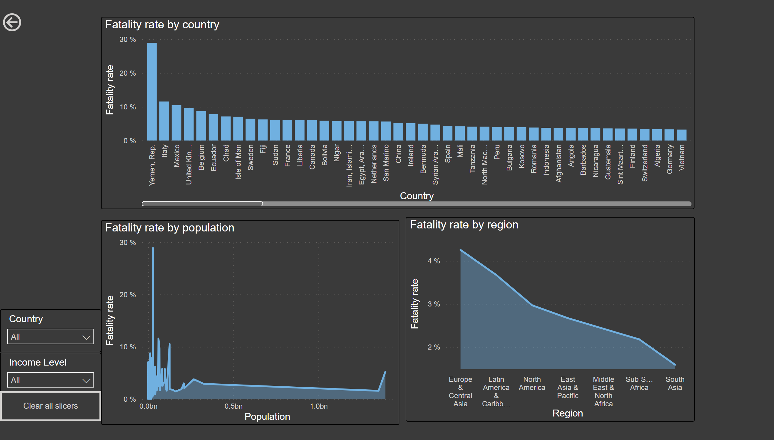
Mortality
Notes:
Fatality rate by population
No alt text provided
Fatality rate by region
No alt text provided
Fatality rate by country
No alt text provided
slicer
No alt text provided
slicer
No alt text provided
actionButton
No alt text provided
actionButton
No alt text provided

Slide 5
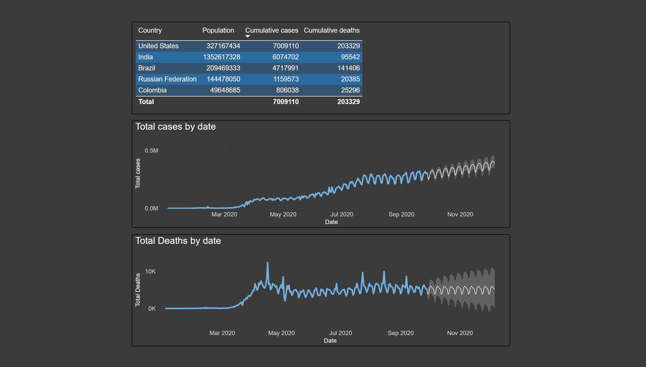
Summary
Notes:
tableEx
No alt text provided
Total cases by date
No alt text provided
Total Deaths by date
No alt text provided

