Slide 1

The web developer’s all-in-one toolbox!
Notes:
Mickey, is there any way to add your logo to the first page of the presentation? Kristina
Yep!. - Mickey

Slide 2
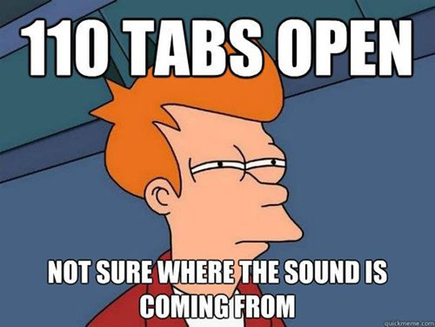
Notes:
The only thing I found so far that remotely fits our inspiration. Will keep looking. Kristina
Let’s paraphrase the pitch from our “About” page here. -Mickey
Also we should mention explicitly that the motivation was personal

Slide 3
Steps to Build
-Research relevant API’s and create mockup
-Discuss added features, UI design, and prioritize features/tasks
-Delegate responsibilities based on strengths and interests
-Research APIs and JS libraries
-Discuss new plans based on research
-Implement plan, using Slack/GitHub and class time to help each other and integrate parts
Notes:
Added this page - Maria

Slide 4
Team Work
Mickey: logo design, social media site
Maria: news site, authorization, firebase storage
John: user interface
Kristina: map, networking site

Slide 5







APIs and technologies used

Slide 6









Technologies and APIs we could not use
Notes:
Feel free to add logos of APIs or technologies you intended to use, but couldn’t. I didn’t remember what everyone was looking into. Kristina

Slide 7
Challenges
Trying to get other API’s to work
GitHub merging, resolving conflicts
Integration of backend to frontend
Learning new JavaScript libraries and applying that knowledge in a short amount of time
Time management - knowing when to stop looking for additional APIs and move on to other parts of the project
Notes:
I added API’s and modified a little here. -Maria

Slide 8
Possible Improvements
Add more APIs to work after learning about Node.js
Add username and e-mail authentication in addition to Google authentication
Working in two.js to make smaller versions of the logo that are still able to animate; displaying them at different screen sizes via media queries
Find ways to make it run faster
Other: include YouTube images in saved items, error message when not signed in, align drop-down menu, improve ui at various browser sizes
Notes:
Added several items to this page. – Maria

