Slide 1
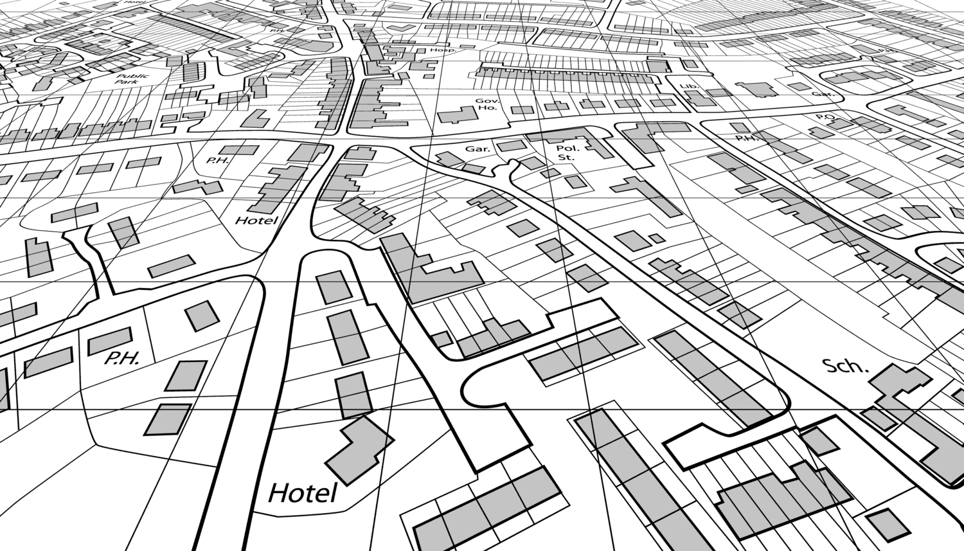
Mander-free

Slide 2
About us

Slide 3
What is gerrymandering?

Slide 4
Why is gerrymandering a problem?

Slide 5
Our solution

Slide 6
roadblocks

Slide 7
applications

