Slide 1
Data Virtualization: More Than Just Hype?
A Practical Implementation of a Virtualized Database System
Using the Denodo Platform

Slide 2
“If you ask for a cup of water, is it more efficient to bring the whole barrel and give you a cup from it, or to just go fetch a cup of water?” Ravi Shankar, CMO at Denodo
What is data virtualization?
Connects heterogeneous data sources
Abstraction layer to hide complexities of the data
Replication is little to non-existent
Real-time data access
High scalability for big data sources
Ability to create ad hoc queries without changing

Slide 3


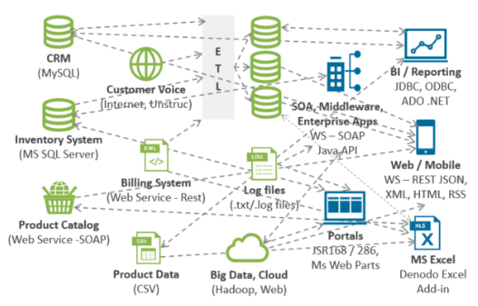
Before Data Virtualization

Slide 4
Denodo Technologies
What does denodo do?
Virtual DataPort allows integration of virtually any data source
Custom wrappers are built dynamically
Read and write access as permitted by user/data source
What sets denodo apart?
Completeness of data sources supported
ITPilot for Big Data applications/queries
Comprehensive documentation with tutorials, support, development forums

Slide 5
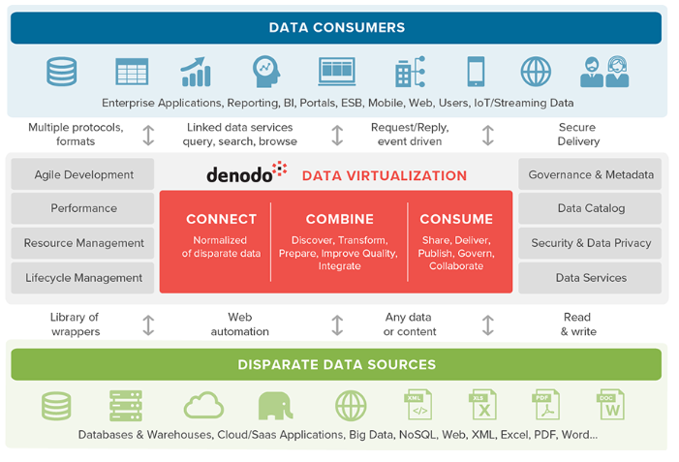
With Denodo

Slide 6
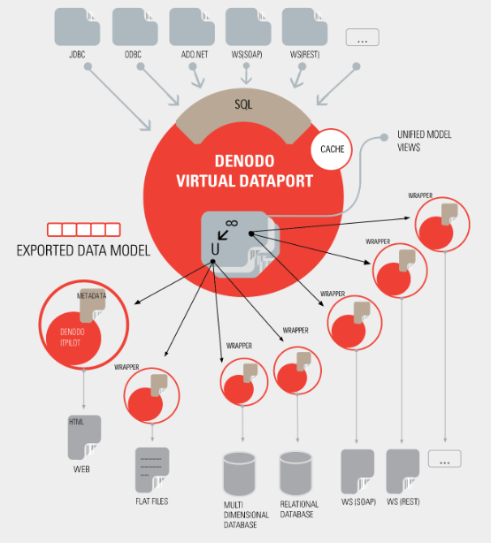
Denodo Under the Hood

Slide 7
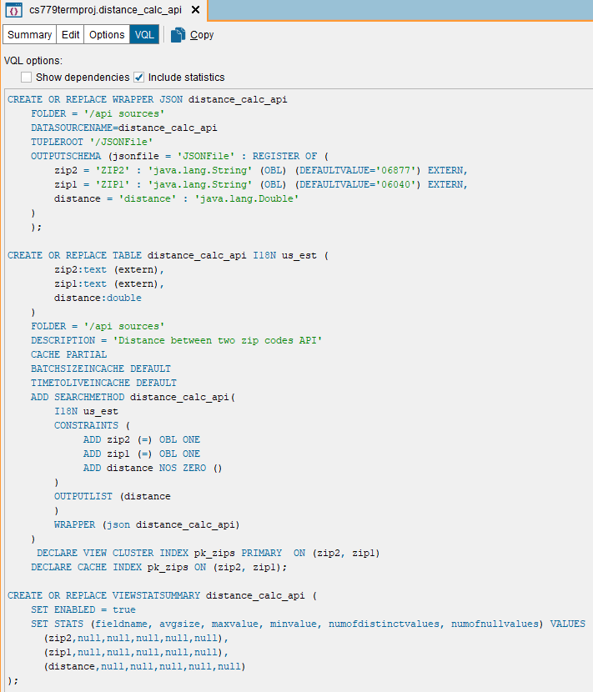
Denodo Under the Hood

Slide 8
Introduction to the ChMS App
Typical client profile
OLTP and CRM built in CS 669
Partial back-end application built in CS 521
Mission is to provide an application that improves operational outcomes and leverages data to improve community services and better serve population
Typical (fictional) client profile:
Places of worship, member-based organizations and community-based groups
Strong desire to leverage technology but lack resources for implementation
Finances often limited and/or strictly governed
Staff is often unskilled and/or limited, often volunteer-based
Notes:
New for 779: to glean data-driven insights into community needs and to access external data sources to facilitate access to community resources

Slide 9
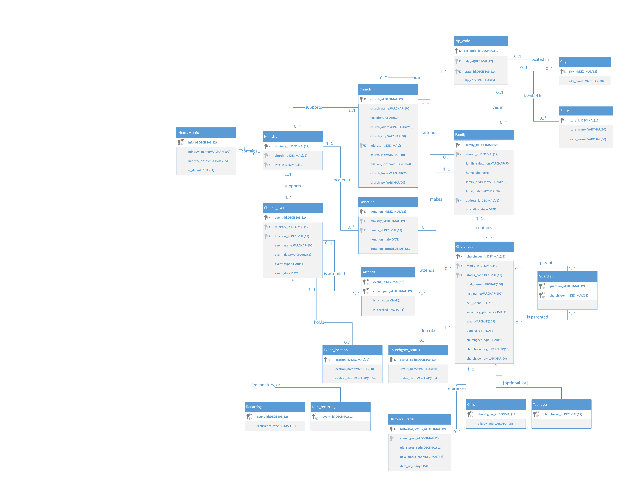
ChMS ERD
Notes:
Martin, K. (2018, October 15). Church Management System: CS669 Term Project.

Slide 10
Getting Started with Denodo
Getting denodo
Try the free version here: https://www.denodo.com/en/denodo-platform/denodo-express
Implement paid, full-feature version with AWS, Azure, or local environment
Straight-forward install, but note high memory requirements (16 GB recommended RAM)
Launching Vdp from control center
Denodo Virtual DataPort (VDP) Server (JVM) connection must be running
Launch data catalog, diagnostics as desired
Launch Virtual DataPort Administration Tool

Slide 11
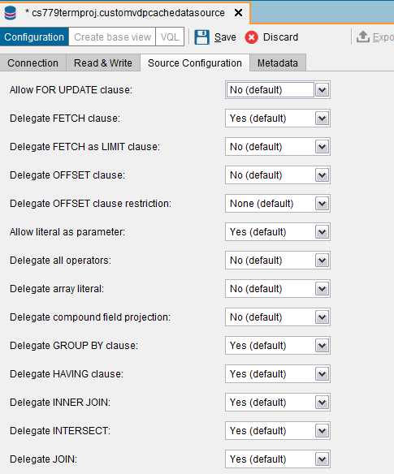
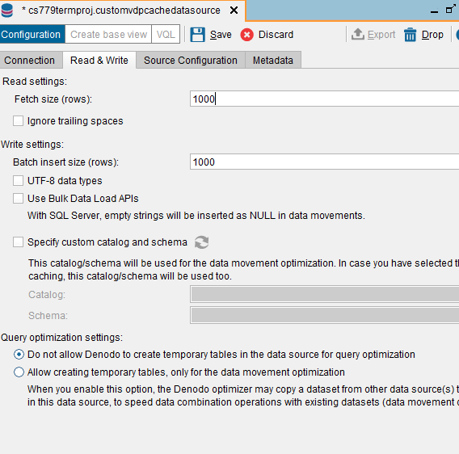
Setting Up Cache

Slide 12
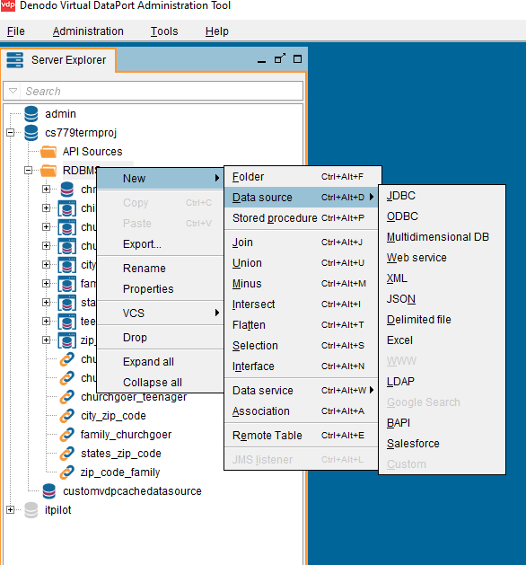
Selecting Data Sources

Slide 13
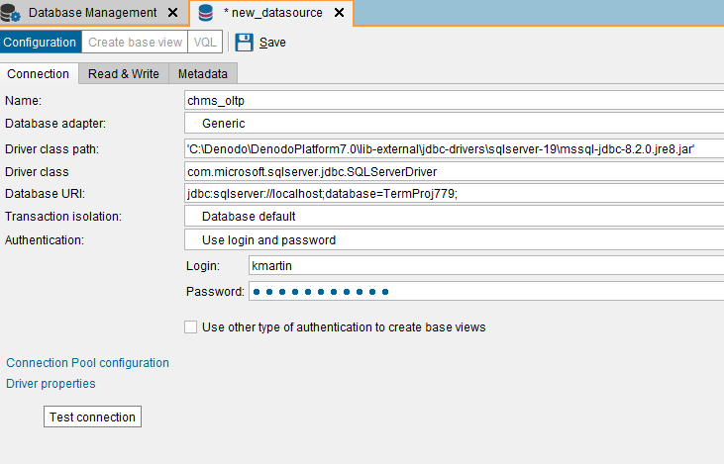
Importing Data Sources (JDBC)

Slide 14
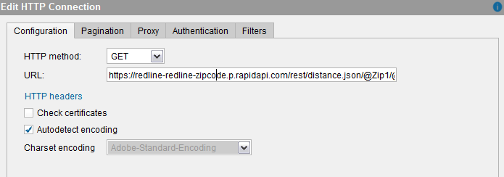
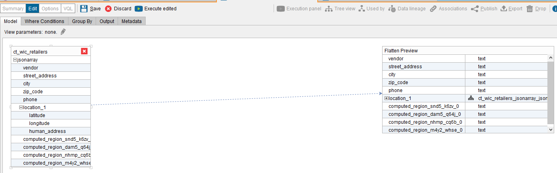
JSON/REST Data Sources Using Interpolation Variables & Flattening arrays
Connecting with interpolation variables
Flattening to create base view
Notes:
Interpolation variables are determined when a call is made to the API and can be passed explicitly or

Slide 15
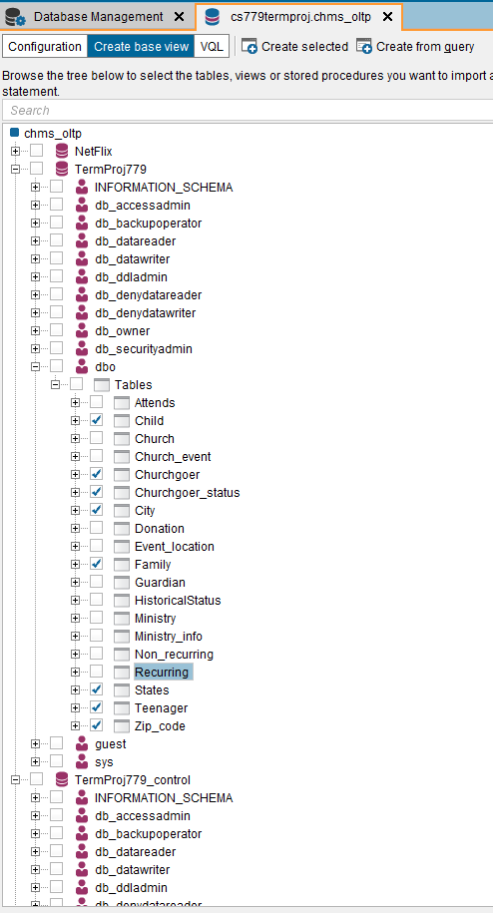
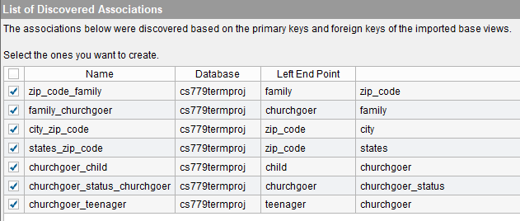
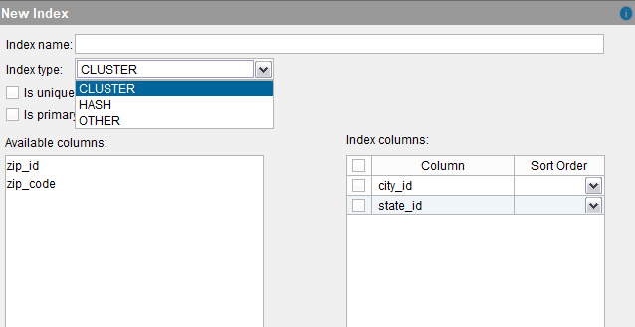
Base Views, Indexes & Associations

Slide 16
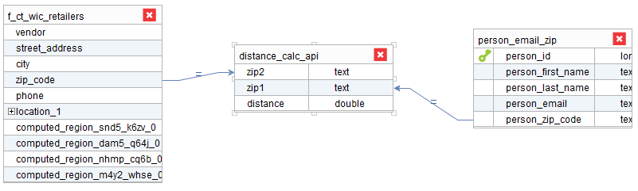
Creating Derived Views
Customizable from GUI or VQL query
Ability to selecting and altering fields including:
adding expressions, functions
Aggregations
Arithmetic calculations (either through denodo or delegated to data source)

Slide 17
Query Testing
JDBC (RDBMS) and REST Web Services (imported as .JSON) as base data sources
Tuning Consisted of:
Indexes
Adjust native optimizer (set to “on” by default) and query simplifiers (set to “on” by default)
Cache inclusion and cache indexes
Specifying execution plans
Adjusting memory allocation
Current authorized WIC retailers within a 5 mi radius of a member’s home zip code
Notes:
Note: WIC is a government program providing supplemental nutrition vouchers to women of infants, and infants and children

Slide 18
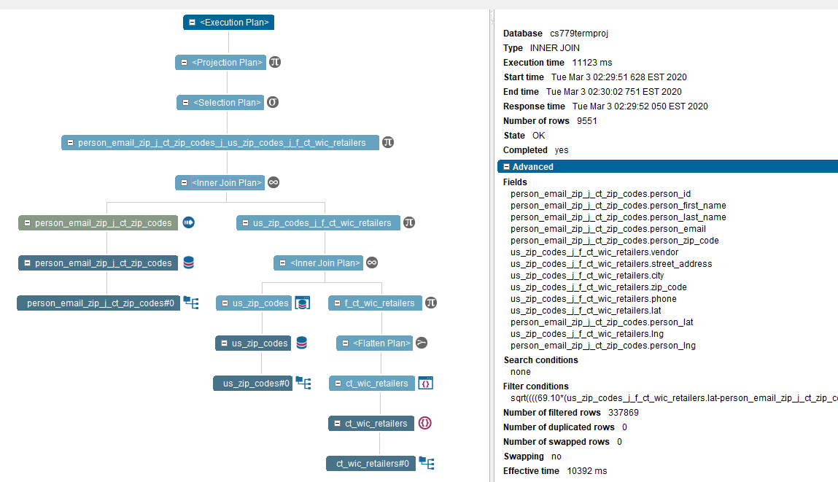
Before Tuning

Slide 19
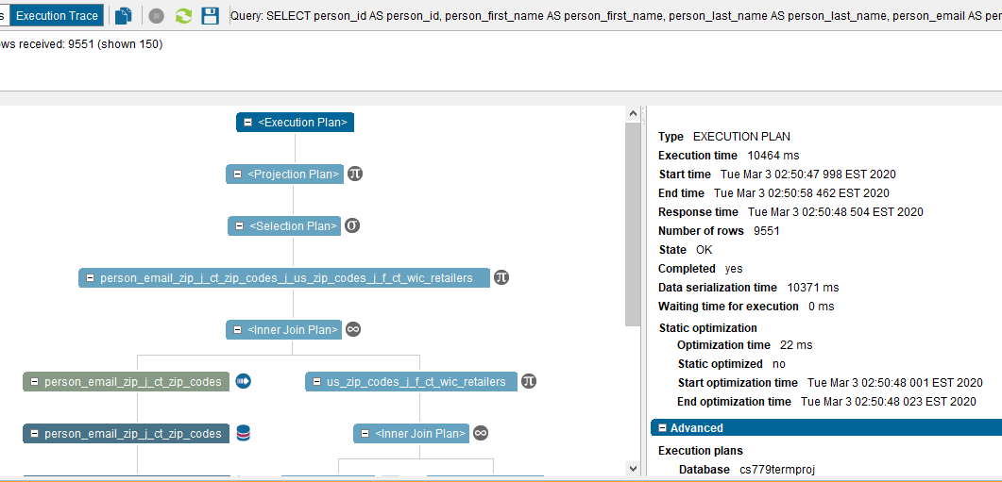
Cost Based Optimizer Off

Slide 20
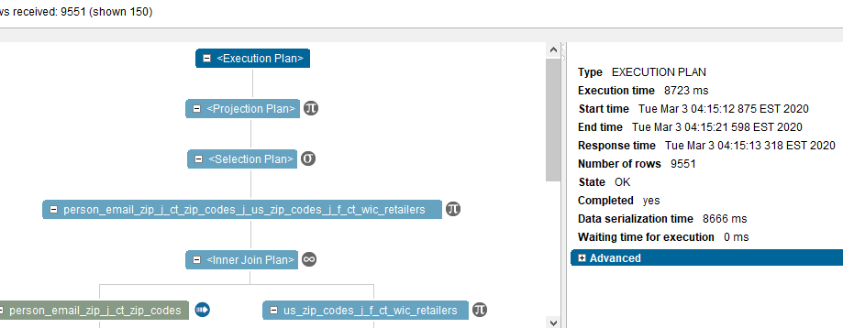
Specifying Execution Plan

Slide 21
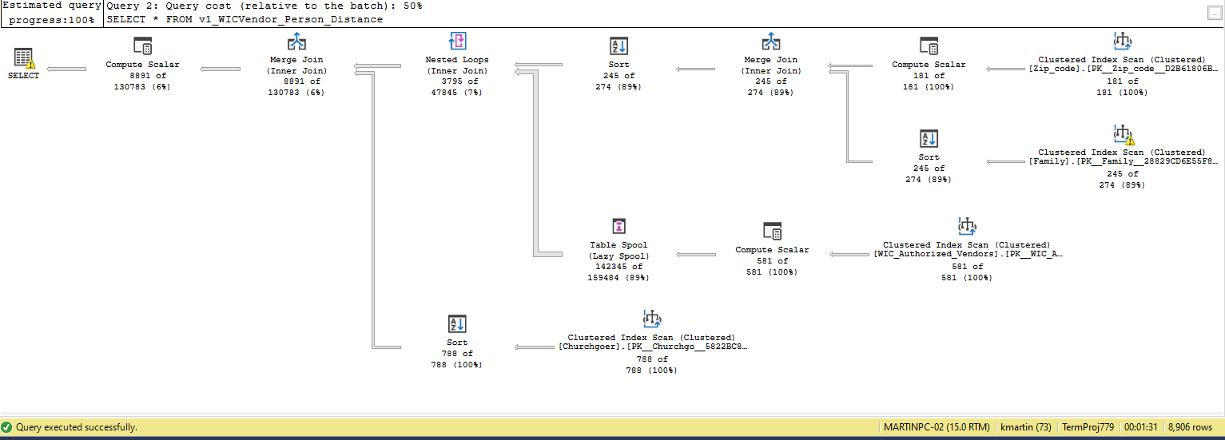
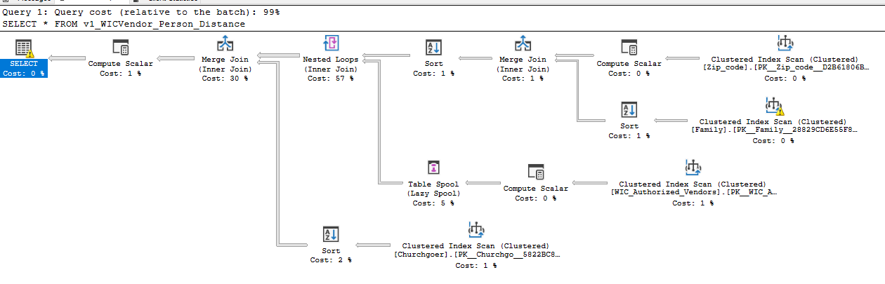
SQL Server Comparison
Note: data type interpretations in Denodo caused minor variation in distance calculation, resulting in slightly different result sets.

Slide 22
Is It Worth It?
Reasons to implement
Increased agility, decreased time-to-market
Improved flexibility, productivity
Delegate processing to data sources or process in Denodo JVM
Simplified, more efficient query process
Access to real-time heterogeneous data without knowledge of data source
Reasons not to implement
System resources required (8 – 16 GB RAM)
Licensing conflicts
Implementation overhead
Governance issues
Notes:
In some “…older Oracle databases, it is not possible to transfer the previous database licenses 1:1 to a virtualized system since the charges refer to the “potential” performance of the system and now what it actually uses”

Slide 23

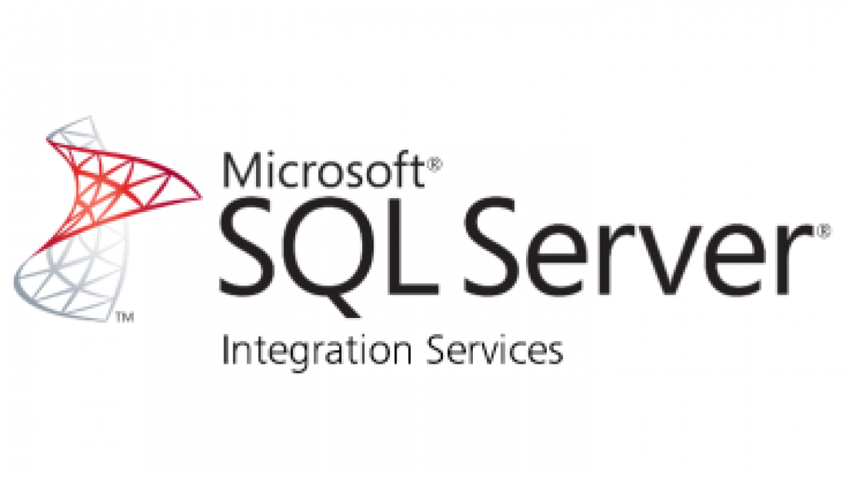



Alternatives to Denodo
Notes:
Data lakes are an alternative to data virtualization, “the data lake acts as…an operational data store. Such a data lake is used by business users, such as data scientists, directly and by the ETL processes that copy the data from the lake to the data warehouse. Replication or streaming technology is used to keep the data lake up to date. From a complete data history perspective and integration of data, this is an interesting alternative. However, it scores poorly on making real-time data available. “
Denodo consistently ranks at the top of data virtualization providers, but the field is becoming more crowded and Denodo is by no means the only way to integrate data sources, via data virtualization or otherwise.
data virtualization can use the in-memory power of Spark to temporarily cash data and speed up queries. Or, Spark can serve as a data source to a data virtualization implementation. For example, data can be streamed with Kafka into Spark. That data can then be made available through data virtualization to support real-time BI dashboards. A data virtualization server can also act as a data source for Spark. This would enable Spark to access even more data sources, and, maybe more importantly, it would enable Spark to execute distributed joins.

Slide 24
Questions?

Slide 25
References
Blomberg, B. (2015, June 11). The Pros and Cons of Database Virtualization. Retrieved from The Data Recovery Blog by Ontrack: https://www.ontrack.com/blog/2015/06/11/pros-cons-database-virtualization/
Denodo Community. (n.d.). General Architecture. Retrieved from Denodo.com: https://www.denodo.com/en/data-virtualization/how-it-works
Denodo Community. (n.d.). Hardware Requirements. Retrieved from Denodo Platform Installataion Guide: https://community.denodo.com/docs/html/browse/7.0/platform/installation/preinstallation_tasks/hardware_requirements/hardware_require ments
Denodo Solutions. (n.d.). Solutions By Use Case: Big Data. Retrieved from Denodo.com: https://www.denodo.com/en/solutions/by-use-case/big-data
Engel, M. (2019, February 20). Use Big Data to Engage Your People and Grow Your Church. Retrieved from Gloo Blog: https://blog.gloo.us/big-data-for- churches-introduction
Martin, K. (2018, October 15). Church Management System: CS669 Term Project.
Microsoft Community. (2019, August 12). Microsoft JDBC Driver for SQL Server. Retrieved from Microsoft SQL Docs: https://docs.microsoft.com/en- us/sql/connect/jdbc/microsoft-jdbc-driver-for-sql-server?view=sql-server-ver15
Polnar, J., & Schudy, R. (2019). Module 4. Advanced Database Management (MET CS 779). Boston, Massachusetts: Boston University Metropolitan College.
Pushpay. (2018, July 30). The Crucial Church Metric You’re (Probably) Not Measuring—But Should! Retrieved February 22, 2020, from Pushpay: https://www.vanderbloemen.com/blog/church-metric-not-measuring
Rapid API Developer Dashboard. (2020, March 4). Retrieved from Rapid API: https://rapidapi.com/developer/dashboard
van der Lans, R. (2019). Data Virtualization:Selected Writings. Lulu.com.
van der Lans, R. (2019, October). Modernizing Data Architectures for a Digital Age Using Data Virtualization. Retrieved from R20/Consultancy: https://www.denodo.com/en/document/analyst-report/modernizing-data-architectures-digital-age-using-data-virtualization
Van Der Lans, R. F. (2019, October 24). Spark and Data Virtualization: Competitors or Cooperators? Retrieved from Data Virtualization Blog: http://www.datavirtualizationblog.com/spark-and-data-virtualization-competitors-or-cooperators/
Wayana Software. (2015). Great Circle Distance Calculator. Retrieved from Geosats.com: http://www.geosats.com/0x2circ.html
WIC Authorized Vendors. (n.d.). Retrieved from Connecticut Data: https://data.ct.gov/Health-and-Human-Services/WIC-Authorized-Vendors/jk32-cd4i

