Slide 1
Bi-lingual Video Conferencing
ECE601 Placement Exam
August 30, 2019
Kristi Perreault

Slide 2

Agenda
Bi-lingual Video Conferencing
Agile Tools
Product Concept
Option Analysis
User Persona
MVP & System Architecture
Testing Strategy
Challenges
Future Releases
Retrospective
Questions
Appendix

Slide 3

Agile Tools
Bi-lingual Video Conferencing
Kanban Board
  To-do, In Progress, Done
Story Writing
  “As a…I want…so that…”
  Acceptance criteria
Sprint planning & backlog
Daily standup
Retrospective

Slide 4

Product Concept
Bi-lingual Video Conferencing
Rapid growth in communication
Video chat supports multiple languages
Real time audio translation
Opportunities
  Working remote
  Long distance relationships
  Travel

Slide 5
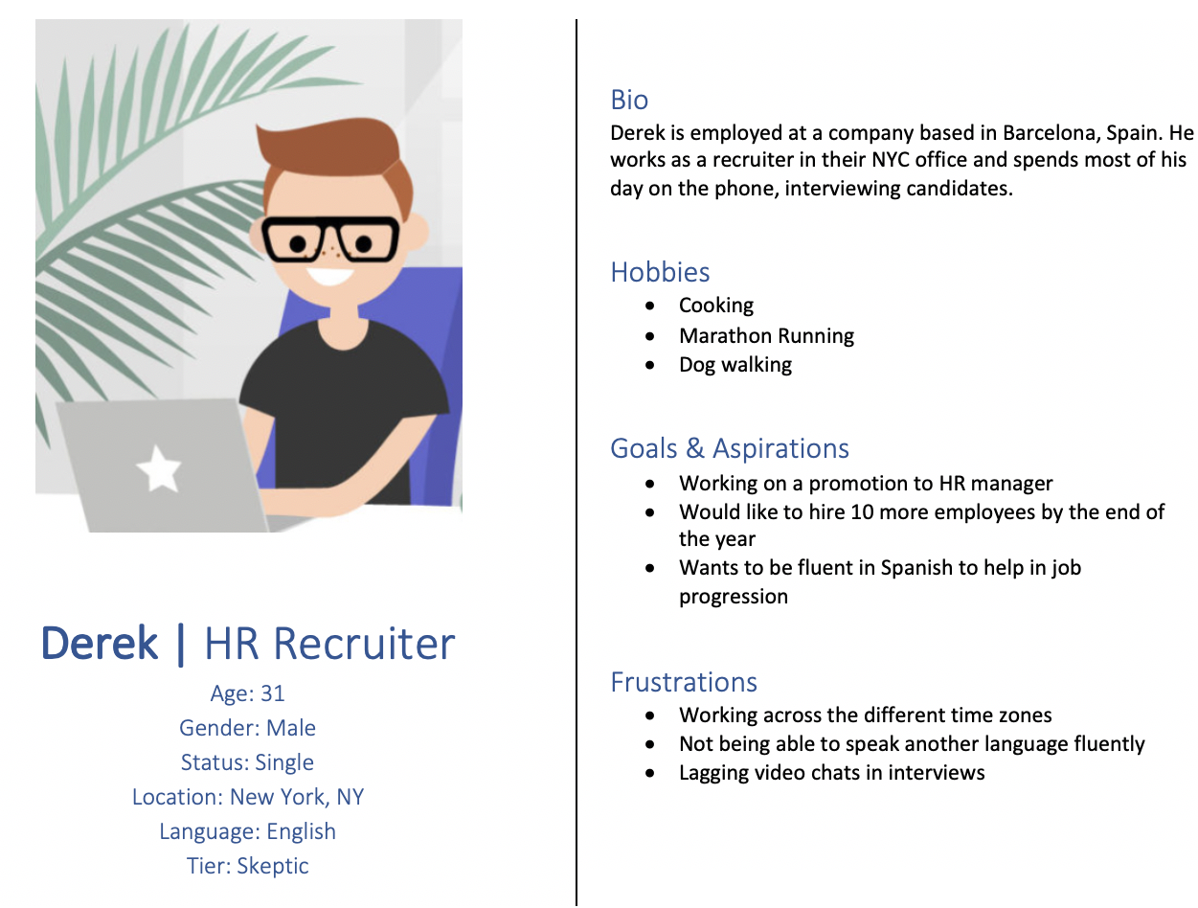
User Persona
Bi-lingual Video Conferencing

Slide 6




Option Analysis
Bi-lingual Video Conferencing
Microsoft Azure
  Skype Bi-lingual Video Conferencing
  Microsoft Translate
  Microsoft Cognitive Services
Google Cloud
  Google Hangouts
  Google Translate
IBM Watson
  Natural Language
  Text/Speech
Amazon Web Services
  Amazon Transcribe
  Amazon Translate
  Amazon Polly

Slide 7

Minimal Viable Product (MVP)
Bi-lingual Video Conferencing
Video conferencing capability
  Place and receive calls
  Video feed present
Basic user interface
  Dial, call, hang up
  Adjust volume
  Set language
Language translation
  English and Spanish
  Audio to text in real time
  Cloud services

Slide 8
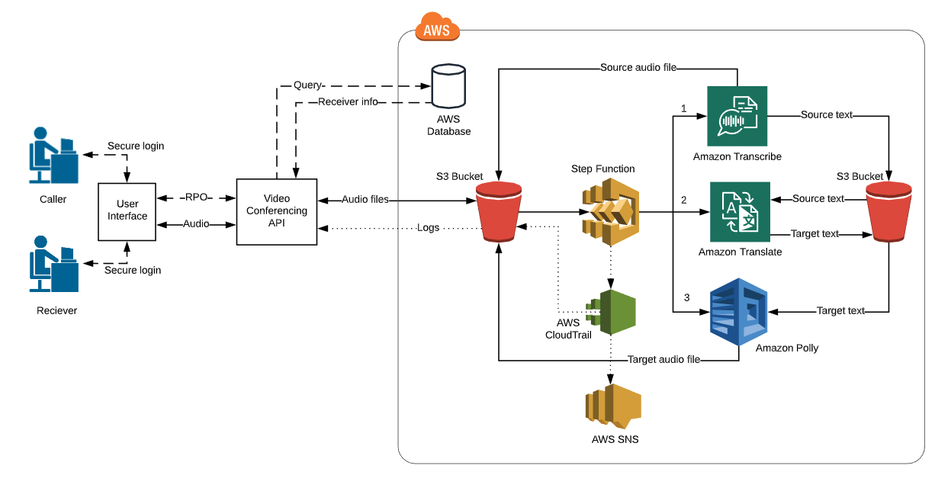
System Architecture
Bi-lingual Video Conferencing

Slide 9

Testing Strategy
Bi-lingual Video Conferencing
Manual testing
Unit testing
End to end testing
User testing
Logging
AWS Console
Validation service

Slide 10

Challenges
Bi-lingual Video Conferencing
Video Quality
  Latency
  Video feed
Real-time translation
  Multiple services
  Processing power
Storage
  Audio & text files
Price
  “Pay as you go”
  Cost per service

Slide 11

Future Releases
Bi-lingual Video Conferencing
Release Two
  Translate to and from another language
  Translated audio playback
  User profiles
Release Three
  Translate to and from a fourth language
  Ability to select voice type
  Chat window

Slide 12
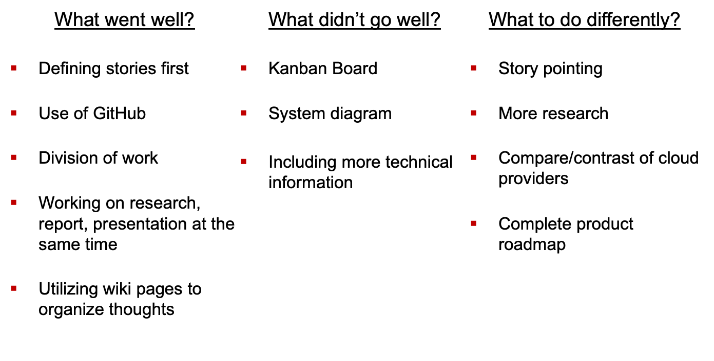
Sprint Retrospective
Bi-lingual Video Conferencing

Slide 13
Questions?
Bi-lingual Video Conferencing

Slide 14
Appendix
Bi-lingual Video Conferencing
GitHub Link
  https://github.com/kristiperreault/ece601-placement-exam
Kanban Board
  https://github.com/kristiperreault/ece601-placement-exam/projects/1
Wiki space
  https://github.com/kristiperreault/ece601-placement-exam/wiki
Email
  kristip@bu.edu

