Slide 1
Bicycle Management app

Slide 2

The Main Aim
Management of available bicycle
Task for staff
Manage maintances
Charts and Diagrams to analize
Control your number of bicycle in any stations

Slide 3
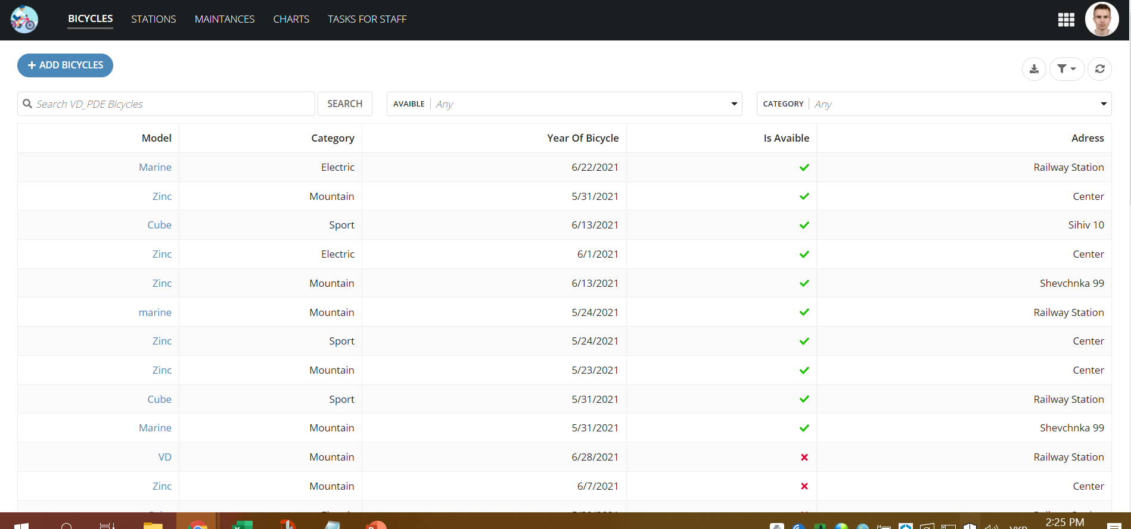
Management bicycle

Slide 4

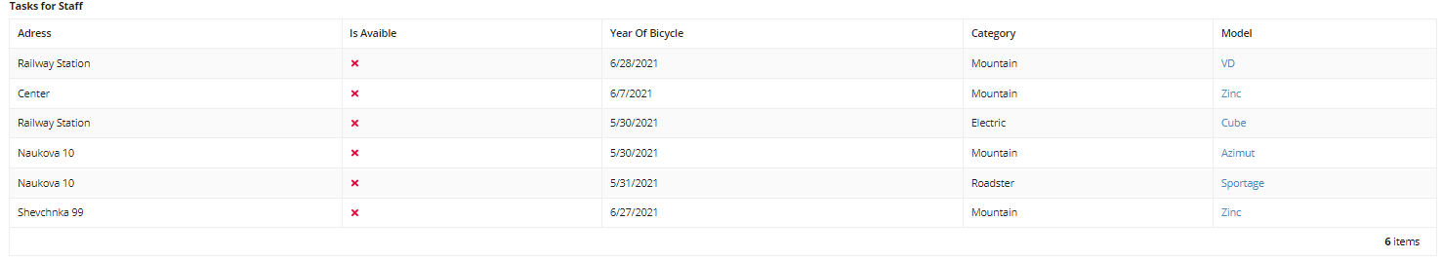
Task for Staff

Slide 5
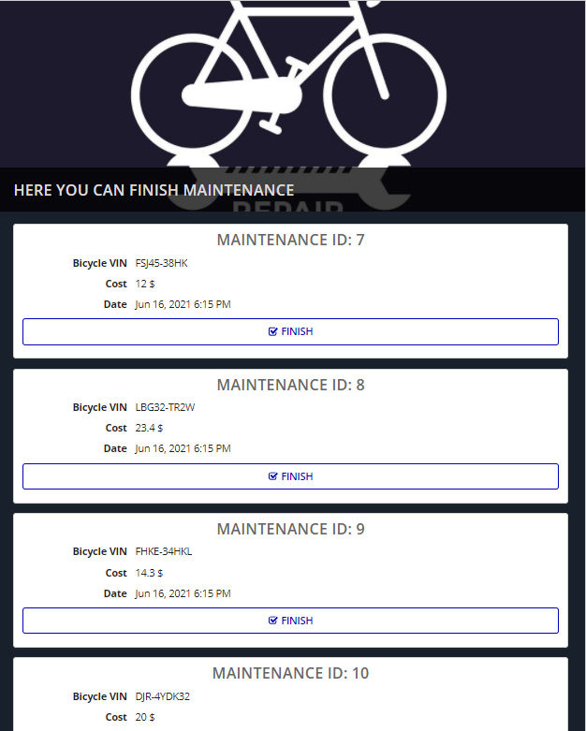
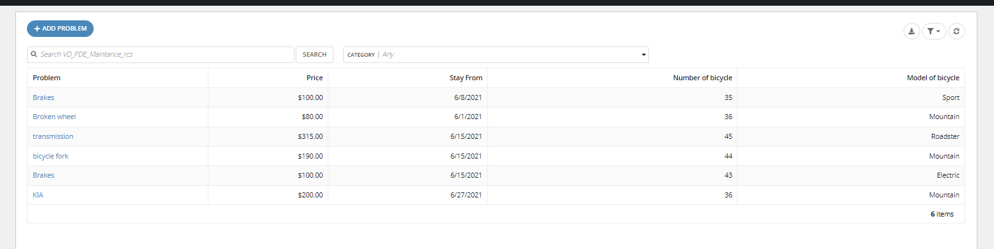
Manage Maintance

Slide 6
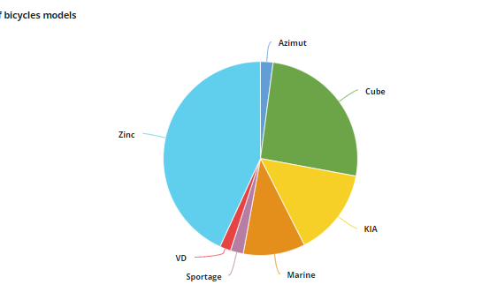
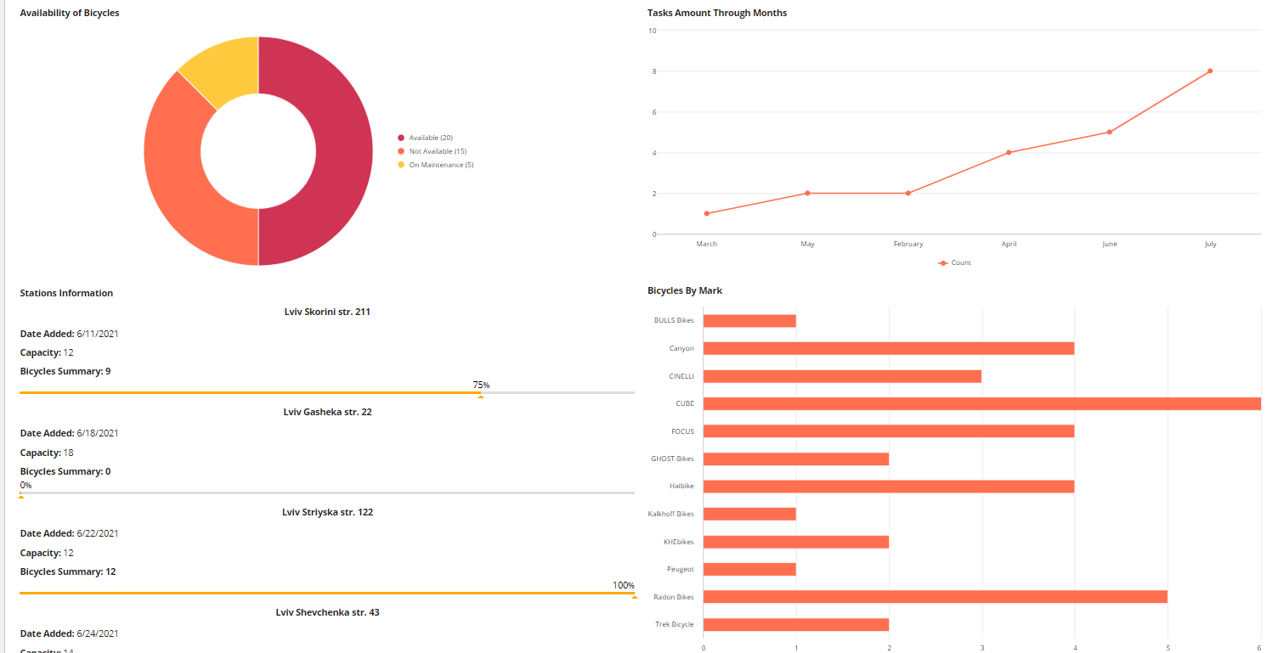
Diagrams and Charts

Slide 7
Type of User
PED Administranors | Contains user that have right of administrators
PED Supervisors | Contains users that have right of supervisor
PED Owners | Contains users that have right of Owners
PED Staff | Contains users that have right of staff members
PED ALL Uses | Contains all users

Slide 8
Advantages And Disadvantages
Advantages
Easy to use
Make from any device
Team app
Security because of Groups
Differency filters
Disadvantages
Limited Storage

Slide 9
Thanks for your Attention

