Slide 1
FLUID SIMULATION
Kristofer Schlachter

Slide 2
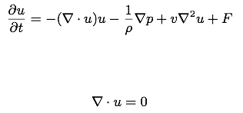
The Equations
Incompressible Navier-Stokes:
  “Incompressibility condition”

Slide 3
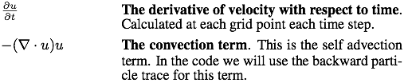

Breakdown

Slide 4
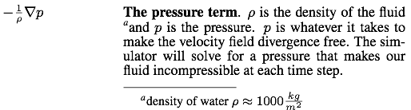
Breakdown

Slide 5
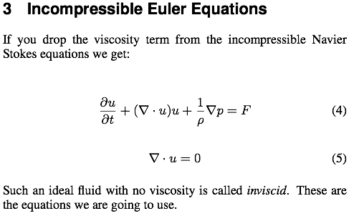

Slide 6
How do we discretize the equations?

Slide 7
A Simple Grid
We could put all our fluid variables at the nodes of a regular grid
But this causes some major problems
In 1D: incompressibility means
Approximate at a grid point:
Note the velocity at the grid point isn’t involved!
[Bridson 07]

Slide 8
A Simple Grid Disaster
The only solutions to are u=constant
But our numerical version has other solutions:
u
x
[Bridson 07]

Slide 9
Staggered Grids
Problem is solved if we don’t skip over grid points
To make it unbiased, we stagger the grid:
put velocities halfway between grid points
In 1D, we estimate divergence at a grid point as:
Problem solved!
[Bridson 07]

Slide 10
The MAC Grid
From the Marker-and-Cell (MAC) method [Harlow&Welch’65]
A particular staggering of variables in 2D/3D that works well for incompressible fluids:
  Grid cell (i,j,k) has pressure p_{i,j,k} at its center
  x-part of velocity u_{i+1/2,jk} in middle of x-face between grid cells (i,j,k) and (i+1,j,k)
  y-part of velocity v_{i,j+1/2,k} in middle of y-face
  z-part of velocity w_{i,j,k+1/2} in middle of z-face
[Bridson 07]

Slide 11
MAC Grid in 2D
[Bridson 07]

Slide 12

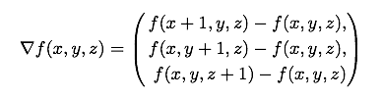
Math on a MAC Grid

Slide 13



Math on a MAC Grid
*There might be a one over h squared term missing

Slide 14
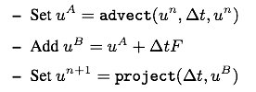
Simulation
*I am ignoring choosing a time step in this presentation

Slide 15
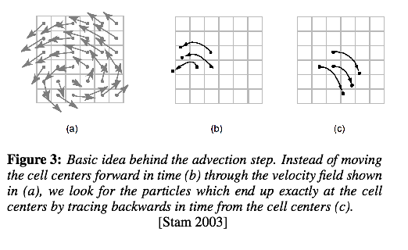
Advection

Slide 16
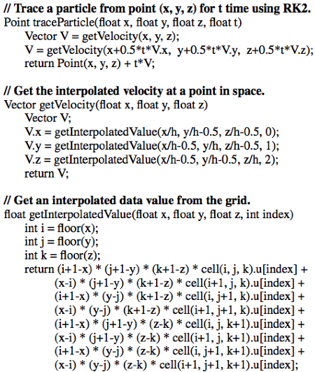


Advection

Slide 17
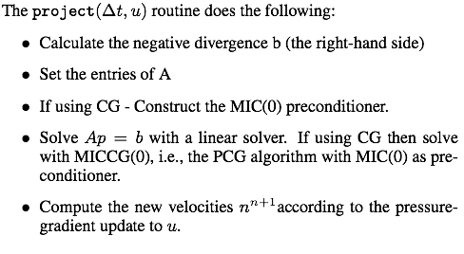
Projection

Slide 18

Projection
Setting up the divergence vector b (the right hand side)

Slide 19
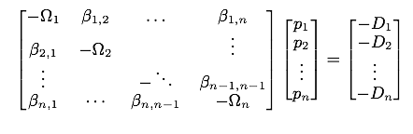

Projection
Setting up the matrix
Where Di corresponds to the divergences through cell i. Ωi is the number of non-solid neighbors of cell i, and βi,j takes values based upon the equation:
This matrix is well known. It is called a 7 Point Laplacian Matrix

Slide 20
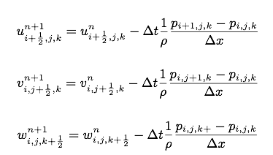
Projection
Calculate the pressure gradient and subtract it from the velocity field to ensure it is divergence free:

Slide 21
Demo

Slide 22
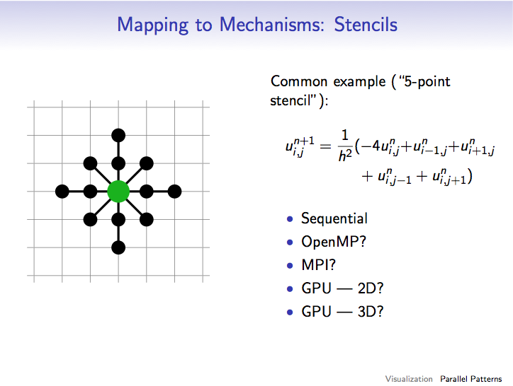
Implementation
Remember this slide from the last lecture?

Slide 23
Implementation
Thoughts on optimization for parallel execution
The most time consuming part of the sim is the pressure solve so the optimization should start with solving it quickly.
Optimizations for serial & CPU:
Blocking: Cache coherent.
Can send blocks to different cores
Optimizations for GPU:
Do blocking again using local memory to store each block.
For 3D use slicing, 3 Slices at a time putting middle slice (block) in local memory.

