Slide 1
Building PostDoc
An Issue-Driven Development Journey
From zero to Beta 1 – one issue at a time
ZipCodeWilmington · PostDoc Beta 1
1

Slide 2

ZCW PostDoc
What is PostDoc?
The Core Idea
Upload a PDF → get a short, shareable link.
No special software needed for visitors.
Optionally gate downloads behind an email address for lead capture.
This became the ideas that were the text to
Two Audiences
👤 Admins – log in, upload PDFs, manage documents.
🌐 Visitors – click a short link, optionally provide an email, get the PDF.
Built with Go · SQLite · Docker
PostDoc started as the simplest thing that could possibly work: A Go HTTP server that accepts a multipart/form-data POST containing a PDF file.
The file is saved to disk with its original name.
A plain URL like http://localhost:8080/report.pdf is returned so the caller can share it.
There was no login, sqlite3 database, no admin page—just a single route that saved a file and returned a URL.
This "version zero" was enough to prove the core idea: upload a PDF, get a shareable link.
2

Slide 3
ZCW PostDoc
@
PostDoc Beta 1
What Does the App do?
5

Slide 4
ZCW PostDoc
Beta 1 Target – What It Does
📤 Upload
🔗 Short Links
📧 Email Tracking
Drag-and-drop PDF upload with a clean admin interface
Every PDF gets a short, memorable URL instantly
Optional: require visitors to enter email before download
📋 Doc Management
📊 CSV Export
👥 Multi-Admin
Admin table showing all uploads, sizes, and download counts
Export document lists or download events to a spreadsheet
Multiple admin accounts, each with their own password
3

Slide 5
ZCW PostDoc
App Architecture
Architecture Overview (3-tier web application)
All routes are protected by JWT auth middleware — except the public /{slug} download route.
URL structure: /login / /upload /admin /documents /{slug}
SQLite3
Internet
Browser
HTTP Go Server
Uploads
4

Slide 6
ZCW PostDoc
Beta 1 UI – The Login Page
┌─────────────────────────────┐
│ ZCW PostDoc │
│ Admin access required. │
│ │
│ Username [____________] │
│ Password [____________] │
│ │
│ [ Sign in ] │
└─────────────────────────────┘
Key Points
• Any protected page redirects to /login if no valid session is found.
• Default credentials on fresh install: admin / foobar
• Wrong credentials show a red error banner above the form.
• After login, a JWT is stored in an HTTP-only cookie — the browser sends it on every request automatically.
5

Slide 7
ZCW PostDoc
Beta 1 UI – The Upload Page
┌──────────────────────────────────┐
│ ZCW PostDoc │
│ ⚙ Admin 📄 Documents Sign out │
│ │
│ ┌──────────────────────────┐ │
│ │ ↑ Drop PDF here │ │
│ └──────────────────────────┘ │
│ │
│ [ Upload & Get Link ] │
│ ☐ Track downloads (email) │
│ Only PDF files. Max 32 MB. │
└──────────────────────────────────┘
Key Points
• Drag-and-drop zone or click to open file picker.
• Only .pdf files accepted (client + server validation).
• 'Track downloads' checkbox: when checked, visitors must enter email before download. Email + timestamp saved to DB.
• After upload: a Success page shows the short URL with a one-click Copy button.
6

Slide 8
ZCW PostDoc
Beta 1 UI – Documents & Download Events
Documents Page (/documents)
☐ report.pdf 10 Mar admin 1.2 MB 3 📋 [short link]
☐ slides.pdf 11 Mar admin 4.7 MB 0 [short link]
[Delete Selected] ◄ Prev 1 Next ► [Download CSV]
Download Events Page (/documents/{id}/downloads)
alice@example.com 2026-03-11 09:14:02
bob@example.com 2026-03-11 10:30:55
[Download CSV]
Admins can view all uploads · bulk delete · see who downloaded · export to CSV
7

Slide 9
ZCW PostDoc
Tech Stack
Layer
Technology
Why It Was Chosen
Language
Go 1.24+
Fast, statically typed, single binary output
Database
SQLite 3 (WAL mode)
Zero-config, file-based, reliable for small-to-medium load
Auth
JWT (HS256, HTTP-only cookie)
Stateless, secure, no server-side session storage needed
Templates
Go html/template
Built-in, safe from XSS injection by default
Deployment
Docker / Docker Compose
Reproducible builds, persistent volumes, health checks
8

Slide 10
ZCW PostDoc
What is Issue-Driven Development?
Every meaningful code change starts with a written issue.
✅ Forces you to think clearly about WHAT to build before you build it.
✅ Closed issues form a living history of the project — why the code is the way it is.
✅ Naturally creates small, focused pieces of work instead of one giant untestable change.
✅ In a team, issues make it easy to divide work: 'I'll take #4, you take #6.'
IDD for PostDoc:
Start → #2 Security → #4 Passwords → #6 Docker → #8 Bug Fix → #10 Admin UI → #12 Tracking → #14 Bug Fix → #16 CSV
No special tool needed — GitHub Issues, a text file, or sticky notes all work.
9

Slide 11
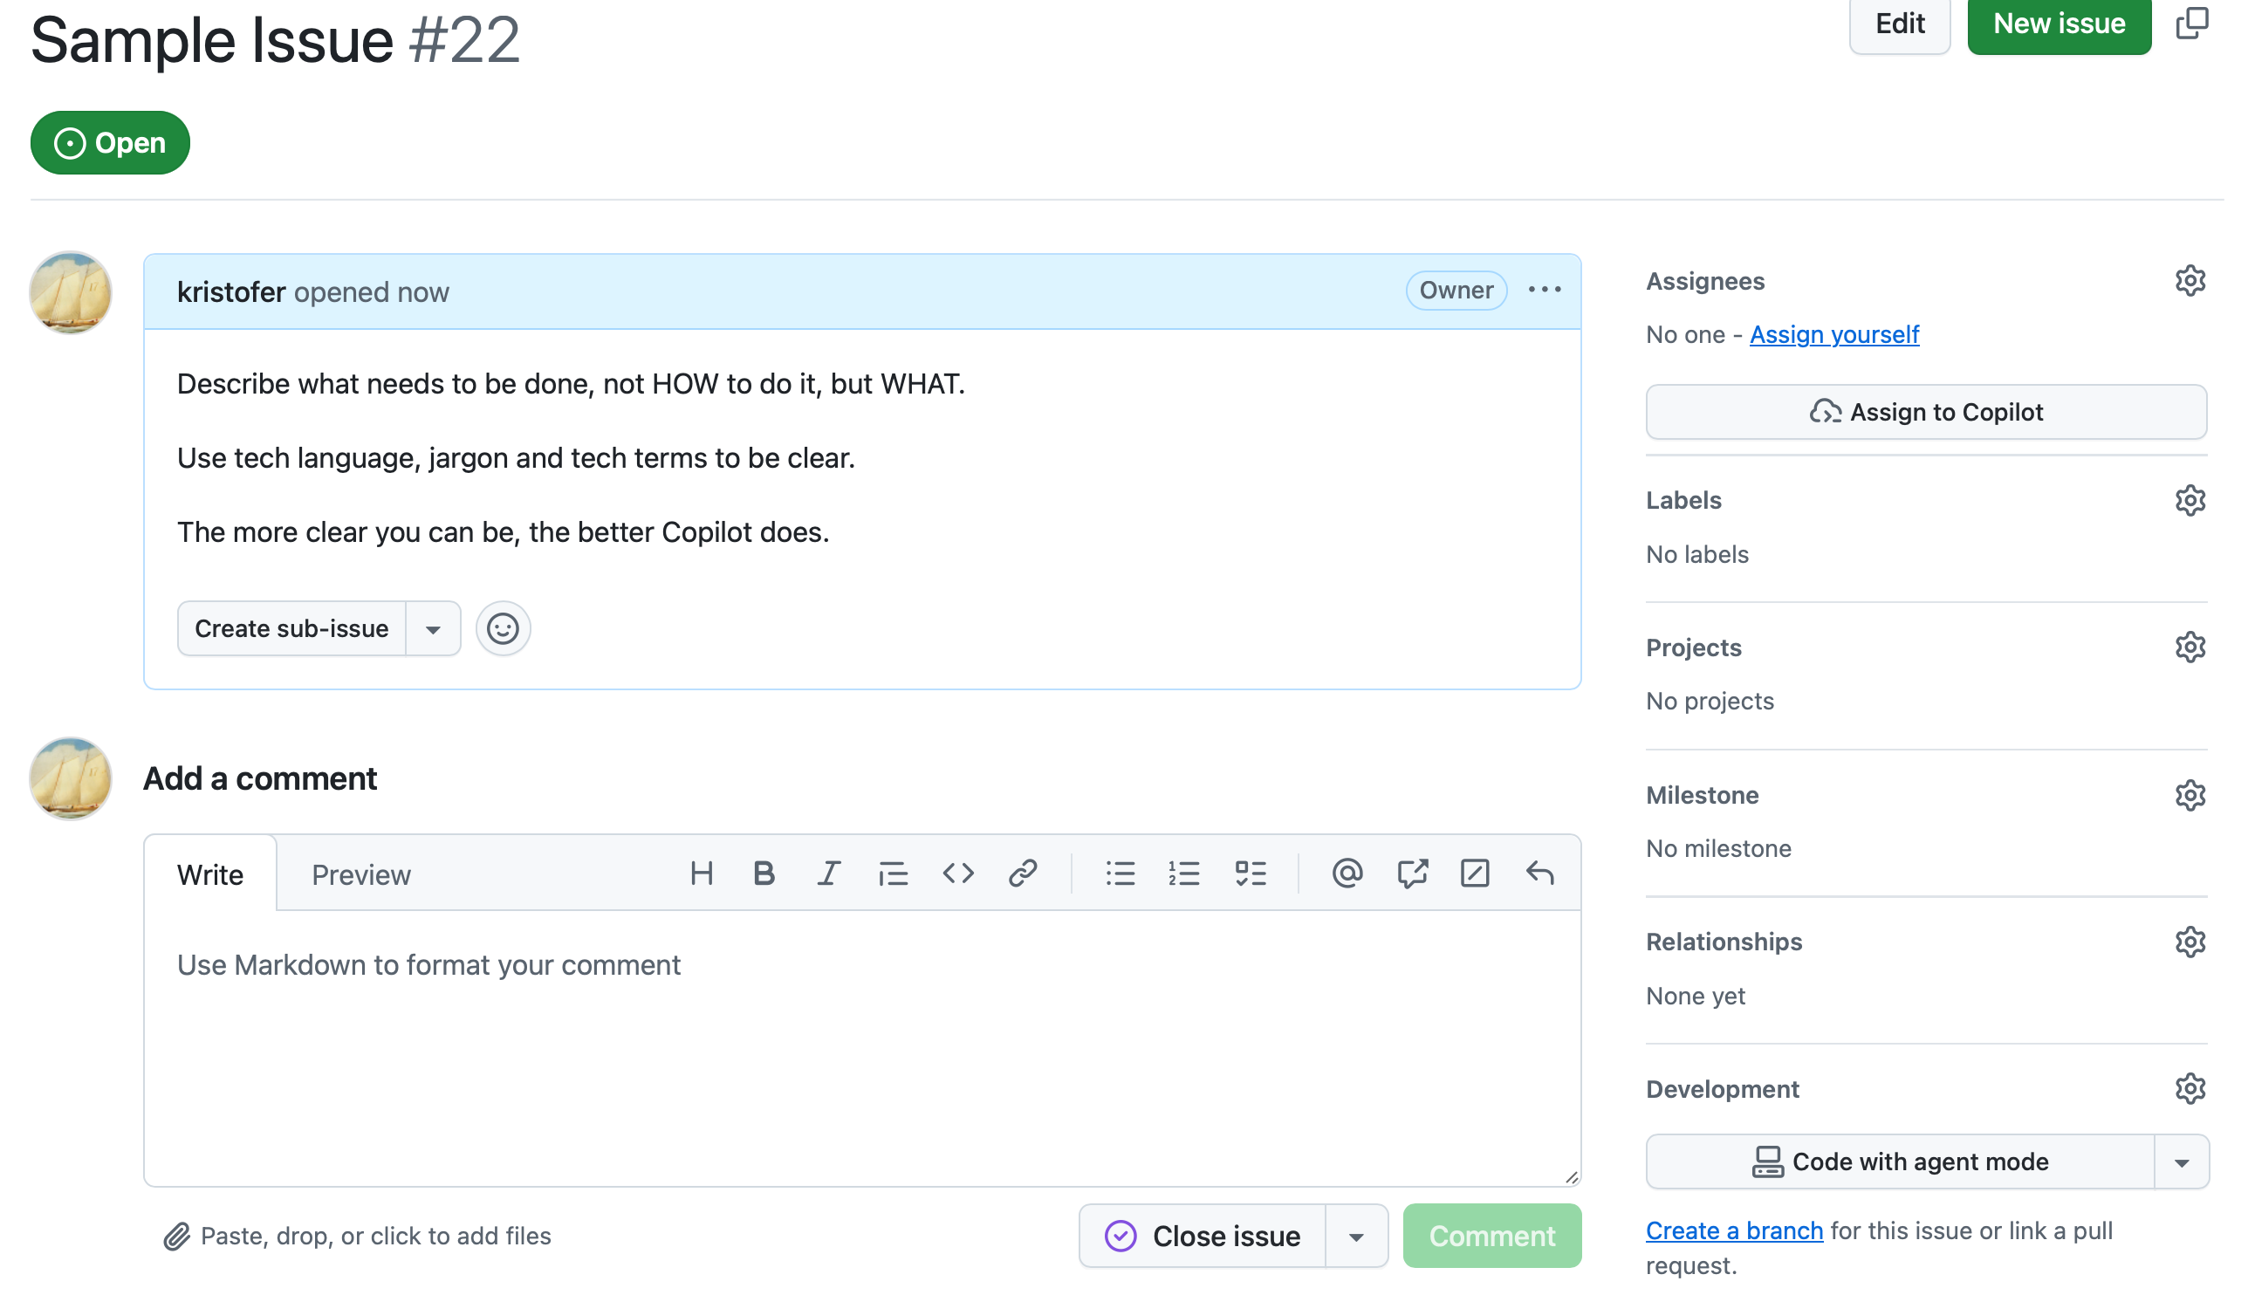
ZCW PostDoc
Use standard GitHub Issues in the repo
Whoa! What?!?
Copilot goes off and plans, codes, tests, & creates a Pull Request for you to approve.
9

Slide 12
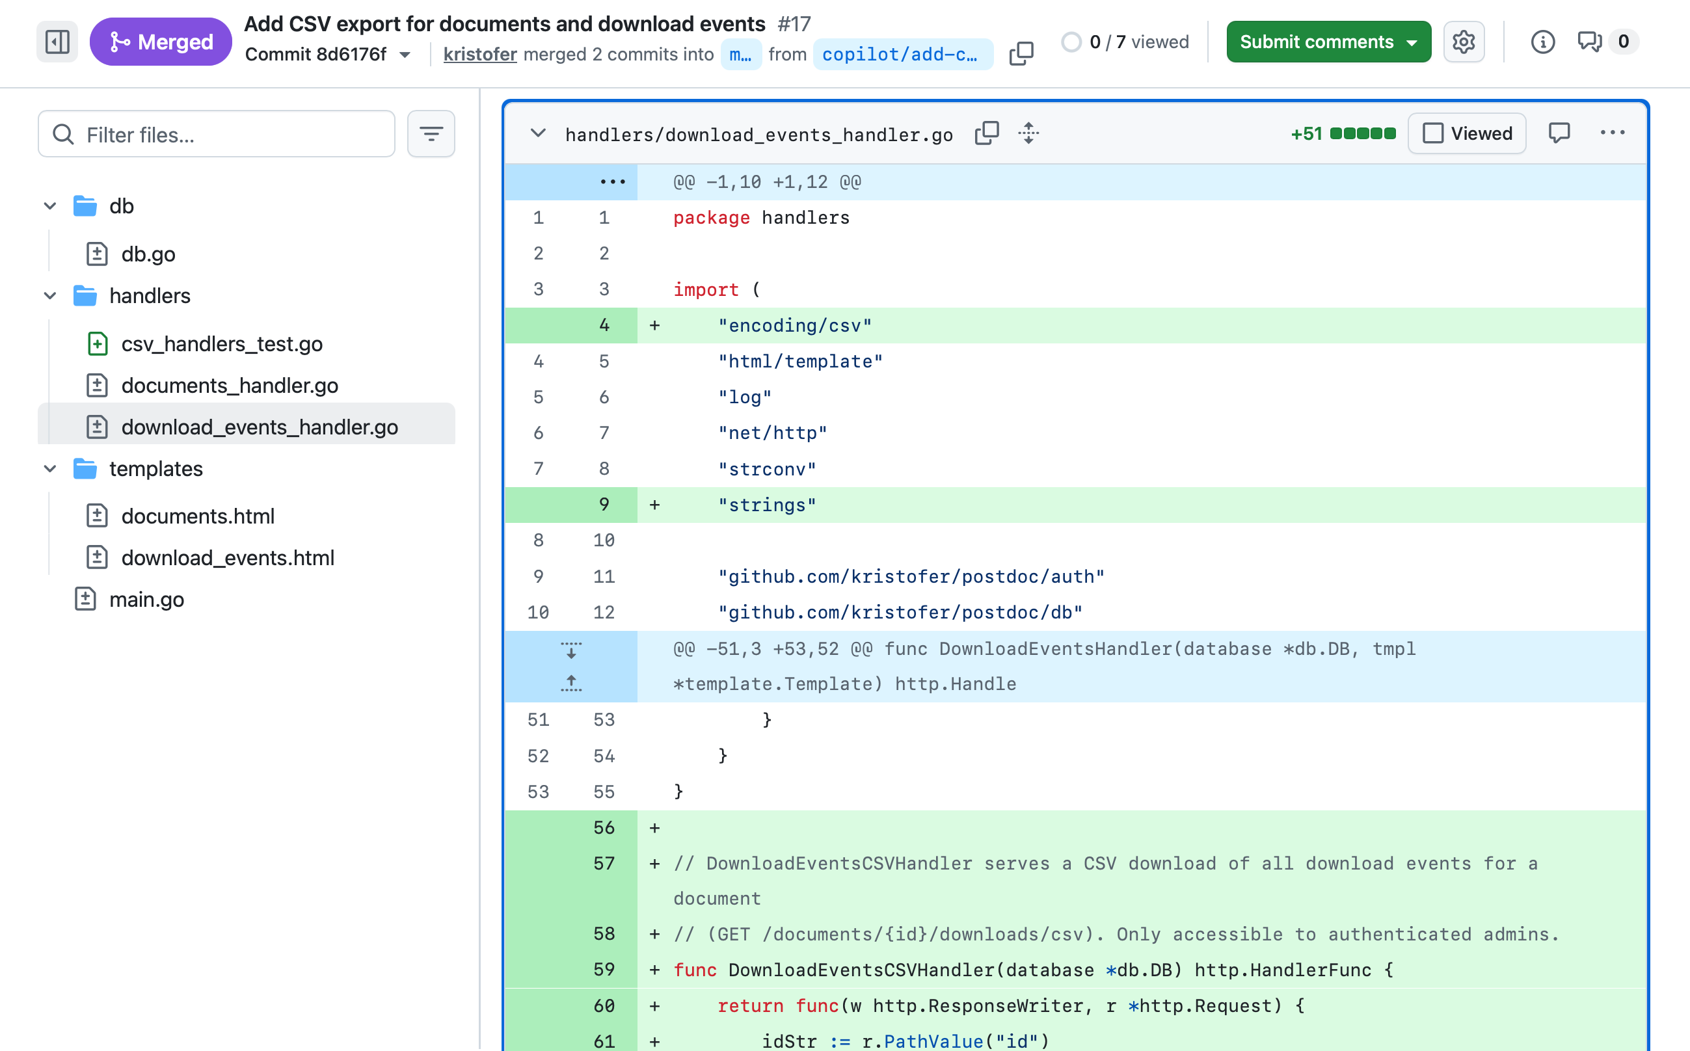
ZCW PostDoc
Use standard GitHub Pull Requests in the repo
You can review, and even ask for changes in the PR, until you like what you’re getting.
Although, if you write the issue well, you will prob not need to.
9

Slide 13
ZCW PostDoc
PostDoc Beta 1
So what was the journey?
5

Slide 14
ZCW PostDoc
Issue #2 – Upload Security (JWT Auth)
The Problem
Anyone who knew the server address could upload files.
No concept of 'who uploaded what.'
The Solution
• admins table in SQLite (bcrypt-hashed passwords)
• POST /login → issues JWT in HTTP-only cookie
• Auth middleware wraps every protected route
• /admin page to add / delete admin accounts
• Default admin / foobar on first run
Key Concepts for Beginners
🔒 Password Hashing: bcrypt turns 'foobar' into a long irreversible string. Stored hash is safe even if DB leaks.
🎫 JWT: After login, a signed token (username + expiry) is stored in a cookie. Server verifies signature on every request — stateless.
🛡️ Middleware: 'Is this user logged in?' is written once as a wrapper function and applied to every protected route.
10

Slide 15
ZCW PostDoc
Issue #4 – Change Password
The Problem
The default password foobar is not secret — there was no way to change it without editing the database directly.
The Solution
• POST /admin/change-password: accepts current password, new password, confirmation.
• Verifies current password with bcrypt.CompareHashAndPassword.
• Hashes and saves the new password in the admins table.
• Error handling: wrong current password or mismatched new/confirm fields re-shows the form with an error message.
Why this matters:
Small, focused feature that reuses existing bcrypt and DB infrastructure. A good example of building on solid foundations.
11

Slide 16
ZCW PostDoc
Issue #6 – Docker & Deployment
The Problem
go run . works on a laptop, but on a server the SQLite DB and uploaded files could be wiped every restart.
The Solution
• Dockerfile: two-stage build
Stage 1: Go toolchain compiles binary
Stage 2: tiny Debian image with binary + templates
• docker-compose.yml:
Persistent volume at /data
base-url via environment variable
Health check polls /login
• SQLite WAL mode for concurrent reads
Key Concepts for Beginners
🐳 Multi-stage Docker builds: Stage 1 is ~600 MB (Go toolchain). Stage 2 is a few MB (binary only). Ship lean.
💾 Persistent volumes: without a volume, docker compose up starts with empty DB and empty uploads every time.
⚡ SQLite WAL mode: allows readers and writers to work at the same time without locking — essential for a web app.
12

Slide 17
ZCW PostDoc
Issue #8 – Fix PDF Downloads (MIME Types)
The Problem
When report.pdf was uploaded, the slug was just report (no extension). Browsers had no idea the file was a PDF — they showed garbled text or asked which app to use.
The Solution
• Slug generation now preserves the .pdf extension: report.pdf → slug report.pdf
• Response header Content-Type: application/pdf is set explicitly.
• Content-Disposition: inline → browser displays the PDF rather than triggering a download dialog.
Why this matters:
MIME types tell the browser what kind of data it is receiving. This bug is invisible by reading the code — you only discover it by actually trying the app in a browser. A reminder to always test in the real environment.
13

Slide 18
ZCW PostDoc
Issue #10 – Admin Documents Page
The Problem
No way to see which documents were uploaded, who uploaded them, how large they were, or their short URLs — except by querying the database directly.
The Solution
• GET /documents: table of all docs (filename, uploader, date, size, download count, short URL)
• Checkbox per row + 'Delete Selected' + JS confirmation dialog
• Pagination: 30 rows per page with Prev/Next links
• 📋 icon links to download-events log (when tracking enabled)
Key Concepts for Beginners
📄 Pagination: LIMIT 30 OFFSET (page-1)*30 fetches only the rows for the current page. Essential once you have thousands of records.
☑️ Bulk operations: form sends a list of selected IDs as a repeated form field; handler loops over them and deletes each one.
Admin tooling gives visibility into a running system — without it, you are flying blind.
14

Slide 19
ZCW PostDoc
Issue #12 & #14 – Email Tracking & Bug Fix
Issue #12 – Email Download Tracking
'Track downloads' checkbox on upload form.
When a tracked link is visited → show email prompt instead of PDF.
On POST: validate email, record in download_events table, then redirect → GET serves PDF.
Post-Redirect-Get (PRG) pattern prevents 'resubmit form?' dialog on browser refresh.
download_events table has a foreign key → documents: prevents orphaned records.
Issue #14 – Off-By-One Download Count
Bug: after 2 downloads the counter showed 3; after 3 it showed 5.
Root cause: counter was incremented in TWO places — once on the email POST, once on the PDF GET. PRG means two HTTP requests per download = counter incremented twice.
Fix: one-line deletion removing the duplicate increment.
Lesson: new features can accidentally break existing ones. Reproduce reliably first, then trace the execution path before touching the code.
15

Slide 20
ZCW PostDoc
Issue #16 & Summary – CSV Export & Lessons Learned
Issue #16 – CSV Export
GET /documents/csv
GET /documents/{id}/downloads/csv
Content-Disposition: attachment; filename=... → browser downloads the file.
Go encoding/csv makes this simple: write header row, loop data rows.
Small change, high practical value for sharing data with colleagues.
Development Arc
Start → Basic upload, no security
#2 → Login, JWT, admin mgmt
#4 → Change-password form
#6 → Docker, persistent data
#8 🐛 → Fix MIME type bug
#10 → Admin documents page
#12 → Email download tracking
#14 🐛 → Fix off-by-one counter
#16 → CSV export
Key Lessons
1. Start minimal — one thing only.
2. Add security early.
3. Make operations safe.
4. Operationalize — deploy without data loss.
5. Fix rough edges found in the real browser.
6. Add admin tooling for visibility.
7. Add the headline feature last.
8. Fix bugs introduced by new features.
9. Small quality-of-life improvements have high value.
One issue at a time.
16

Slide 21
ZCW PostDoc
DEPLOYED
PostDoc Beta 1
http://post.zipcode.rocks
ZipCodeWilmington · PostDoc Beta 1
5

