Slide 1
Factors Affecting Conscientiousness
Kristofer Svendsen, MSc.

Slide 2
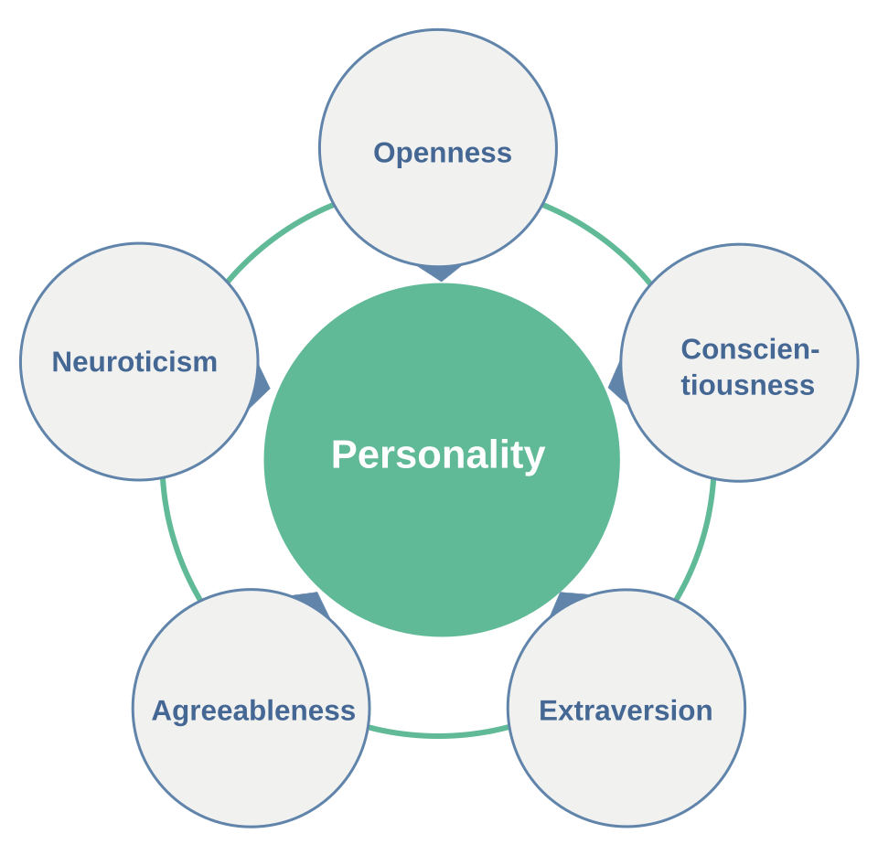
What is conscientiousness?
One of the Big Five personality traits
Set of personality constructs related an individual’s propensity to be self-controlled, responsible to others, hardworking, orderly, and rule-abiding.
High levels of conscientiousness are associated with:
High achievement in formal education
High job performance
Marital stability
Lower risk of depression
(Roberts et al., 2014); image: Anna Tunikova

Slide 3
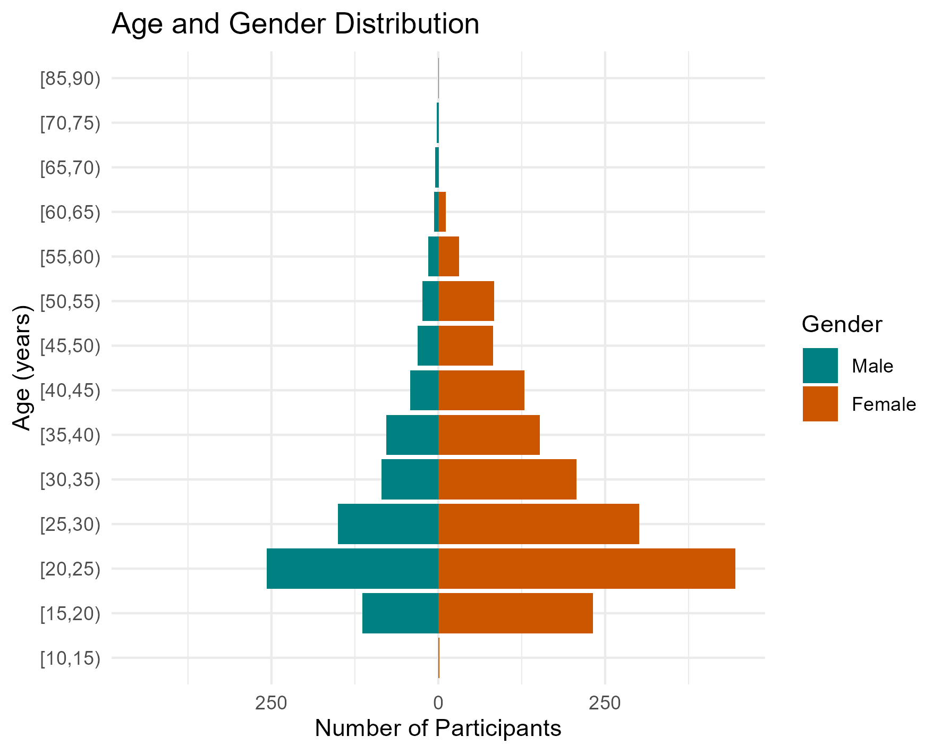
Participants: Age & Gender
Responses:
Males: 809
Females: 1679
Total: 2488
Age (years):
Combined Median: 26
Males Median: 25
Females Median: 27
Youngest: 14
Males: 15
Females: 14
Oldest: 86
Males: 74
Females: 86

Slide 4
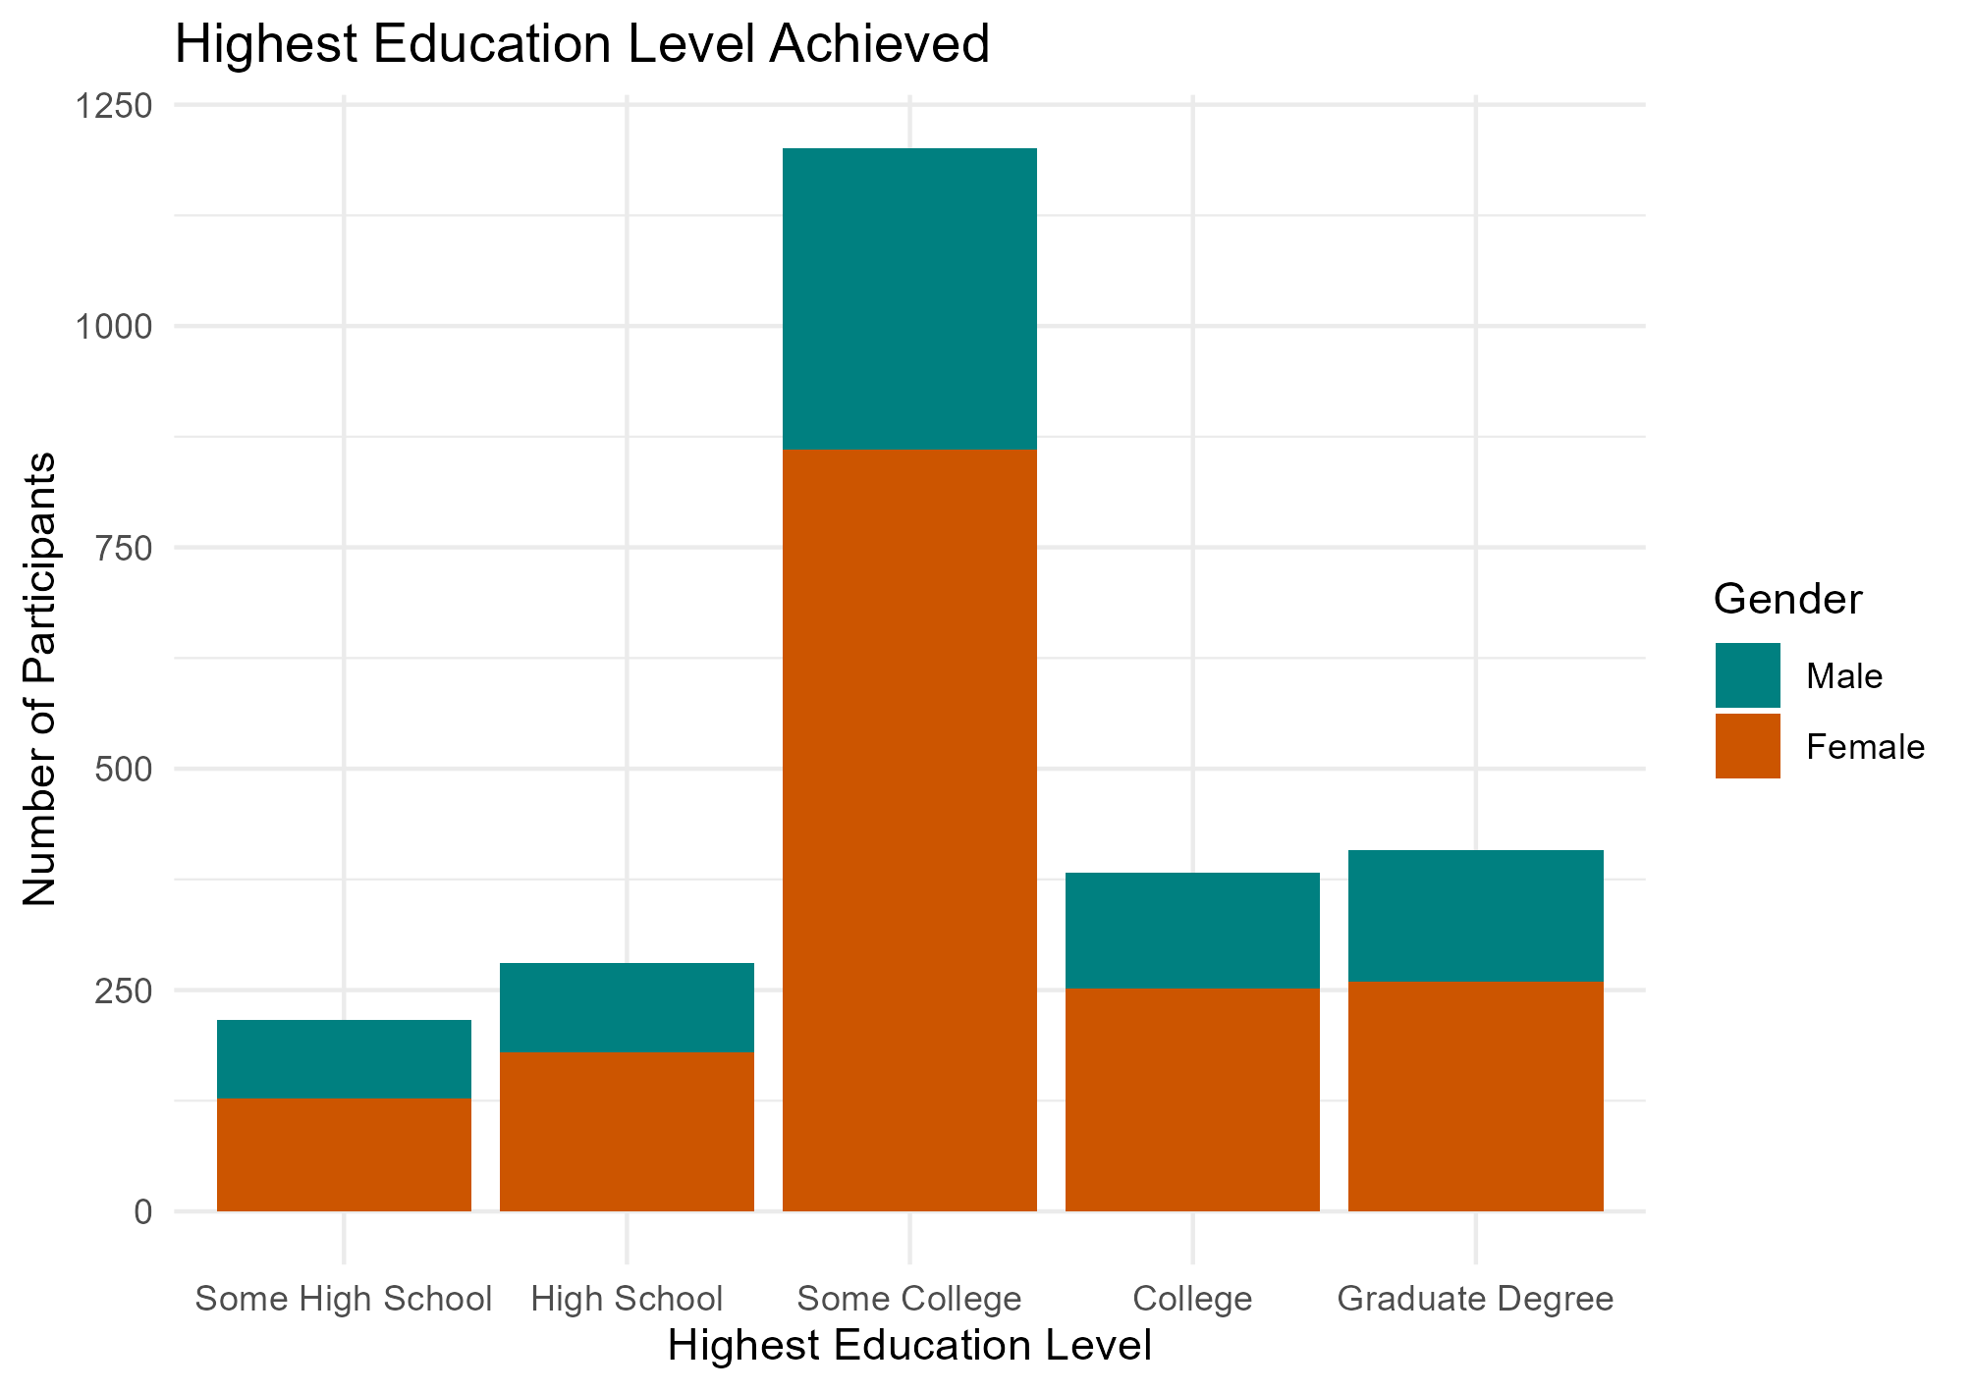
Participants: Education
Some High School:
Male: 88
Female: 128
High School:
Male: 101
Female: 180
Some College:
Male: 341
Female: 860
College:
Male: 130
Female: 252
Graduate Degree:
Male: 149
Female 259

Slide 5
Conscientiousness Questionnaire
Questions 4 and 5 are reverse scored
Maximum score of 24
Questions:
Am exacting in my work.
Continue until everything is perfect.
Do things according to a plan.
Do things in a half-way manner.
Waste my time.
Score | Response
NA | NA
1 | Very Inaccurate
2 | Moderately Inaccurate
3 | Slightly Inaccurate
4 | Slightly Accurate
5 | Moderately Accurate
6 | Very Accurate

Slide 6
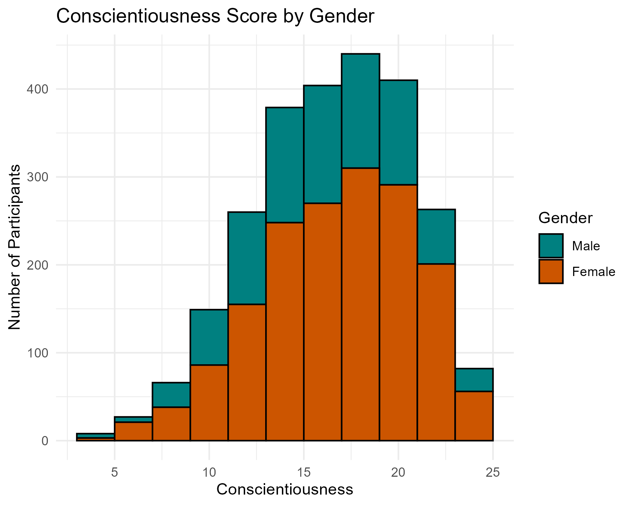
Questionnaire Results
Average Score Overall = 16.98
Average Male = 16.36
Average Female = 17.24
Reliability Measures:
⍺ = 0.72, 95% CI [0.70, 0.74]
ꭥ_{h} = 0.73, 95% CI [0.71, 0.74]

Slide 7
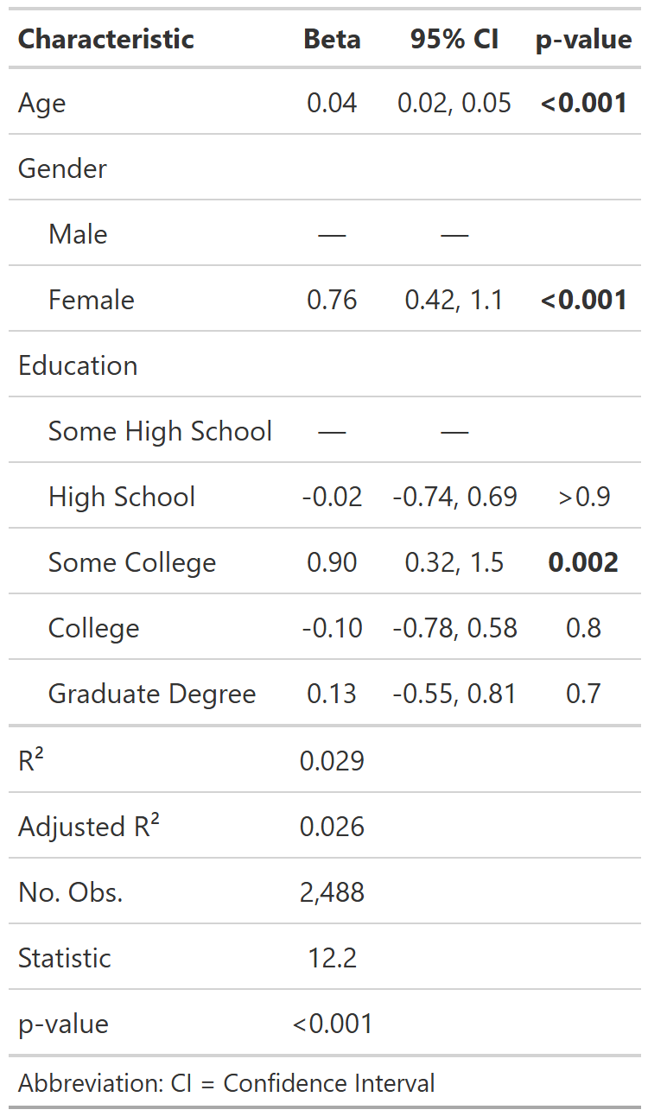
Factors Affecting Conscientiousness
Age is positively correlated showing a small but statistically significant effect.
Gender shows a significant effect with females averaging 0.78 higher on our conscientiousness scale.
Some college education is associated with an average of 0.98 higher scores compared to some high school education. All other education levels showed no significant difference from some high school education.

Slide 8
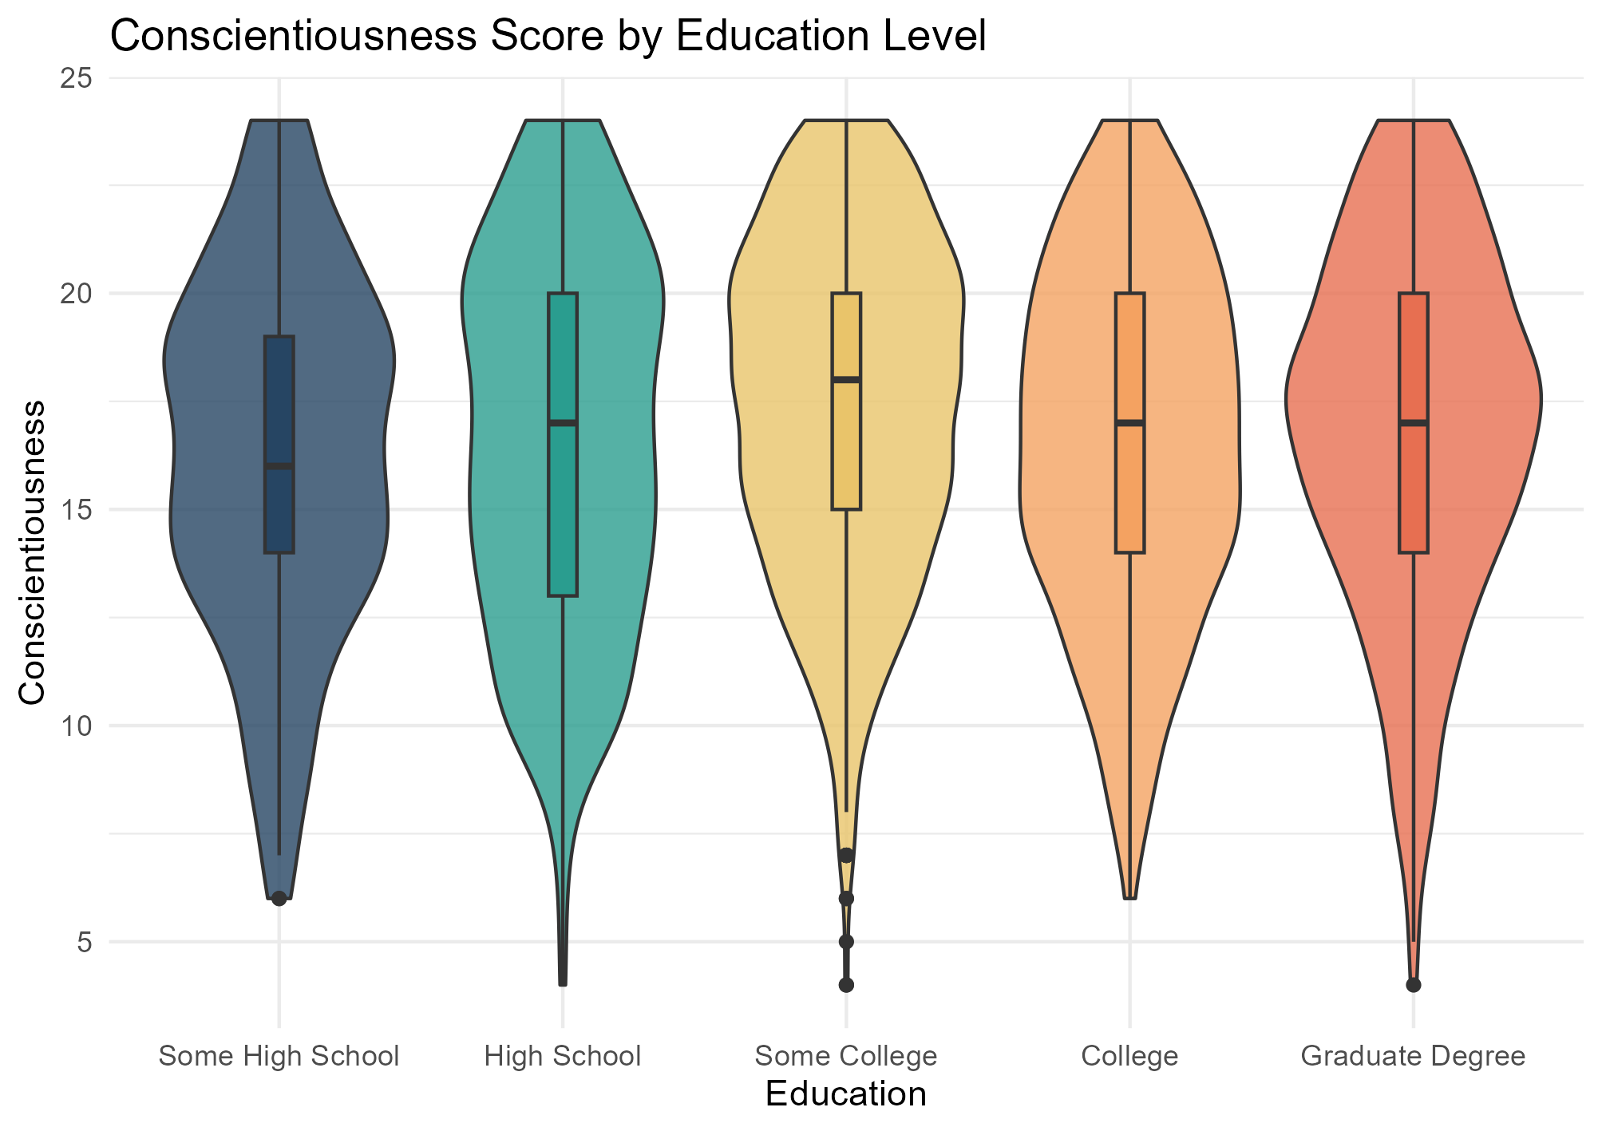
Summary of Findings
Conscientiousness increases with age
Females are more conscientious than Males
Participants with some college education showed higher conscientiousness scores than those with higher education levels. This is counter to what would be expected as conscientiousness is considered a predictor of higher-education success and thus you would expect to find higher levels of this personality trait present in the higher education population (Roberts et al., 2014).

Slide 9
Appendix
2800 survey responses total → 2488 remain after cleaning:
223 removed for NA in education
2 removed for age <14
87 removed for NA in survey questions
No interaction between predictor terms:
VIF <1.2 for all terms

Slide 10
References
Roberts, B. W., Lejuez, C., Krueger, R. F., Richards, J. M., & Hill, P. L. (2014). What is conscientiousness and how can it be assessed?. Developmental psychology, 50(5), 1315.
Image attribution: Original: Anna Tunikova for peats.de and wikipedia Vector: EssensStrassen, CC BY 4.0 <https://creativecommons.org/licenses/by/4.0>, via Wikimedia Commons

