Slide 1

The Fractal Structure of Treelines on High Mountains
Individual Project Laboratory 2
Bálint Kovács, Kristóf Kássa, Muhammad Najeed
Master’s students, Institute of Mathematics
Advisor: Dr. Beáta Oborny Associate Professor, Department of Plant Systematics, Ecology and Theoretical Biology,
Eötvös Loránd University
Budapest University of Technology and Economics

Slide 2
Contents
Introduction. Short Software Demo
Fractal Analysis, Mass Simulations
Application to Real Life Data: Satellite Images
Budapest University of Technology and Economics

Slide 3

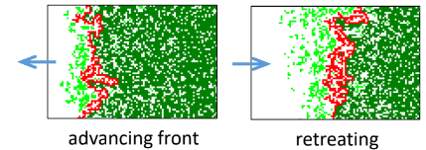
Introduction
What is the treeline?
What does it tell us? (e.g. the effect of climate change on the tree population – range shifts)
Budapest University of Technology and Economics

Slide 4
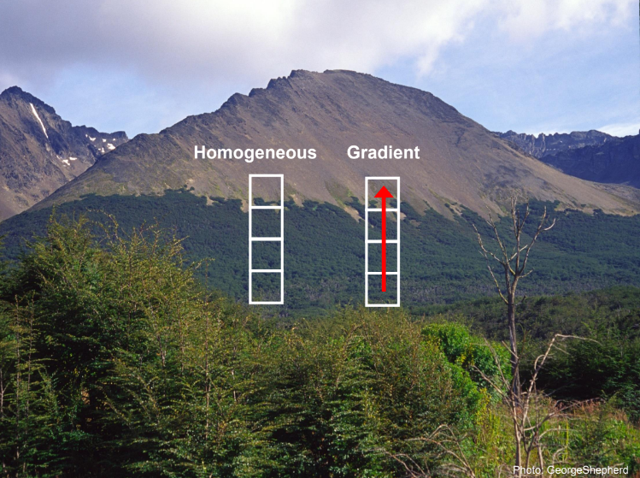
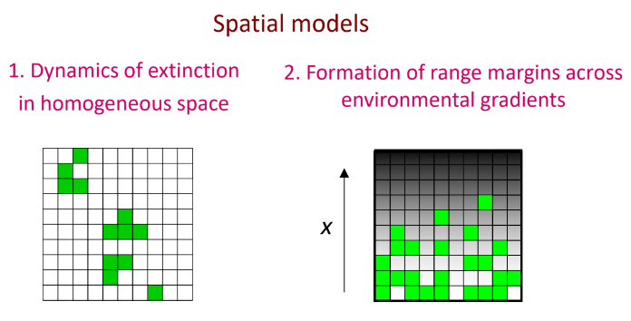
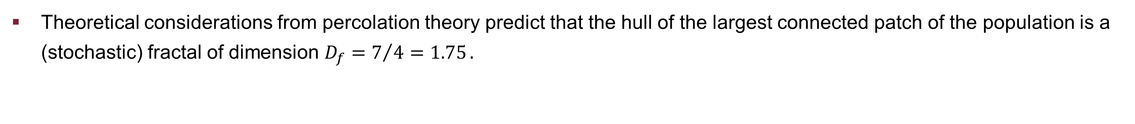
Modelling
Theoretical considerations from percolation theory predict that the hull of the largest connected patch of the population is a (stochastic) fractal of dimension ${D_{f}=7}/{4=1.75}.$
Budapest University of Technology and Economics

Slide 5
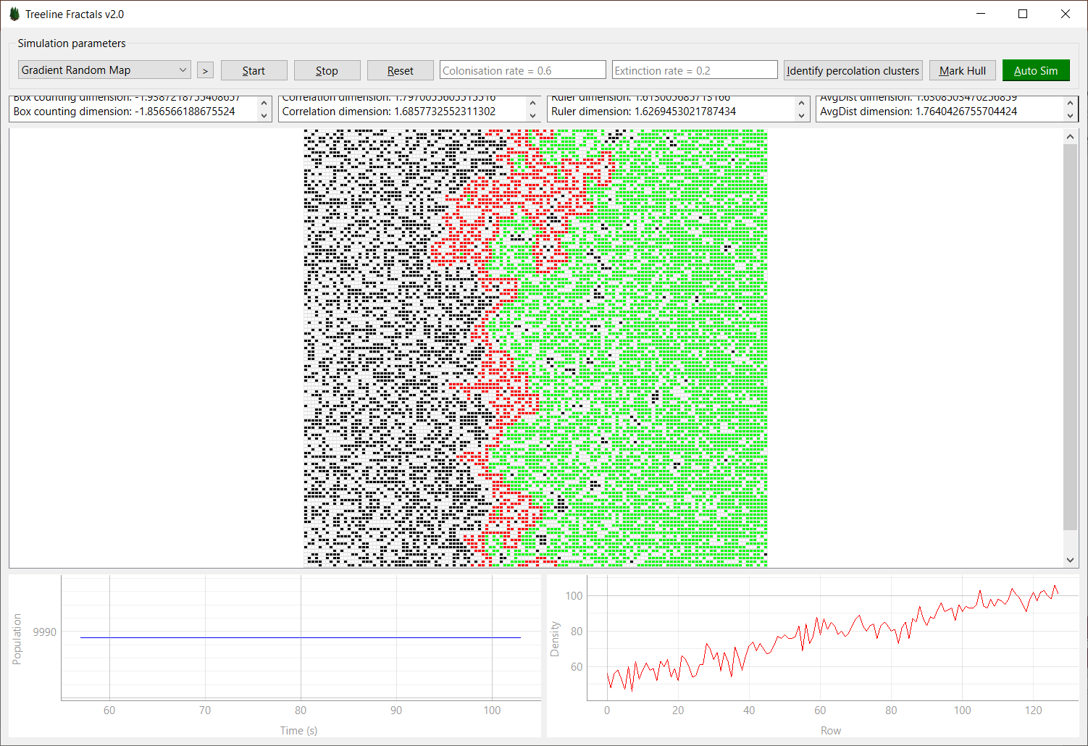
Software
Technology used: Python
Implemented:
Simulating populations
Finding the largest percolation cluster (largest connected patch)
Delineating the hull of the largest connected patch
Fractal Analysis
Box Counting
Correlation Dimension
Ruler Method
Equipaced Polygon Method
Budapest University of Technology and Economics

Slide 6

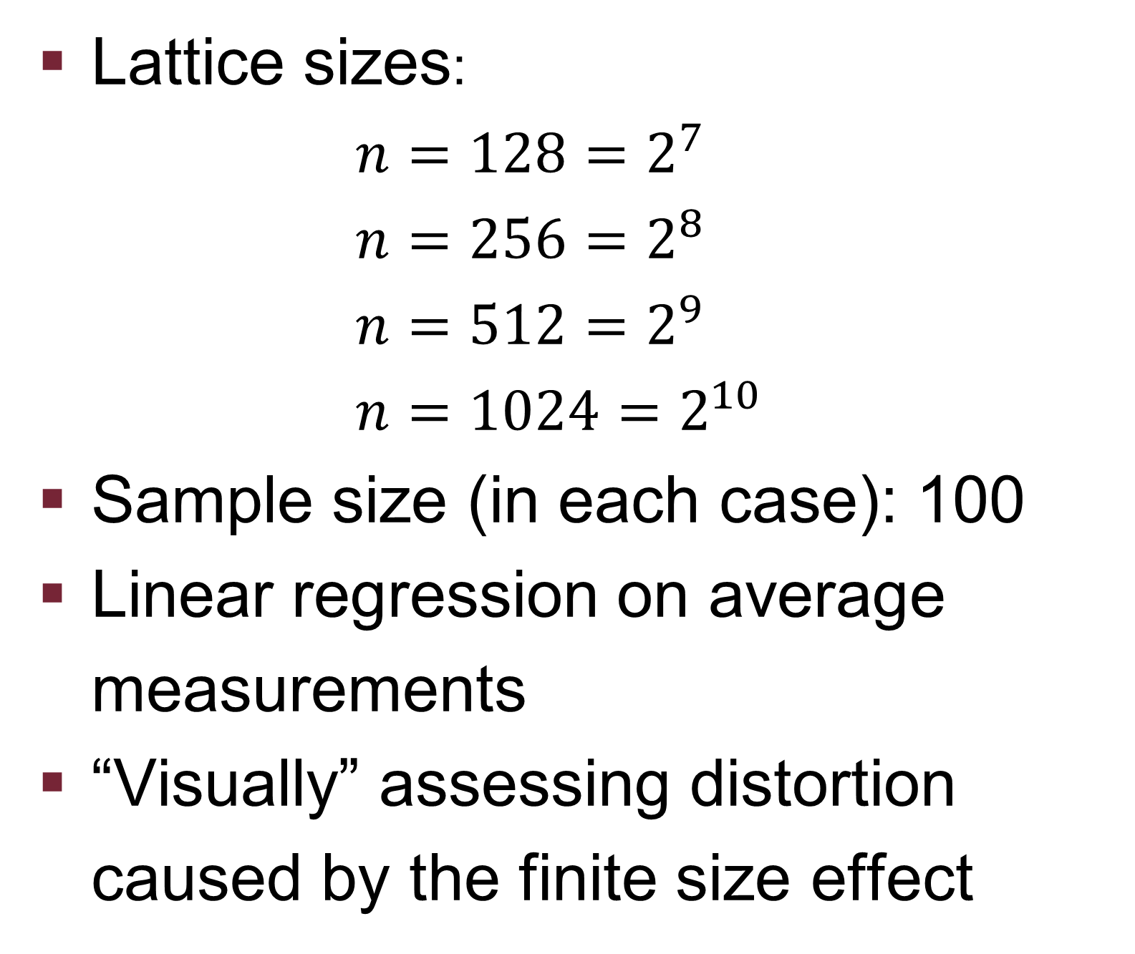
Mass Simulations
Lattice sizes: $n=128=2^{7}$ $n=256=2^{8}$ $n=512=2^{9}$ $n=1024=2^{10}$
Sample size (in each case): 100
Linear regression on average measurements
“Visually” assessing distortion caused by the finite size effect

Slide 7
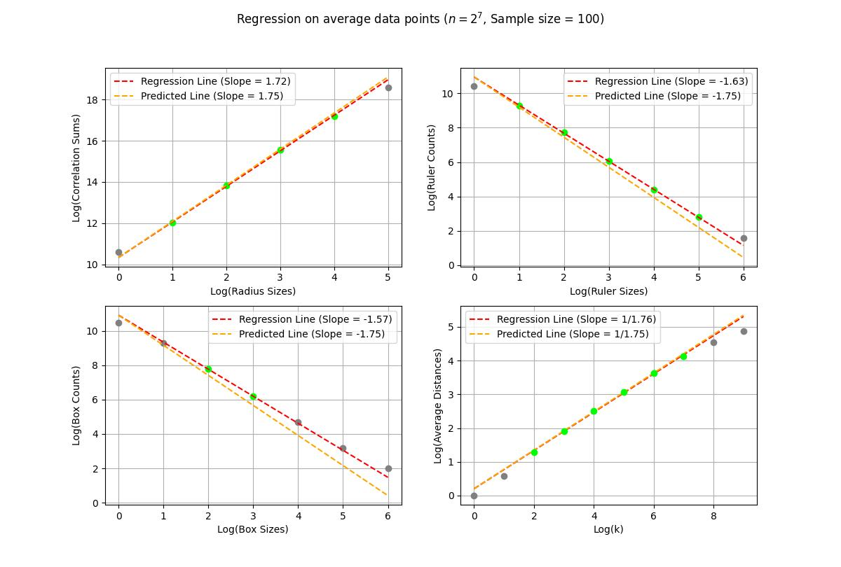
$$n=128=2^{7}$$
Budapest University of Technology and Economics

Slide 8
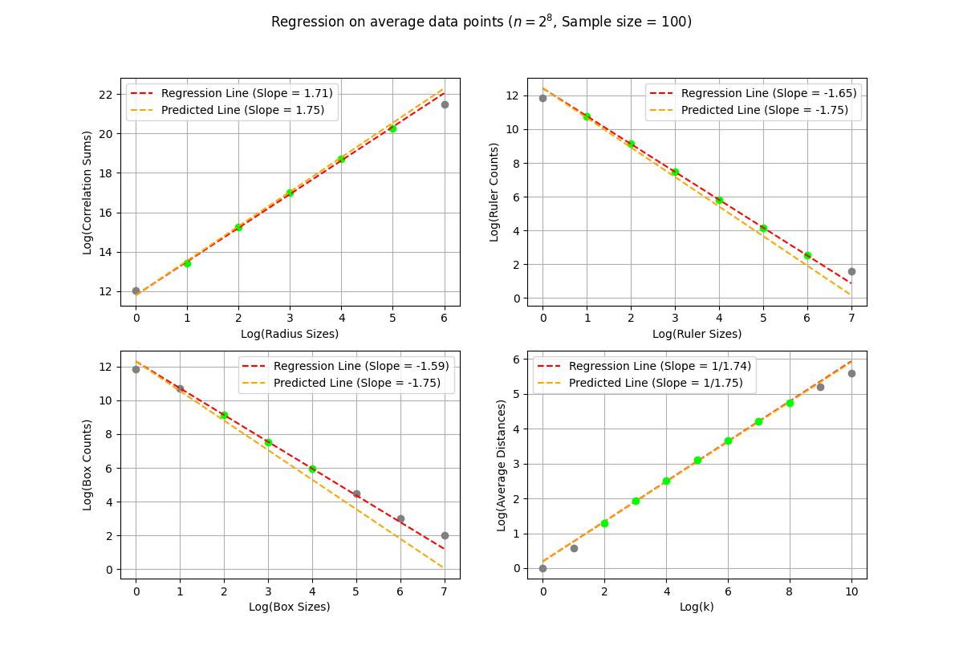
$$n=256=2^{8}$$
Budapest University of Technology and Economics

Slide 9
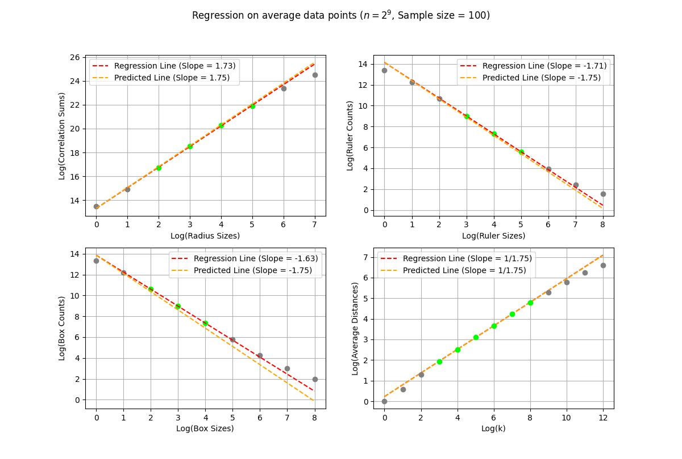
$$n=512=2^{9}$$
Budapest University of Technology and Economics

Slide 10
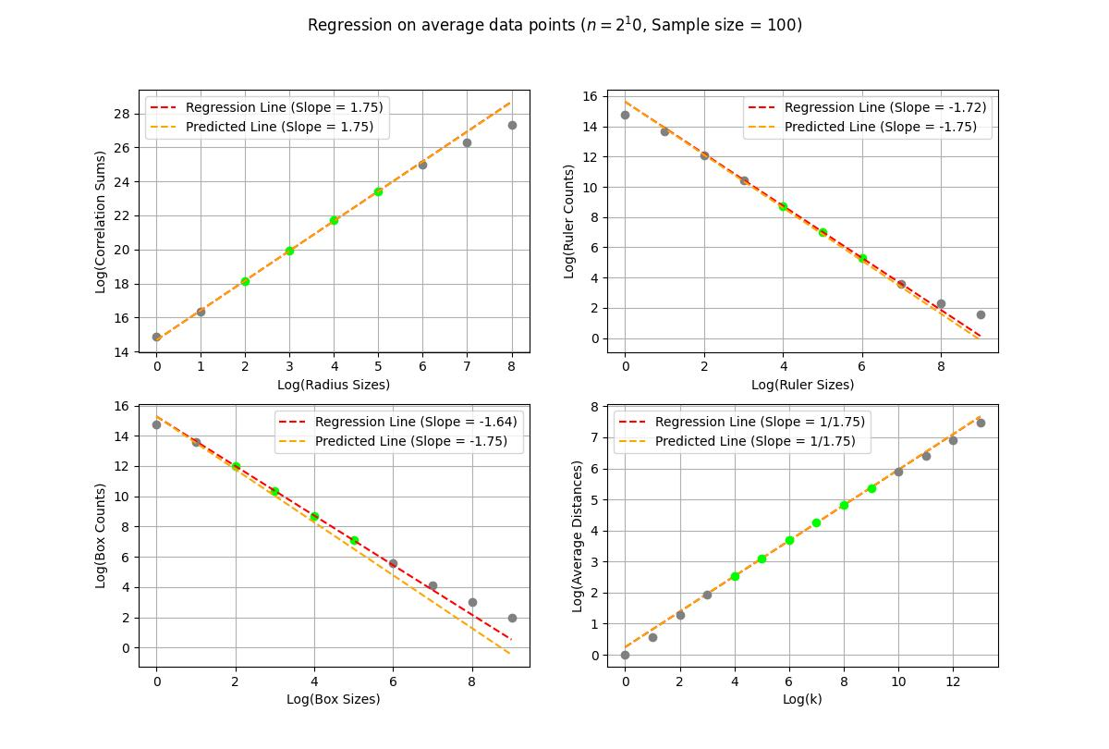
$$n=1024=2^{10}$$
Budapest University of Technology and Economics

Slide 11
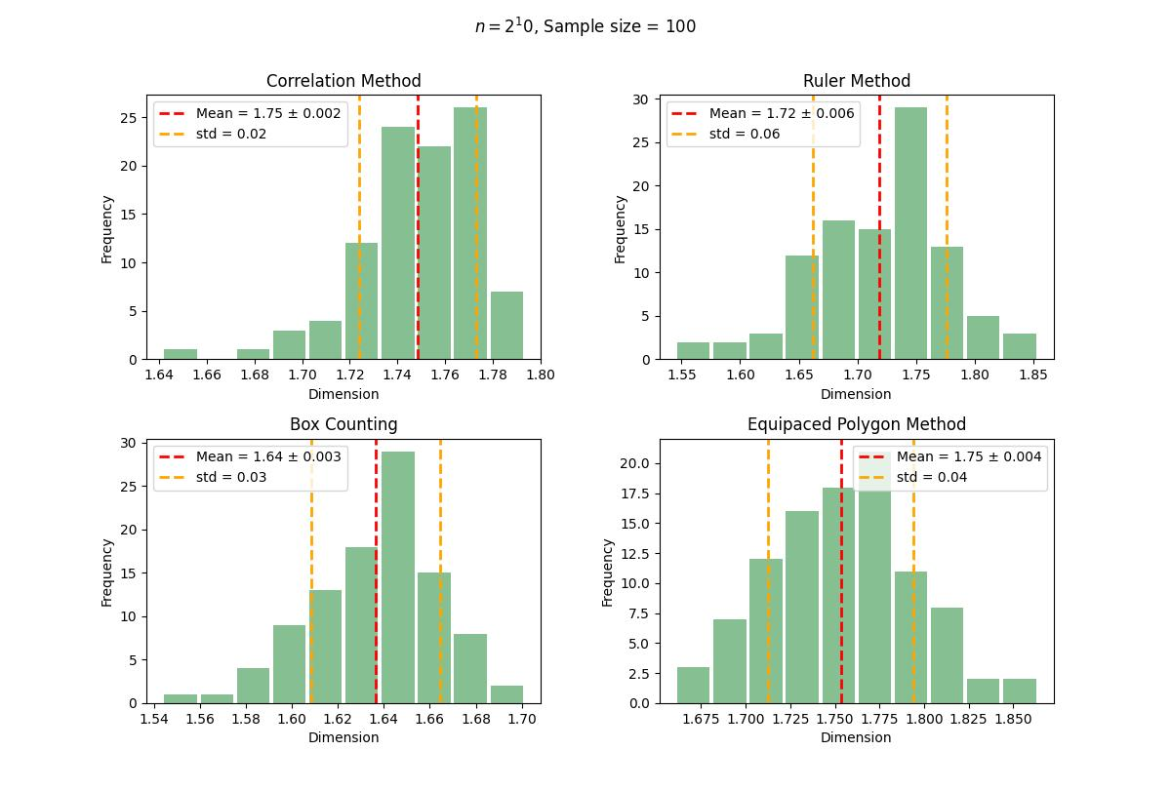

Initial Distribution Analysis for $n=1024$
Histograms of individual simulation data for each method
Shapiro-Wilk normality test at significance 0.01:
Assuming normality, one sample t-test accepts that the true population mean is 1.75 in case of the Equipaced Polygon Method
rejects normality for the Correlation Method
fails to reject normality for the other methods
Budapest University of Technology and Economics

Slide 12
Real Life Data: TODO
Címsor2
Címsor 3
Felsorolás
Pont1
Pont2
Pont3
Budapest University of Technology and Economics

