Slide 1
The problem that your project will solve
Console app
Usable, but only for technical users: command prompt, keyboard input
Quick development: easy to develop, fast to change
GUI
For non-technical users: graphical interface, mouse click
Well designed for User Experience
More effort to develop and maintain

Slide 2
The solution presented by your project
Requirements:
Basic operations: add, edit, delete, load, save
Filters: Date, Suspect Record, Gin Number
Shortcuts support
Others: Status bar, Navigation bar

Slide 3
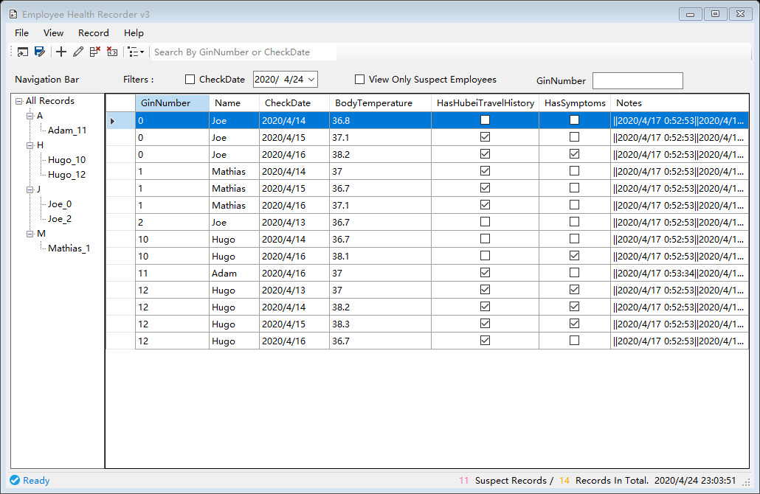
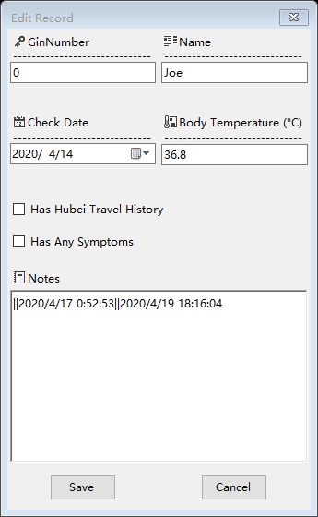
The solution presented by your project
Records Explorer
Record Editor

Slide 4
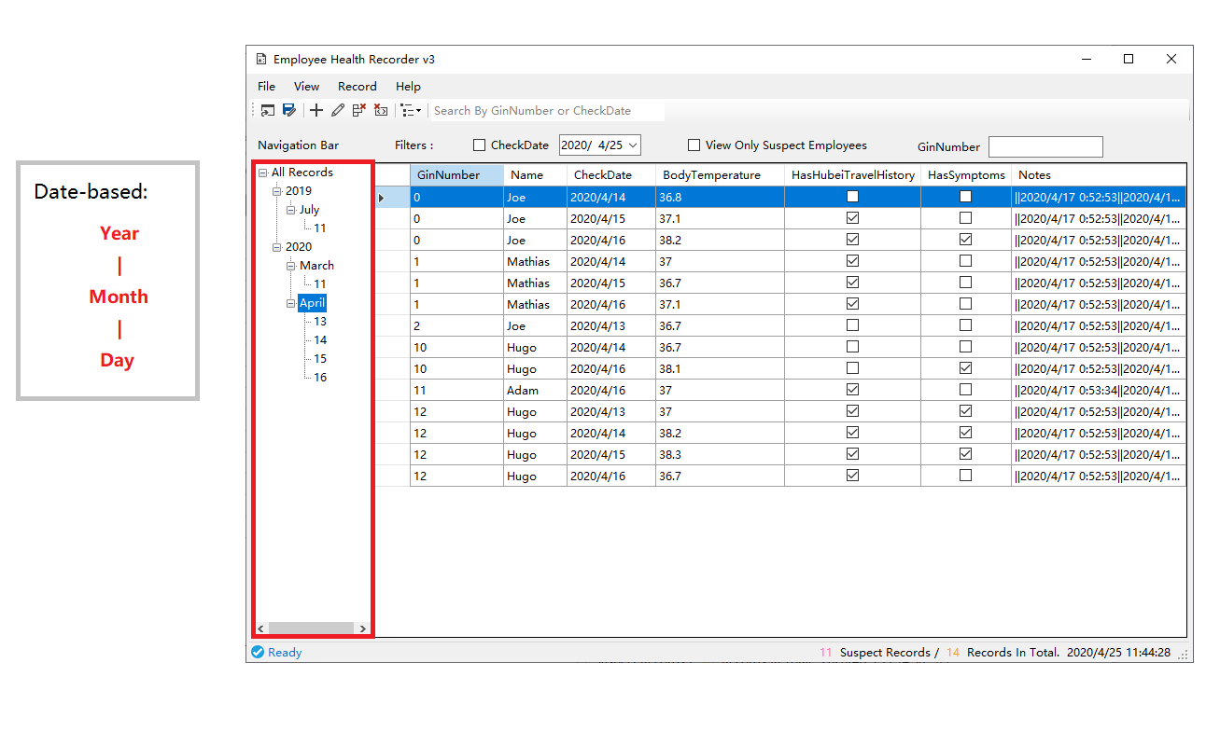
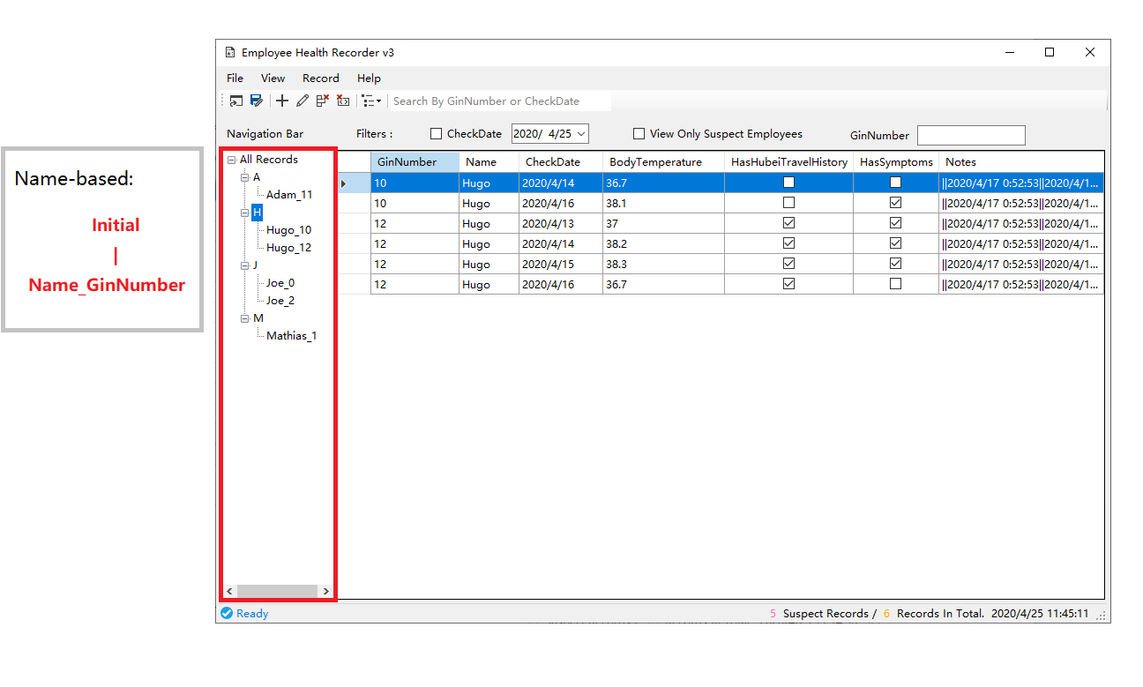
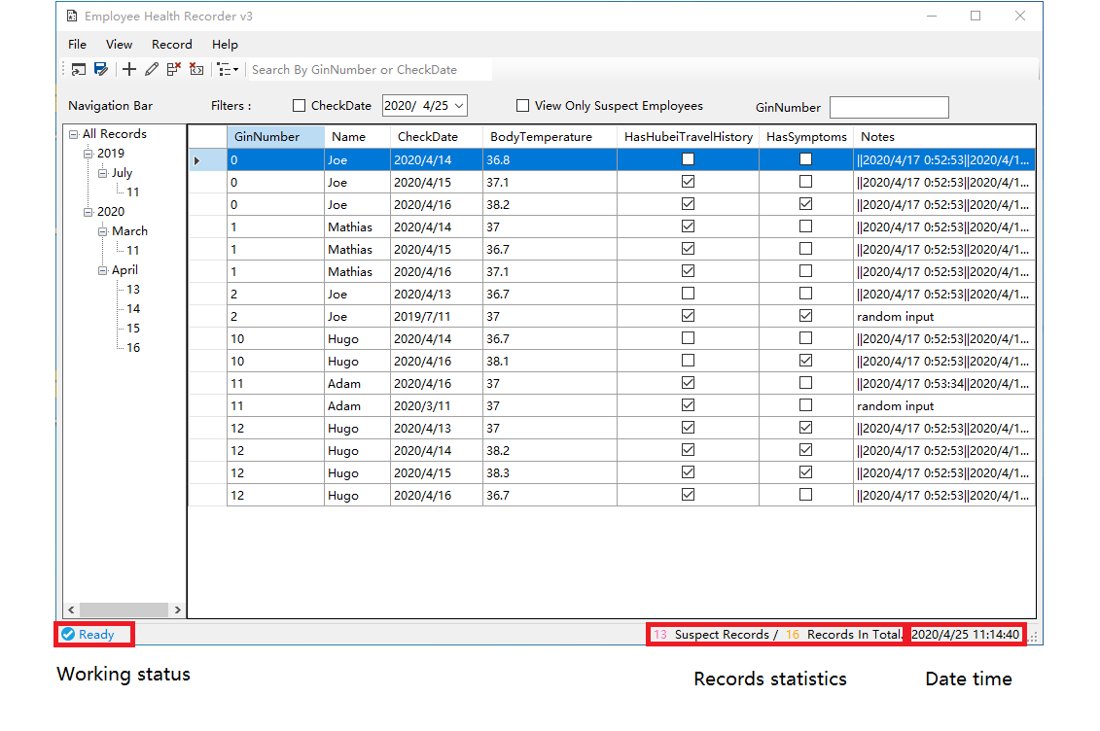
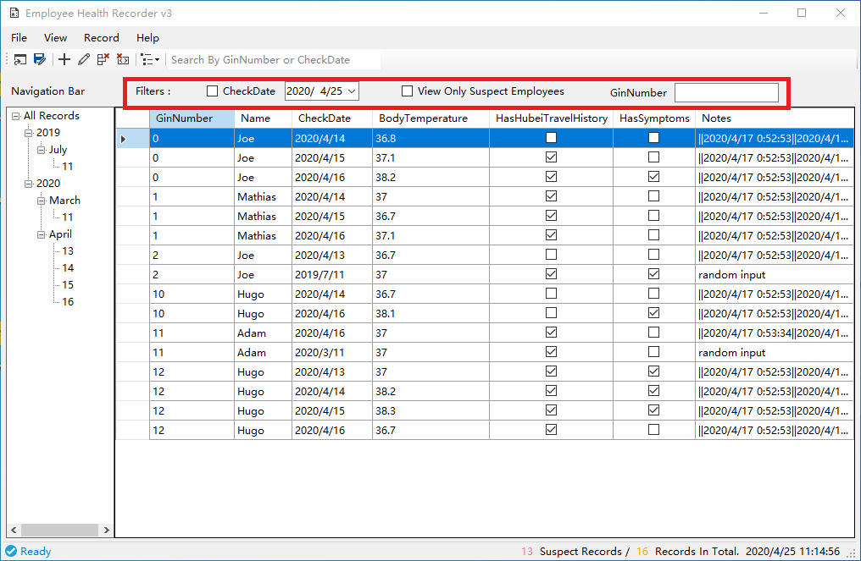
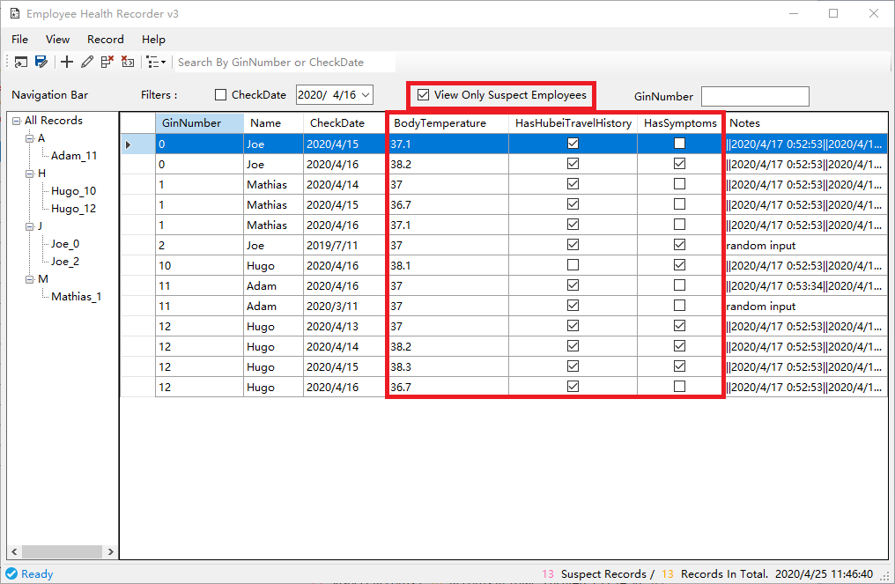
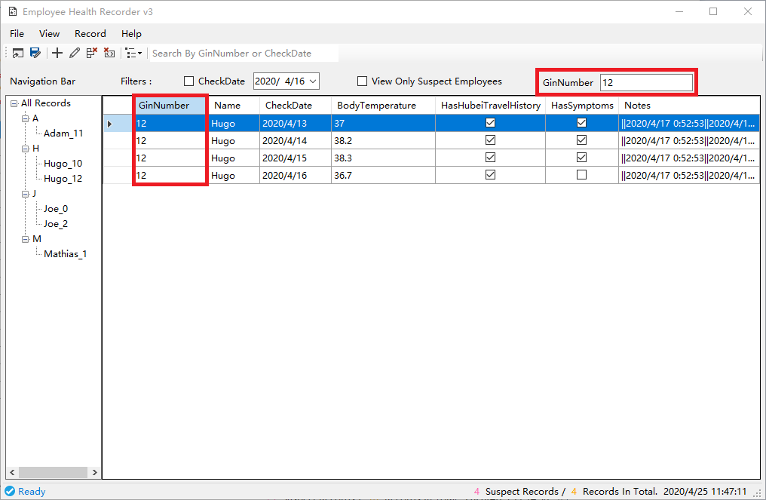
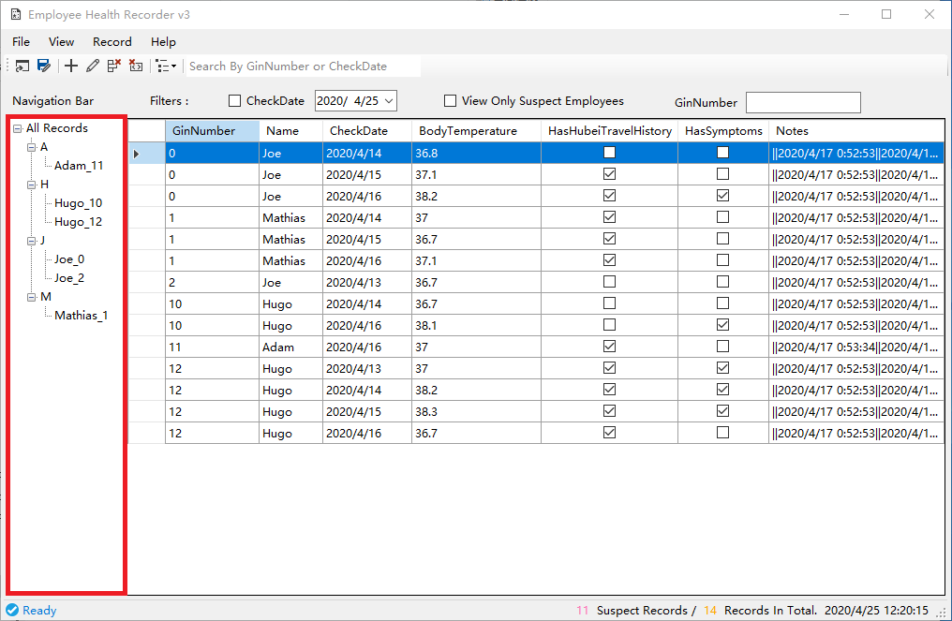
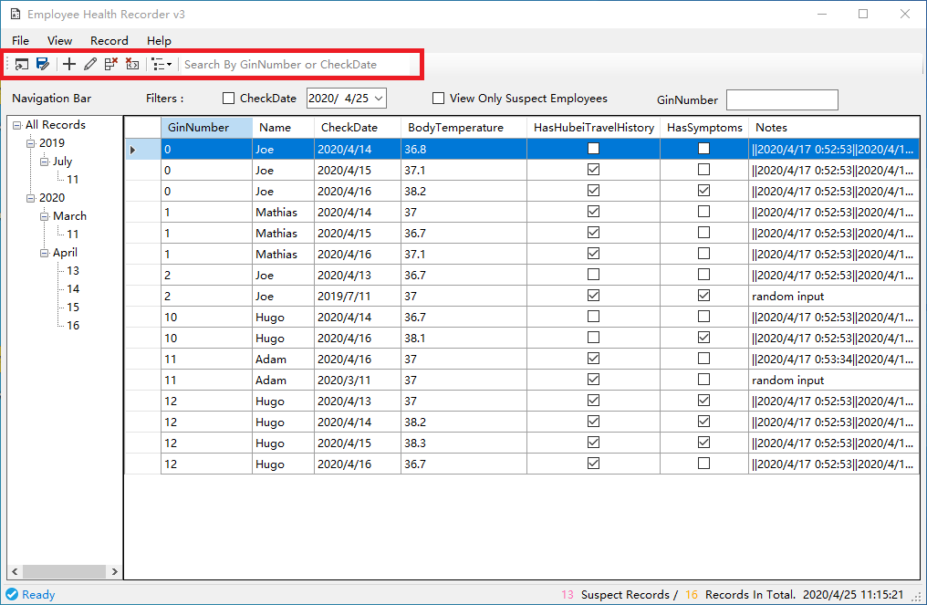
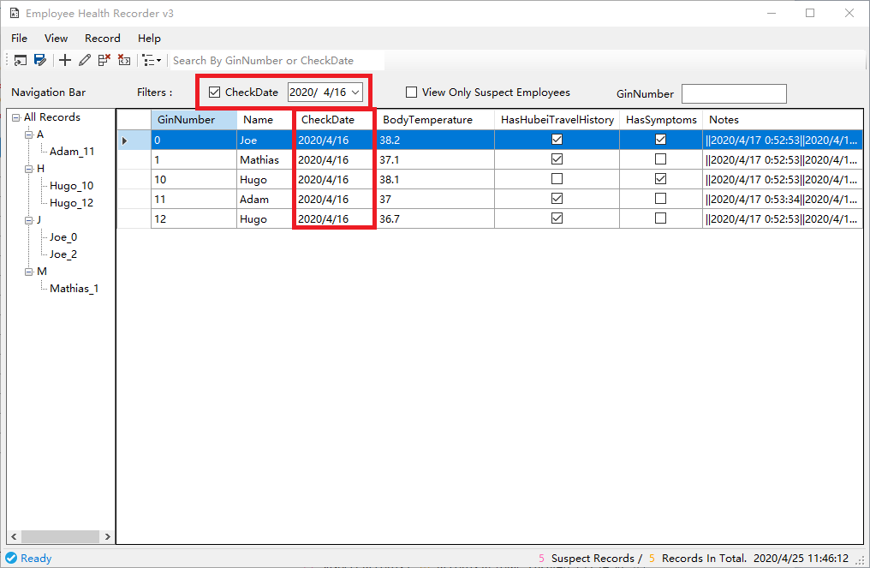
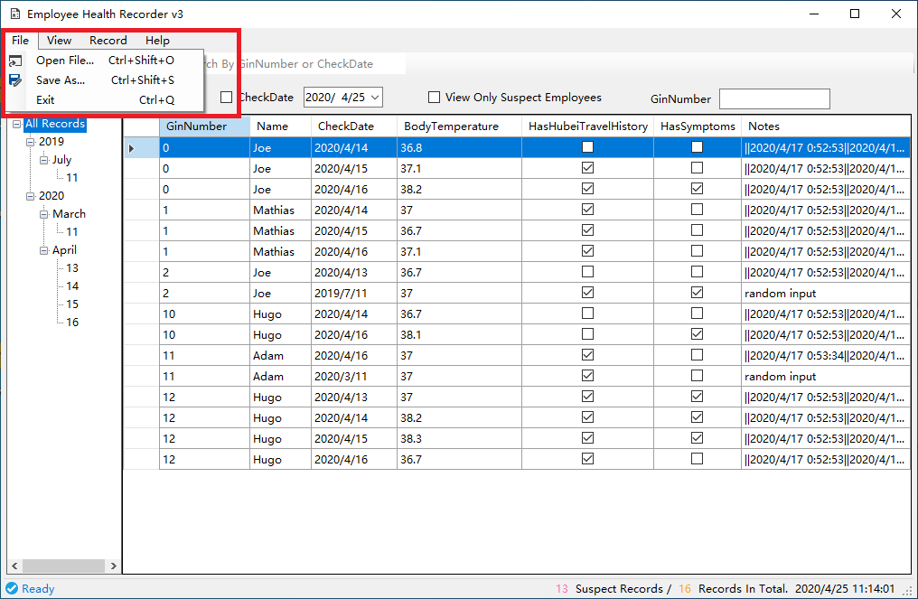
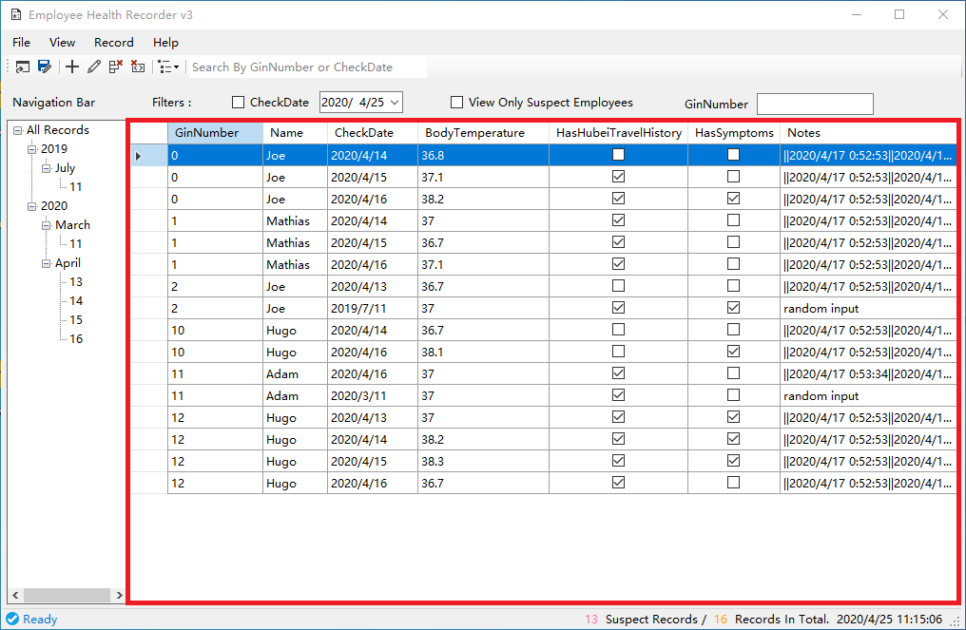
Intro to interface
Tool bar
Menu bar
Filters
Tree view
for navigation and filtering
Data table
Status bar

Slide 5
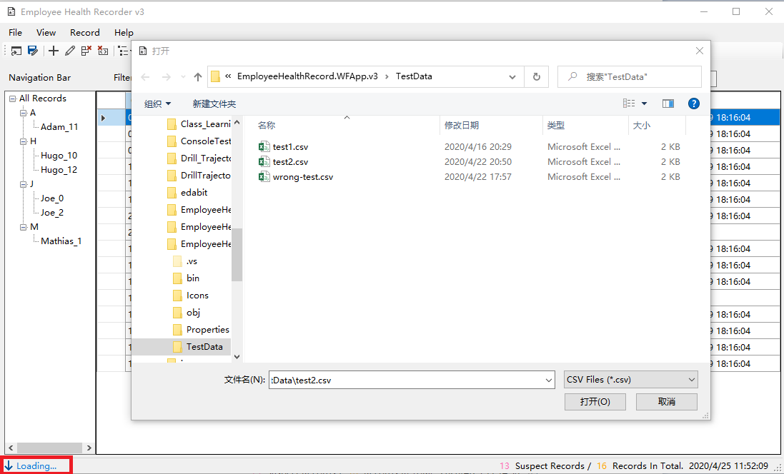
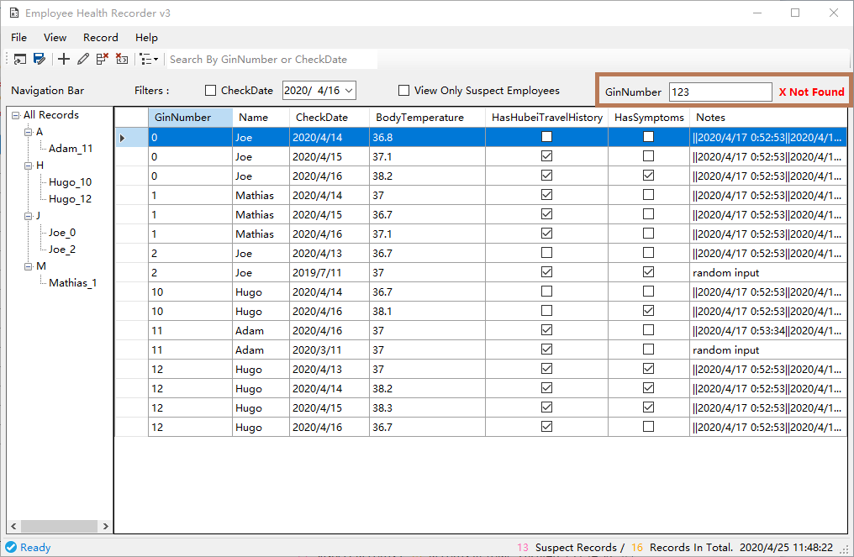
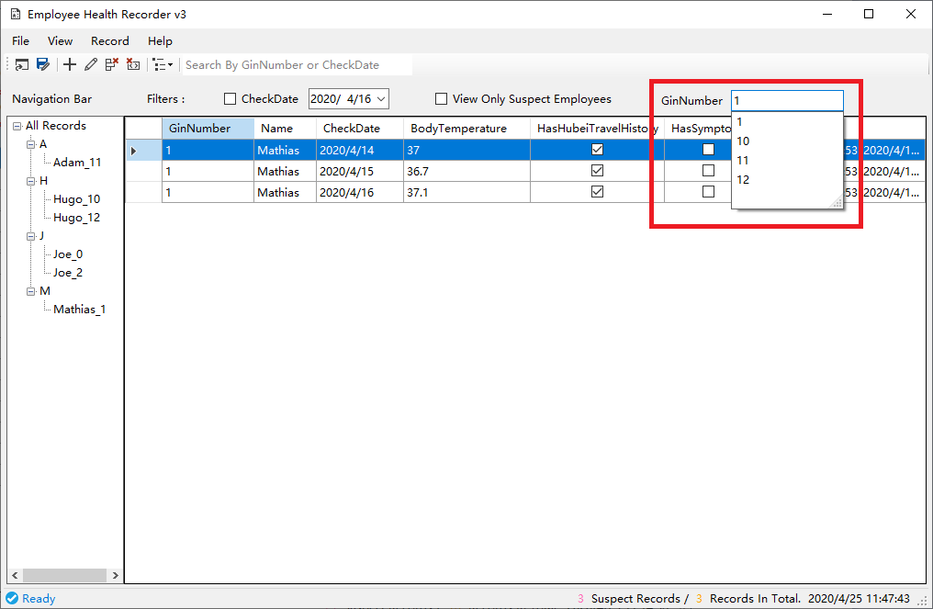
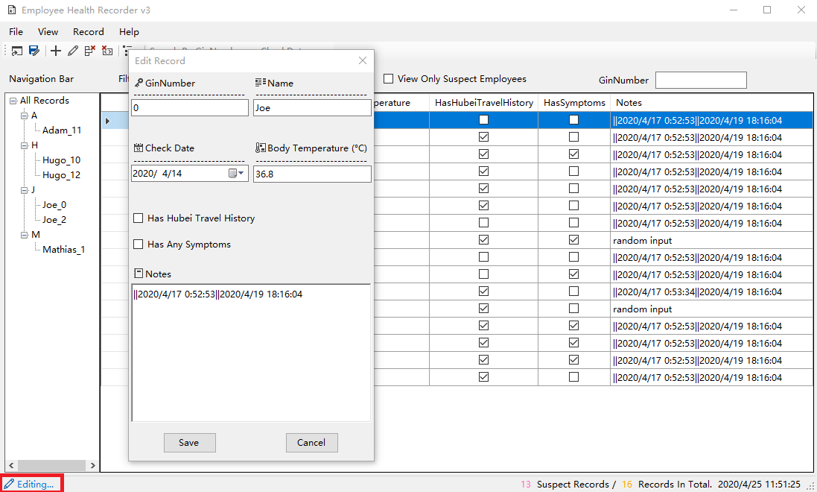
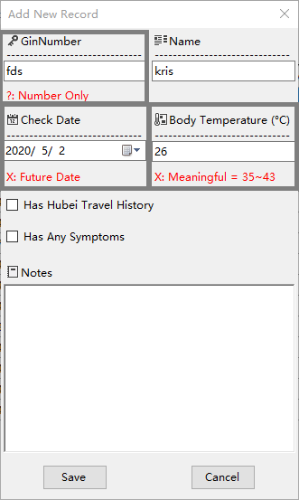
Other features
Editing advice
Auto suggestion and Tips
Working status auto-updating

Slide 6
Why should people use it
Clean and consistent interface
Full-featured while easy to use
Free & open source
Active development, integrated with users needs

Slide 7
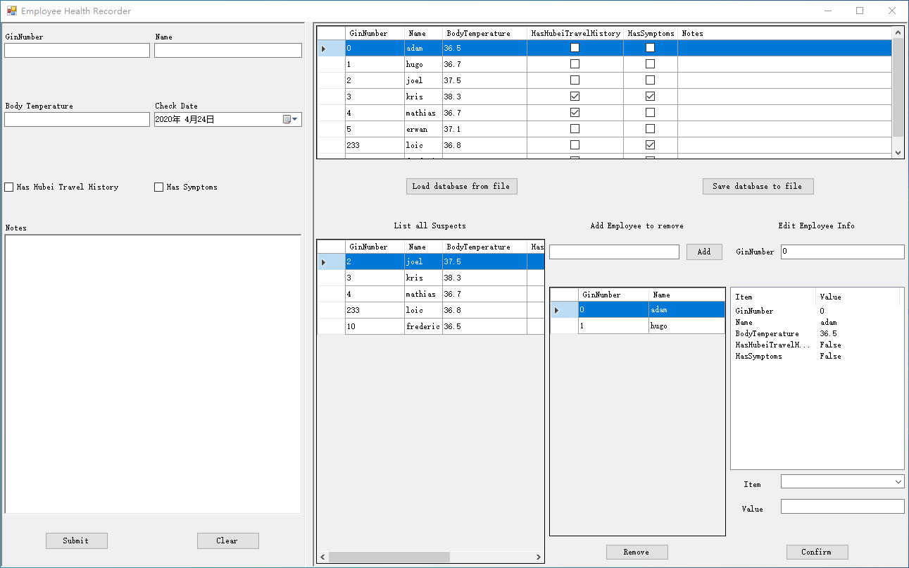
Who developed it and how it was developed
Personal ideas
Learn from others design
Feedback to and from model
Deliverable version

Slide 8
Who will use it
For non-technical users

