Slide 1
Azure Stack HCI The best infrastructure for hybrid
Module Monitoring & Troubleshooting

Slide 2
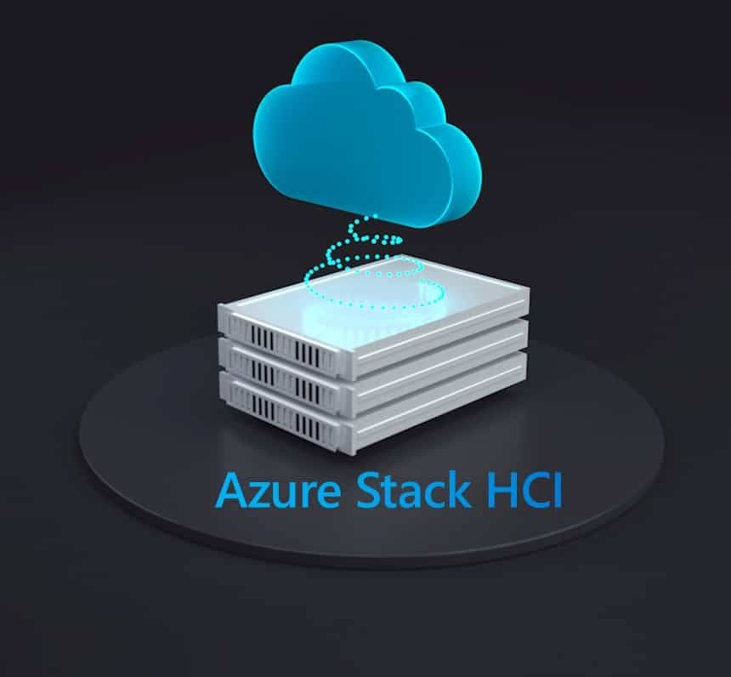
Monitoring & Troubleshooting
Notes:
The Hyper-V role in Azure Stack HCI OS lets you create a virtualized computing environment where you can create and manage virtual machines. You can run multiple operating systems on one physical computer and isolate the operating systems from each other. With this technology, you can improve the efficiency of your computing resources and free up your hardware resources.
Trainers: Throughout this module, make sure to emphasize that this section applies to both Azure Stack HCI as well as Windows Server with Hyper-V.
#########

Slide 3







Learnings covered in Unit
Troubleshooting Compute

Slide 4

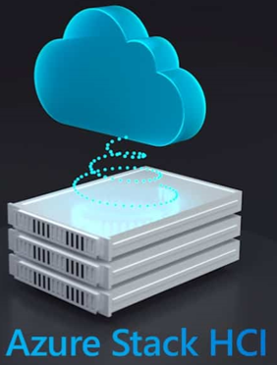
Troubleshooting Compute
The Goal of this module is to help you understand the options available to backup your Azure Stack HCI hosted Workloads.
Learn about:
Performance Counters
Hyper-V Logs
Notes:
The goal of this section is to help you understand exactly what virtualization is, to understand the different layers of virtualizations and the core functionality of the technology.

Slide 5
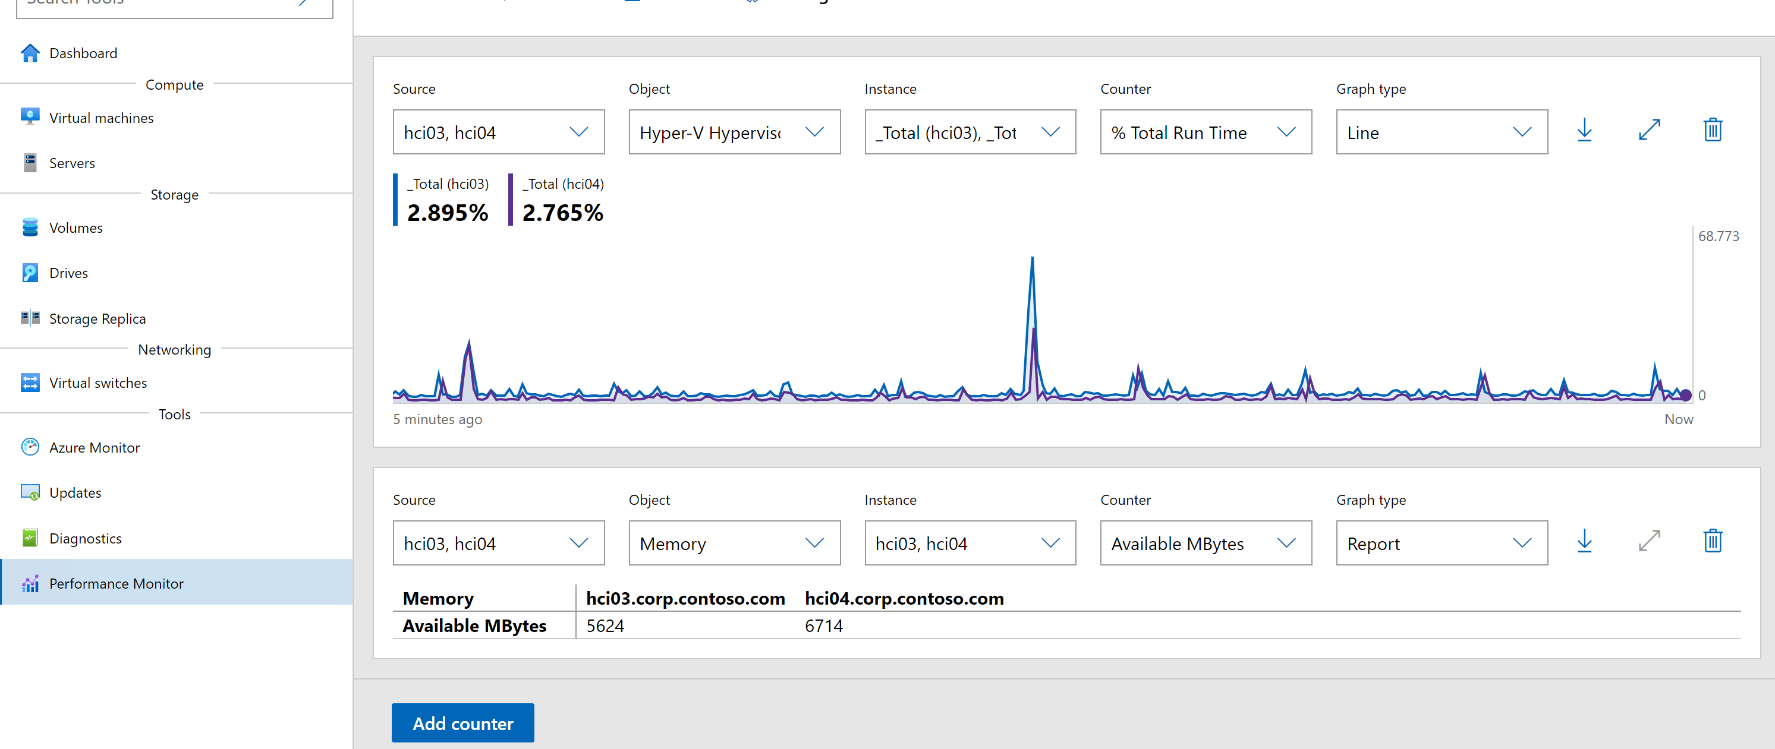
Windows Admin Center Performance Monitor
Select your Azure Stack HCI Nodes
Select the best visualization type
Select the Counter Object
Select the counter instance
Select Select the Counter

Slide 6
Hyper-V Hypervisor Logical Processor\
% Guest Run Time | The percentage of time spent by the processor in guest code.
% Hypervisor Run Time | The percentage of time spent by the processor in hypervisor code.
% Total Run Time | The percentage of time spent by the processor in guest and hypervisor code. | Healthy Less than 75%
 |  | Caution Between 75% and 85%
 |  | Critical Between 85% and 100%
Notes:
All thresholds represent most common defaults. In real life they will depend specific environment

Slide 7
Hyper-V Hypervisor Logical Processor\ (continued)
Context Switches/Sec (per core instance) | The rate of virtual processor context switches on the processor | Healthy Less than 10,000
 |  | Caution Between 10,000 and 20,000
 |  | Critical Above 20,000
Note: does not take into account the number of context switches made by the threads running in the host OS
Notes:
\Hyper-V Hypervisor Logical Processor\Context Switches/Sec
Is the number of context switches made for switching out/in the VM virtual processors. . This does not keep into account the number of context switches made by the threads running in the host OS
Any context switch made in the host OS’s scheduler will be accounted for in this counter.
The \Hyper-V Hypervisor Logical Processor\Context Switches/sec will not be part of the context switches you see in the \System\Context Switches/sec counter.

Slide 8
Hyper-V Hypervisor Virtual Processor\
% Guest Run Time | The percentage of time spent by the processor in guest code.
% Hypervisor Run Time | The percentage of time spent by the processor in hypervisor code.
% Total Run Time | The percentage of time spent by the processor in guest and hypervisor code. | Healthy Less than 75%
 |  | Caution Between 75% and 90%
 |  | Critical Above 90%
Note: if \Hyper-V Hypervisor Virtual Processor\% Total Run Time (VPTR) is High and (LPTR) is low, consider allocating additional processors to VMs

Slide 9
Hyper-V Hypervisor Root Virtual Processor\
% Guest Run Time | The percentage of time spent by the processor in guest code.
% Hypervisor Run Time | The percentage of time spent by the processor in hypervisor code.
% Total Run Time | The percentage of time spent by the processor in guest and hypervisor code. | Healthy Less than 5% sustained
 |  | Caution Between 5%-10% sustained
 |  | Critical Above 10% sustained

Slide 10
Measuring Host Memory Usage
To measure total physical memory available on the host, use:
Memory\Available MBytes
Windows Server total memory addressable is equal to physical memory + page file(s).
Hyper-V never uses page file for running VMs except when:
VM with Dynamic Memory + Smart Page file.

Slide 11
Memory\
Available MBytes | Available MBytes is the amount of physical memory, in Megabytes, immediately available for allocation to a process or for system use. | Healthy Above 10 %
 |  | Caution < 10%
 |  | Critical < 5%
Commit Limit | RAM + Page File. If this value is going up, the system might be increasing the size of a page file.
Committed Bytes | Total amount of committed memory that is in use by all processes and by the kernel.
% Committed Bytes In Use | Compare Committed Bytes to Commit Limit expressed in percentage.

Slide 12
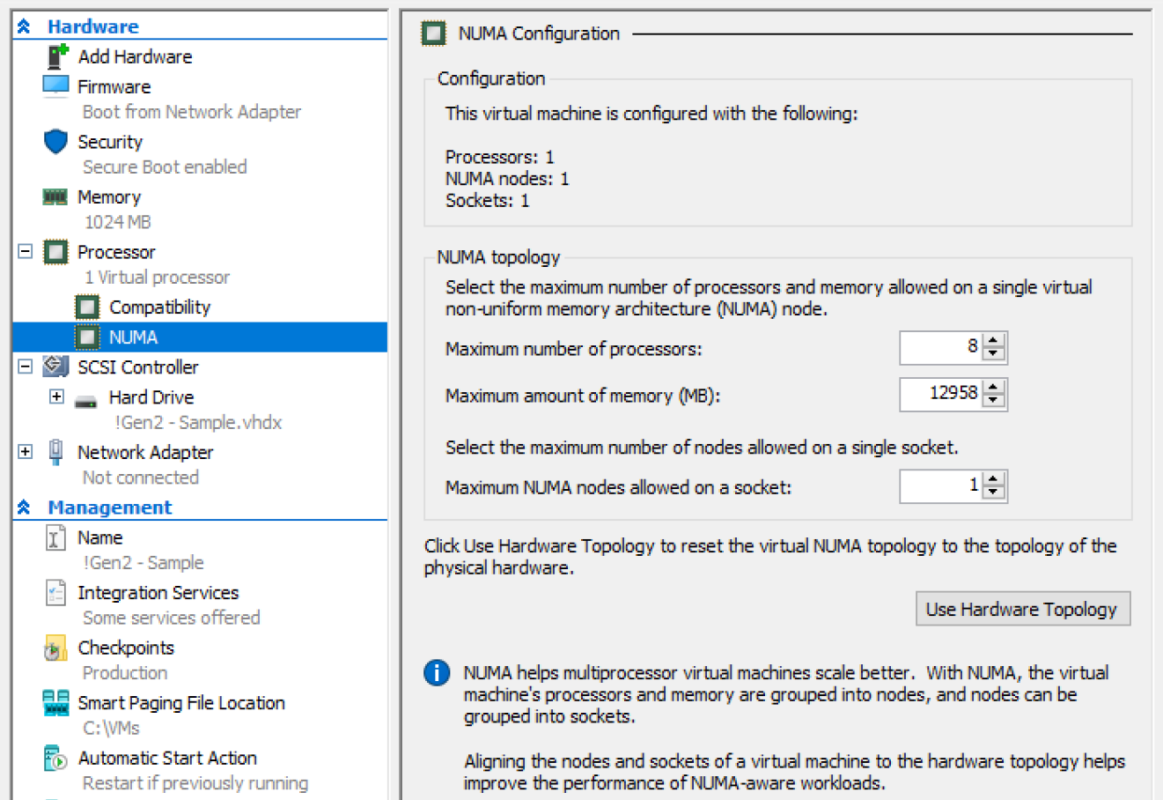
Memory (NUMA)
Since Windows Server 2012 virtual NUMA is available for Guest OS
Hyper-V automatically uses the best option possible and configures a VM NUMA topology to the optimal settings based on the physical hardware.
\\Hyper-V Hypervisor Virtual Processor(*)\ % Remote Run Time | The percentage of time spent by the virtual processor running on a remote node. The lowest value will represent the best performance, ideally 0, which means the VM will be using only local resources. VM NUMA topology is only available when static memory is used on a particular VM.
Healthy
If value is close to 0
Notes:
Depending on hardware design and amount of RAM per NUMA node might not be possible to have Remote Run Time near 0.

Slide 13
Hyper-V Dynamic Memory Balancer\
Available Memory | This counter represents the amount of memory left on the node that can be assigned to VMs. When close to 0, then the system is running close to 100% memory utilization and VM’s might see performance issues
Average Pressure | This counter represents the average pressure on the balancer node | Healthy: Below 83
 |  | Caution: Between 83 to 100
 |  | Critical: Above 100
Notes:
Pressure thresholds assume default VM reserve of 20%
For Static memory VMs, you will see the current memory consumption within the VM from the HOST view.

Slide 14
Hyper-V Dynamic Memory VM\
Guest Visible Physical Memory | This counter represents the amount of memory visible in the VM
Physical Memory | This counter represents the current amount of physical memory assigned in the VM
Average Pressure | This counter represents the average pressure on the VM | Healthy: Below 83
 |  | Caution: Between 83 to 100
 |  | Critical: Above 100
Note: Also applies to WS 2016, WS 2019 and Windows 10 VMs running static memory
Notes:
Pressure thresholds assume default VM reserve of 20%
New Counters in 2016/2019
\Hyper-V Dynamic Memory VM(*)\Memory Remove Operations
\Hyper-V Dynamic Memory VM(*)\Removed Memory
\Hyper-V Dynamic Memory VM(*)\Memory Add Operations
\Hyper-V Dynamic Memory VM(*)\Added Memory

Slide 15
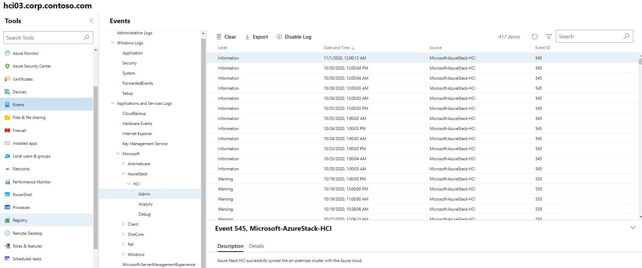
Azure Stack HCI Events
Notes:
In the Server Manager interface, click the Hyper-V page. This displays all Hyper-V servers in the domain, provided they have been added to the All Servers page in the navigation pane. Each Hyper-V server has multiple Tiles associated with it. The Events Tile displays a list of events from the Hyper-V Event Logs.

Slide 16
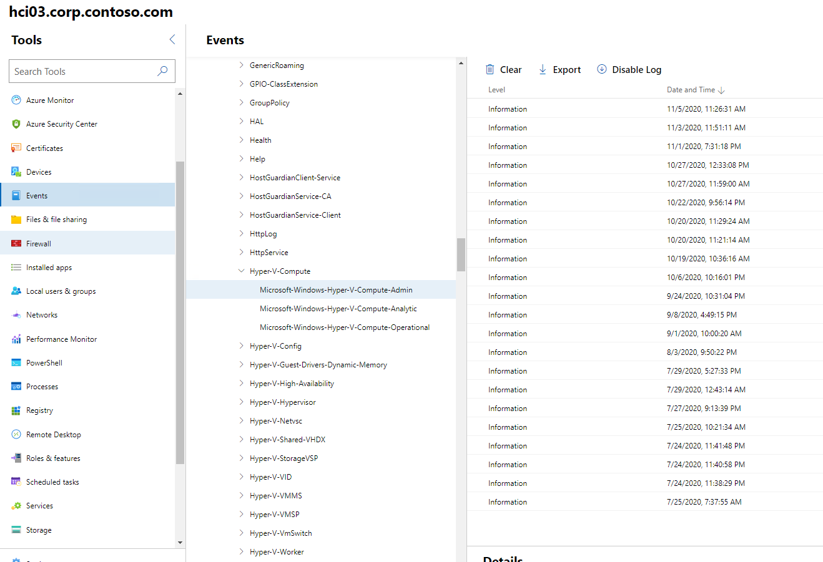
Event Logs in Event Viewer
Hyper-V Event Logs are found in the Event Viewer under Applications and Services Logs\Microsoft\Windows
Notes:
Event Logs in Event Viewer
Hyper-V Config—events are logged here that relate to problems accessing a virtual machine’s configuration file
Hyper-V-High-Availability—events are logged here that relate to Live and Quick migration events in Hyper-V Failover Cluster
Hyper-V-Hypervisor—events are logged here that relate to problems with the hypervisor itself, or if the hypervisor fails to load because of a problem. If the hypervisor does not load because hardware virtualization is not enabled in the BIOS, the event will not be logged here
Hyper-V-Integration—events are logged here that relate to problems with the integrated components
Hyper-V-SynthFC—events are logged here if there is a problem with connectivity using synthetic fibre channel in the virtual machine
Hyper-V-SynthNic—events are logged here if there is a problem with connectivity with the virtual machine network adapter(s)
Hyper-V-SynthStor—events are logged here that relate to any storage issues when using the synthetic storage driver
Hyper-V-VID—events in this log relate to the parent partition, virtual processor, and memory management services
Hyper-V-VMMS—events are logged here that relate to the components running in the Virtual Machine Management Service
Hyper-V-VmSwitch—events are logged here that relate to the virtual switch
Hyper-V-Worker—events are logged here that relate to the worker processes functionality

Slide 17
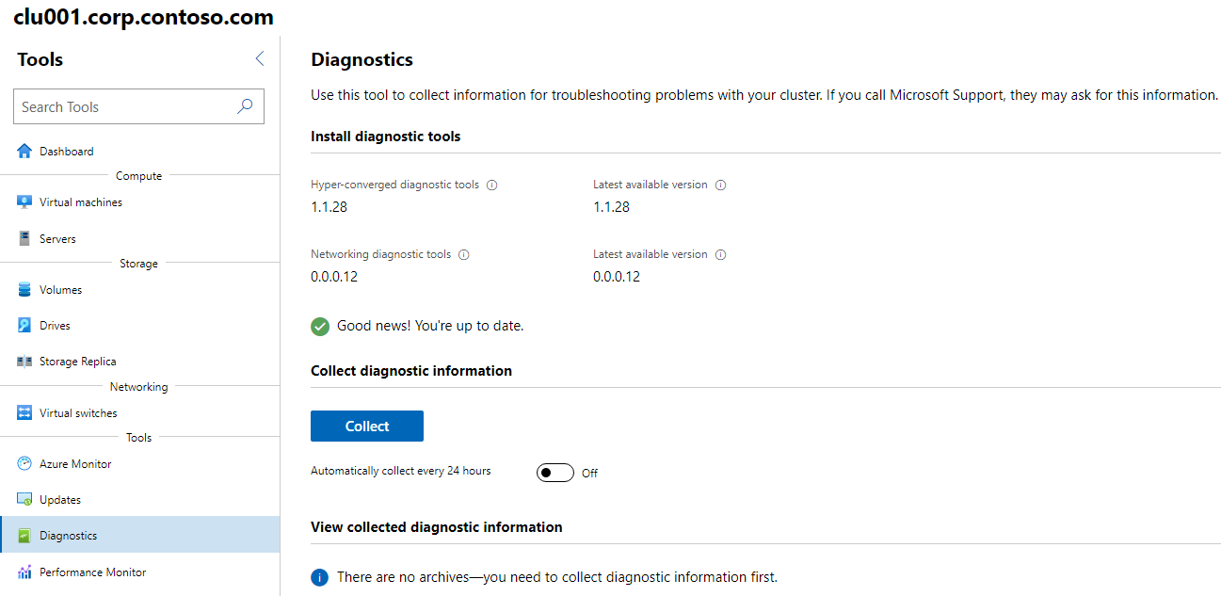
Azure Stack HCI Diagnostics
Dianostics is in the backplane:
Get-SDDCDiagnosticInfo
A powershell cmdlet that is used to gather logs and perfmon health checks for :
Failover Cluster;
Storage spaces Direct;
CSV;
Deduplication
Get-SDDCDiagnosticInfo -ClusterName CLU001
Notes:
Event Logs in Event Viewer
Hyper-V Config—events are logged here that relate to problems accessing a virtual machine’s configuration file
Hyper-V-High-Availability—events are logged here that relate to Live and Quick migration events in Hyper-V Failover Cluster
Hyper-V-Hypervisor—events are logged here that relate to problems with the hypervisor itself, or if the hypervisor fails to load because of a problem. If the hypervisor does not load because hardware virtualization is not enabled in the BIOS, the event will not be logged here
Hyper-V-Integration—events are logged here that relate to problems with the integrated components
Hyper-V-SynthFC—events are logged here if there is a problem with connectivity using synthetic fibre channel in the virtual machine
Hyper-V-SynthNic—events are logged here if there is a problem with connectivity with the virtual machine network adapter(s)
Hyper-V-SynthStor—events are logged here that relate to any storage issues when using the synthetic storage driver
Hyper-V-VID—events in this log relate to the parent partition, virtual processor, and memory management services
Hyper-V-VMMS—events are logged here that relate to the components running in the Virtual Machine Management Service
Hyper-V-VmSwitch—events are logged here that relate to the virtual switch
Hyper-V-Worker—events are logged here that relate to the worker processes functionality

Slide 18

Please Provide Feedback

