Slide 1

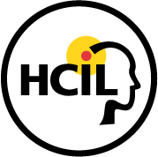
LifeFlow Case Study:
How do people read children books online?
Human-Computer Interaction Lab
University of Maryland
This case study was conducted by Krist Wongsuphasawat and Hsueh-Chien Cheng
under the supervision of Ben Shneiderman and Catherine Plaisant.
We appreciated the feedback from Anne Rose of the ICDL.
Last updated: Nov 22, 2011
http://www.cs.umd.edu/hcil/lifeflow

Slide 2
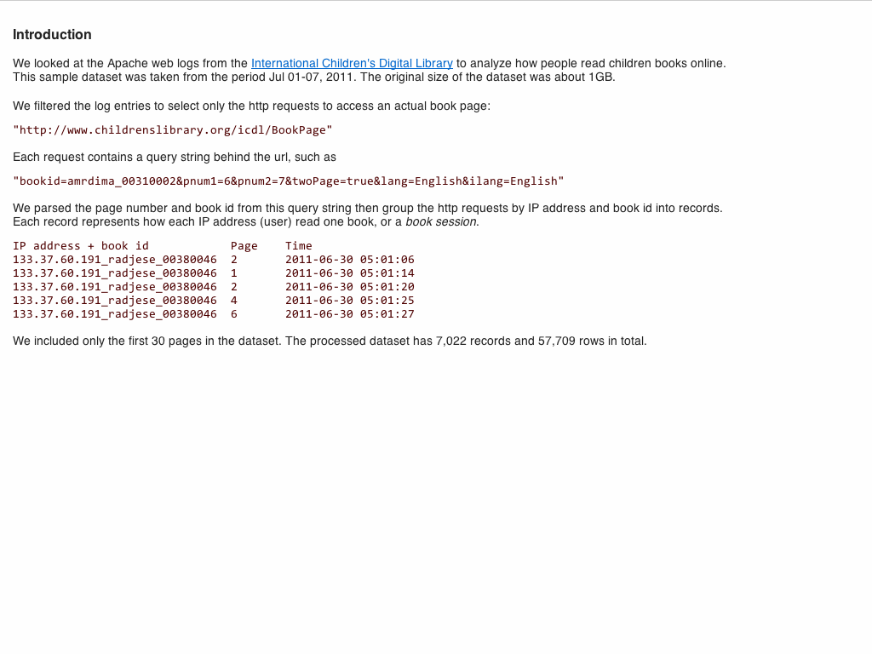

Slide 3
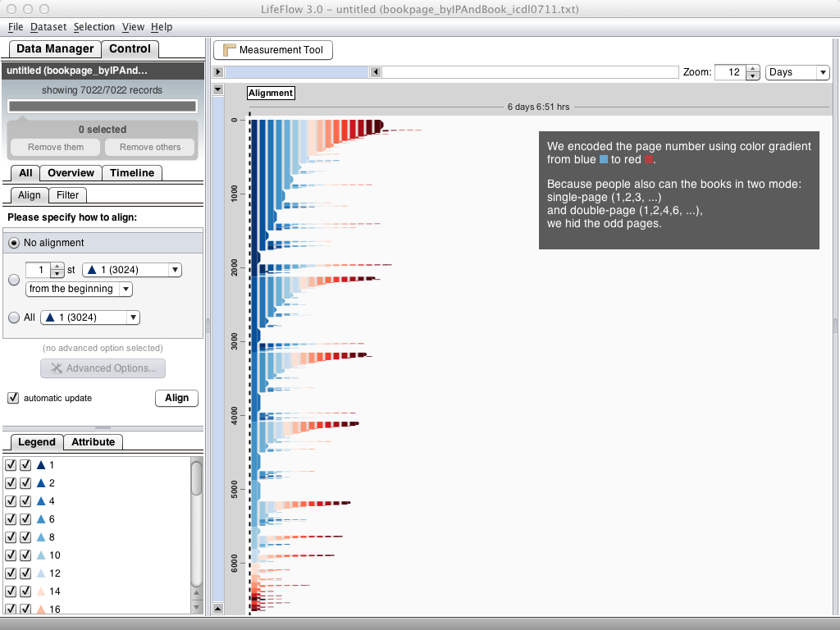

Slide 4
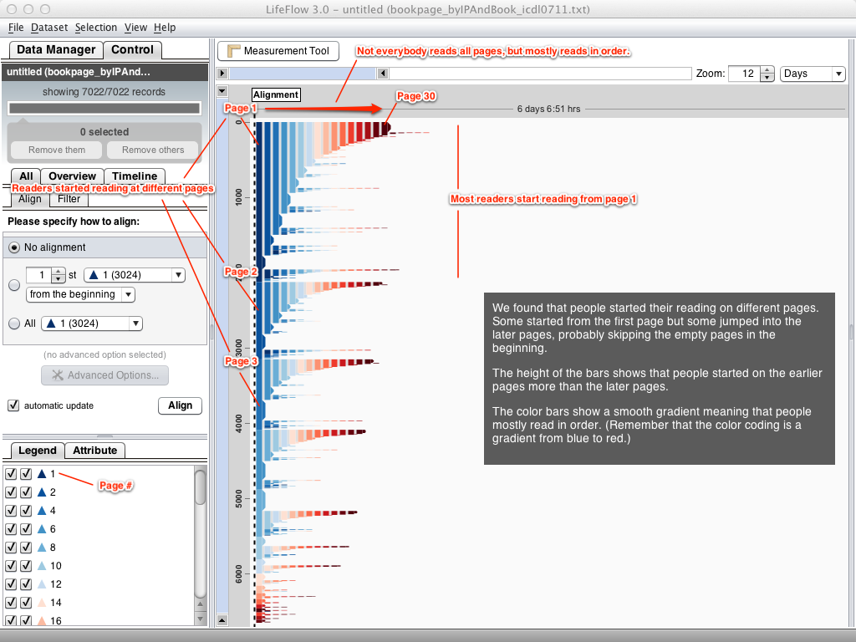

Slide 5
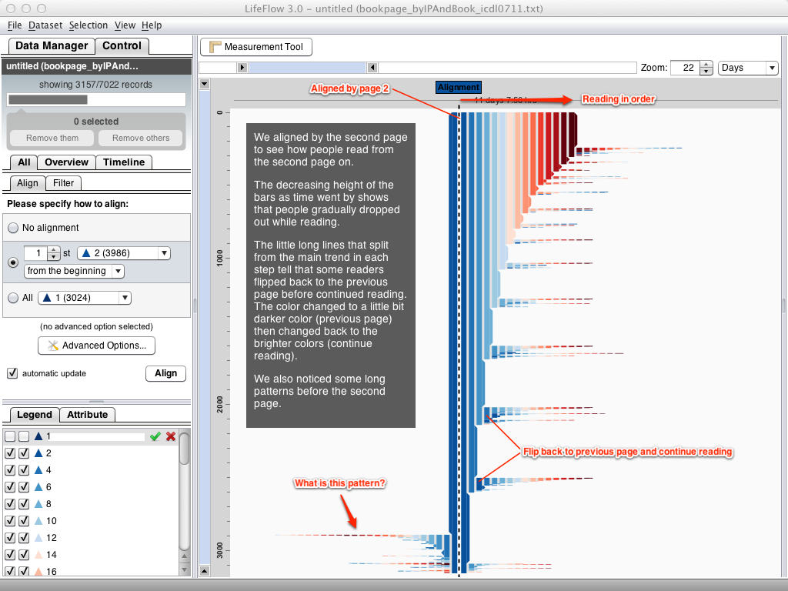

Slide 6
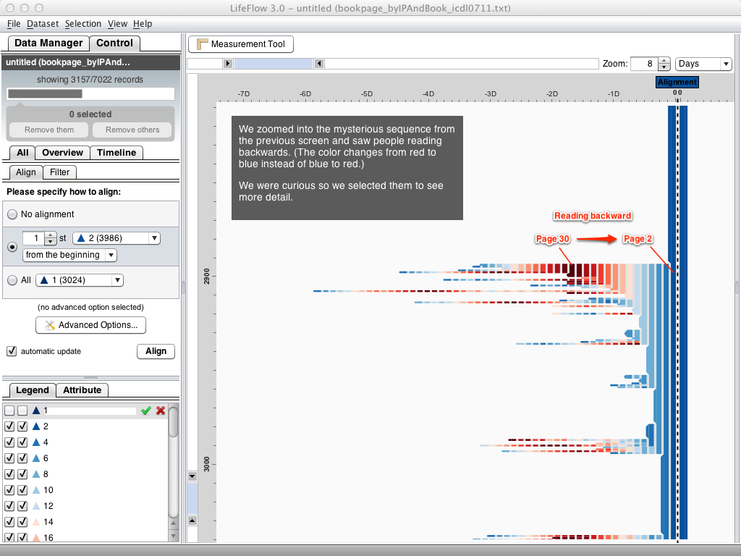

Slide 7
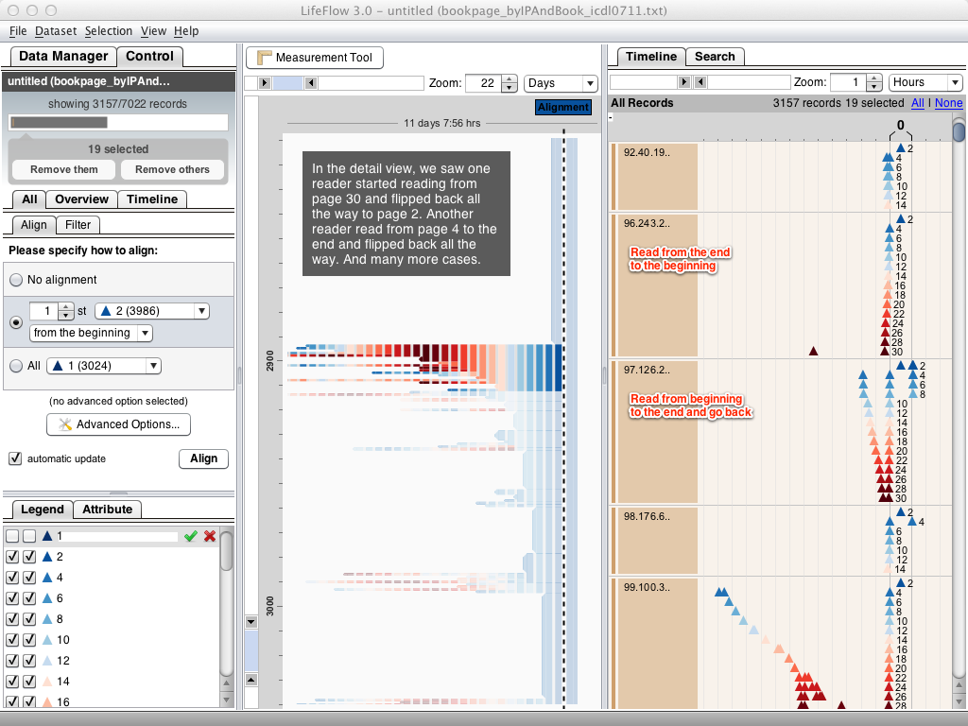

Slide 8
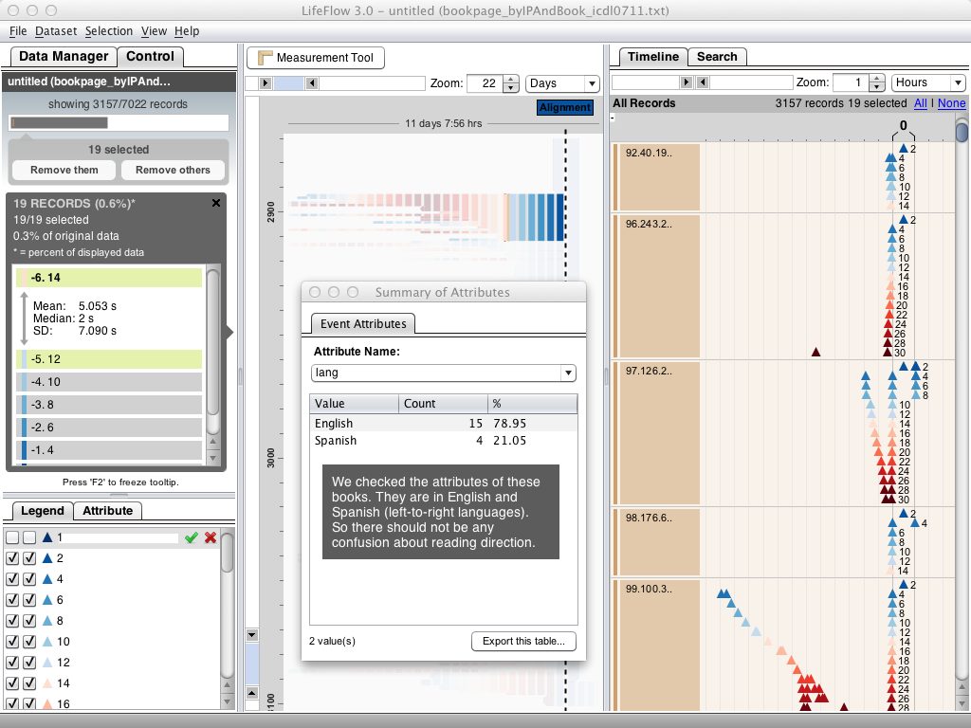

Slide 9
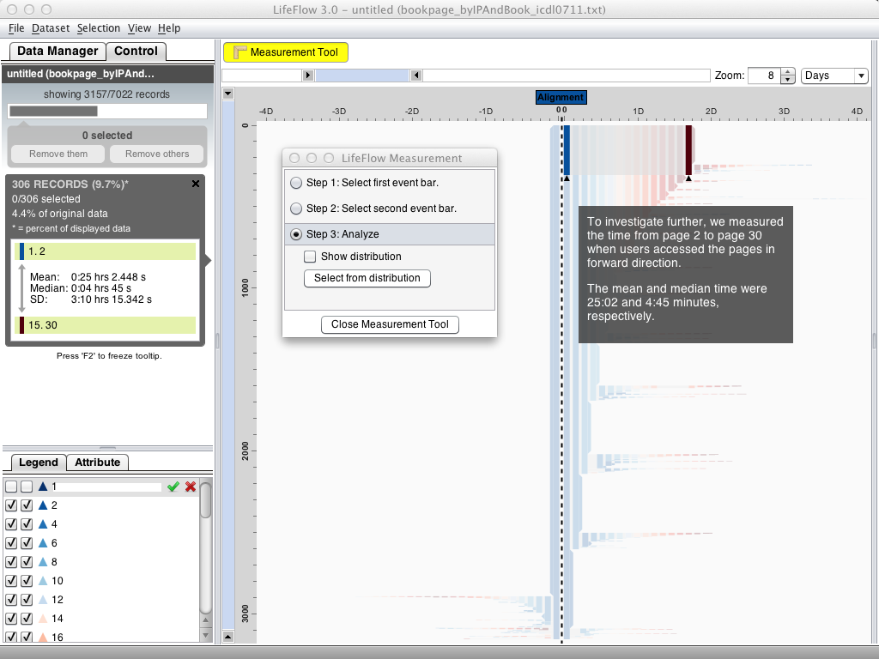

Slide 10
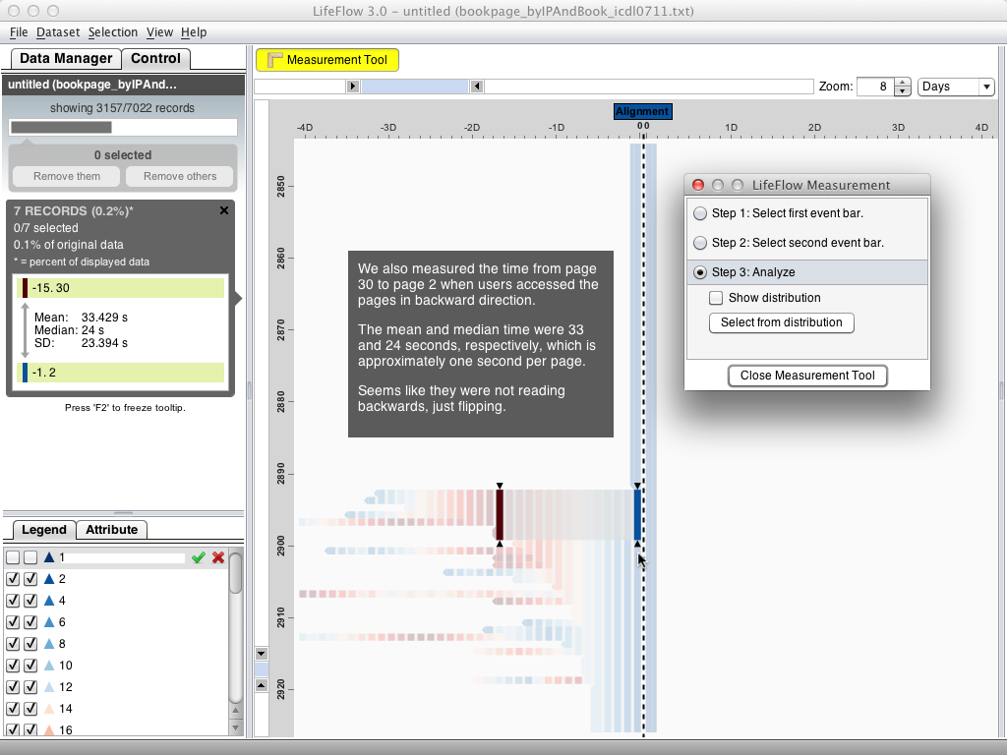

Slide 11
