Slide 1
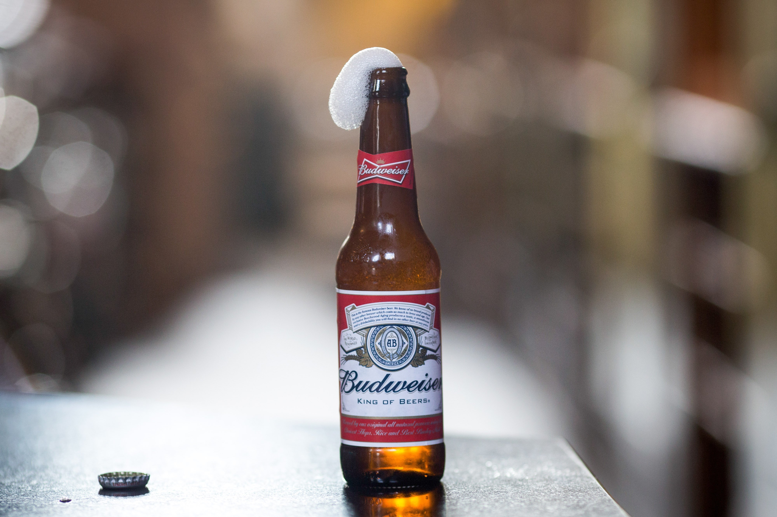
Doing Data Science: Case Study 1
Kristi Herman & Phu Truong

Slide 2

Links
GitHub Repo: https://github.com/kristxh/6306-CaseStudy1-Beer Phu Truong YouTube Presentation: https://youtu.be/c_I0v0TIQ10
Kristi Herman YouTube Presentation: https://www.youtube.com/watch?v=OPZmAFZuCQE

Slide 3
Introduction
There is a growing market for and interest in craft beer in the United States. Anheuser-Busch InBev SA announced in 2019 that it would purchase Craft Brew Alliance in 2020.
https://www.marketwatch.com/story/anheuser-busch-plans-to-buy-out-craft-brew-alliance-for-large-premium-2019-11-11
Budweiser (owned by Anheuser-Busch) is formulating new craft beers and interested in potential opportunities for launching new products and breweries in the United States. This presentation answers specific questions from Budweiser and provides possible states for Budweiser to open new breweries in the U.S.

Slide 4
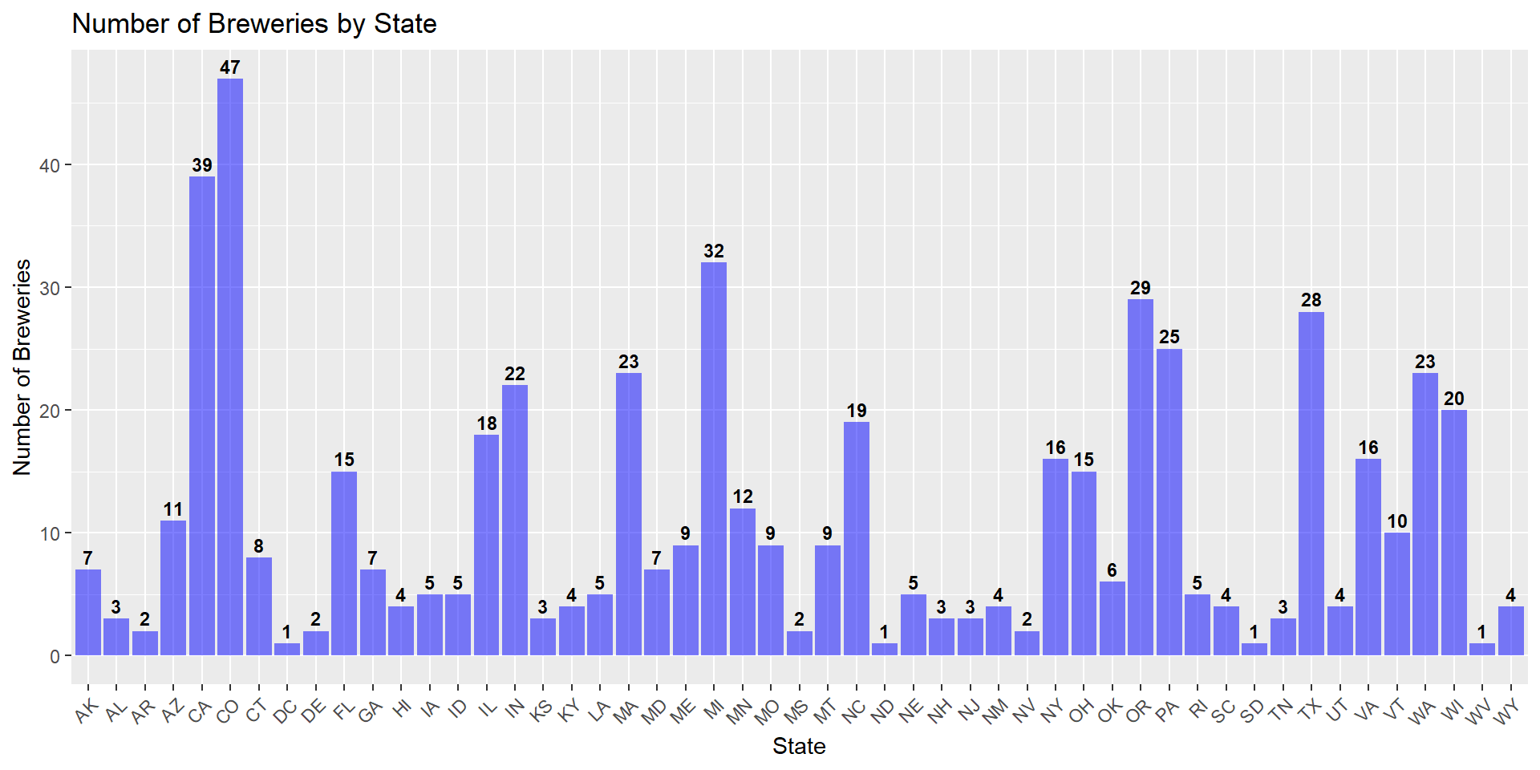
How many craft breweries are in each state?
Every state has at least one craft brewery.
Colorado has the highest number of craft breweries.

Slide 5
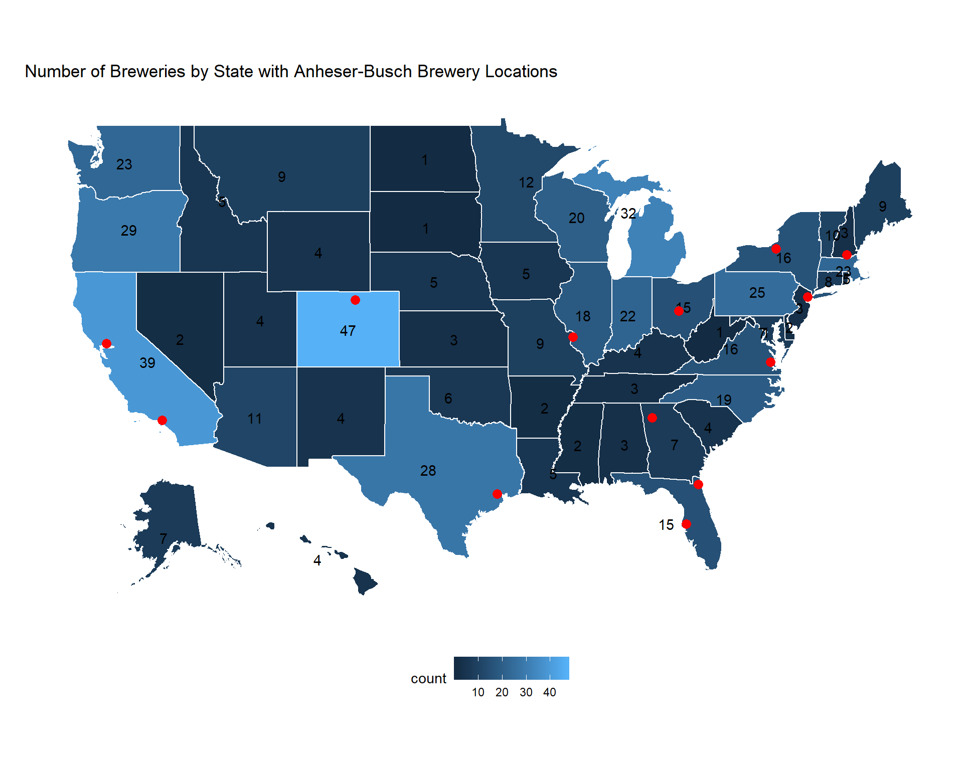
How many craft breweries are in each state?

Slide 6
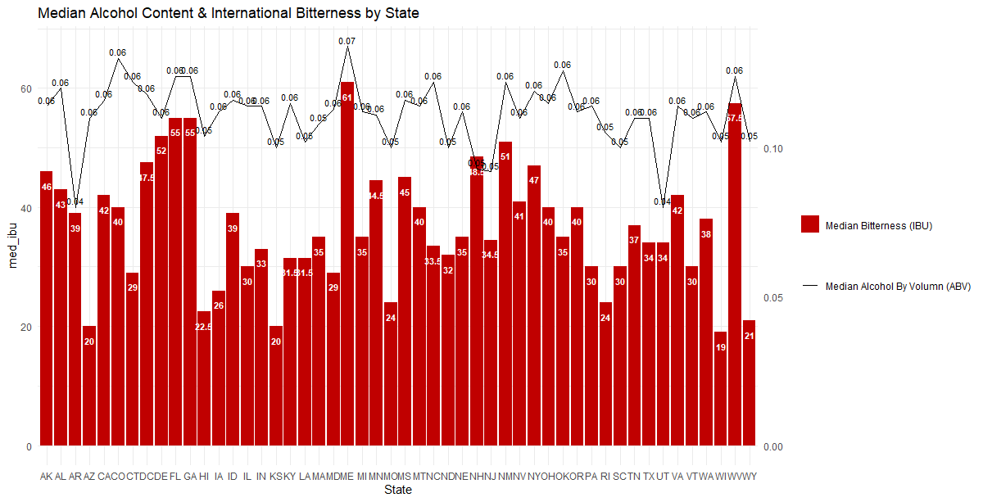
What is the median ABV and IBU in each state?
Maine has the highest median ABV and IBU of all the states. Arkansas and Utah have the lowest median ABV, while Wisconsin has the lowest median IBU.

Slide 7
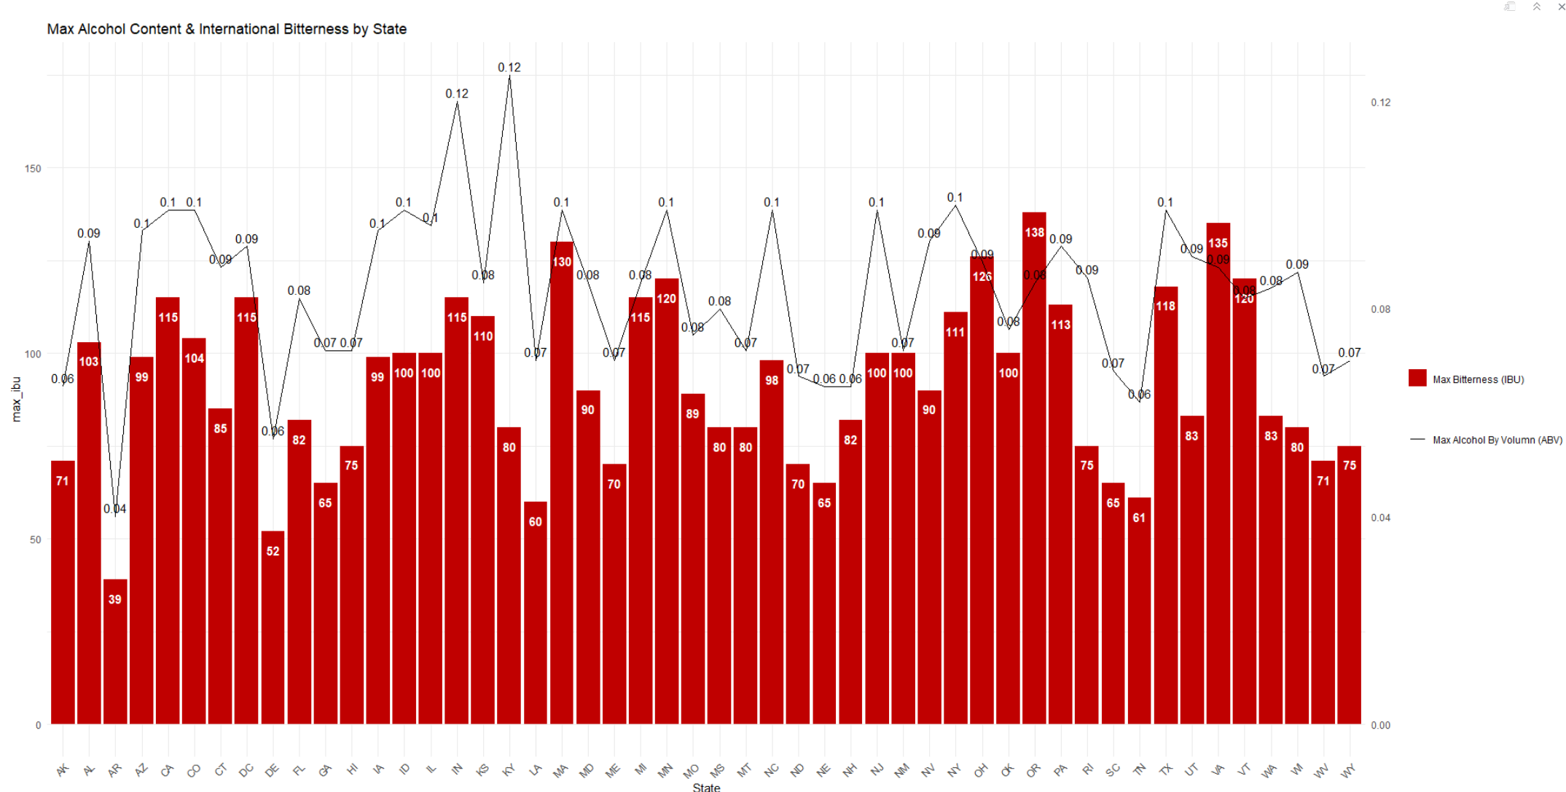
What states have the maximum ABV and IBU?
Kentucky has the highest ABV beer at 0.125, which is called ‘London Balling’, made by Against the Grain Brewery, located in Louisville, KY.
Oregon has the highest IBU beer at 138, which is called ‘Bitter Bitch Imperial IPA’, made by Astoria Brewing Company, located in Astoria, OR.

Slide 8
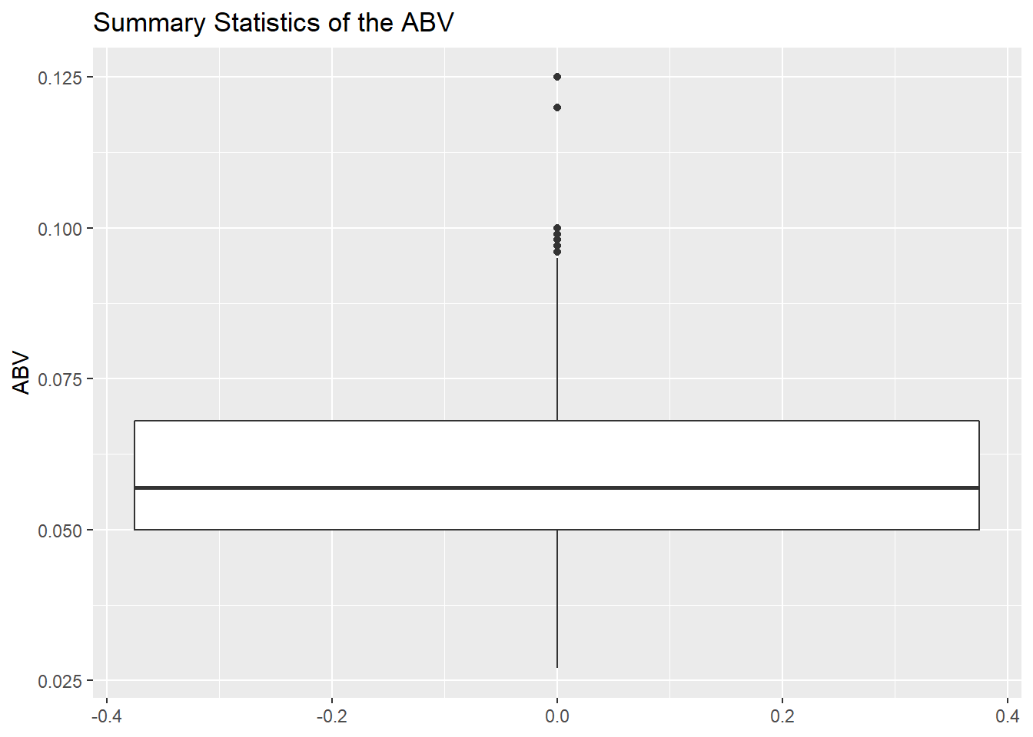
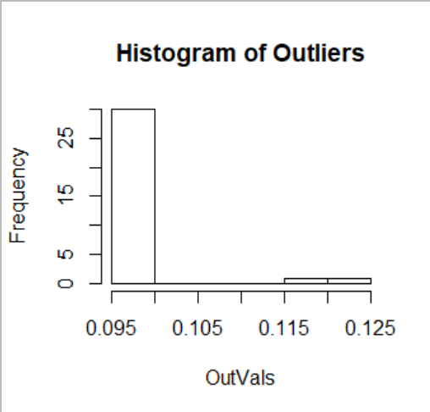
What are the summary statistics and distribution of ABV?
Below are the summary statistics of ABV for craft beers. This shows the minimum, maximum, median, and 1st & 3rd quartiles of the data set. There are 32 outliers of 0.096 and above.

Slide 9
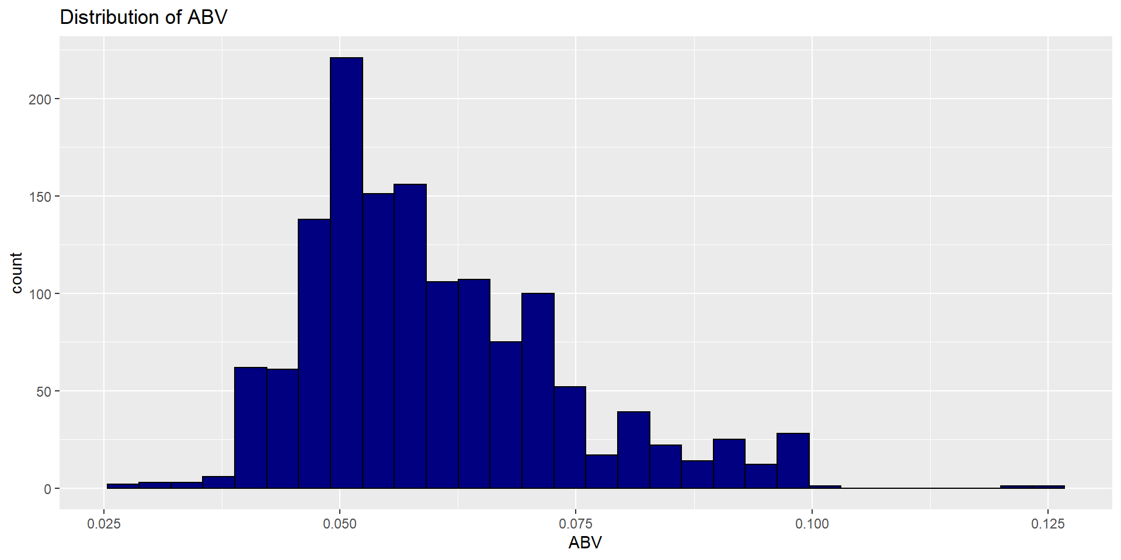
What are the summary statistics and distribution of ABV?
The distribution of ABV is slightly right-skewed. The data is concentrated at 0.050. According to Central Limit Theorem, the sample size is large enough (n =1405), the population of the ABV is normally distributed. The data is significantly different from 0 and the 95 percent confidence interval is (0.059, 0.061).
outliers

Slide 10
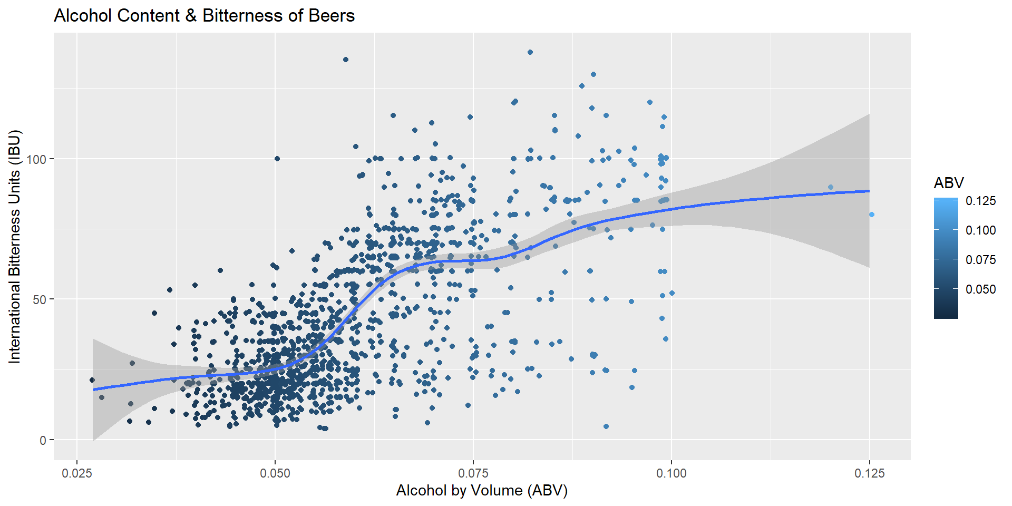
Is there a relationship between bitterness and alcohol content?
Higher ABV values are associated with higher IBUs and vice versa. With p-value < 2.2e-16, there is sufficient evidence at alpha = .05 level of significance to suggest that the data is linearly correlated. Correlation estimate = 0.67 suggests that the relationship between IBU and ABV is positive and strong.

Slide 11
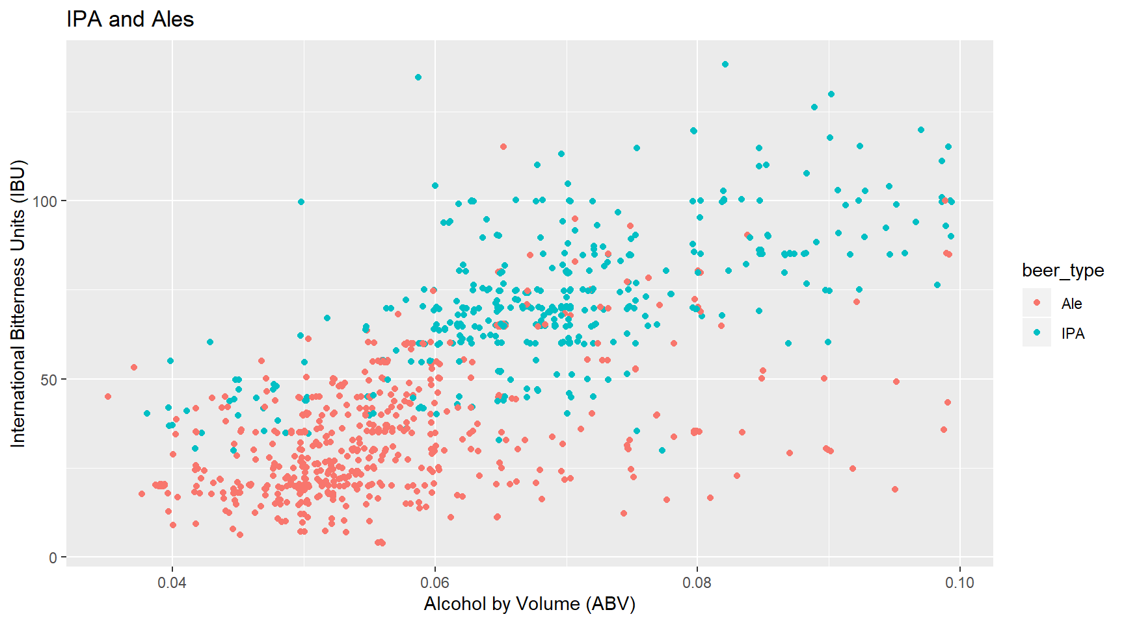
What is the difference in ABV and IBU between IPAs and other Ales?
IPAs have higher average ABV and IBU than other ales.

Slide 12
What is the difference in ABV and IBU between IPAs and other Ales?
Using K-Nearest Neighbors machine learning classification on a training and test dataset, the model can predict whether a beer is an IPA or an other ale based on its ABV and IBU values with an accuracy of 85.16%.
K=5 | Truly Ale | Truly IPA
Classified as Ale | 158 | 20
Classified as IPA | 22 | 83
Classifications
There are 241 craft beers that are classified accurately, and 42 craft beers are misclassified.

Slide 13
What is the difference in ABV and IBU between IPAs and other Ales?
We used Welch two sample t-test to test for the mean differences of ABV/IBU between IPAs and Ales. At alpha=.05 level of significance, there is sufficient evidence to suggest that the mean ABV/IBU of IPAs is significantly different from the mean ABV/IBU of Ales (p-value <2.2e-16).
We are 95% confident that the mean differences in ABV stay within (0.011, 0.014) and the mean differences in IBU stay within (35.16, 40.07) between IPAs and other Ales groups.

Slide 14
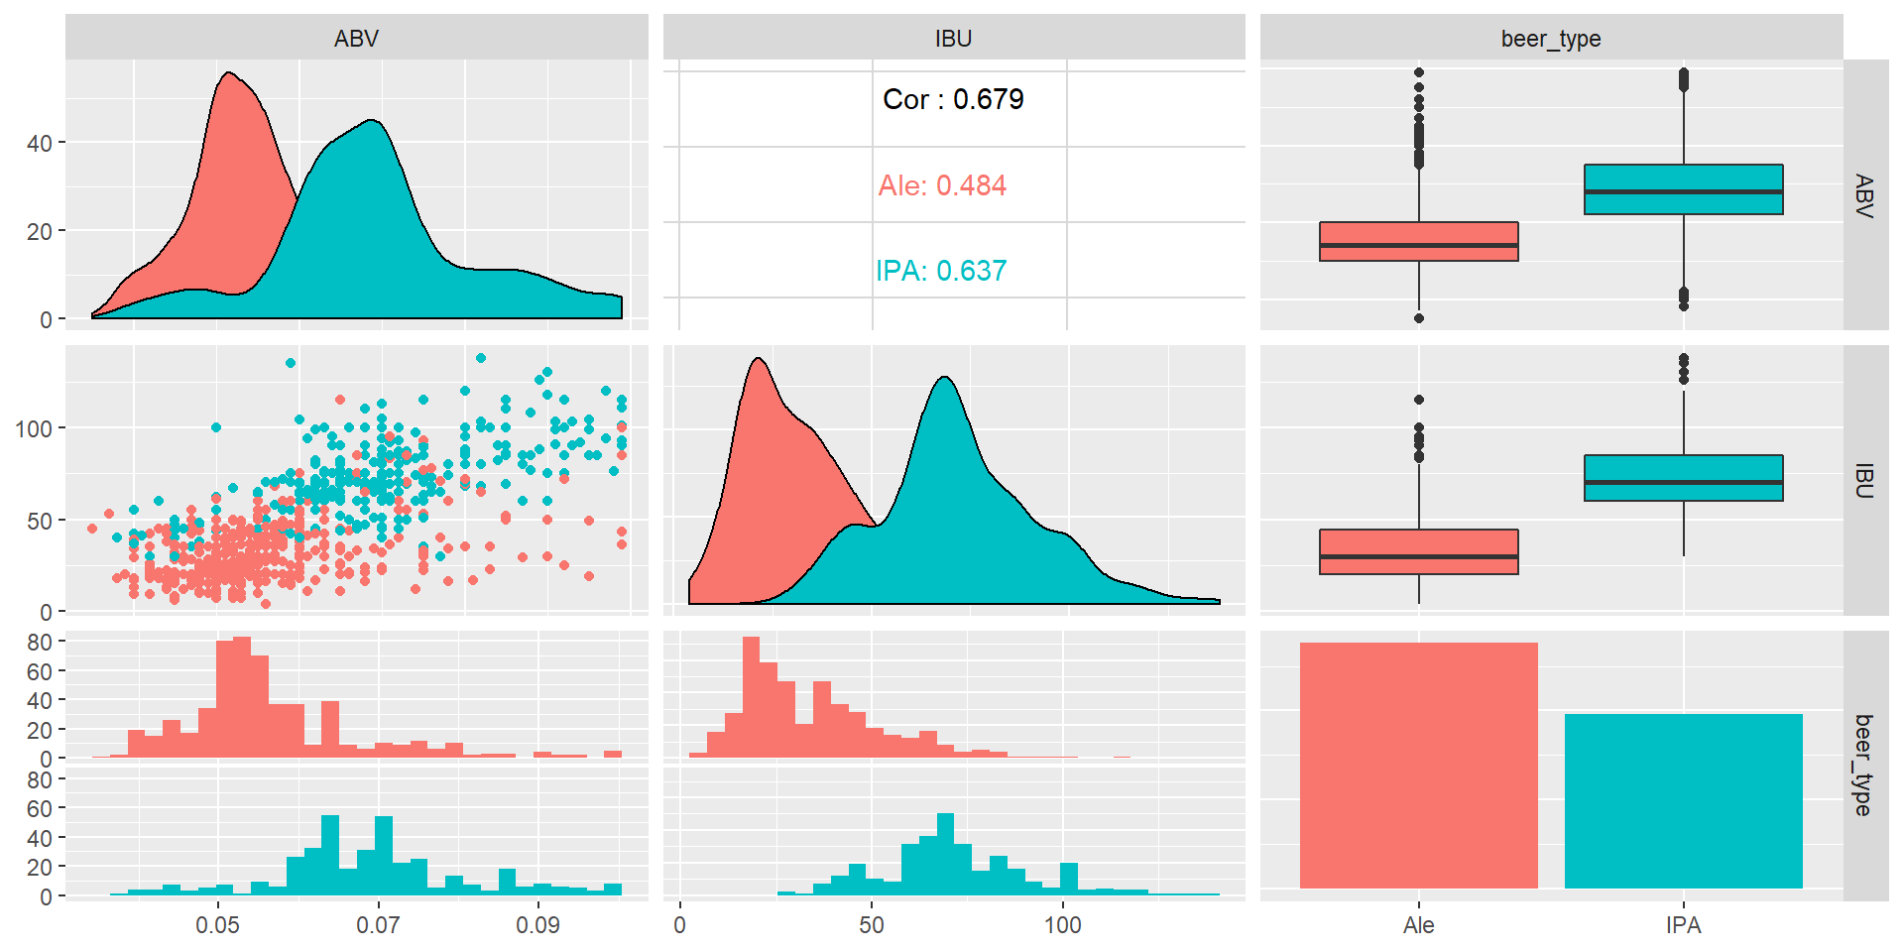
What is the difference in ABV and IBU between IPAs and other Ales?
The correlation of ABV and IBU is stronger in IPAs.
Ale has more outliers and larger variance.

Slide 15
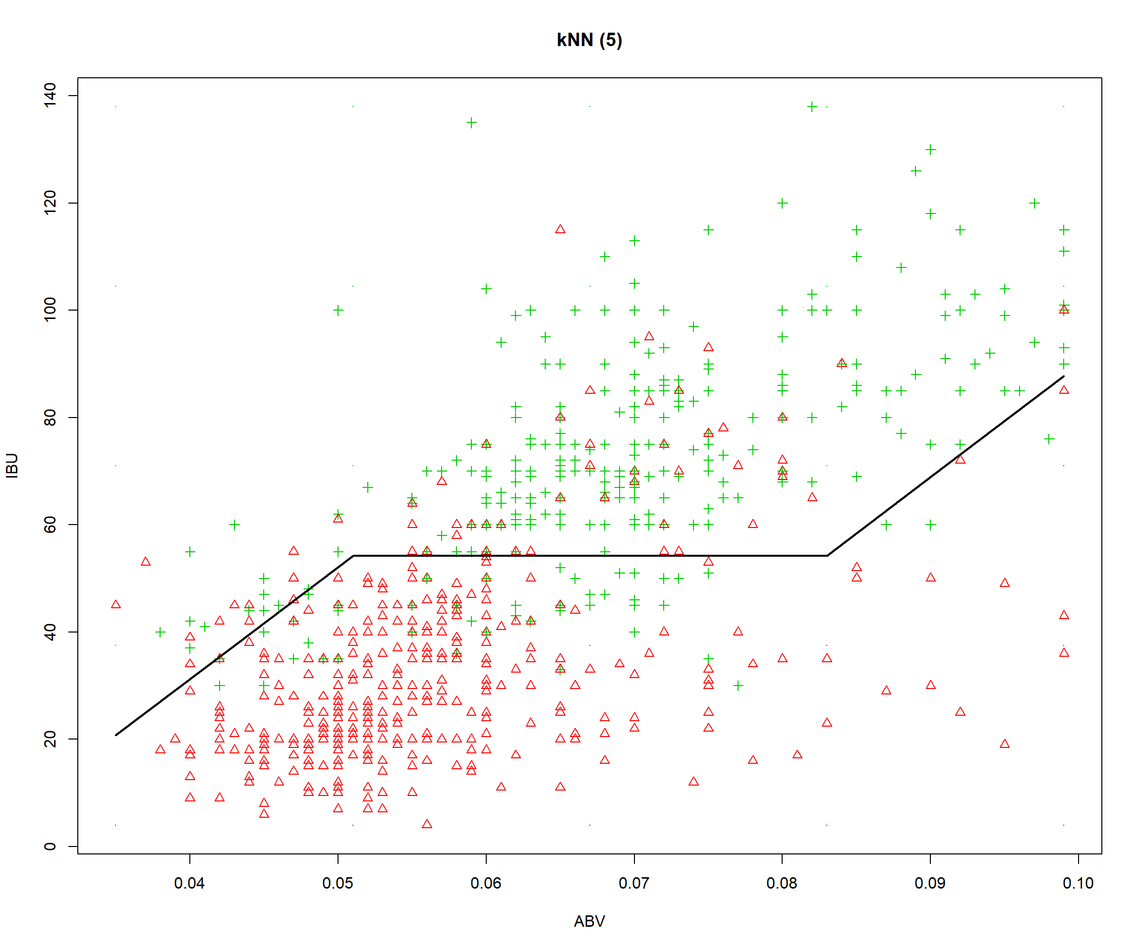
What is the difference in ABV and IBU between IPAs and other Ales?
This model’s prediction Budweiser (ABV = .05, IBU = 12) is Ale with 100% probability when the model uses 5 of the nearest neighbors.
Budweiser

Slide 16
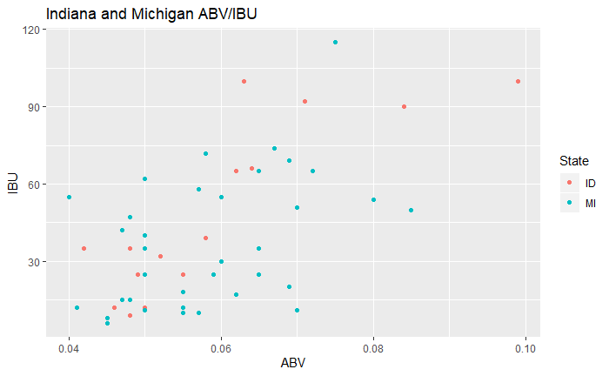
Possible new brewery locations based on ABV/IBU
An KNN model is created to compare Budweiser’s ABV/IBU (ABV= .05 IBU =12) to others’ . The 2 States that have the most beers with closest ABV/IBU profile to Budweiser’s are:
States | Median ABV | Median IBU
INDIANA | .058 | 39
MICHIGAN | .056 | 35
Budweiser

Slide 17
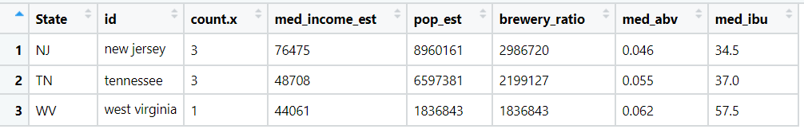
Possible new brewery locations based on population
Budweiser might explore new craft brewery locations in these states based on the low number of breweries for the population: New Jersey, Tennessee, and West Virginia.

Slide 18
Conclusions
Indiana and Michigan have the closest ABV and IBUs of the Budweiser brews. If Budweiser wants to consider opening new craft breweries in states where craft beer drinkers have similar taste to Budweiser, then these states should be considered. Michigan has the third most craft breweries in the US based on our data, indicating that there is a lot of interest in craft breweries.
New Jersey, Tennessee, and West Virginia have a low number of craft breweries for the population of those states. If Budweiser wants to consider opening breweries that might have more demand, these states should be considered.
When comparing Budweiser to IPAs and other ales, Budweiser would be considered an ale.
The median ABV in the dataset is .057. The median IBU is 35. ABV and IBU have a strong positive linear correlation. Budweiser ABV and IBU are very low compared to the other beers in the dataset. Budweiser could consider creating a new craft beer with a higher ABV and IBU.

Slide 19
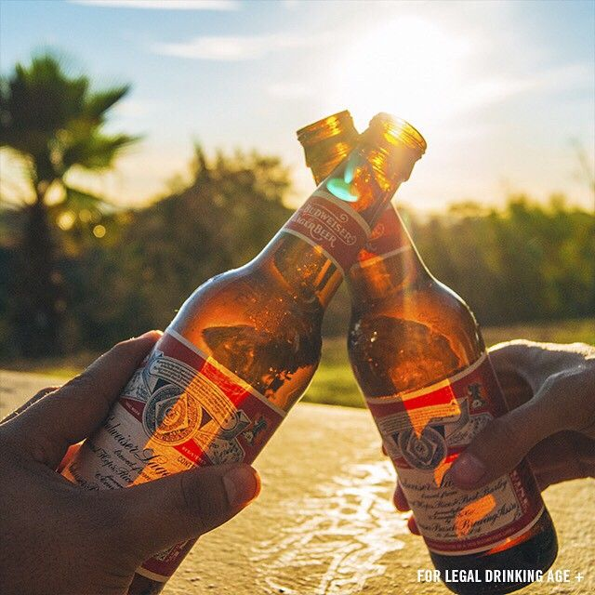
Cheers

Slide 20
Appendix: References
MarketWatch Article https://www.marketwatch.com/story/anheuser-busch-plans-to-buy-out-craft-brew-alliance-for-large-premium-2019-11-11
Budweiser Logo https://www.anheuser-busch.com/beers.html
Budweiser Image – Slide 1 https://si.wsj.net/public/resources/images/BN-TL780_2kRu4_OR_20170516101058.jpg?width=620&height=413
Budweiser Image – Slide 19 https://i.pinimg.com/474x/f4/cd/7c/f4cd7c82c85fc46dc9a403af77e1289e--patio-the-photo.jpg
Data -Beers.csv -Breweries.csv -cities.csv
-Census API: https://www.census.gov/data/developers/data-sets.html

