Slide 1
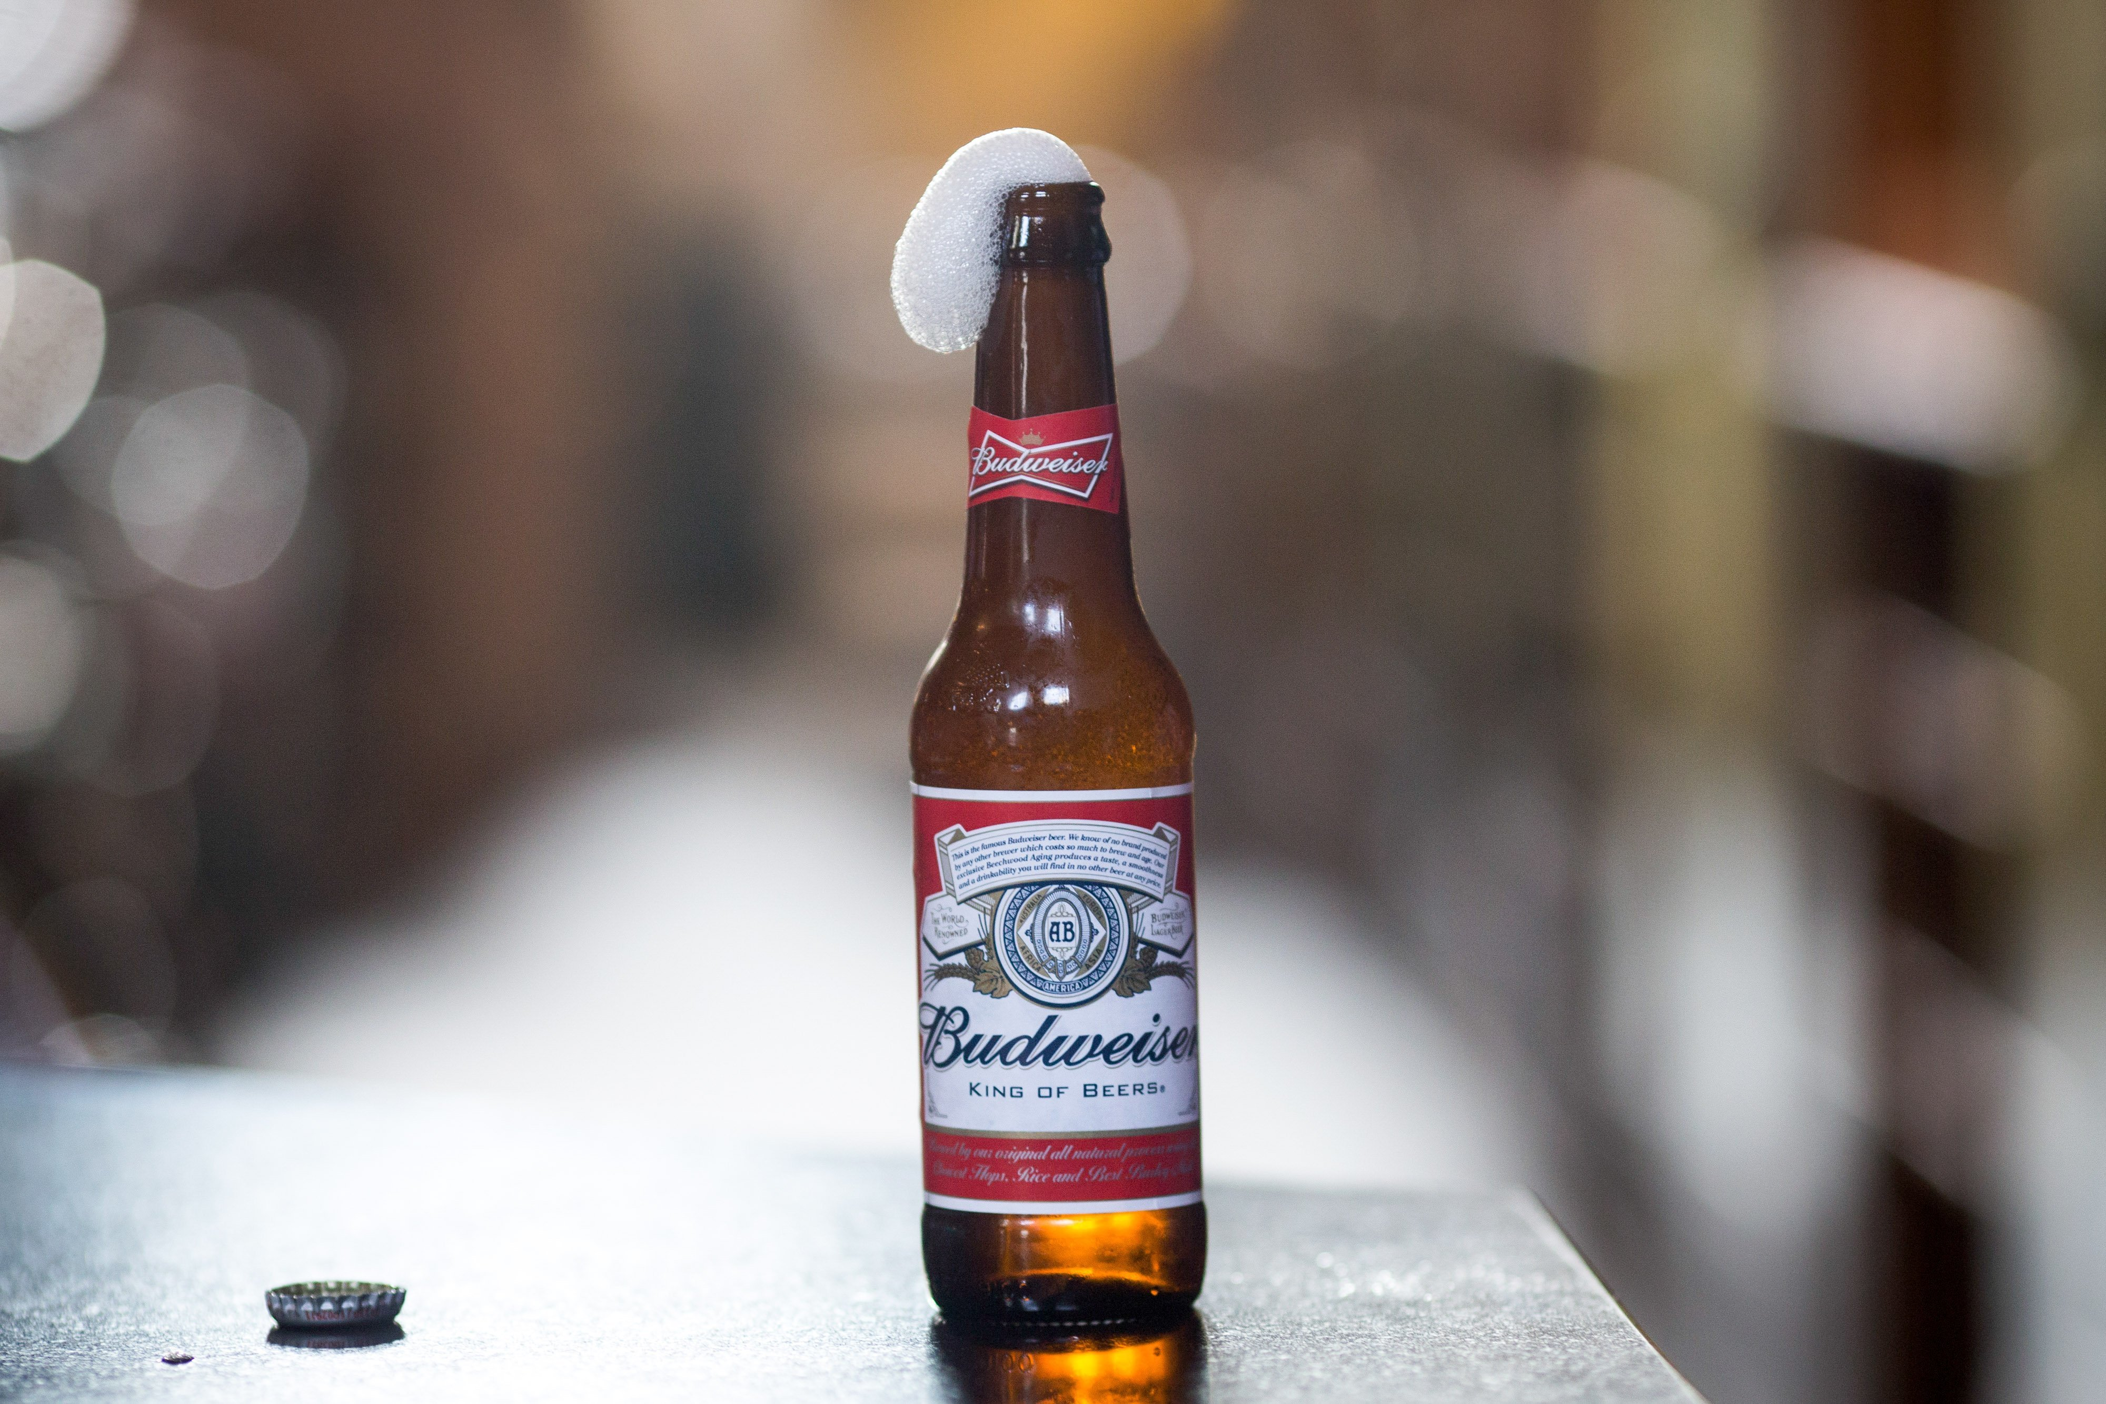
Doing Data Science: Case Study 1
Kristi Herman & Phu Trong

Slide 2

Introduction
There is a growing market for and interest in craft beer in the United States. Anheuser-Busch InBev SA announced in 2019 that it would purchase Craft Brew Alliance in 2020.
https://www.marketwatch.com/story/anheuser-busch-plans-to-buy-out-craft-brew-alliance-for-large-premium-2019-11-11
Budweiser (owned by Anheuser-Busch) is formulating new craft beers and interested in potential opportunities for launching new products and breweries in the United States. Some questions we explore in this presentation are:
What states currently have craft beers that are similar in ABV and IBU to their current brands?
For a new craft beer that is currently under development, how should it be classified?

Slide 3
To import dependencies and data
# Import dependencies
library(tidyverse)
library(dplyr)
library(ggplot2)
library(data.table)
library(ggthemes)
library(usmap)
library(naniar)
library(class)
library(caret)
# Import Beer and Brewery data
beer_df <- read_csv("Beers.csv")
brew_df <- read_csv("Breweries.csv")

Slide 4
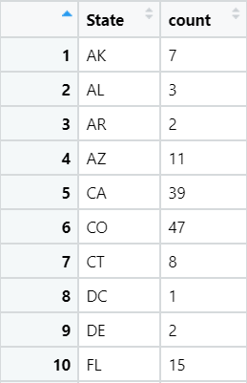
How many craft breweries are in each state?
# Group breweries by state
brew_by_state <- brew_df %>% group_by(State) %>% summarize(count=n())
# Display number of breweries by state
View(brew_by_state)

Slide 5
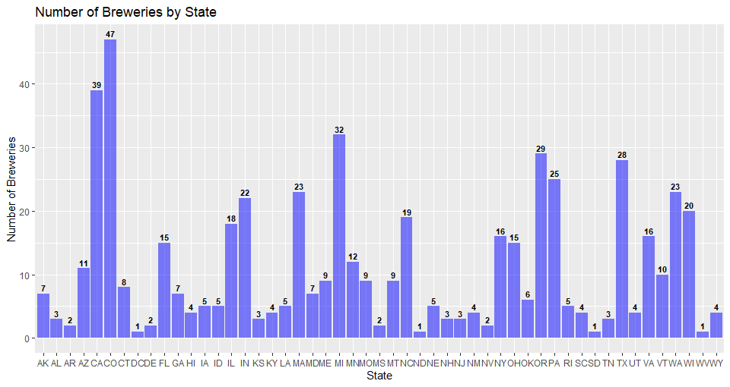
How many craft breweries are in each state?

Slide 6
How many craft breweries are in each state?
# Plot number of breweries by state in a bar chart
brew_by_state %>%
ggplot(aes(x = State, y = count)) +
geom_bar(stat = "identity", fill = "blue", alpha = .5) +
ggtitle("Number of Breweries by State") + xlab("State") + ylab("Number of Breweries") +
geom_text(aes(y = count, label = count), fontface = "bold", vjust = -.4, color = "black", size = 3)

Slide 7
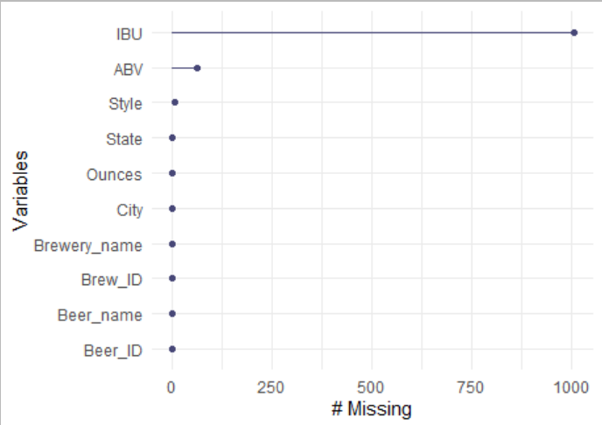
Address missing values in each column
# Create a chart and count missing values in each column
gg_miss_var(all_df)
s = sapply(all_df, function(x) sum(is.na(x)))
# Remove missing values in “ABV” “IBU” “Style” columns
clean_df <- all_df %>% filter(!is.na(ABV) & !is.na(IBU) & !is.na(Style))

Slide 8
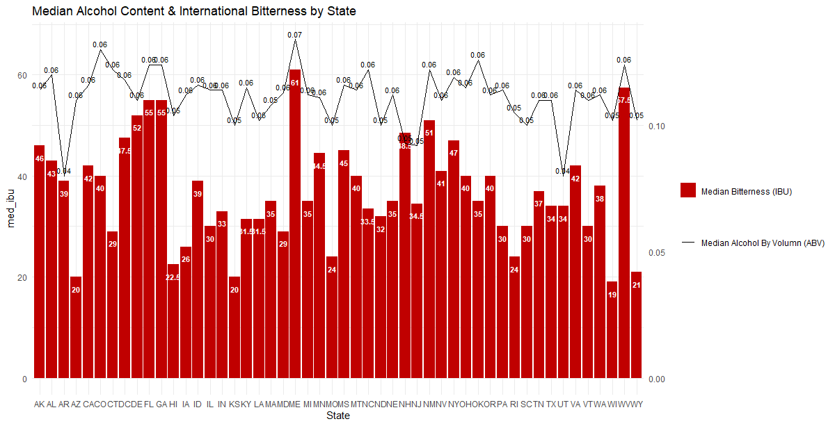
What is the median ABV and IBU in each state?

Slide 9
What is the median ABV and IBU in each state?
# Dataframe with median values for ABV and IBU
(med_abv_ibu <- clean_df %>%
group_by(State) %>%
summarize(med_abv = median(ABV), med_ibu = median(IBU), count = n()))
# Plot
ggplot(med_abv_ibu, aes(x = State)) +
geom_col(aes( y = med_ibu, fill="redfill")) +
geom_text(aes(y = med_ibu, label = med_ibu), fontface = "bold", vjust = 2.4, color = "white", size = 3) +
geom_line(aes(y = med_abv * 1000, group = 1, color = 'blackline')) +
geom_text(aes(y = med_abv * 1000, label = round(med_abv, 2)), vjust = -.4, color = "black", size = 3) +
scale_y_continuous(sec.axis = sec_axis(trans = ~ . / 500)) +
scale_fill_manual('', labels = 'Median Bitterness (IBU)', values = "#C00000") +
scale_color_manual('', labels = 'Median Alcohol By Volumn (ABV)', values = 'black') +
ggtitle("Median Alcohol Content & International Bitterness by State") +
theme_minimal()

Slide 10


What states have the maximum ABV and IBU?
# Create a new data frame with max ABV and IBU by states
max_abv_ibu <- clean_df %>% group_by(State) %>% summarize(max_abv = max(ABV), max_ibu = max(IBU), count = n())
# List state with max ABV
(highest_abv <- max_abv_ibu %>% filter(rank(desc(max_abv))<=1))
# List state with max IBU
(highest_ibu <- max_abv_ibu %>% filter(rank(desc(max_ibu))<=1))

Slide 11
What states have the maximum ABV and IBU?
#List row with max ABV
view(clean_df[which.max(clean_df$ABV),])
#List row with max IBU
view(clean_df[which.max(clean_df$IBU),])
Answer:
Kentucky has the highest ABV beer, which is called ‘London Balling’, made by Against the Grain Brewery, located in Louisville city.
Oregon has the highest IBU beer, which is called ‘Bitter Bitch Imperial IPA’, made by Astoria Brewing Company, located in Astoria city.

Slide 12
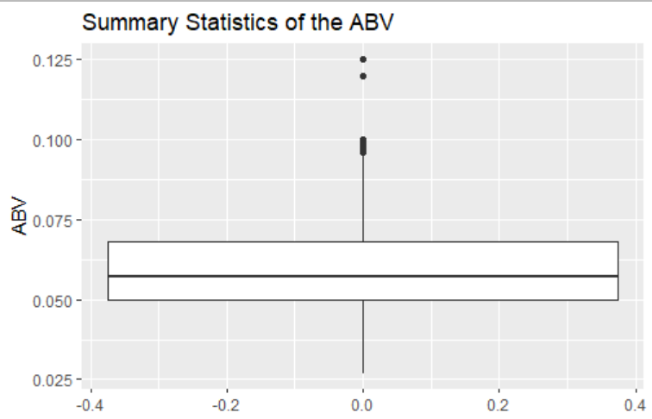
What is the statistics and distribution of ABV?
# Summary of key statistics
summary(clean_df$ABV)
# Plot boxplot
clean_df %>% ggplot(aes(y = ABV))+ geom_boxplot() +
ggtitle("Summary Statistics of the ABV") + ylab("ABV")

Slide 13
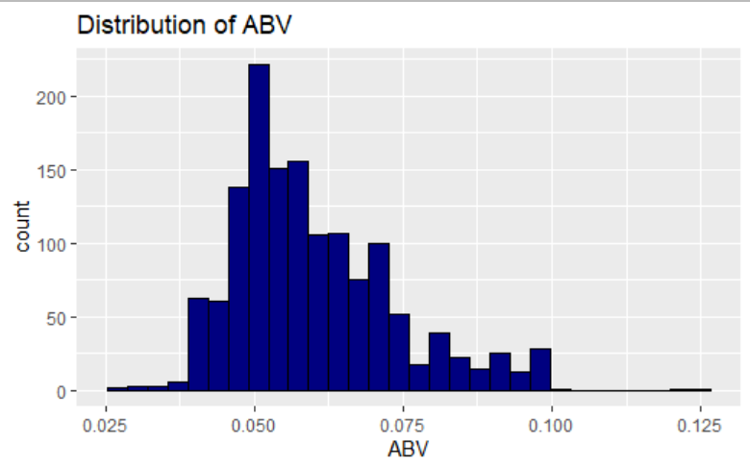
What is the statistics and distribution of ABV?
#Plot histogram
clean_df %>% ggplot(aes(x = ABV)) + geom_histogram(colour="black",fill="navy") +
ggtitle("Distribution of ABV") + xlab("ABV")
Comment: the distribution of ABV is slightly right-skewed

Slide 14
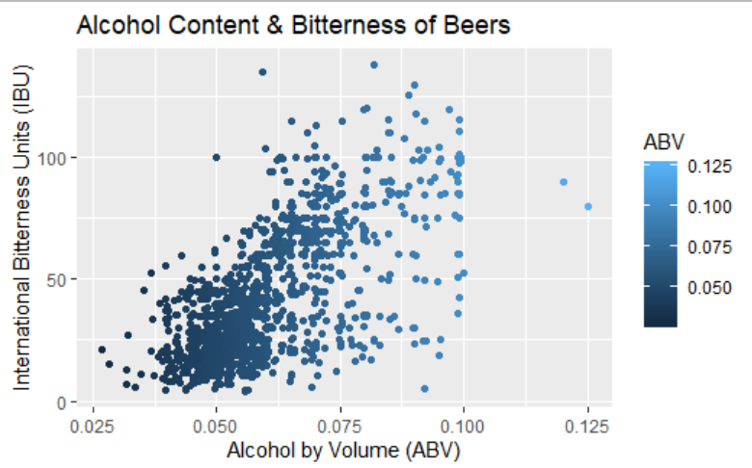
Is there a relationship between bitterness and alcohol content?
# Plot scatter plot for ABV and IBU
ggplot(data = clean_df) +
geom_point(mapping = aes(x = ABV, y = IBU, color=ABV), position ="jitter") +
ggtitle("Alcohol Content & Bitterness of Beers") + xlab("Alcohol by Volume (ABV)") + ylab("International Bitterness Units (IBU)")

Slide 15
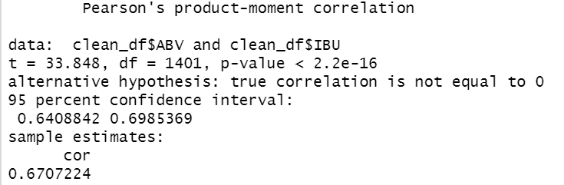
Is there a relationship between bitterness and alcohol content?
# test correlation between ABV and IBU
cor.test(clean_df$ABV,clean_df$IBU)
Answer:
With p-value < 2.2e-16, there is sufficient evidence at alpha= .05 level of significance to suggest that the data is linearly correlated. Correlation estimate =0.67 suggests that the relationship between IBU and ABV is positive and strong.

Slide 16
What is the difference in ABV and IBU between IPAs and other Ales?
# Create a dataframe with only IPAs & Ales
ipa_ale_df <- clean_df %>% filter(str_detect(Style, 'IPA') |str_detect(Style, 'Ale'))
# Add a column for "IPA" or "Ale"
ipa_ale_df$beer_type = ifelse(grepl("IPA", ipa_ale_df$Style), "IPA", "Ale")
# Check to make sure there are no NAs for IPA or Ale
ipa_ale_df %>% filter(is.na(beer_type))
str(ipa_ale_df)
# Split data into train and test data
# Train/Test with 70/30
splitPerc = .7
set.seed(4)
trainIndices = sample(1:dim(ipa_ale_df)[1],round(splitPerc * dim(ipa_ale_df)[1]))
train = ipa_ale_df[trainIndices,]
test = ipa_ale_df[-trainIndices,]

Slide 17
What is the difference in ABV and IBU between IPAs and other Ales?
# Loop for many k and the average of many training / test partition
```{r}
iterations = 200
numks = 30
masterAcc = matrix(nrow = iterations, ncol = numks)
for(j in 1:iterations)
{
accs = data.frame(accuracy = numeric(30), k = numeric(30))
trainIndices = sample(1:dim(ipa_ale_df)[1],round(splitPerc * dim(ipa_ale_df)[1]))
train = ipa_ale_df[trainIndices,]
test = ipa_ale_df[-trainIndices,]
for(i in 1:numks)
{
classifications = knn(train[,c("ABV","IBU")],test[,c("ABV","IBU")],train$beer_type, prob = TRUE, k = i)
table(test$beer_type,classifications)
CM = confusionMatrix(table(test$beer_type,classifications))
masterAcc[j,i] = CM$overall[1]
}
}
MeanAcc = colMeans(masterAcc)
plot(seq(1,numks,1),MeanAcc, type = "l")

Slide 18
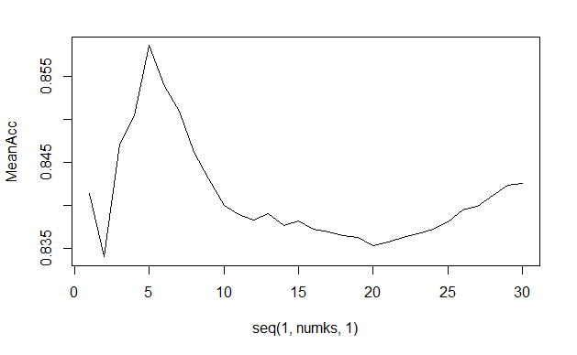
What is the difference in ABV and IBU between IPAs and other Ales?
Comment: K= 5 provides best Accuracy

Slide 19
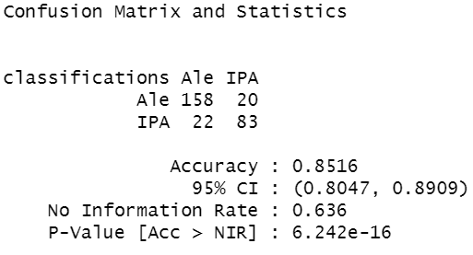
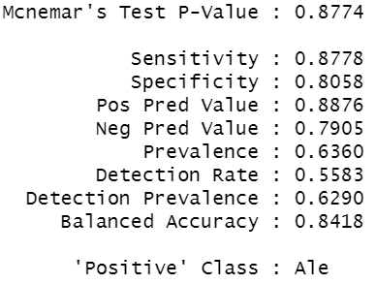
What is the difference in ABV and IBU between IPAs and other Ales?
# Run the KNN model on the train and test data with k = 5
classifications = knn(train[,c("ABV","IBU")],test[,c("ABV","IBU")],train$beer_type, prob = TRUE, k = 5)
# Create a confusion matrix of the results with k = 5
table(classifications,test$beer_type)
CM_KNN_IPA = confusionMatrix(table(classifications,test$beer_type))
CM_KNN_IPA

Slide 20
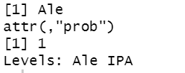
What is the difference in ABV and IBU between IPAs and other Ales?
# Predict what Budweiser would be classified as
bud_test = data.frame(ABV = .05, IBU = 12)
classify_bud = knn(train[,c("ABV","IBU")], bud_test, train$beer_type, prob = TRUE, k = 5)
classify_bud

Slide 21
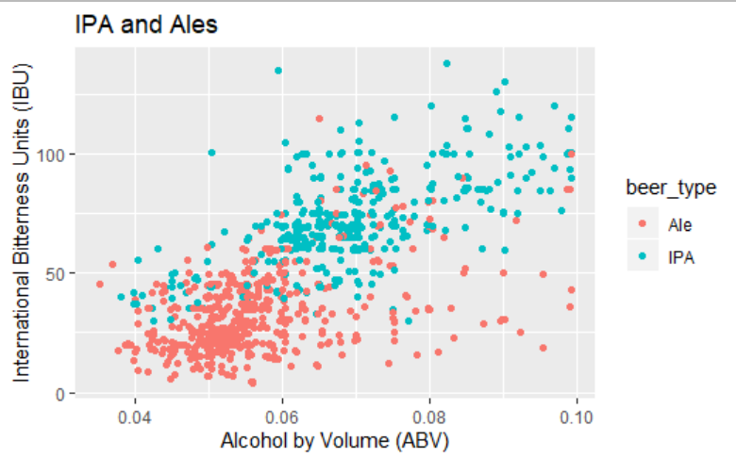
What is the difference in ABV and IBU between IPAs and other Ales?
# Plot scatter plot of ABV and IBU for beer classified as “Ale” and “IPA”
ggplot(data = ipa_ale_df) +
geom_point(mapping = aes(x = ABV, y = IBU, color=beer_type), position ="jitter") +
ggtitle("IPA and Ales") + xlab("Alcohol by Volume (ABV)") + ylab("International Bitterness Units (IBU)")

Slide 22
Opportunities for Budweiser
TBD

Slide 23
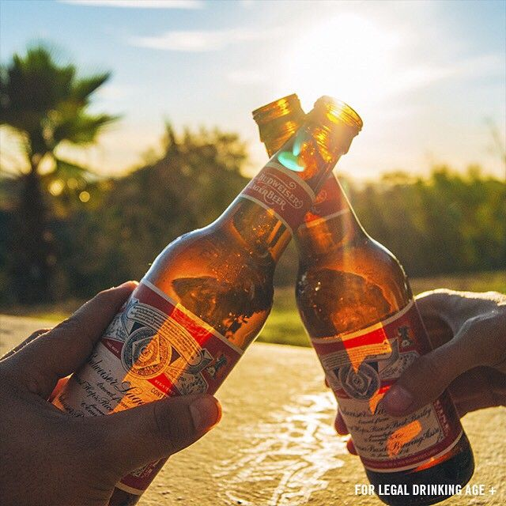
Cheers

