Slide 1
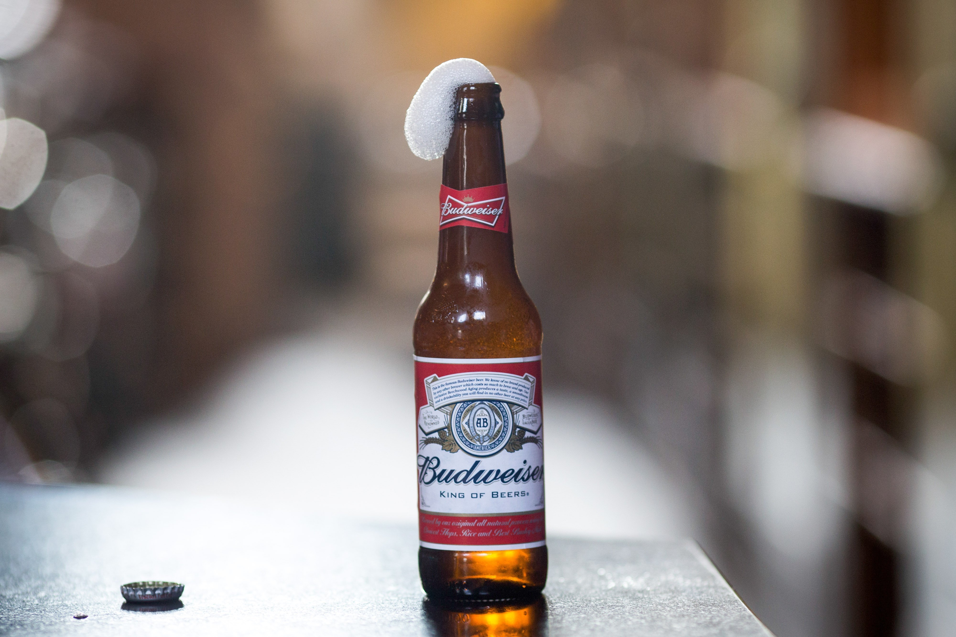
Doing Data Science: Case Study 1
Kristi Herman & Phu Trong

Slide 2

Introduction
There is a growing market for and interest in craft beer in the United States. Anheuser-Busch InBev SA announced in 2019 that it would purchase Craft Brew Alliance in 2020.
https://www.marketwatch.com/story/anheuser-busch-plans-to-buy-out-craft-brew-alliance-for-large-premium-2019-11-11
Budweiser (owned by Anheuser-Busch) is formulating new craft beers and interested in potential opportunities for launching new products and breweries in the United States. Some questions we explore in this presentation are:
What states currently have craft beers that are similar in ABV and IBU to their current brands?
For a new craft beer that is currently under development, how should it be classified?

Slide 3
How many craft breweries are in each state?
TBD

Slide 4
What is the median ABV and IBU in each state?
TBD

Slide 5
What states have the maximum ABV and IBU?
TBD

Slide 6
What is the distribution of ABV?
TBD

Slide 7
Is there a relationship between bitterness and alcohol content?
TBD

Slide 8
What is the difference in ABV and IBU between IPAs and other Ales?
TBD

Slide 9
Opportunities for Budweiser
TBD

Slide 10
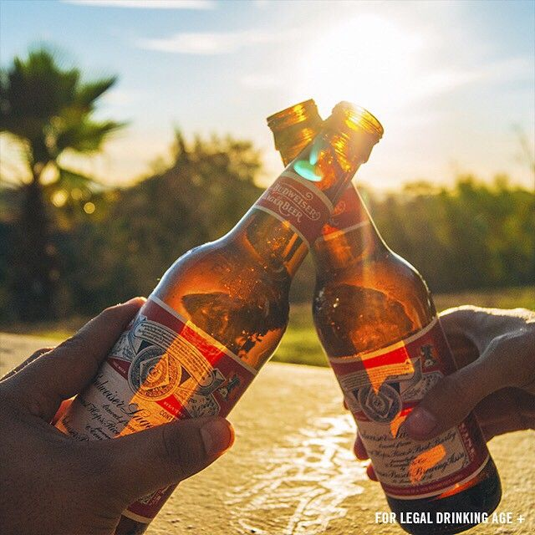
Cheers

