Slide 1

SMU Doing Data Science Case Study 2
Kristi Herman

Slide 2

Introduction
Background Frito-Lay places a high value on their employees. To improve employee retention, DDSAnalytics is here to help you identify which factors are related to employee attrition.
Purpose Analysis will be presented on factors that lead to attrition. Two machine learning models have also been created to predict attrition and monthly salary.

Slide 3
Questions
Job role specific trends
Which roles make the highest average monthly salary?
Which roles have the highest average job satisfaction?
Which roles have the most attrition?
Does job satisfaction equate to lower levels of attrition?
What are the top three factors that lead to attrition?
What is the predicted attrition for the 300 employees in the CaseStudy2CompSet No Attrition.csv dataset?
What are the predicted salaries for the 300 employees in the CaseStudy2CompSet No Salary.csv dataset?

Slide 4
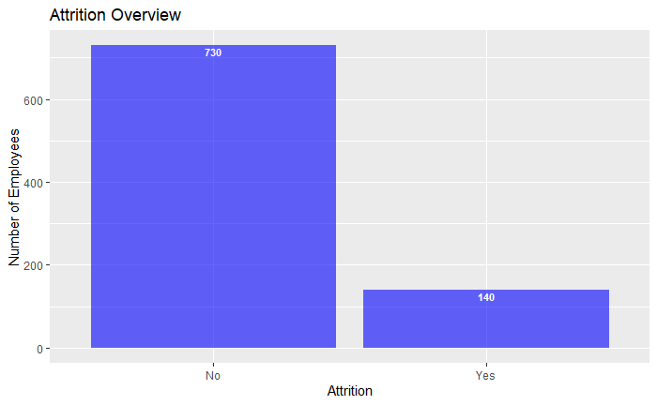
What is the attrition for the company?
From the data in this dataset, we see attrition for 140 employees out of 870 total employees. This is a 16% turnover.

Slide 5
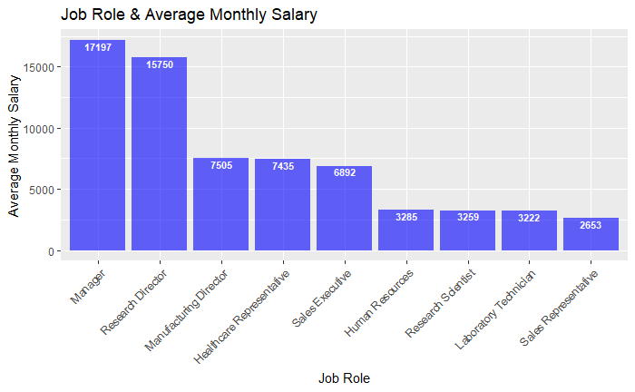
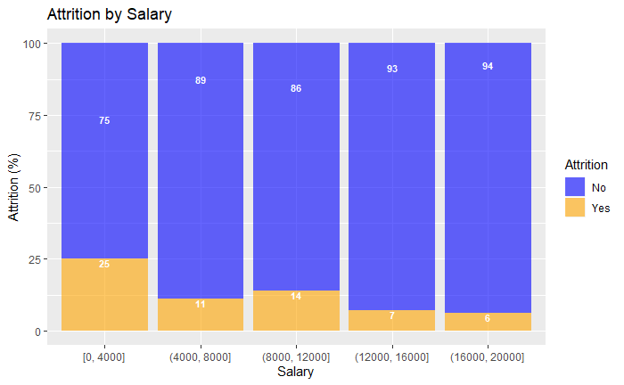
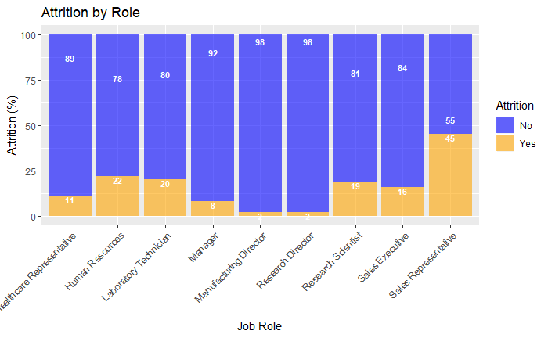
Job Role and Salary
Managers make the highest average monthly salary, followed by Research Directors. Those roles have the lowest attrition and the highest salaries overall have the lowest attritions. Sales Reps have the highest attrition at 45%.

Slide 6
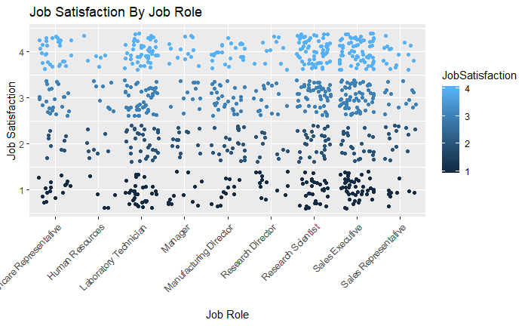
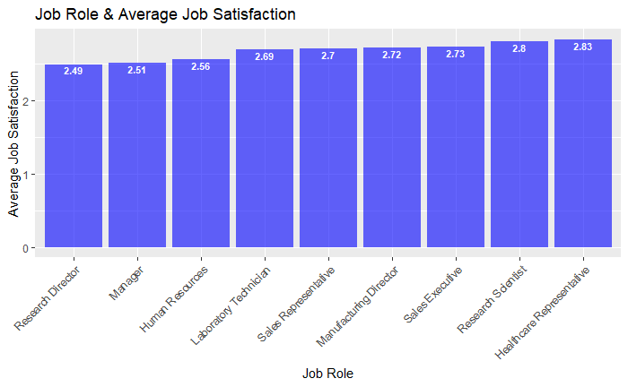
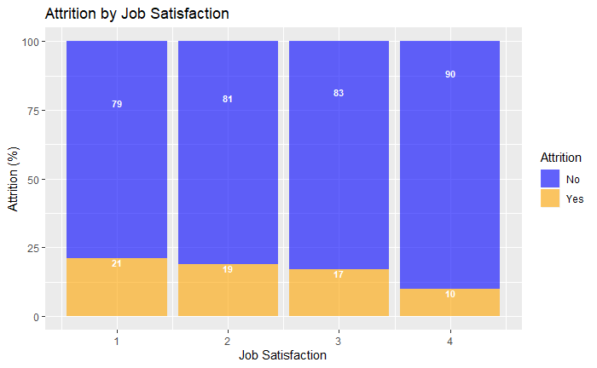
Job Role and Satisfaction
Average job satisfaction does not vary much across roles. Managers and Research Directors have the lowest average job satisfaction even though they have the highest average monthly salaries.

Slide 7
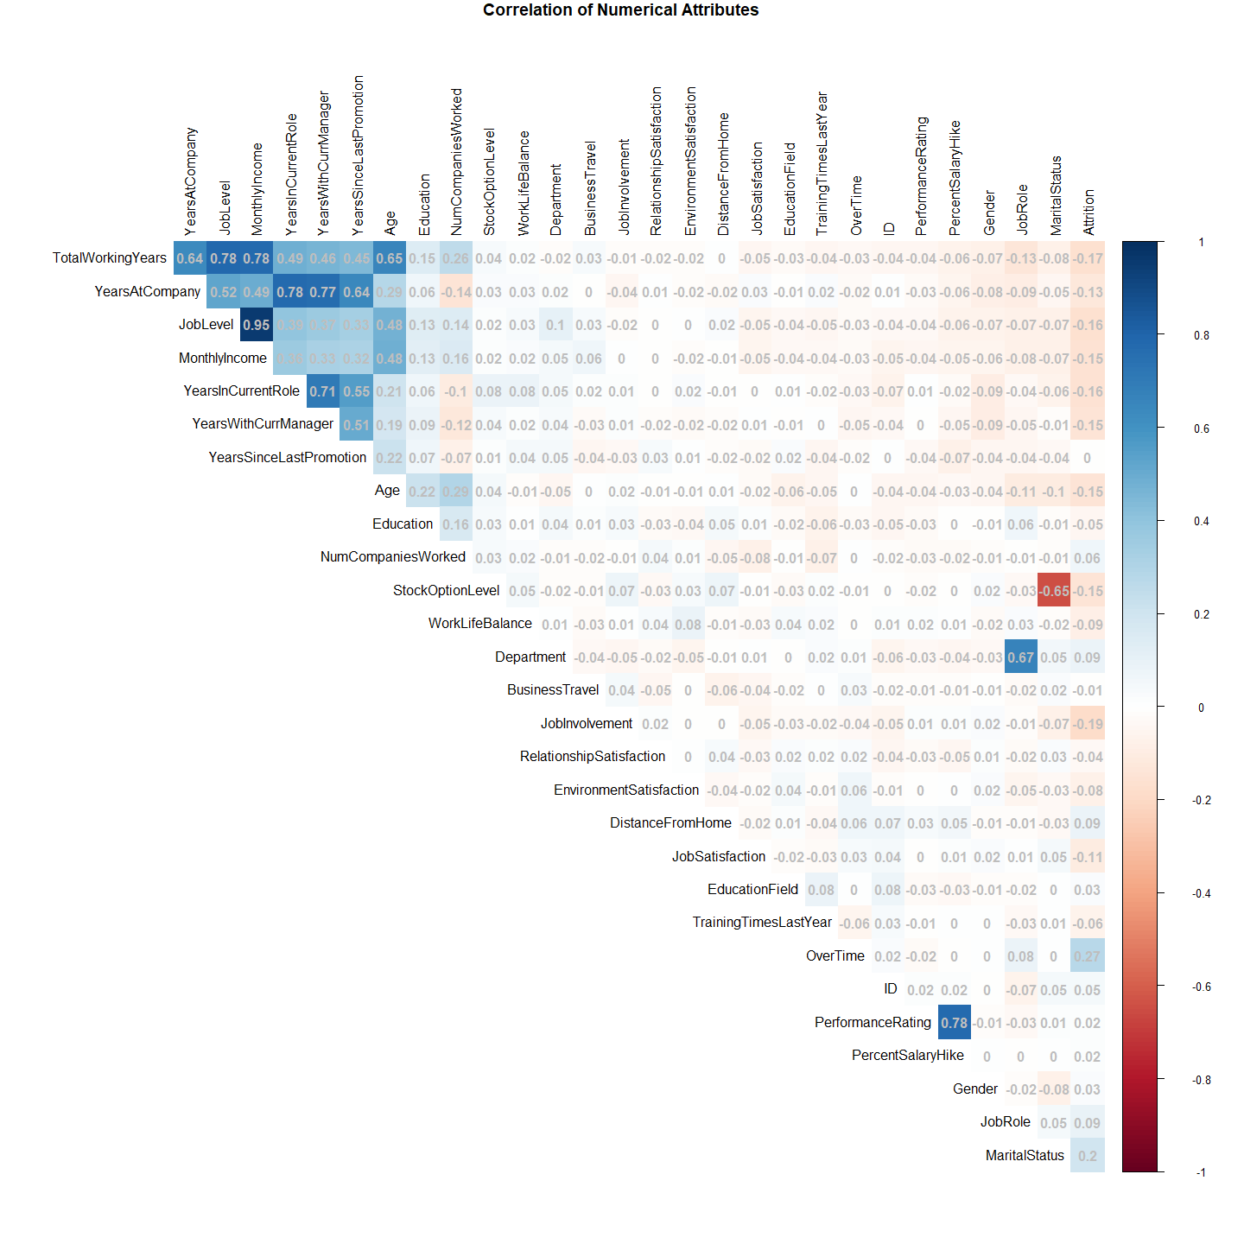
Factors that contribute to Attrition
This correlation matrix shows that Overtime, Marital Status, and Job involvement have the highest correlation with attrition.

Slide 8
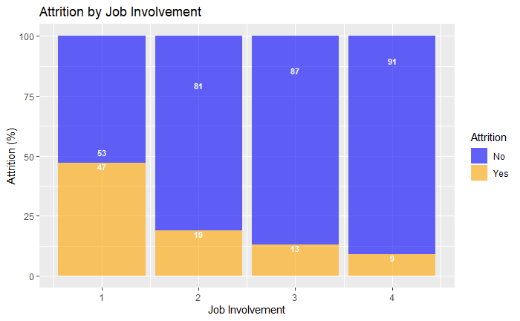
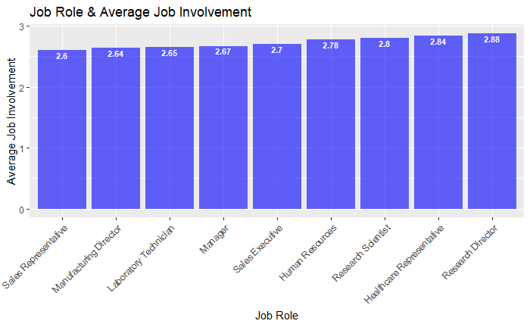
Job Involvement
Attrition is almost 50% when job involvement is low. Sales Reps have the highest attrition and the lowest average job involvement.

Slide 9
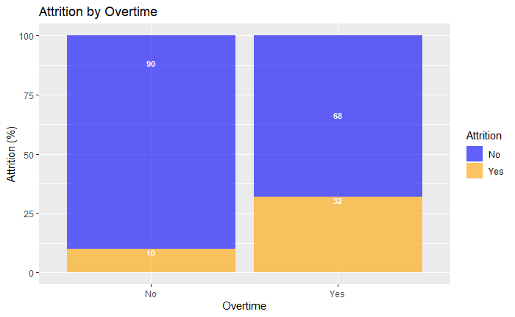
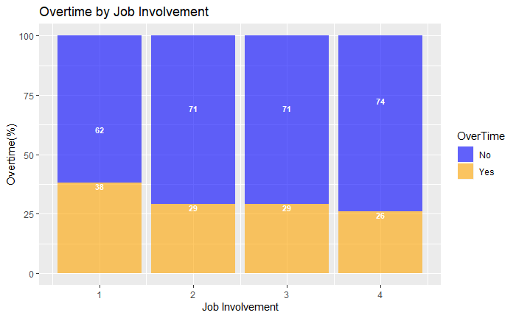
Overtime
Attrition is higher for staff who are eligible for overtime.

Slide 10
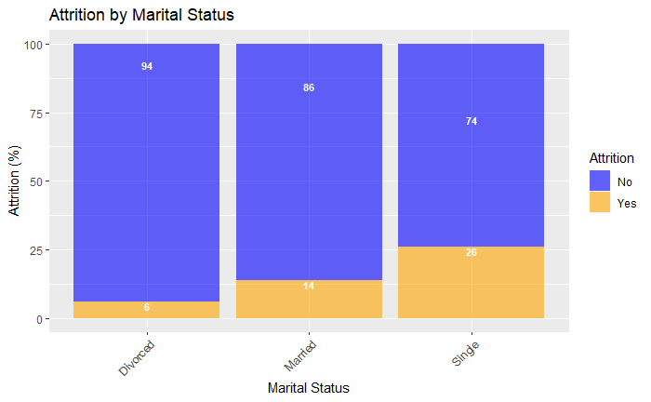
Marital Status
Attrition is highest for singles and lowest for divorced employees.

Slide 11
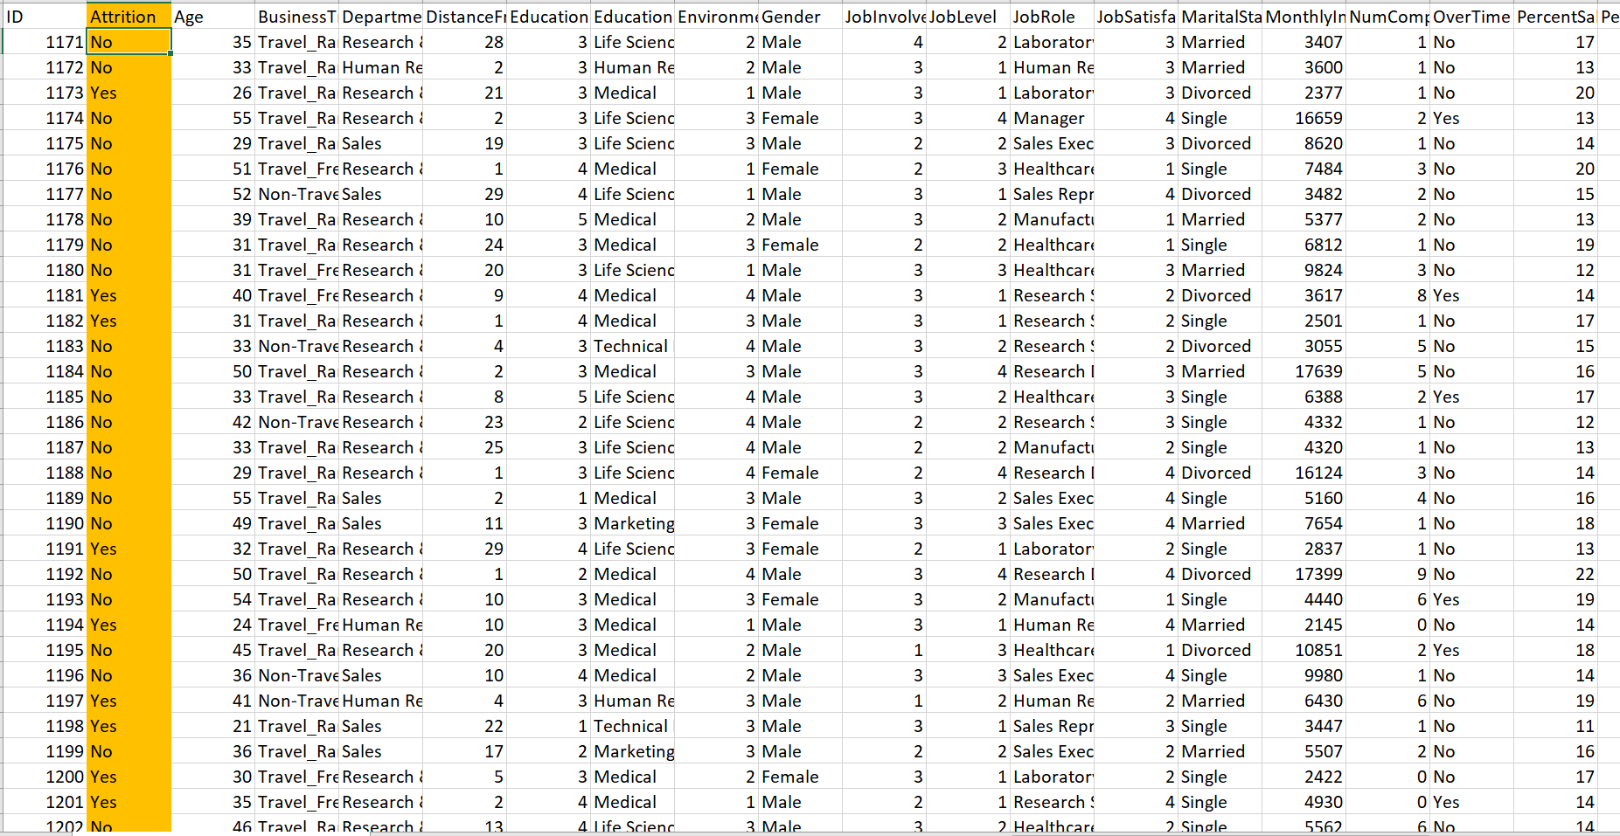
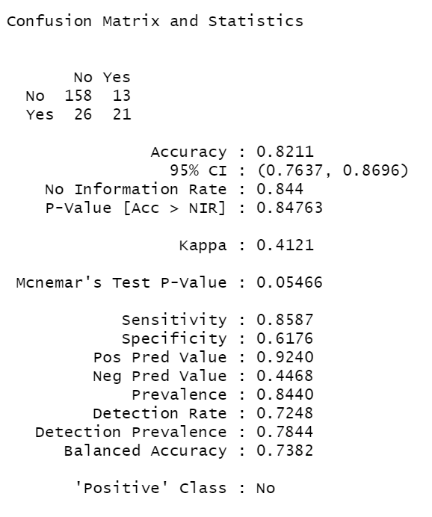
Predicting Attrition
KNN, KNN cross-validation and Naïve Bayes models were tested to predict attrition. The Naïve Bayes model was chosen for the final prediction model because it had the highest accuracy, sensitivity, and specificity. Predictions based on this model for 300 employees can be found in the Case2PredictionsHermanAttrition.csv.

Slide 12
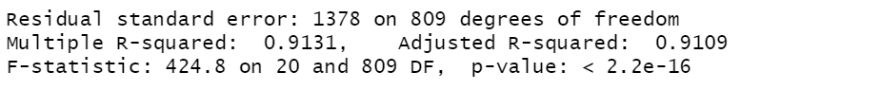
Predicting Monthly Salary
The Linear Regression model was tested and used for salary predictions achieving an Root Mean Squared Error of less than $1500. Predictions for 300 employees based on this model can be found in the Case2PredictionsHermanSalary.csv file.

Slide 13
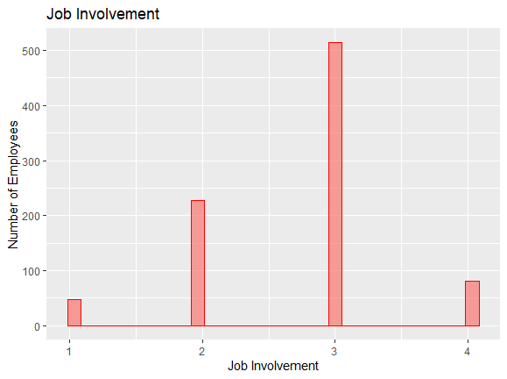
Conclusions
While higher salaries do not necessarily equate to higher job satisfaction, the highest paying jobs do have the lowest attrition rates.
Statistically the three factors most correlated with Attrition in this dataset are: Job Involvement, Marital Status, and Overtime.
There is an opportunity to explore why overtime-eligible employees have higher attrition. Is the overtime pay not competitive? Do they not feel involved enough with their work?
There is an opportunity to explore why single employees have higher attrition rates than married and divorced employees.
The Sales Representative role needs to be further investigated to find out why the attrition is so high.
It’s encouraging that job involvement is important to employees because this is an area that the company significant influence and can improve.

Slide 14

Thank you

Slide 15
Appendix: References
GitHub Link
https://github.com/kristxh/6306-CaseStudy2-DDSAnalytics
YouTube Link
https://youtu.be/B3NS19GLUCk
GitHub Pages Link
https://kristxh.github.io/
Frito-Lay Coversheet Image
https://www.fritolay.com/about-frito-lay/our-people
Frito-Lay Logo
https://www.fritolay.com/
Data CaseStudy2-data.csv

