Slide 1

Clean It Application
Author: Kristina Shiryagina Salini
Date: 23.03.2022

Slide 2
Outline
Introduction
Methodology
System Architecture and System Design
User Interface
Demo
Testing
Conclusion

Slide 3
Introduction (Problem Statement)
- Actual teacher assignment planning is done using Microsoft Excel.
- Plan is handled by one person.

Slide 4
Introduction(Goals)
1. Order overview.
2. Reception of a cleaned textile.

Slide 5
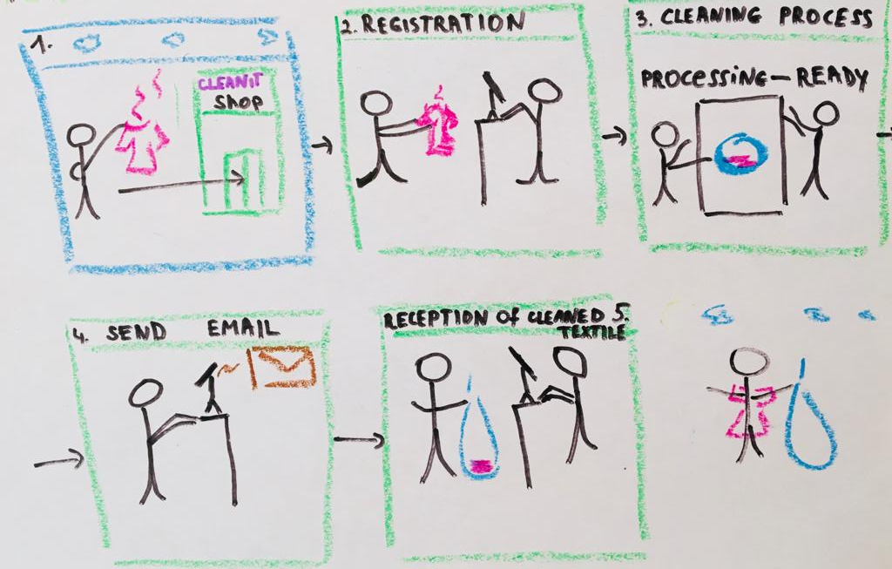
Introduction (Textile cleaning process)

Slide 6
Methodology
Requirements Engineering
Domain Analysis
System
Technologies

Slide 7

Methodology(System)
Excel vs Web Application vs Desktop Application
designed to involve many users
data consistency
accessible from anywhere

Slide 8

Methodology TECHNOLOGIES

Slide 9
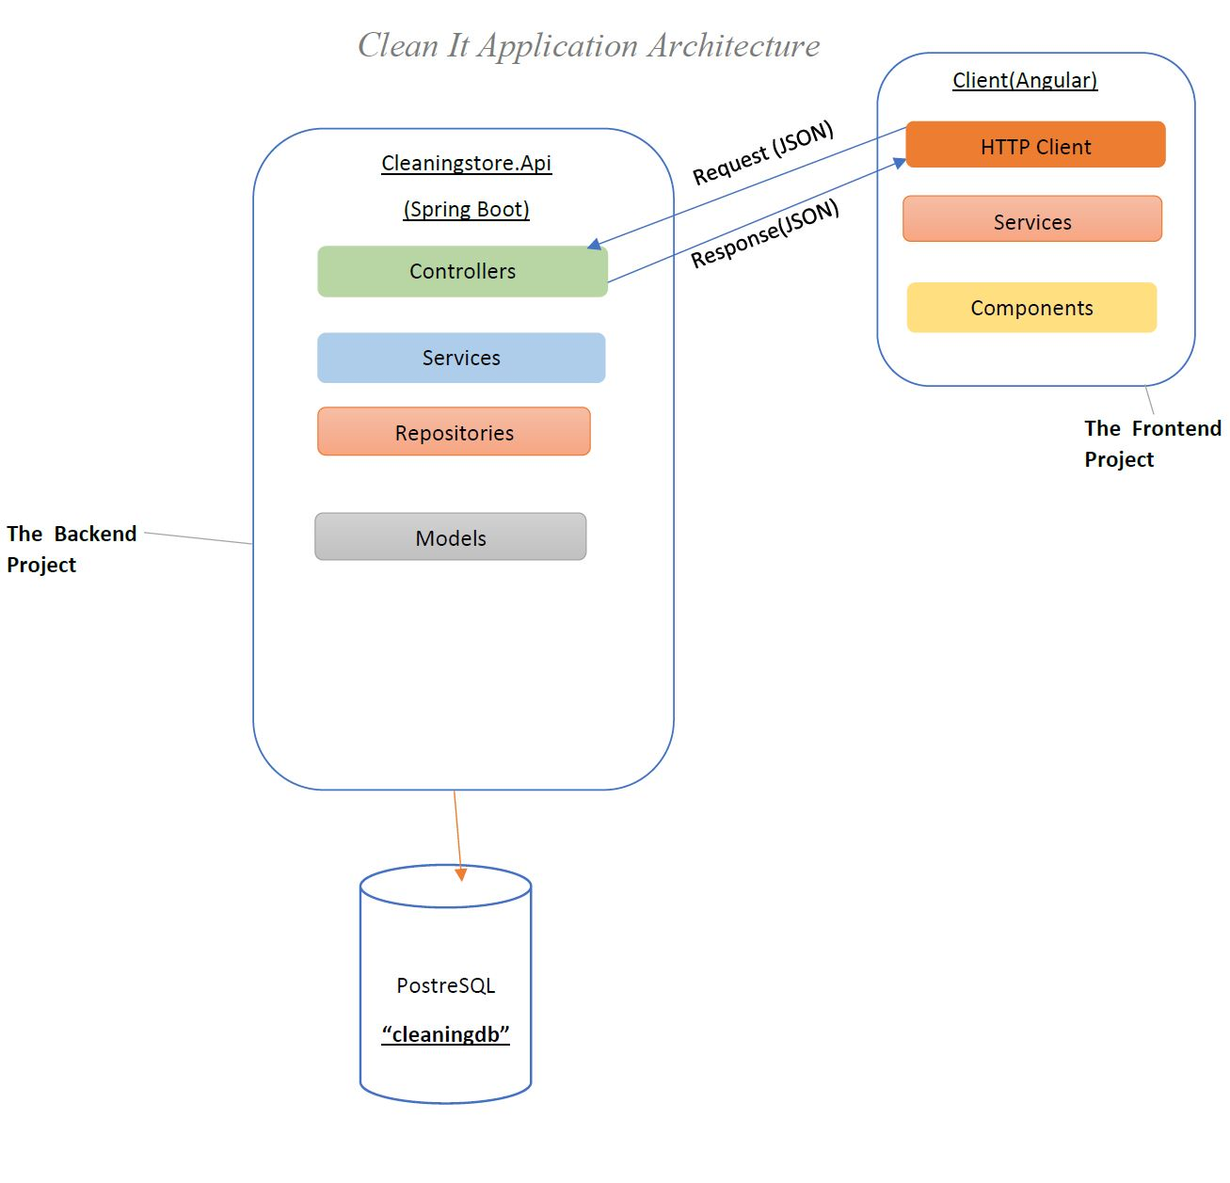
System Architecture and System Design

Slide 10
User interface design
Study director page

Slide 11
User interface design
Order overview

Slide 12
User interface design
Order overview

Slide 13
Testing
Testing API
Testing Frontend

Slide 14

Conclusion

