Slide 1
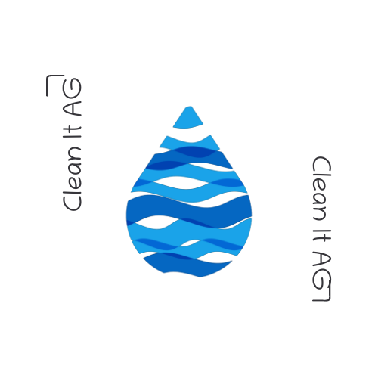
Clean It Application
Author: Kristina Shiryagina Salini
Date: 23.03.2022

Slide 2
Outline
Introduction
Methodology
System Architecture and System Design
User Interface
Demo
Testing
Conclusion

Slide 3
Introduction (Problem Statement)
-Textile cleaning company named "Clean It! AG" needs an application to handle their daily business in their local cleaning shops.

Slide 4
Introduction(Goals)
1. Order overview.
2. Reception of a cleaned textile.

Slide 5
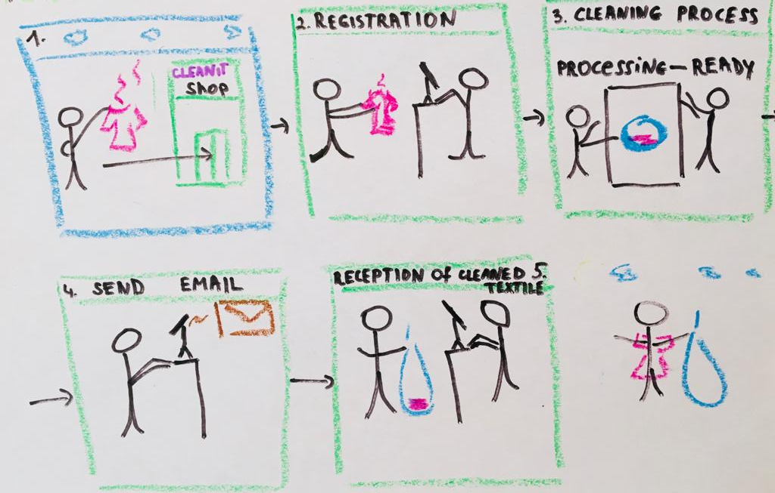
Introduction (Textile cleaning process)

Slide 6
Methodology
Domain Analysis
System
Technologies

Slide 7


Methodology TECHNOLOGIES

Slide 8
Methodology(System)
easy to develop
reduces development time
easy to integrate Spring Boot Application with its Spring Ecosystem like Spring JDBC, Spring ORM, Spring Data, Spring Security etc.
Embedded HTTP
It provides lots of plugins
Why Spring Boot?

Slide 9
Why Angular?
Faster Development Process
Readable and Testable Code
More Lightweight Web Applications
Efficient Problem-Solving Patterns
Excellent Material Design Library

Slide 10
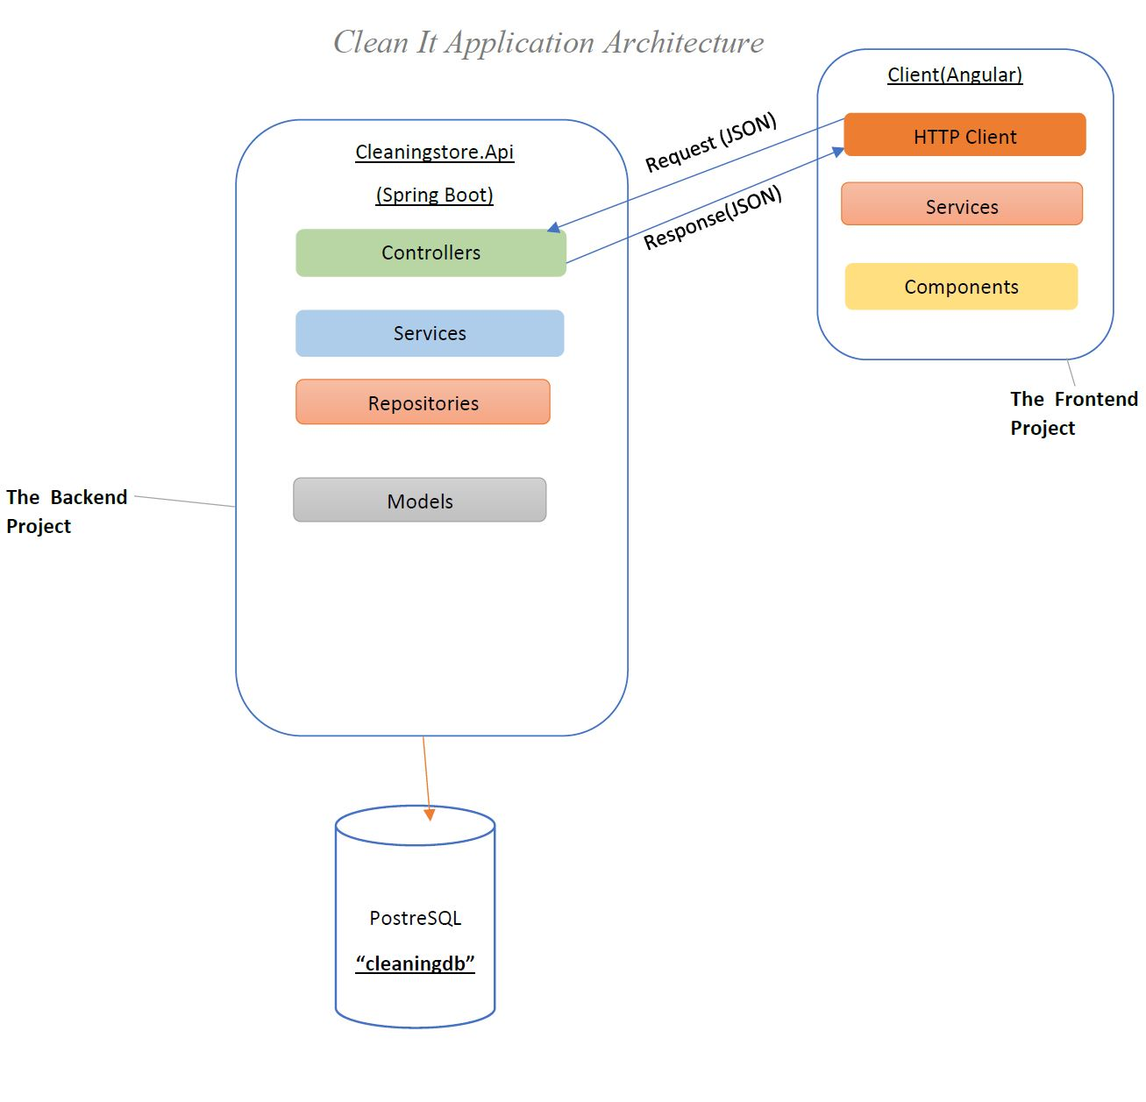
System Architecture and System Design

Slide 11
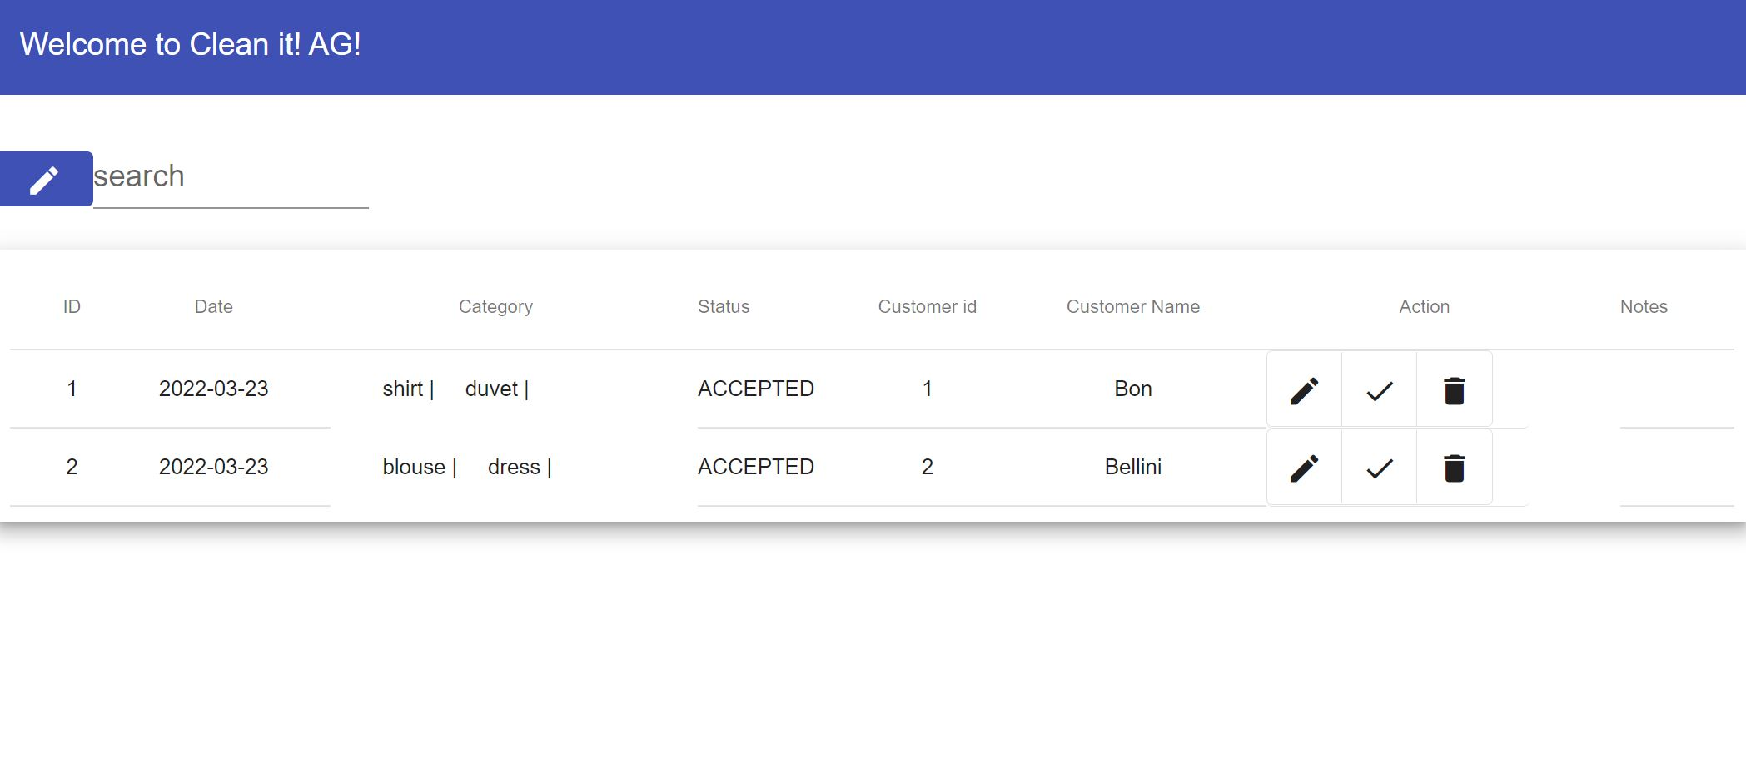
User interface design
Order overview

Slide 12
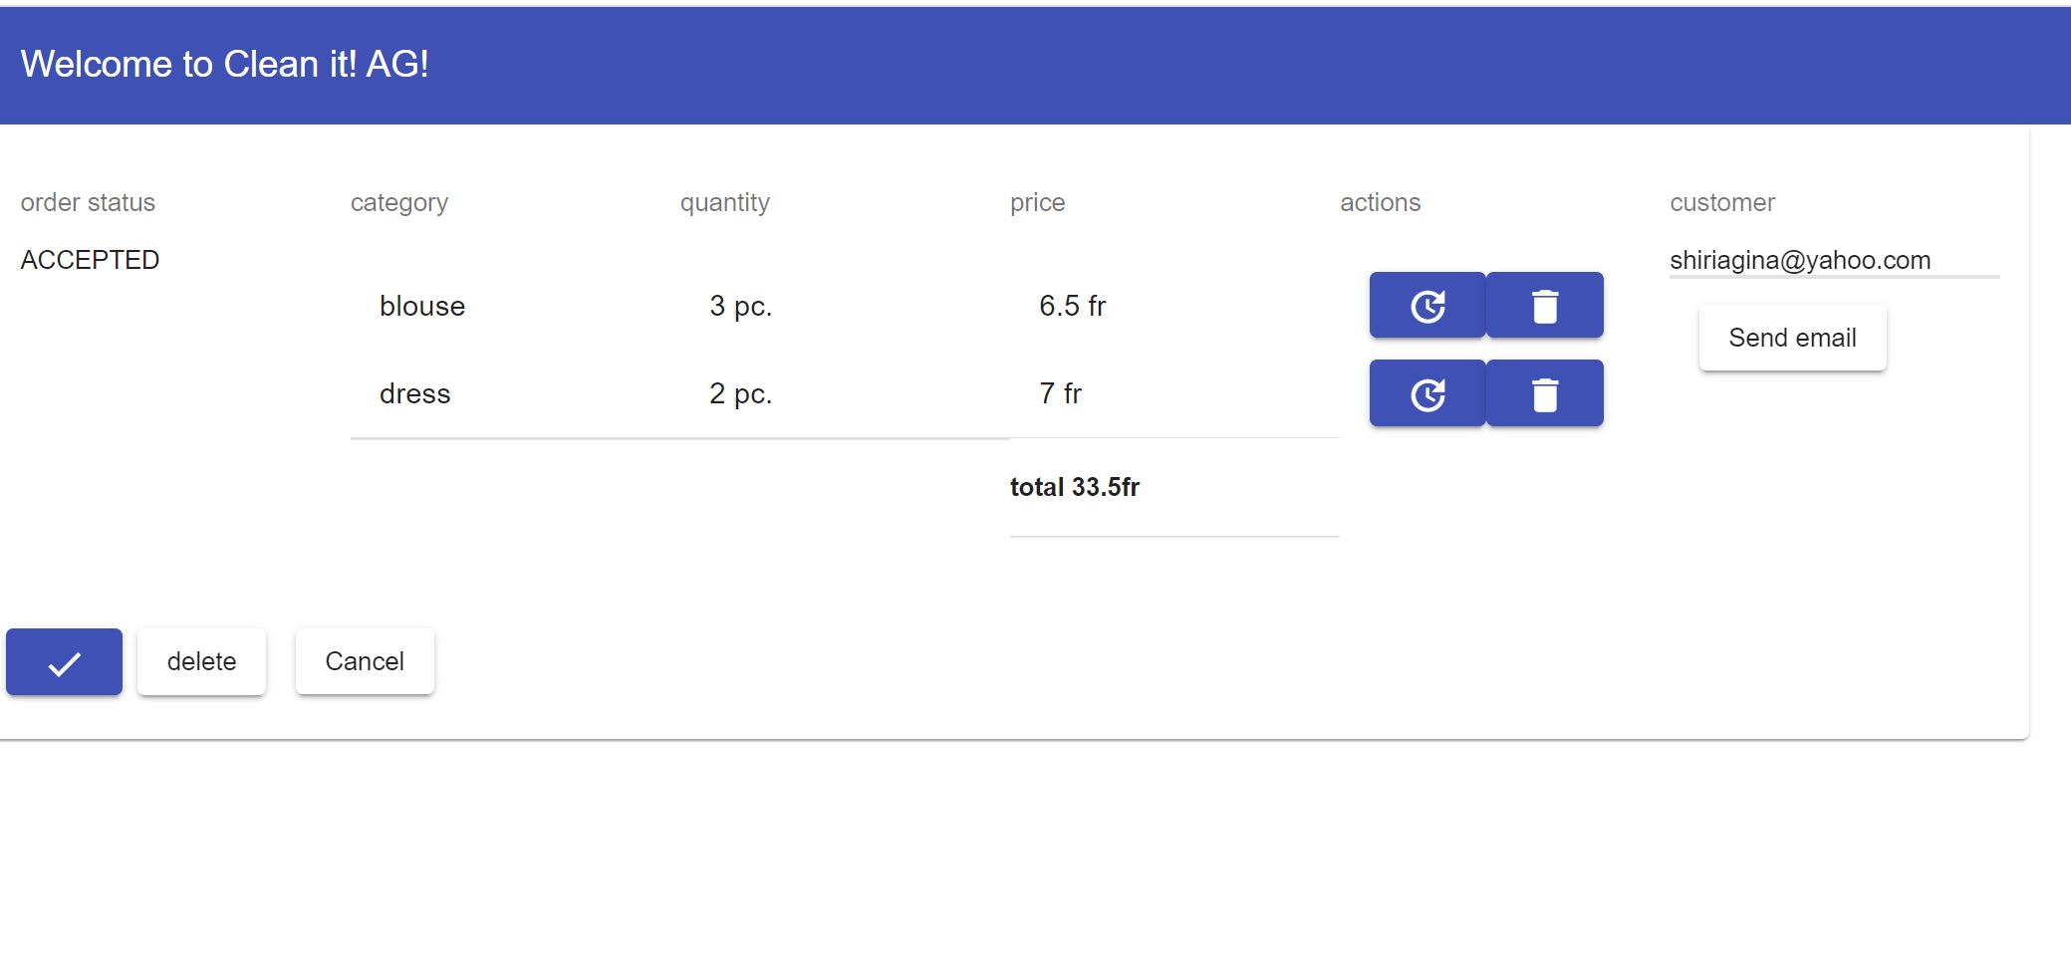
User interface design
Order detail page

Slide 13
Testing
Postman API
__________________________
Usability Test
Error-free test
Acceptance test
Testing API
Testing Frontend

Slide 14

Conclusion

