Slide 1
CS Final Project - Expectations
Open ended project
3-4 weeks to complete (Due 5/27)
A lot of time will be available in class.
Thus,
  Scope of project will be bigger than other programming projects (about 2x a regular assignment, plus design, plus presentation)
  Detailed design document required.

Slide 2
CS Final Project - Examples
Learn another language and re-implement 2-4 previous non-trivial programming assignments in that language
  Python
  LISP
  Scheme - http://www.programbydesign.org/
  Ruby
  Flash (with Director programming)
  Objective C/C#
  LOLcode
  Javascript (http://eloquentjavascript.net/)

Slide 3
Python
Python’s own IDE: IDLE – http://python.org, information in See http://www.skylit.com/python/index.html, "Getting Started with Python."
Portable Python IDE - http://www.portablepython.com/site/about/ (can be run from a USB drive)
Jython Environment for Students (JES). Jython is Python but Java underneath.
  http://coweb.cc.gatech.edu/cs1315/3569
  Ideas for multimedia programming" in Python www.cs.kzoo.edu/cs107/
Easy Eclipse for Python (PeyDev plugin) http://pydev.org

Slide 4
CS Final Project - Examples
Learn GUI programming from chapter 14 and re-implement a project with a GUI. Possibly use NetBeansBlueJ - http://www.netbeans.org/kb/articles/gui-functionality.html
Design a project using the ObjectDraw library from Williams - http://eventfuljava.cs.williams.edu/library/
Project extending GridWorld (Sudoku, Battleship, etc).
*Any new project must not contain violence or sex (same criteria as Randy Pausch).

Slide 5
CS Final Projects - Hardware
Lego, Scribbler, Brainy control (http://www.flowol.com/InterfaceBrainyControl.aspx) or other Robotics
Raspberry Pi, .NET Gadgeteer (http://www.netmf.com/gadgeteer/), Arduino*
PIC Development
  http://www.gooligum.com.au/tutorials/PIC_Intro_0.pdf
  http://www.amazon.com/PIC-Microcontrollers-Second-Introduction-Microelectronics/dp/0750662670
*Might not want to do Arduino if you’re taking CS 4 next year

Slide 6
CS Final Project – Mobile
Developing an application for a phone using J2ME (Java for Mobile Devices)
Projects using Objective C for iPhone (difficult)
  http://www.gnu.org/software/gnustep/
  http://developer.apple.com/iphone/program/university.html
  http://www.stanford.edu/class/cs193p/cgi-bin/drupal/
TouchDevelop
  https://www.touchdevelop.com/

Slide 7
CS Final Project –
More Devices
Jinput java library to use gamepads, dance pads, guitar, etc. https://java.net/projects/jinput
C# and XNA
Using the Nintendo Wii remote. Code here is in C#. http://johnnylee.net/projects/wii/
Kinect
Leap Motion

Slide 8
CS Final Project – More Ideas
http://www.php.net
Project Euler - http://projecteuler.net/
Something connected to another class’ project

Slide 9
CS Final Project - Grading
You will be writing your own grading rubric that will take into account
  Your functional specification
  Your design
  Your code
  How well your code worked and was tested.
  Your presentation
Approximately 20% of final grade.

Slide 10
CS Final Project – Functional Specification and Design
Functional Specification: http://en.wikipedia.org/wiki/Functional_specification
Design
  Object diagrams
  Functional decomposition
  Detailed Pseudocode (we’ve gotten a little lax!)
Testing Plan
Grading Rubric
All in one nice document that I can read.

Slide 11
CS Final Project - Presentation
Ten minute presentation at the end of May.
Worth a “Quiz” grade.
Expectations: You. In front of the class. Prepared. A Demo. Perhaps some slides.

Slide 12
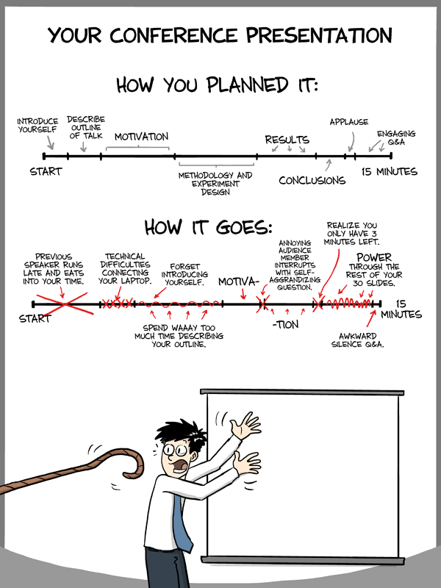

http://www.phdcomics.com/comics/archive.php?comicid=1553

Slide 13
CS Final Project – Presentation II
Presentation parts:
  Goals (summary of your functional specification)
  Assumptions
  Design (any object diagrams, or functional breakdown)
  Testing that was done (how many users?)
  Conclusions. Examples:
    If you choose to learn a different language, I would expect you to say something about what you found were the similarities and differences in the language, what was easy, what was hard.
    If you did a GUI program: what kind of user testing did you do?

Slide 14
Projects from 2007-8
Blackjack with a Graphical User Interface - done by a pair of students
Graph Theory - Dijkstra's algorithm.
Project Euler Problem 193
Graphing Calculator
Python reimplementation of 3 Java projects
Survey
Call schedule calendar
C# reimplementation of project 5 - student sorter
GUI Hangman
C implementation of a linked list
Learning LOLcode
Battlefield Simulator with Gridworld
GUI Battleship
http://teachers.lakesideschool.org/us/math/bricker/CS2007-8/2008projects.html

Slide 15
Projects from 2008-9
Blackjack with a Graphical User Interface - done by a pair of students
Graphical Lesson on Sequences and Series
Sudoku Solver
Guitar Hero
Learning Mathematica
Bridge
Graphical Tic Tac Toe
Minesweeper
Chemistry Solver (using A*)
Robocode
Facebook game of life application
CubeFall - Game by 2 students
Reimplementation of 3 programs in Ruby
Learning LOLcode
GUI Rock, Paper, Scissors
Learning XNA
http://teachers.lakesideschool.org/us/math/bricker/CS2008-9/2009projects.html

Slide 16
Projects from 2009-10
Quadrun – an iPhone app
Advanced Wars in C#
Android Rock Paper Scissors
Reimplementing 3 programs in Perl
Physics Simulator
Blob Tanks
Reimplementing 2 programs in QBasic, C++, and Python
Reimplementing 2 large programs in Python and C#
Disc Golf in GameMaker
iPhone vs Android programming showdown
Rowing application
iPhone development
http://teachers.lakesideschool.org/us/math/bricker/cs2009-10/2010projects.html

Slide 17
Projects from 2010-11
Neural net
Baseball Scorekeeper (iPhone app attempt)
Java fashion: Graphical Clothing database
Cryptography software
Scientific calculator
Windows Mobile Reminder app
Java program for blocking websites while working
Hacking Minecraft (adding blocks)
Reimplementing “bookstore” project on the web
GUI battleship game
Chess Engine
Reimplementation of the “student” database in C++
http://teachers.lakesideschool.org/us/math/bricker/cs2010-11/2011projects.html

Slide 18
Projects from 2011-12 (1)
Twitter “scraping” project
Text based adventure (java)
Asteroids game (java)
GUI Towers of Hanoi (java)
Rock and Rolling NXT Robot (Wii remote)
GUI Image editing program
Android “24” game
Programs reimplemented in Python
XNA/C# side scrolling game
Snake game (java)
Basketball statistics app for Windows Phone (XNA/C#)
Latin/English Windows phone app
Google Chrome Extension to simulate a smartphone browser
Laser Tower Defense (java)

Slide 19
Projects from 2011-12 (2)
Chess interface
Pool game (java)
Chess engine (java)
Arduino/processing Lights that respond to music
RPSLSp in C
Drug testing in companies (java)
Comparison of Entity Component Systems vs Standard OO drawing
Visual RPS 15 (java)
Minesweeper Program (java)
Battleship and prime number generator (java)
TCP chat
Arduino
C# vs Java vs Python

Slide 20
Projects from 2012-13
Leap motion
Camera Hacking
WordGame
Phone app for crew
Space Slammin’
Calculus Calucator
Study helper
TargetBlaster game
Mathematica
nQueens
Asteroids
Android programming
Graphing program
Ruby programming
SQL/Databases/JDBC: A ‘Student Scheduler’ re-Implemented

Slide 21
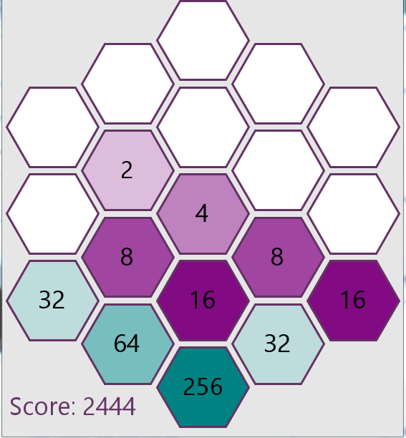
Projects from 2013-14
Arduino (Flappy Bit, Repunzel costume)
Cryptography
Basketball stats
Dodgeball statistics
Photo mosaic
Photo mosaic website
Windows phone sports app
Four Chord Song Generator
Learning a language (C, C++, Python, C#)
Game theory simulator
HSCTF
Project Euler
Twitter sentiment analysis
Reddit sentiment analyzer
Games (Hangman, Galaga, Battleship, Minesweeper, Turlte Tactic, Chess, Pong, 2048 in Processing)
4 color theorem
Mobile apps (Android apps, TouchDevelop)

