Slide 1
Review
Algorithms – what are they? How is it different from a program?
Name some languages
What is a compiler?
Tell me about Java….
Tell me about syntax? What’s a statement? What notation do we generally use for describing syntax?

Slide 2
Software Engineering
“Software isn't released, it's allowed to escape.”

Slide 3
Embracing Your Inner Geek
Software Engineering
  I am, in the States, known as a Software Engineer. In Canada we’re not allowed to call ourselves engineers, although the discipline is no less rigorous than any other kind of engineering. But perhaps its for the best, because “engineering” describes only a part of what I do.
  A software developer must be part writer and poet, part salesperson and public speaker, part artist and designer, and always equal parts logic and empathy. The process of developing software differs from organization to organization. Some are more “shoot from the hip” style, others, like my current employer are much more careful and deliberate. In my 8 years of experience I’ve worked for 4 different companies, each with their own process. But out of all of them, I’ve found these stages to be universally applicable:
    Dreaming and Shaping
    Prose and Poetry
    Publishing and Documenting
    And Repeat…
From http://www.jonandnic.com/topics/ravings/embracing-my-inner-geek-part-2-the-job

Slide 4
Software Quality
Software Engineering
Correctness – How closely the final software matches the requirements
Reliability – How often or how badly the software fails
Robustness – How gracefully errors are handled
Usability – How easily users can learn and execute tasks within the software
Maintainability – How easily changes can be made to the software
Reusability – How easily pieces of the software can be reused in the development of other software systems
Portability – How easily pieces of the software can be reused in multiple computer environments
Efficiency – How well the software does it job without wasting resources

Slide 5
Goal
Software Engineering
Create high quality software in a specific time with specific resources
  Money
  People
  Computers

Slide 6
Software Engineering
Weeks of programming can save you hours of planning.
  Anonymous
The sooner you start to code, the longer the program will take.
  R. Carlson

Slide 7
Software Life Cycle
Software Engineering
Software starts as an idea and somehow has to turn into a quality running system.
Three Software Engineering techniques
  Waterfall Model
  Spiral Model
  Agile Development

Slide 8
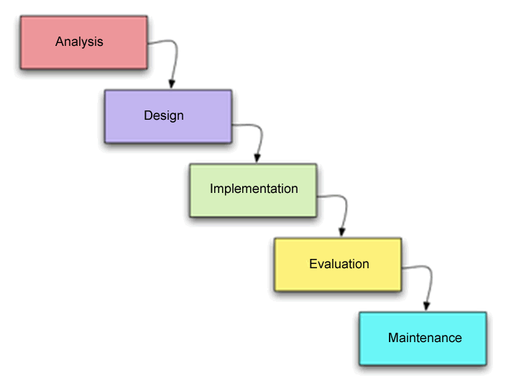
Waterfall Model
Software Engineering

Slide 9
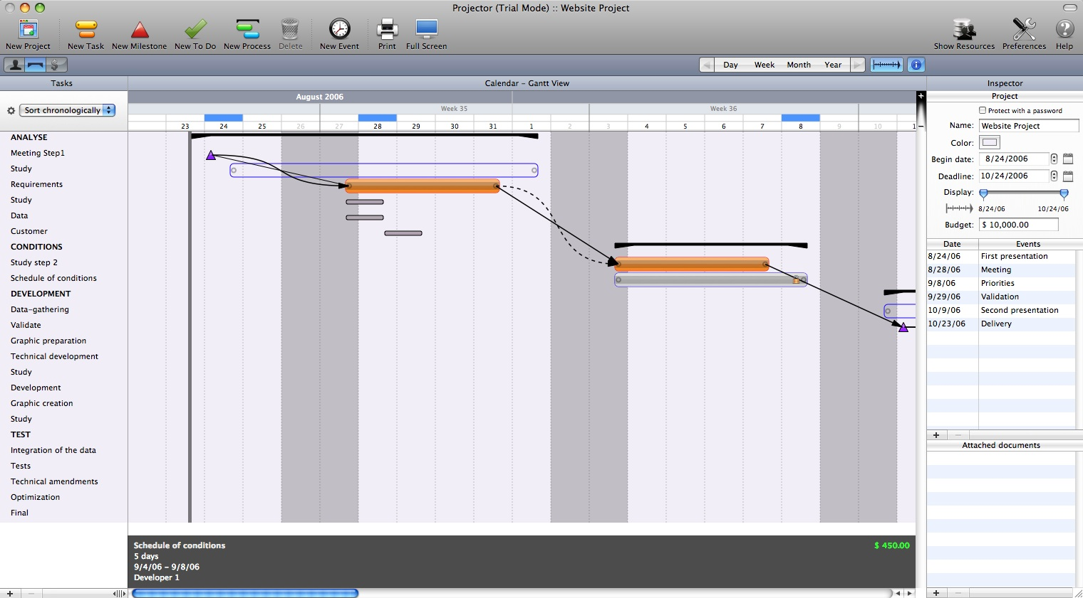
Software Engineering

Slide 10
Design Documents
Functional Overview – what it will do and who will use it
Design Overview - How will your program run? Inputs and outputs? Visual sketches of the UI.
Design Details - Imagine you’re writing it in Java, even if you aren’t.
Test Plan – in detail.
Grading Rubric – out of 40 points
Proposed Implementation Schedule
Potential Showstoppers
Open Questions
Resources

Slide 11
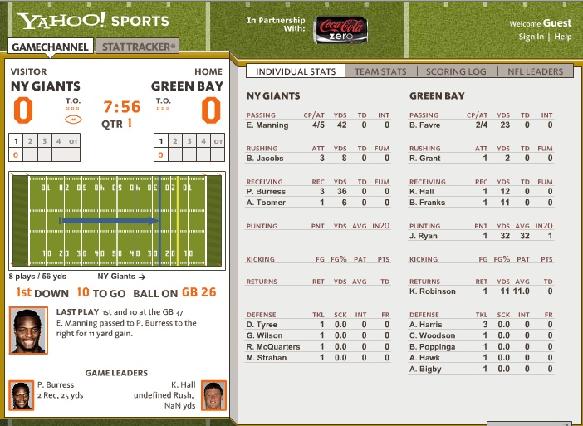
Missed in Testing
Software Engineering

Slide 12
Testing
Software Engineering
The Waterfall model does not take into account that testing is an important part of Software Engineering.
Testing can NOT wait until all of the implementation is done. (User documentation (Tech Pubs) also can’t wait until the end)
Test and publication planning should start WITH the design.
Publication development should begin concurrent with the implementation phase. Test script development also happens at this time.

Slide 13
Waterfall Model of Software Engineering
Software Engineering
Test design
Publication
design
Test plan/script
development
Publication
development
Test plan/script
execution
Publication
evaluatoin
Test plan/script
maintenance
Publication
maintenance

Slide 14
Software Engineering
Computer Science is the only discipline in which we view adding a new wing to a building as being maintenance.
  J. Horning

Slide 15
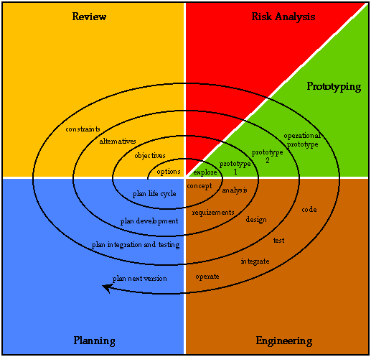
Spiral Model
Software Engineering

Slide 16
Key Points of
Waterfall or Spiral Models
Software Engineering
Documentation (Requirements specification, high level design, detail design, code, test plan, documentation plan, project planning documents)
Used on longer cycles.
Often a top down management approach (manager has final say in what features get implemented or bugs get fixed)

Slide 17
Agile Development
(Evolutionary Development Model)
Software Engineering
Analysis
Design
Implementation
Evaluation
Initial Requirements
Intermediate versions
Intermediate versions
Intermediate versions
Intermediate versions
Promotes development iterations throughout the software life cycle.
Iterations are 1-4 weeks

Slide 18
Key Points
Software Engineering
Face to face communication – few documents
Teams contain people from many different disciplines (coders, artists, testers, etc) for cross fertilization of ideas.
Development team makes decision about what is in the product.
Sticky notes!
Scrum

Slide 19
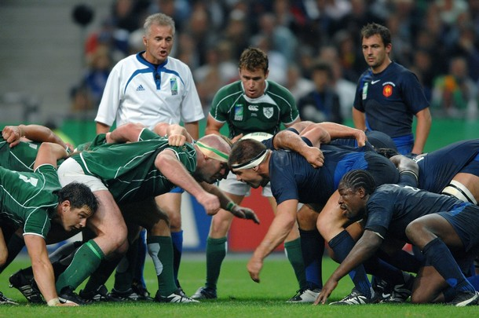
Scrum?
Software Engineering
Term from Rugby “(an abbreviated form of scrummage, which is now rarely used), in the sports of rugby union and rugby league, is a way of restarting the game, either after an accidental infringement or (in rugby league only) when the ball has gone out of play) – Wikipedia
Used in Software
Development as “a
process skeleton that
includes a set of practices
and predefined roles.”

Slide 20
Roles
Software Engineering
Business Development tells what they want to see in a product. The team decides how to do it.
Scrum Roles
  Product Owner: the person who represents the stakeholders (anyone interested in the product)
  ScrumMaster: the person who maintains the processes (similar to a project manager)
  Team: developers (usually 7 +/- 2 people)

Slide 21
Brooks' Law
Software Engineering
"Adding people to a late software project makes it later.“
http://en.wikipedia.org/wiki/Brooks_Law
Coined by Fred Brooks in The Mythical Man-Month (1975)

Slide 22
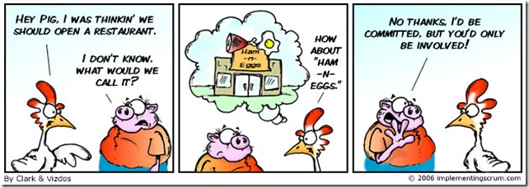
Pigs and Chickens
Software Engineering

Slide 23
Pigs and Chickens
Software Engineering
Roles are divided into two groups: Pigs and chickens.
  A pig and a chicken are walking down a road. The chicken looks at the pig and says, "Hey, why don't we open a restaurant?" The pig looks back at the chicken and says, "Good idea, what do you want to call it?" The chicken thinks about it and says, "Why don't we call it 'Ham and Eggs'?" "I don't think so," says the pig, "I'd be committed but you'd only be involved."

Slide 24
Pigs
Software Engineering
Product Owner
ScrumMaster
Team

Slide 25
Chickens
Software Engineering
Users
Stakeholders (who enables the project but are not directly involved in the process (like Executives))
Consulting experts (anyone who provides expertise here and there...)

Slide 26
Planning
Software Engineering
Product Vision: determined 1-2 times a year by the Product Owner
Roadmap: done 2-3 times a year by the Product Owner
Release Planning: a full day meeting done 4 times a year by the Product Owner and Team
Sprint Planning: happens every sprint by the Product Owner and Team
Daily Planning: happens every day by the team

Slide 27
Product Backlog
Software Engineering
Product backlog is what is left to do on a product.
Items in the product backlog should be estimated before the Release Planning meeting.
Move items from the Product Backlog into a sprint.
Agree on a definition of “done”
All team members must commit to release plan

Slide 28
Sprint Backlog
Software Engineering
Outcome of Sprint Planning meetings.
This is the definition of “how” things are going to get done.
Each item is given a weight (estimate) of the work - it’s recommended to use the Fibonacci sequence (what’s the difference between a 5 and a 6 in “difficulty?”)
Total work for a sprint: No more than the total work for what was accomplished on the last sprint. (i.e. you estimated 45 for last sprint, but got 30 done, so next sprint you may only plan to do 30 work units)...

Slide 29
Daily Scrum Meetings
Software Engineering
Meeting starts on time with team-decided punishments for tardiness
All are welcome, but only "pigs" may speak
Meeting is 15 minutes regardless of the team size
All attendees should stand
The meeting should happen at the same location and same time every day

Slide 30
Questions Answered
Software Engineering
What have you done since yesterday?
What are you planning to do by tomorrow?
Do you have any problems preventing you from accomplishing your goal? (It is the role of the ScrumMaster to remember these impediments.)

Slide 31
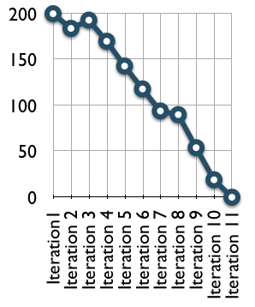
Burndown Chart
Software Engineering
Outcome of a Sprint
A graphical representation of work left to do vs. time.

Slide 32
And Now The Truth
Software Engineering
Software doesn't just appear on the shelves by magic. That program shrink-wrapped inside the box along with the indecipherable manual and 12-paragraph disclaimer notice actually came to you by way of an elaborate path, through the most rigid quality control on the planet. Here, shared for the first time with the general public, are the inside details of the program development cycle.
From: http://www.urbaczewski.com/humor/softdevcycle.htm

Slide 33
Programmer produces code he believes is bug-free.
Product is tested. 20 bugs are found.
Programmer fixes 10 of the bugs and explains to the testing department that the other 10 aren't really bugs.
Testing department finds that five of the fixes didn't work and discovers 15 new bugs.
See 3.
See 4.
See 5.
See 6.
See 7.
See 8.
Users find 137 new bugs.
Original programmer, having cashed his royalty check, is nowhere to be found.
Newly-assembled programming team fixes almost all of the 137 bugs, but introduce 456 new ones.
Original programmer sends underpaid testing department a postcard from Fiji. Entire testing department quits.
Company is bought in a hostile takeover by competitor using profits from their latest release, which had 783 bugs.
New CEO is brought in by board of directors. He hires programmer to redo program from scratch.
Programmer produces code he believes is bug-free....
Due to marketing pressure and an extremely pre-mature product announcement based on overly-optimistic programming schedule, the product is released.

Slide 34
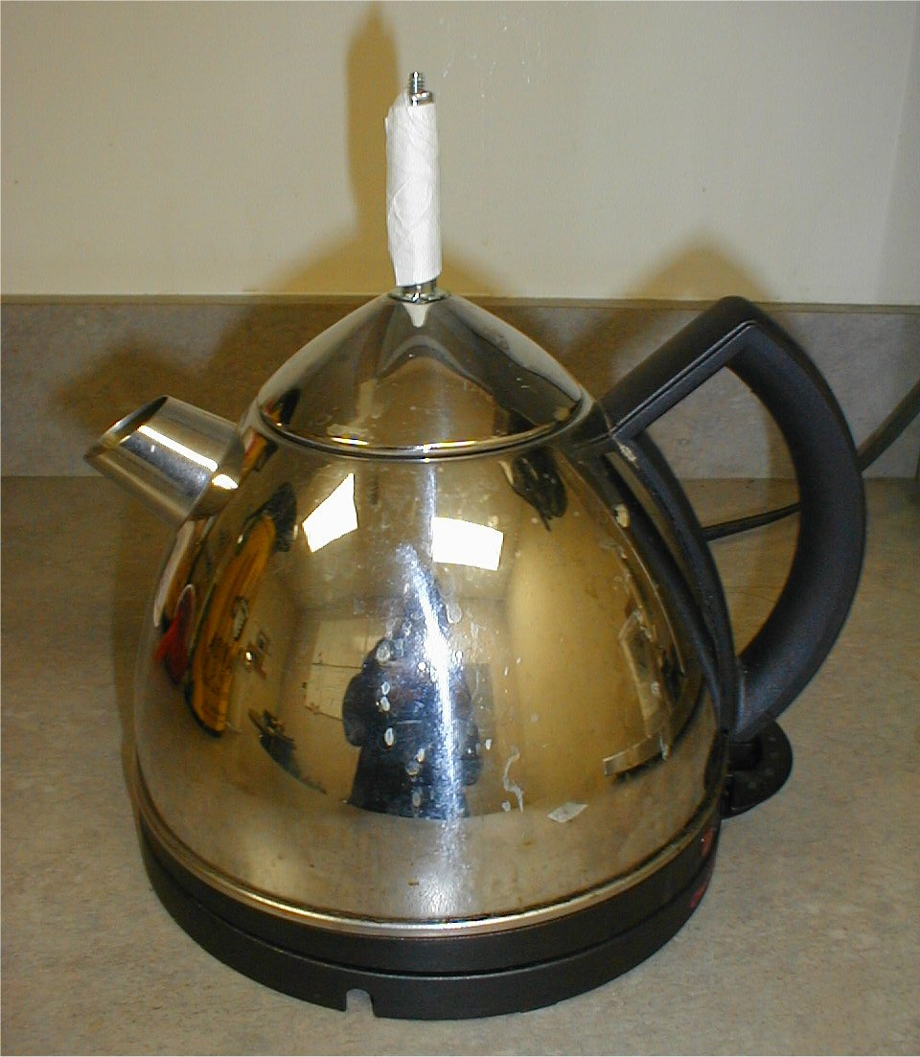
When Process Isn’t Followed
Software Engineering
From Performant,
Implemented by the Pres/CEO/marketing guy
http://brickware.com/personal/lauren/fun/Performant_Design_Process.html

