Slide 1
GETTING STARTED WITH POWER BI

Slide 2




ABOUT ME
Kristy Wedel
Sr Manager, Data Scientist – Abbott
Women in Analytics – Analyst & Visualization Developer
Instructor – Power BI, SQL

Slide 3
AGENDA
Loading Data & Connectivity Modes
Creating Measures
Visualization Tips
Files: https://github.com/kristywedel/Jeopardy

Slide 4
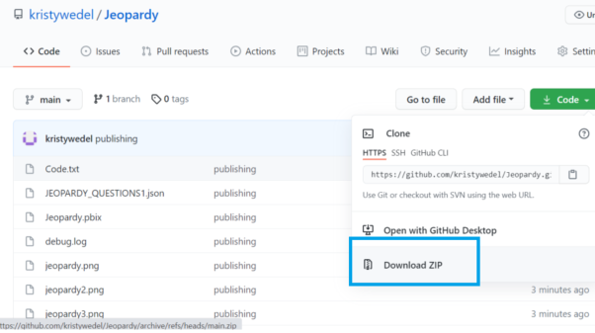
FILES
Files: https://github.com/kristywedel/Jeopardy

Slide 5
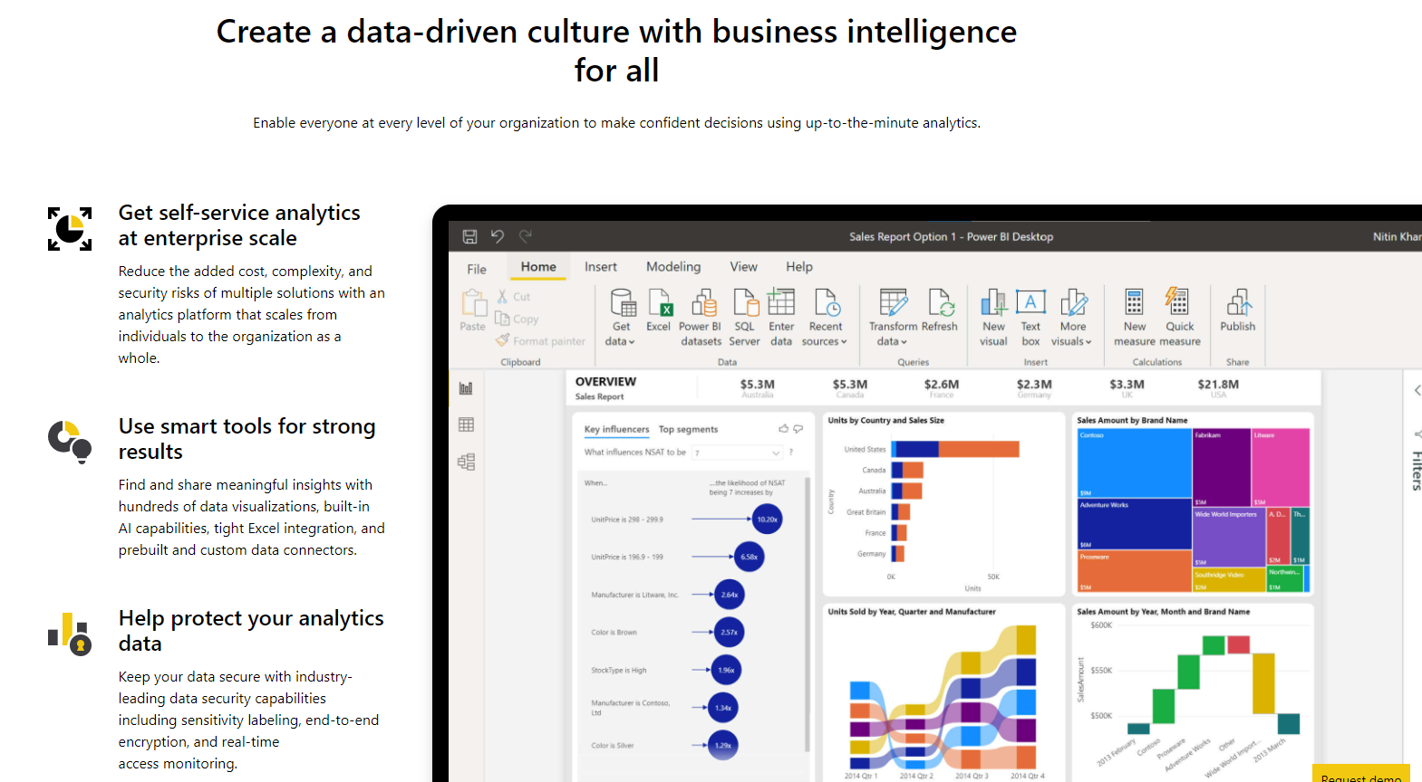
POWER BI
https://powerbi.microsoft.com/en-us/
Files: https://github.com/kristywedel/Jeopardy

Slide 6
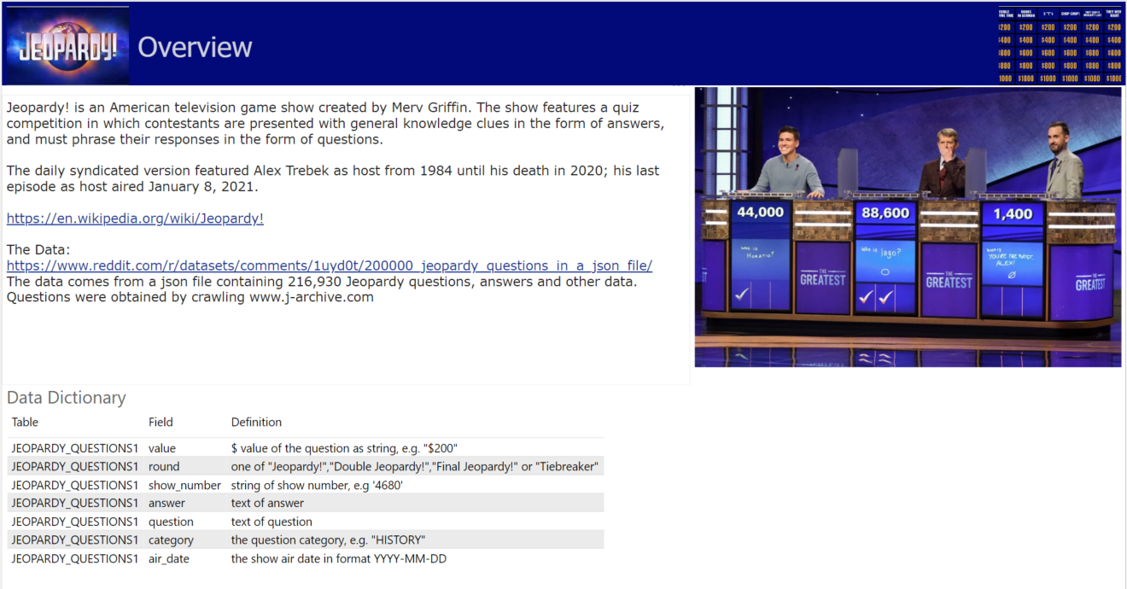
JEOPARDY!

Slide 7
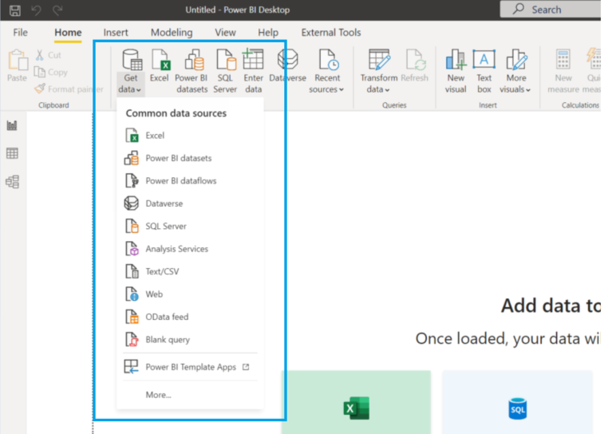
DATA SOURCES
Files – csv, xlsx, txt
Databases
SSAS
Websites
Odata feeds
Streaming Data
etc

Slide 8
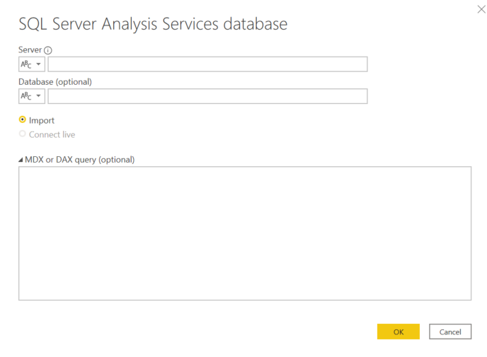
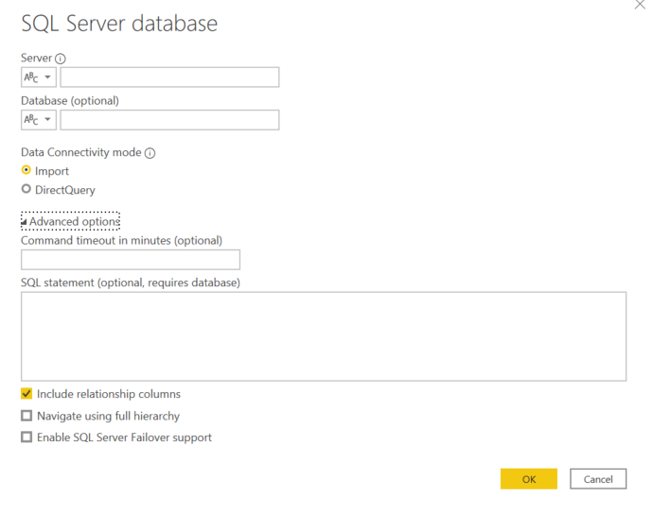
DATA CONNECTIVITY MODES
SASS – Import vs Connect Live
SQL Server DB – Import vs DirectQuery

Slide 9
DATA CONNECTIVITY MODES
DirectQuery
Live Connection
Yes
Yes
Real-Time / Large Data
Power BI Dataset or AS Model
Start
Import
No
No
*There is a preview mode to allow multiple data sources when connecting Live in Power BI

Slide 10
DEMO
Import JSON File
Create a Calendar
Joining Tables
Create Data Dictionary

Slide 11
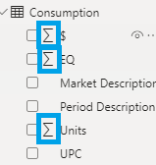

IMPLICIT VS EXPLICIT MEASURES
IMPLICIT
EXPLICIT
Pros
Automatically available based on field type
Cons
Cannot be referenced by other measures
Not visible in data model
May not aggregate as desired
Pros
More flexible
Can be referenced by other measures
Visible in data model
Cons
Requires writing DAX

Slide 12

THANKS!
Any questions?
You can find me at:

